Slide 1
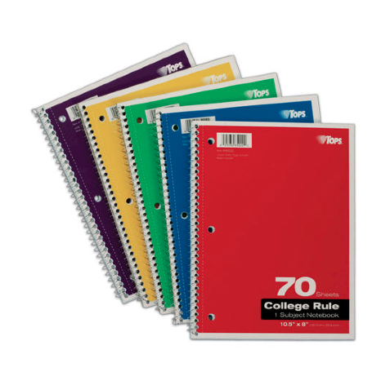
Your Art Journal
The Art Journal is used for:
Daily writing and drawing responses
Self-Reflections on artwork
Artist statements
Brainstorming on projects
Extra Credit drawing opportunities
Drawing for fun!
The journal always stays in Art. It is graded for 10% of the overall course grade.

Slide 2
LAST TIME: In YOUR Journal…
Your FULL Name
In thinking of the 2016-17 school year:
What was your favorite class?
What might be some reasons why?
In thinking way-way back…
What might be some things you already know about art?
What art project from Elementary or Middle school was your favorite?
Other jazz:
Favorite Color
After School Activities
Favorite Food or Restaurant
Preferred Music/Genre
My Website

Slide 3
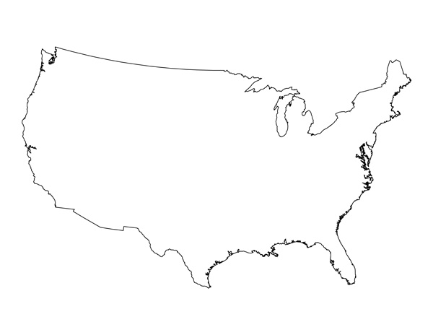
OBSERVE: Memory Maps
Use a basic outline of the United States of America to create your own map from memory.

Slide 4
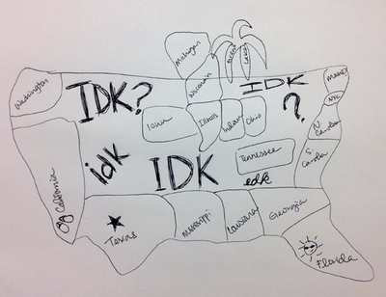
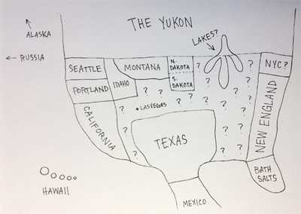
British Versions
One Thanksgiving, British people were asked to draw their own map of the United States... Not surprisingly, this was really difficult for them. They were compiled and presented by Buzzfeed. The results were creative and hilarious!
British People try American Sweets

Slide 5
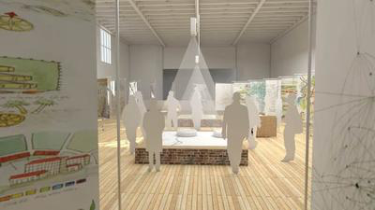
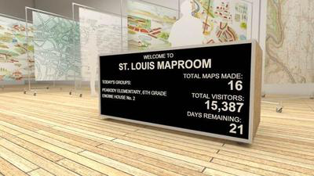
The Map Room
Artist Jer Thorp combines data and history in his artwork to help people control and understand the information around them. In 2017 Jer Thorp created an installation in Saint Louis call "The Map Room" where community members were invited to create a variety of giant maps of Saint Louis from their personal experiences. This begs the question: can maps be subjective?
More about the Map Room
TED Talk

Slide 6
MAP of OUR CLASSROOM
Glue this map into the front of the folder I pass out to you.
Label it with your seat and any other important areas of the room.
GLUE IT. LABEL IT. USE IT

Slide 7
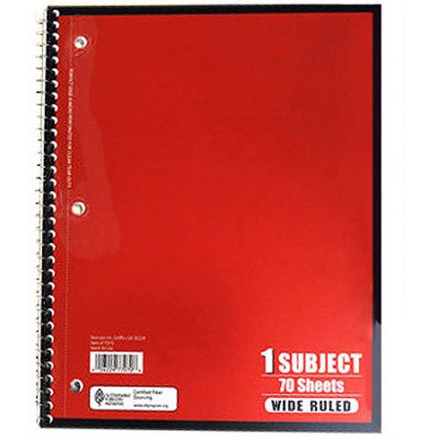
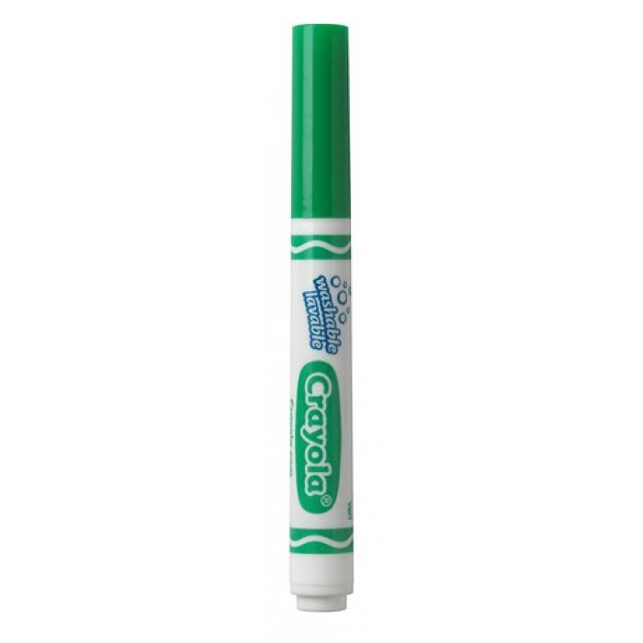
Setting up your Journal
see the example upfront on the board if you need to SEE what this looks like…
AND NOW
FOR THE
COVER!
Cut off the little extra tab at the top
Glue the folder into the VERY BACK of your journal with the opening facing INWARDS
this is where you will keep all loose documents
Glue your prompts page to the inside FRONT cover
COLOR THE EDGE OF THE BACK 5 PAGES GREEN
COLOR THE EDGE OF THE NEXT 5 PAGES RED
Notes:
Demonstrate this step-by-step with the group. Give everyone tape and a sticker for their names as well.

Slide 8
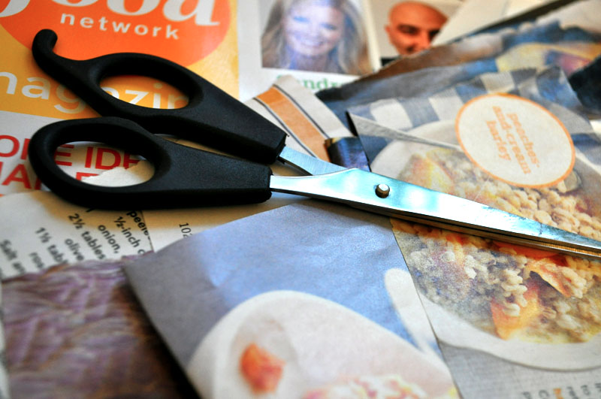
MINI PROJECT: COLLAGE
noun: a piece of art made by sticking various different materials such as photographs and pieces of paper or fabric onto a backing.
Notes:
Talk about the green section where they can place techniques and processes that they enjoy; they can write tips for themselves like turn the paper not

Slide 9
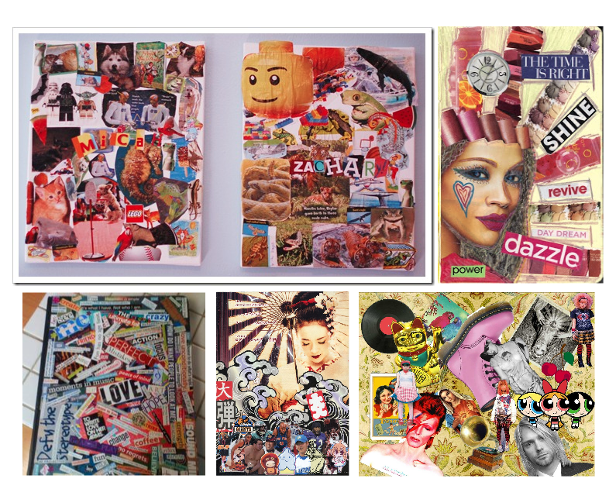
Things that you like

Slide 10
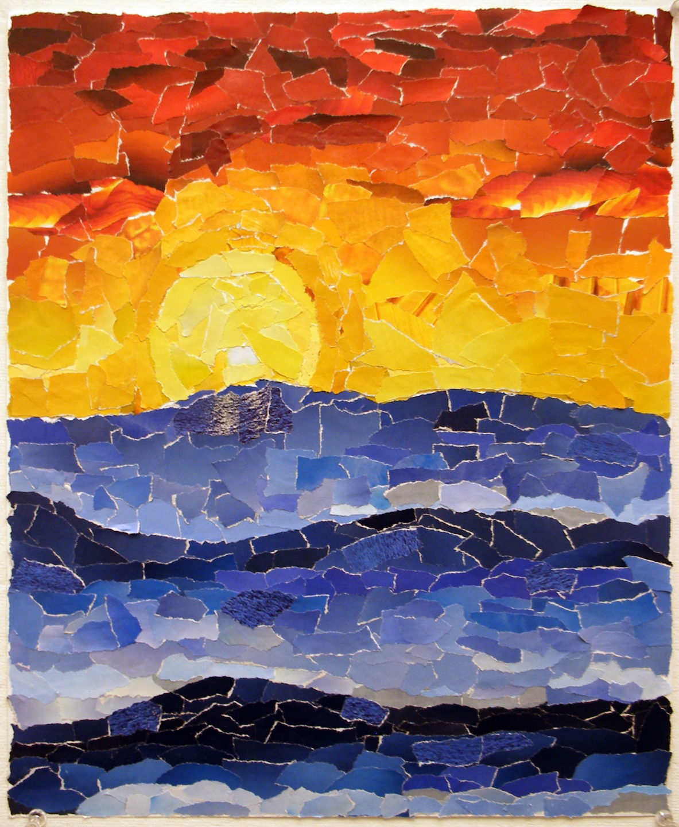
USE COLOR TO CREATE AN IMAGE

Slide 11
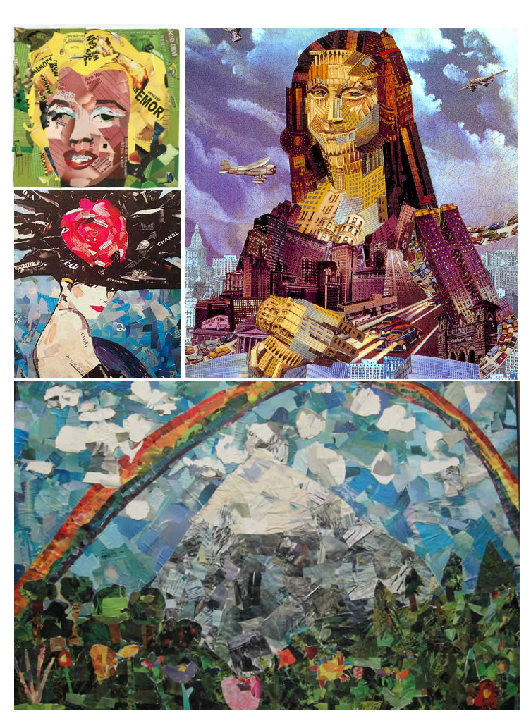
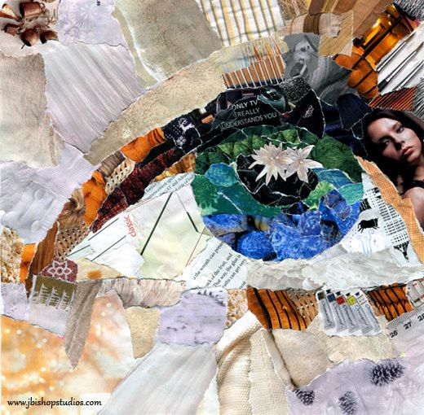
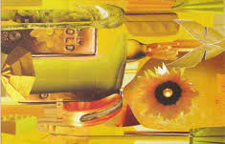
Collage by Color
Notes:
Use color to create an image

Slide 12
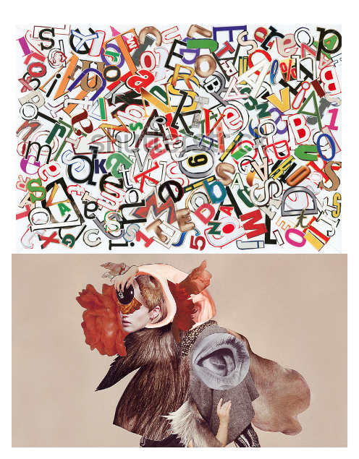
USE REPETITION OR BE RANDOM

Slide 13
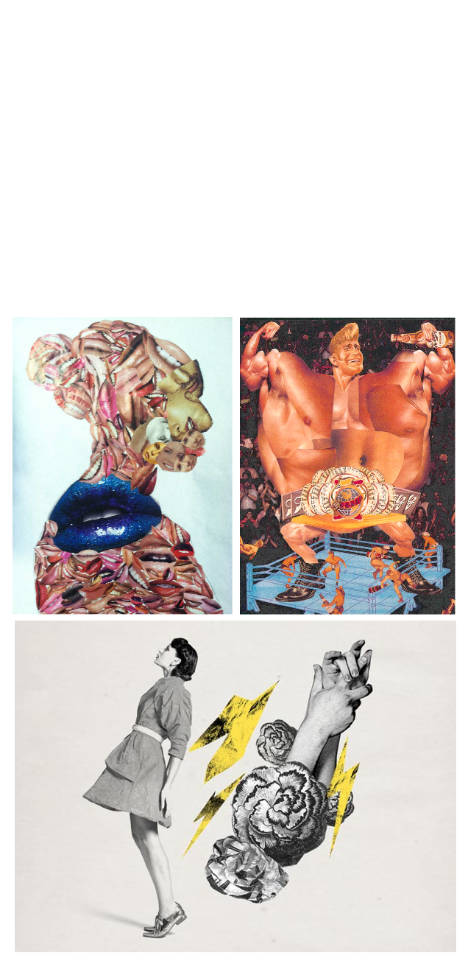
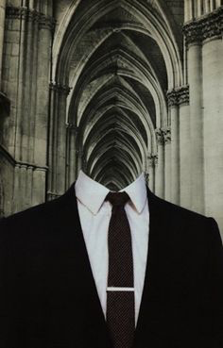
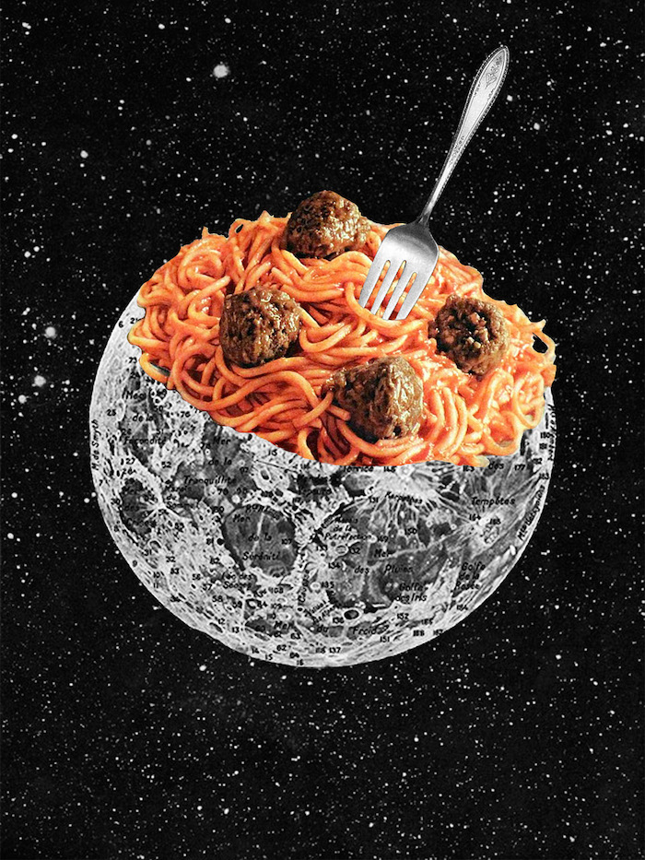
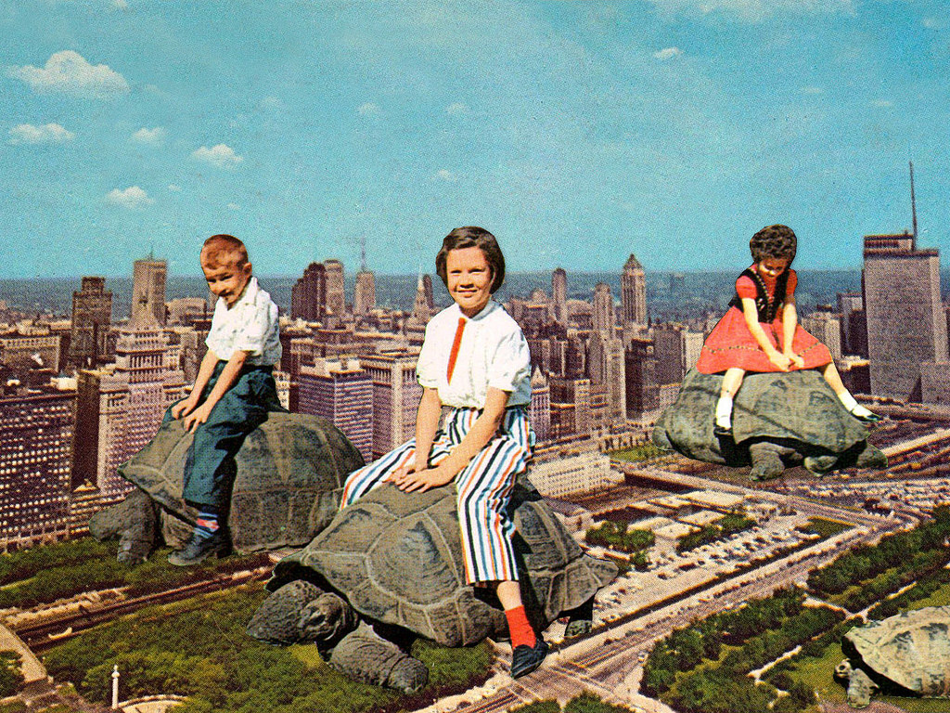

Slide 14
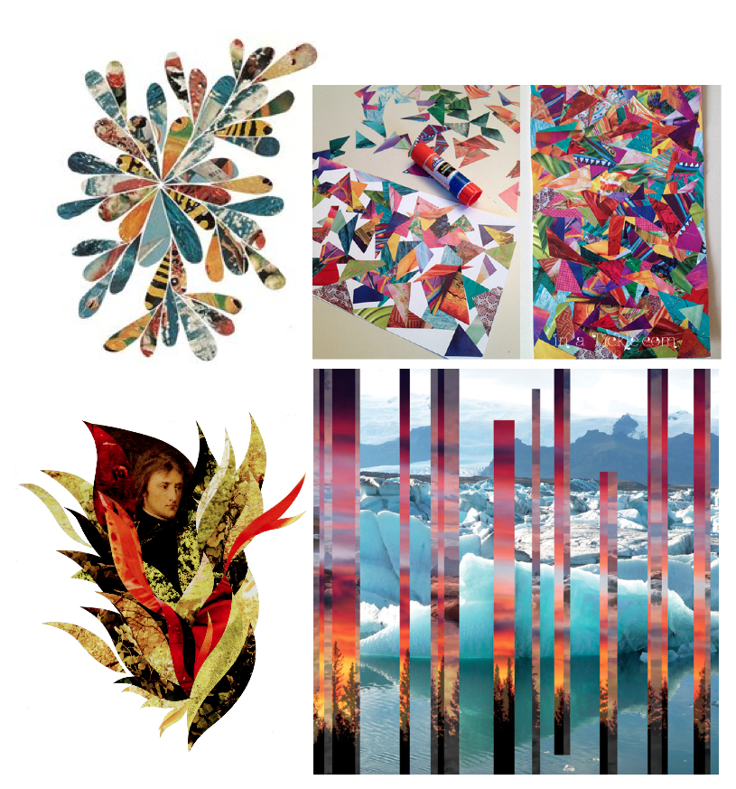
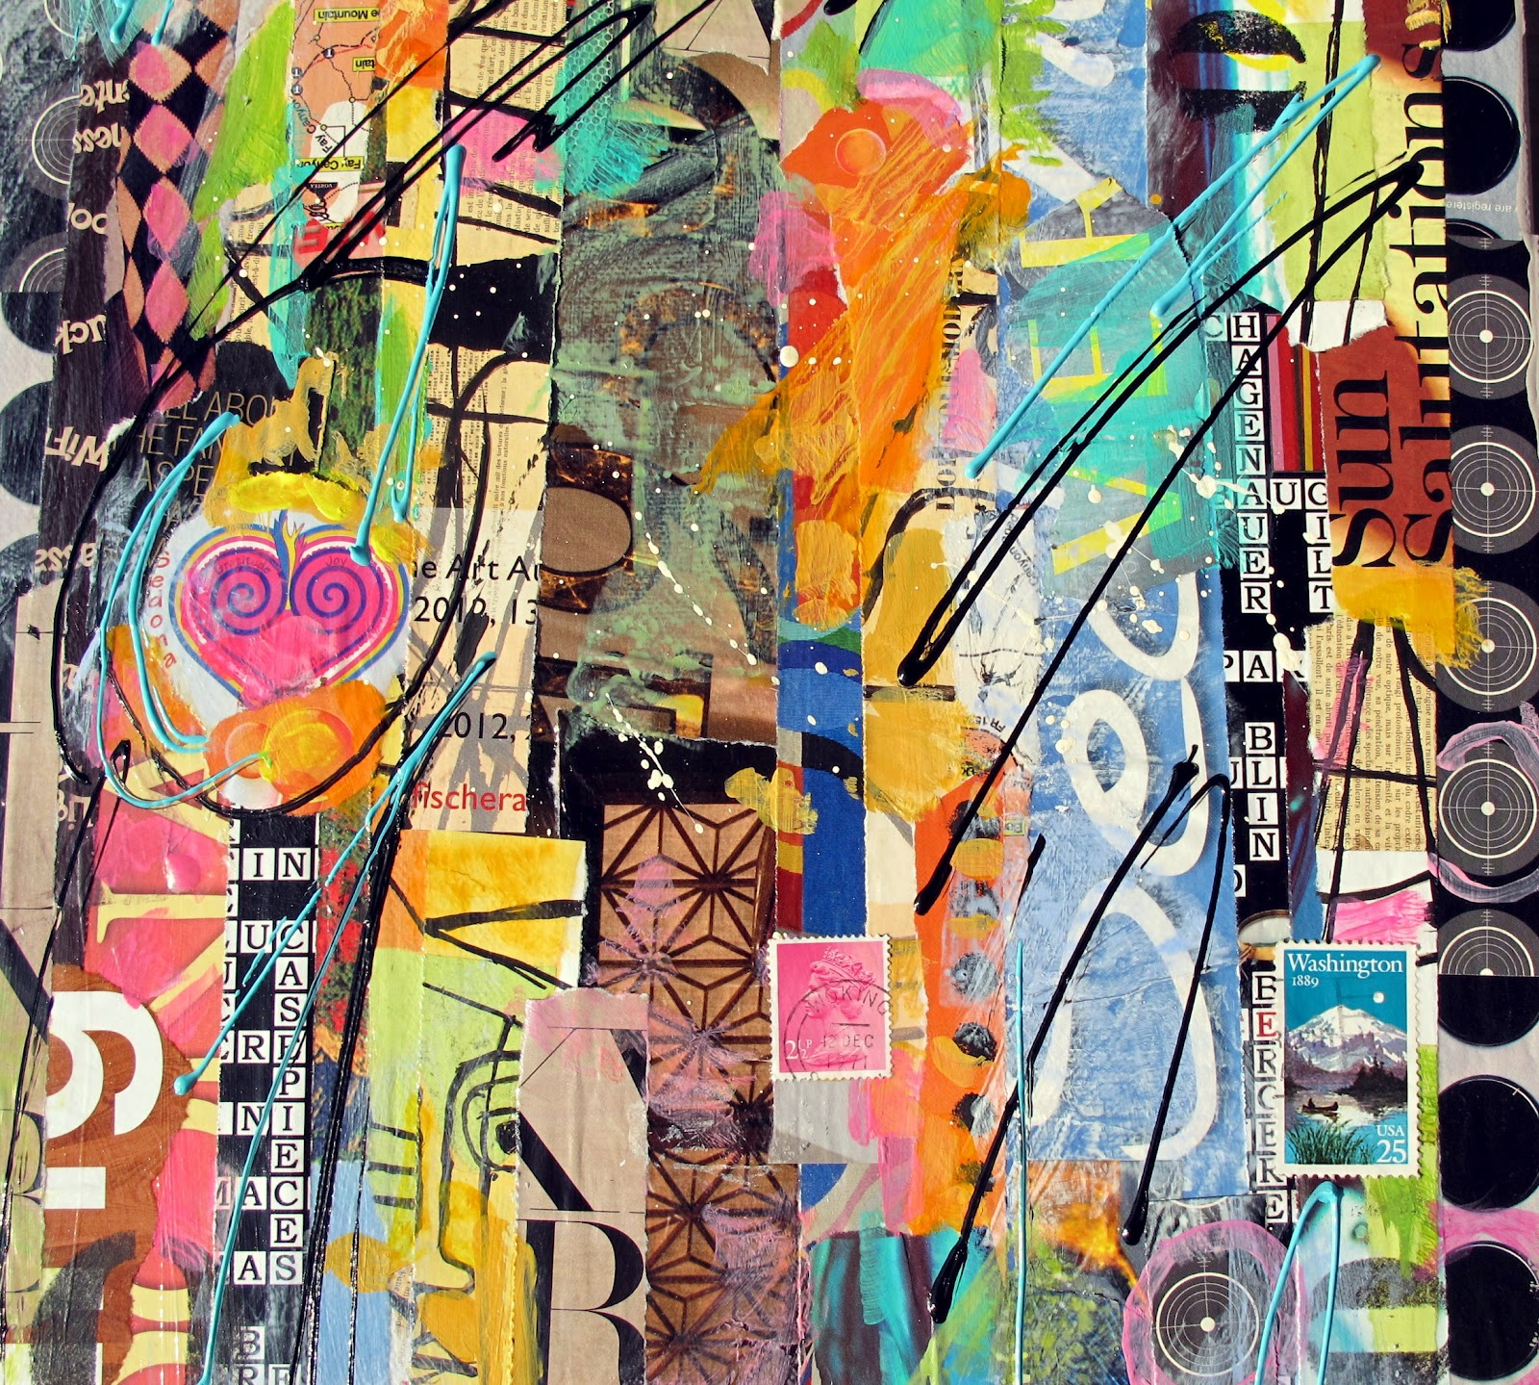
CREATE AN ABSTRACT DESIGN

Slide 15
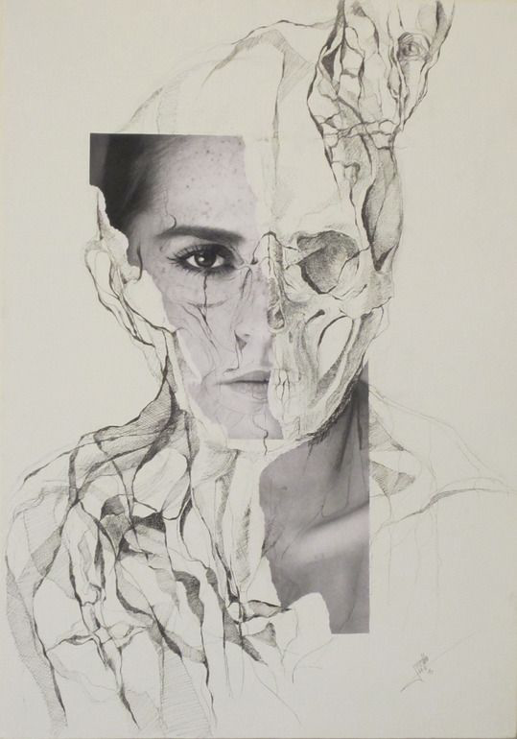
DRAW ONTOP

Slide 16
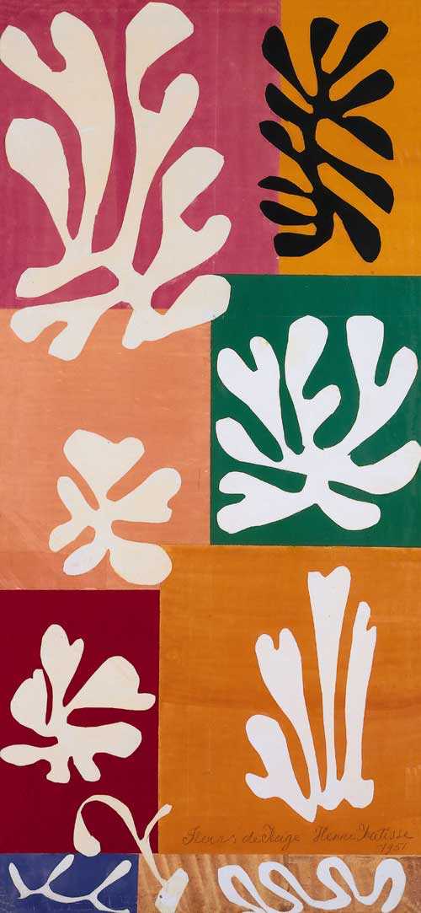
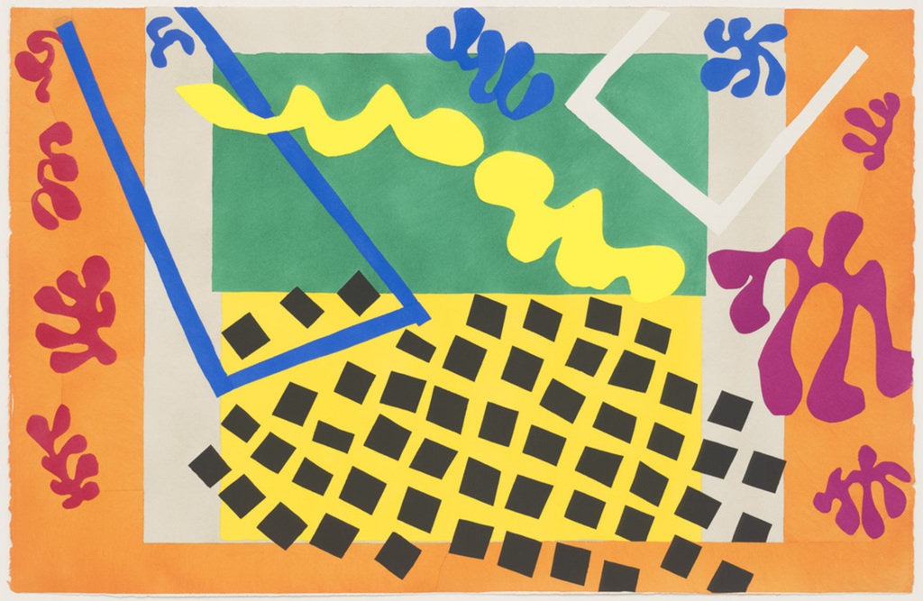
HENRI MATISSE
A famous artist who focused on the technique of collage.
Henri Matisse would use bold/bright colors and simple shapes.
Notes:
If you’re interested in collage or the images presented here, write down the name Henri Matisse in the RED section of your journal. I am going to continually give you examples of modern, contemporary and historical artists and works as a catalyst for your research process. Please take advantage of that; as you will be expected to have your own ideas and motivations later.

Slide 17
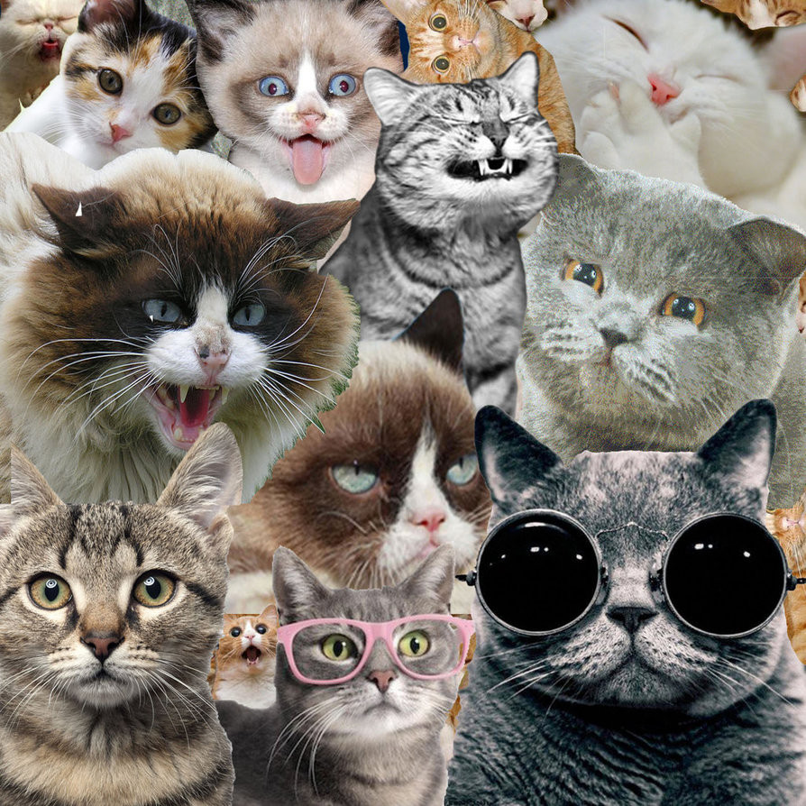
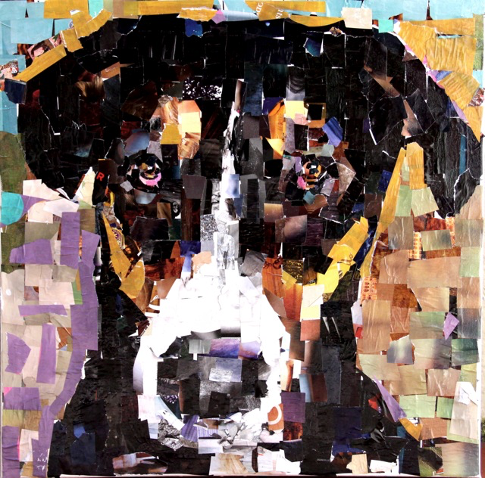
PRO TIPS YO!
WHEN CREATING A COLLAGE WITH PAPER
Turn the paper NOT the scissors to cut
Cut into the corners to remove areas
Use an X-Acto* for internal pieces
*this needs to be checked out and returned
Gather ALL of the images prior to pasting
Layer images in desired fashion and take a photo
Use stick glue initially then cover with Mod Podge
Backgrounds are just as important as the images
Be inventive in the images you choose
Collage by color
Create an abstract or geometric design
Incorporate drawings or other materials
Use repetition or randomness
Think about how the images could interact

