Slide 1
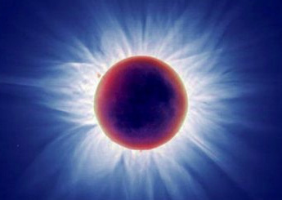
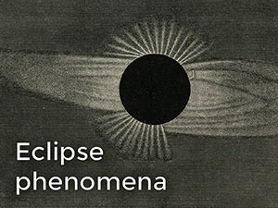
ATRT + THE ECLIPSE
Notes:
The sun and moon have been used as subjects of and materials for creation for centuries. In honor of the solar eclipse we are going to talk quickly about a number of artists who exhibit the moon in their work. These are all artists that you could write into the newly designed RED section of your journal.

Slide 2
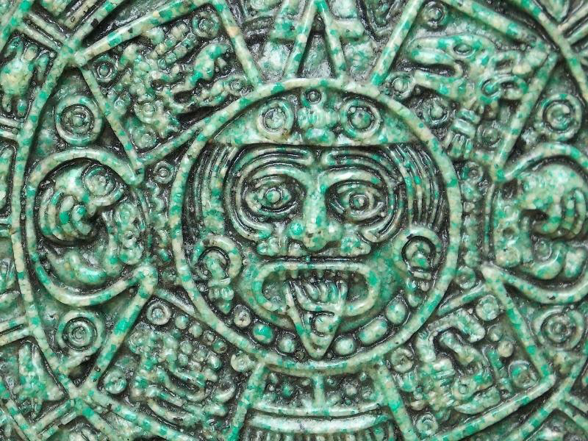
Mayan Sun Calendars
The MET Museum
Notes:
The most common subjects in Maya art are mortal rulers and supernatural beings. Maya sculptors also invested a monumental amount of labor in portable goods made of stone. This is an image of the Mayan Sun Calendar, which were notorious for predicting the end of the world in 2012.

Slide 3
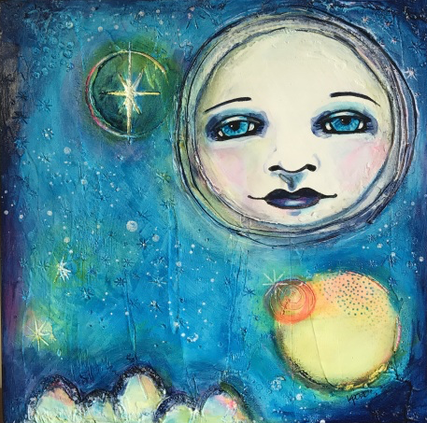
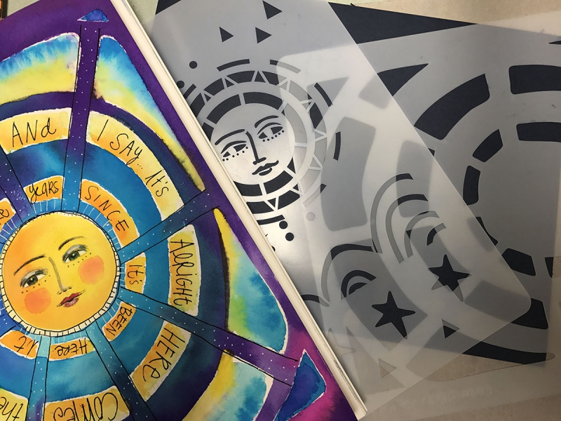
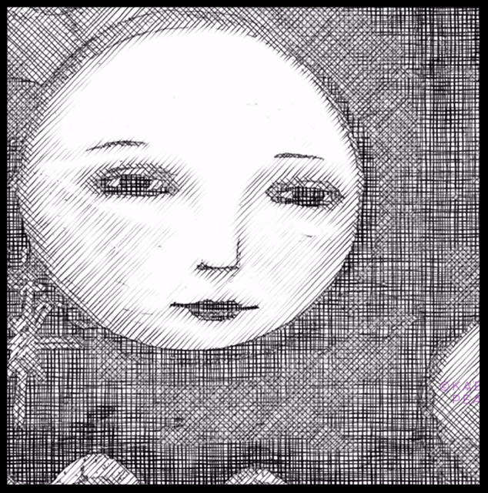
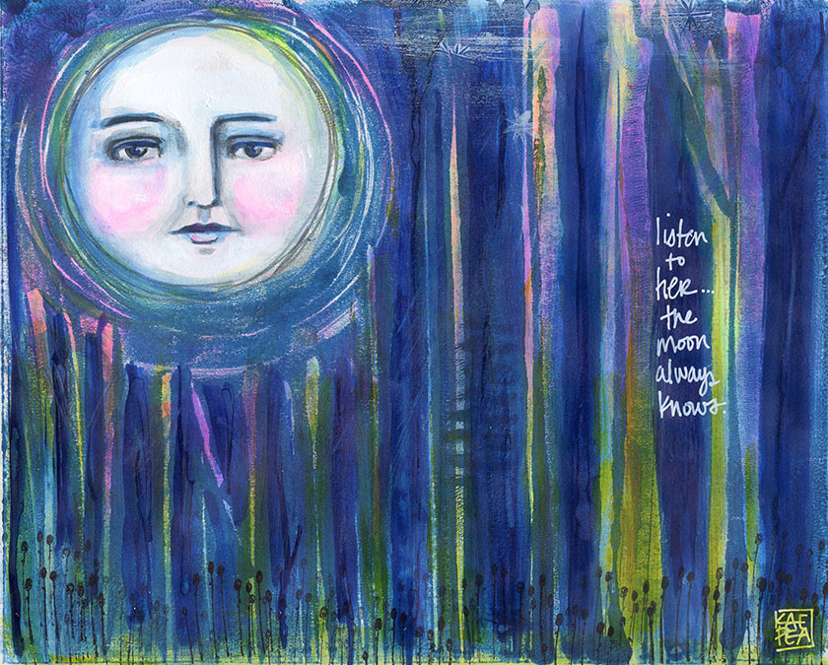
THE MOON & THE MAKER
Notes:
Artist Kae Pea lives/works in Louisiana, MO where she runs a stamp and stencil business called “rubbermoon” which she uses as the basis of much of her artwork. Kae Pea combines watercolor, pen & ink and more into her paintings; this would be deemed mixed media. The use of stamps as a base for creation gives her work a holistic feel and similar theme.

Slide 4
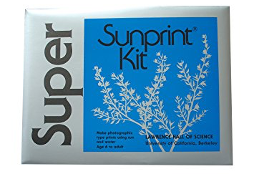
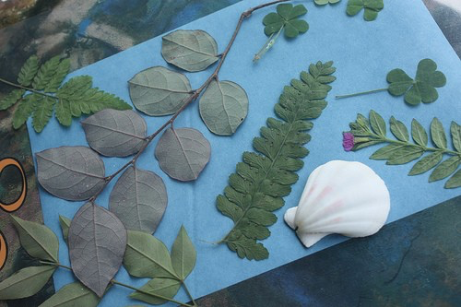
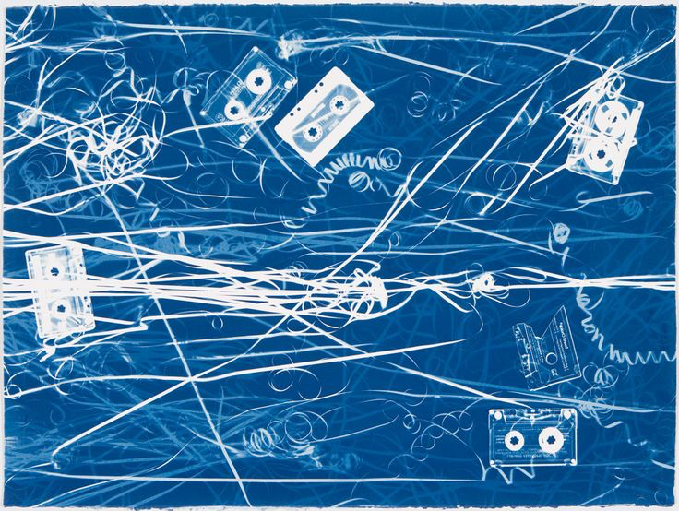
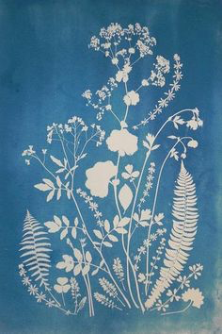
SUN PRINTS
Notes:
Has anyone created an image this way before? These are called sun prints. and they are created via resist onto photo-sensitive paper. Basically you place an object onto the paper and wait an undetermined about of time before removing those items. Wherever your items were placed will remain white as the sun was unable to effect those areas. This paper is available at all major craft supply stores.

Slide 5
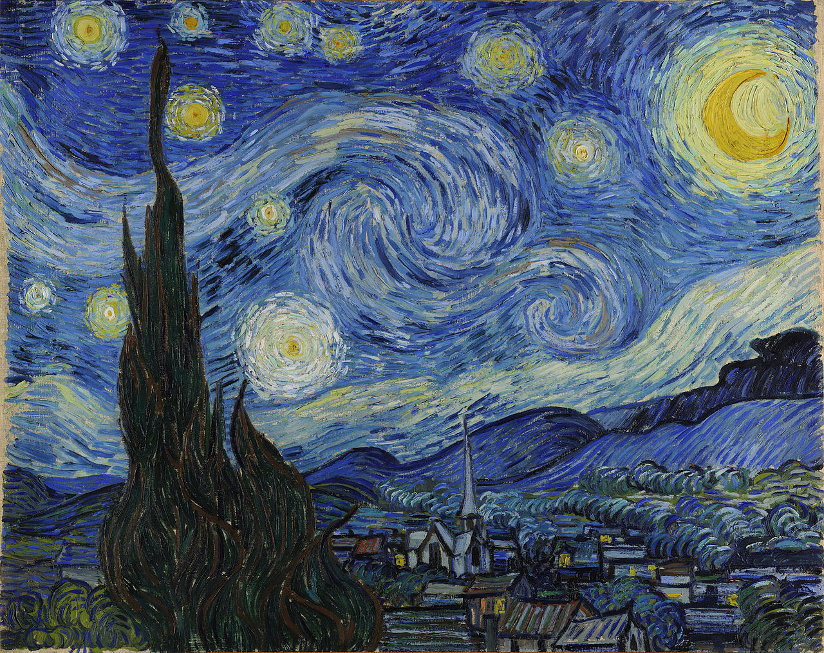
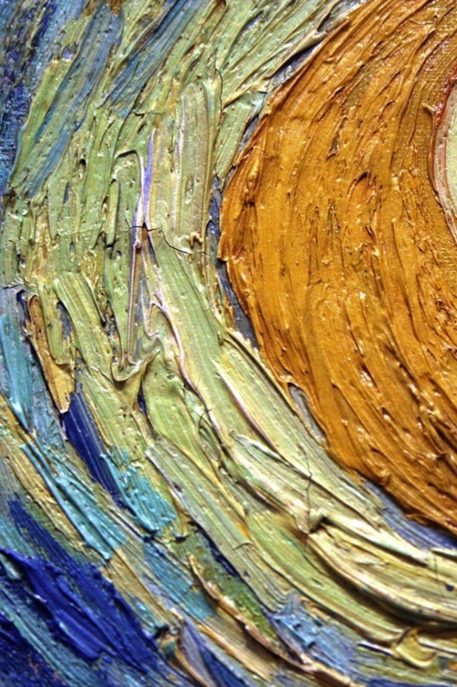
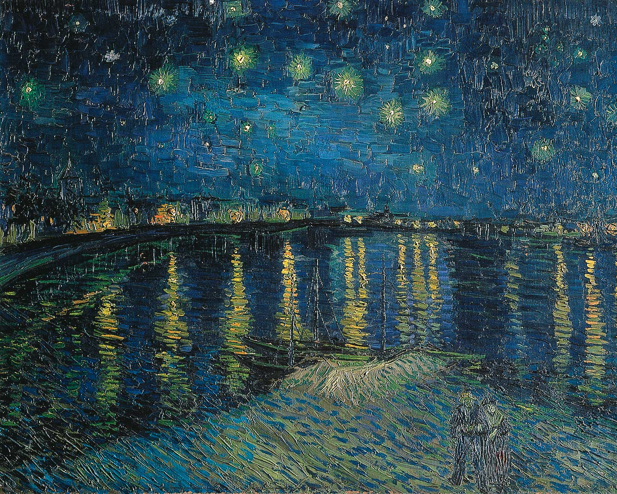
VINCENT VAN GOGH
Notes:
On the right are 2 different “starry nights” created by Van Gogh. The left hand image gives a view of what the physical texture of the work looks like up close… It was actually kind of messy. Remember, like other impressionist painters Van Gogh would paint en pleine aire or outside infront of his subject matter. These were painted quickly to capture a moment.

Slide 6
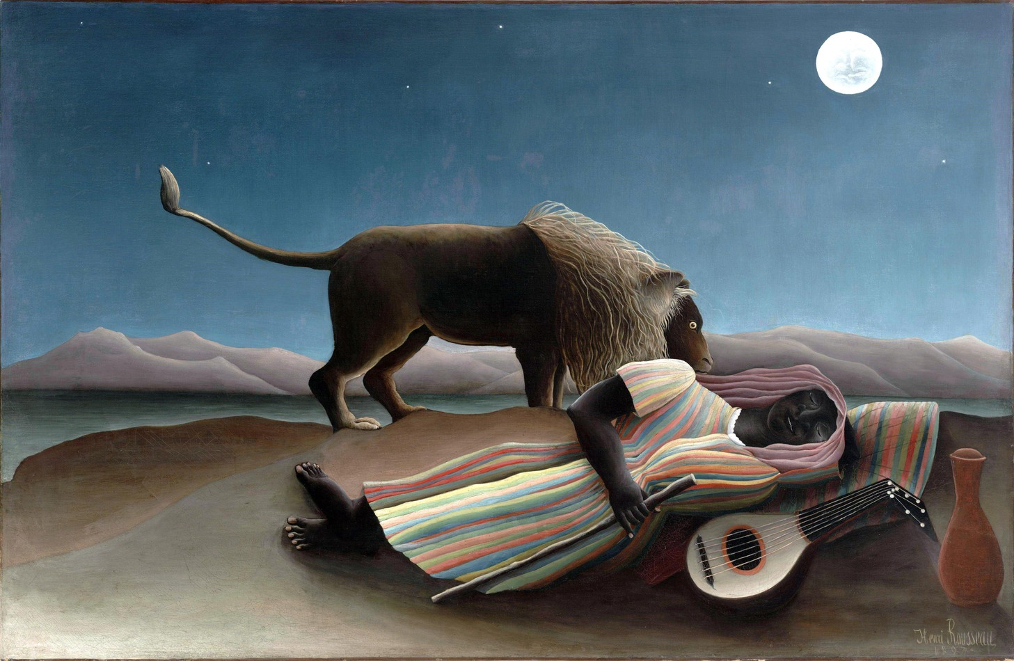
HENRI ROUSSEAU
Notes:
A self-taught artist who painted in the primitive style; only later recognized as a genius. This image is called The Sleeping Gypsy, created in 1897.

Slide 7
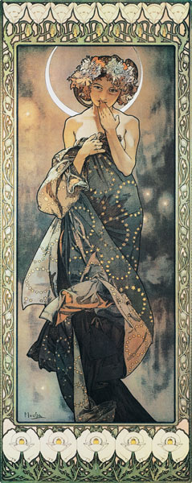
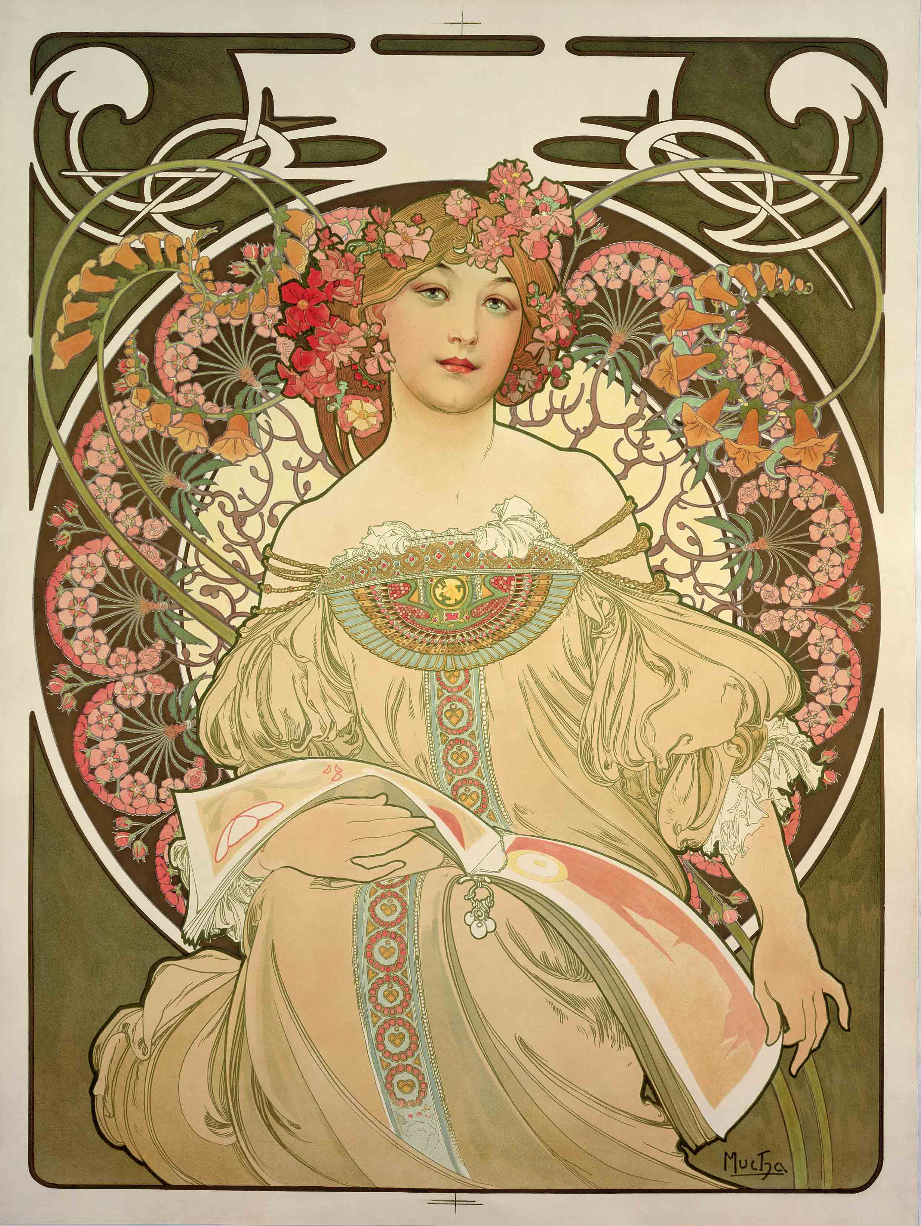
ALPHONSE MUCHA
Biography
Notes:
A Czech artist who began his career painting theatrical scenery. He helped to develop what’s known as the Art Nouveau style; usually more pale or pastel poster designs featuring women with many floral borders. The image on the left is entitled The Moon Study and the right (The Pole Star) is from the same series entitled, The Moon Series.

Slide 8
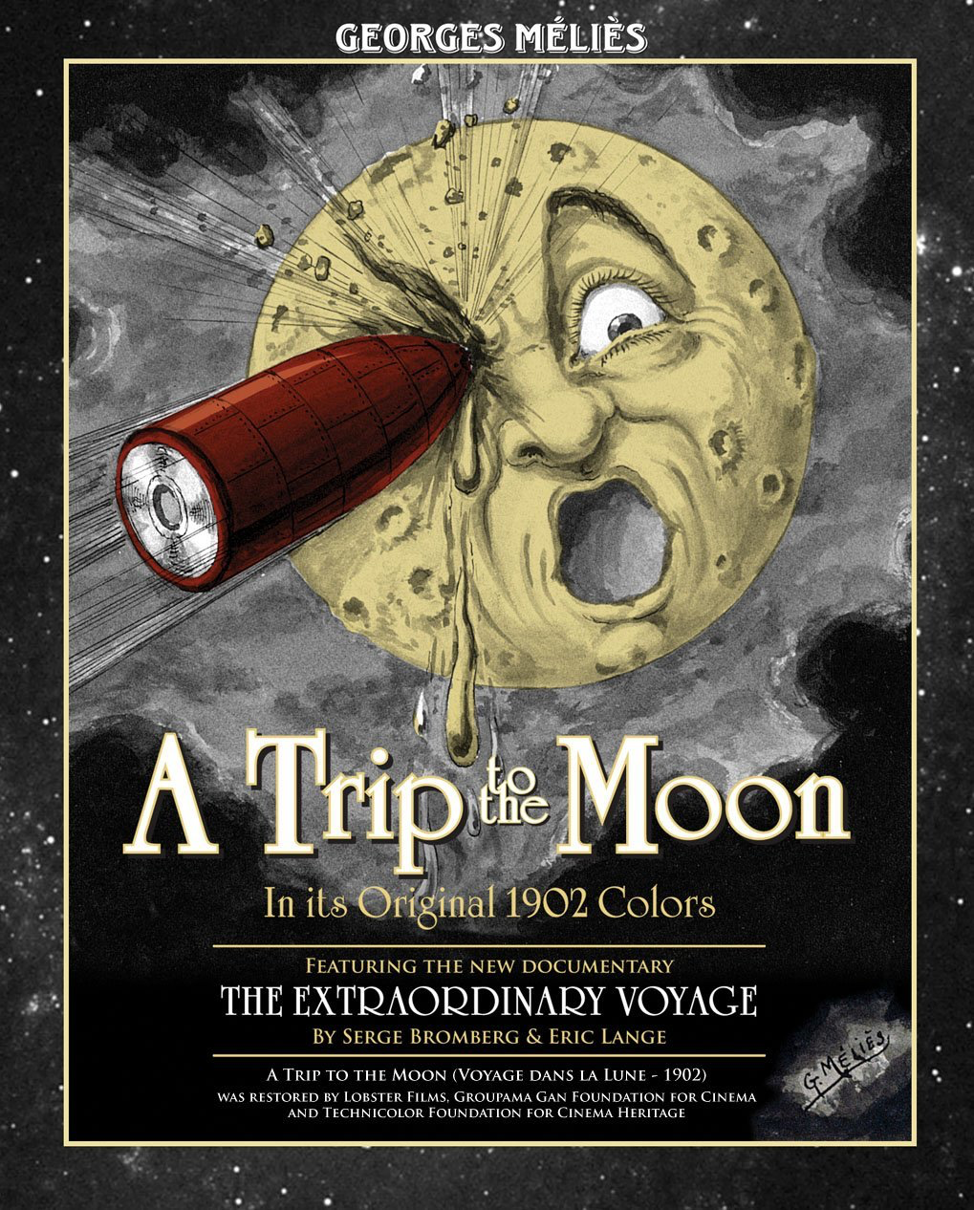
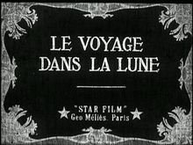
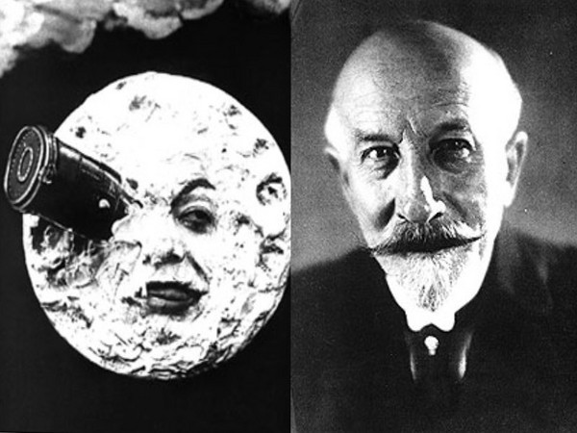
George Melies
B&W VIDEO
COLOR VIDEO
Notes:
A Trip to the Moon was created in 1902 by Georges Melies and is heralded as one of the most iconic films of the 20th century. The special effects created by this film were state of the art! I have 2 different versions linked here. The color version was lost and only found in 1995 for recreation.

Slide 9
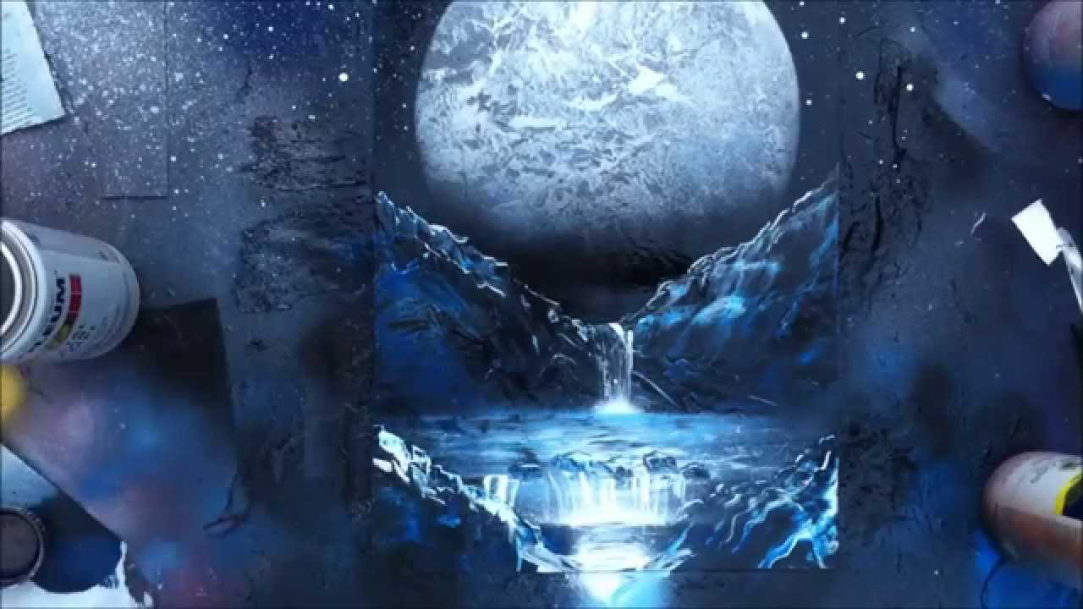
STREET ART
SPEED SPRAY PAINT
Notes:
Some of you may have seen these street artists creating galaxy scenes from spray paint. I think it’s super neat how they’re able to use layers of texture and a simple resist to create what seems like a complex image. If we have time we’ll watch this video of an artist actually creating.

