Slide 1
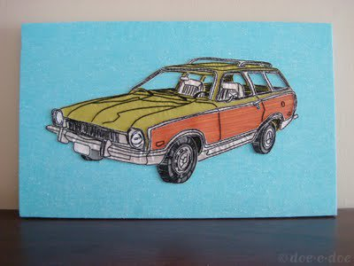
EMBROIDERY WORKSHOP

Slide 2
DISCLAIMER:
We’re just hitting the VERY TIP of the iceberg with this workshop.
There are many different techniques, tools, histories and current artists that cannot be represented due to a lack of time.
Let me know at the end of the workshop if you would be interested in a follow up session

Slide 3
OF EMBROIDERY

Slide 4
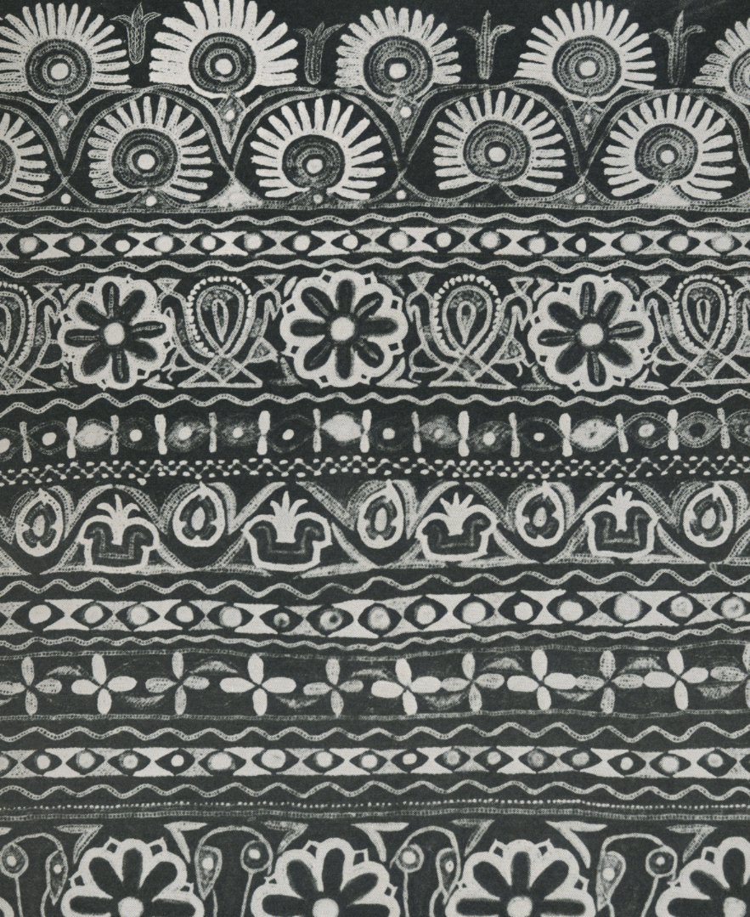
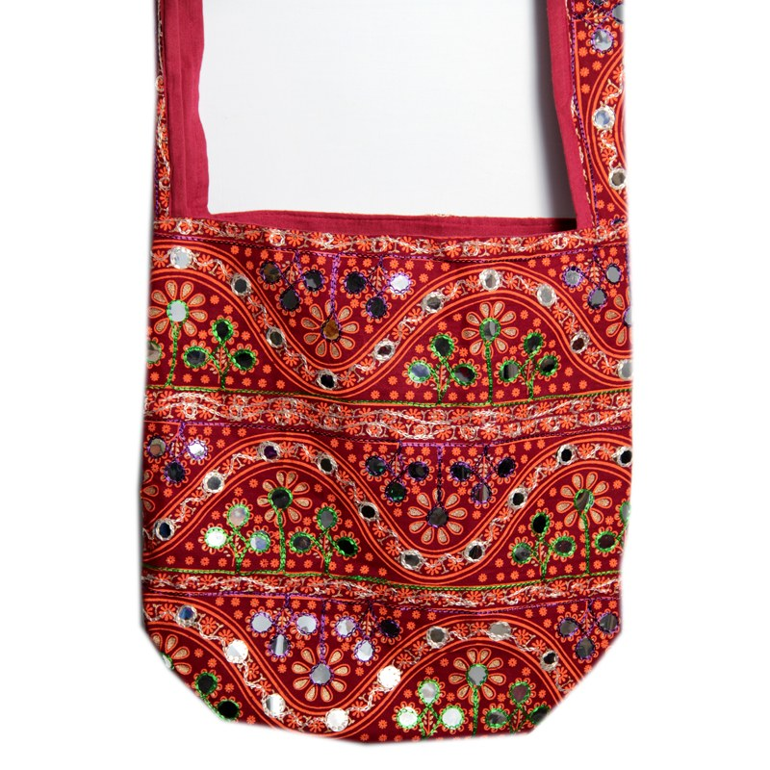
INDIAN EMBROIDERY

Slide 5
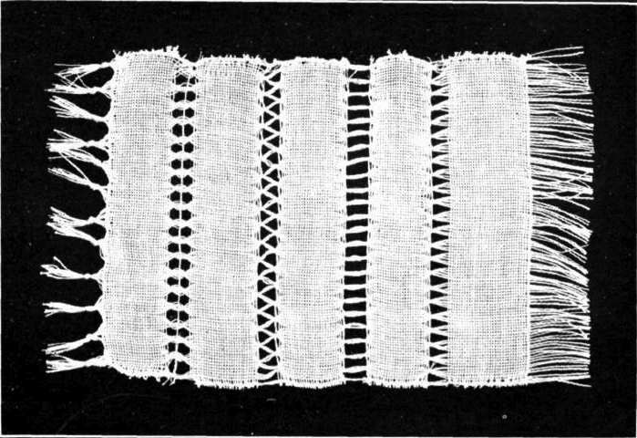
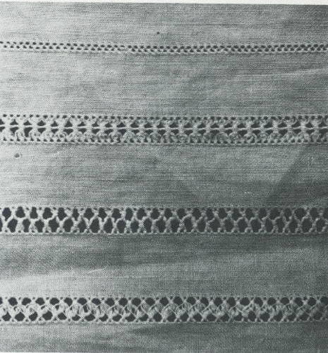
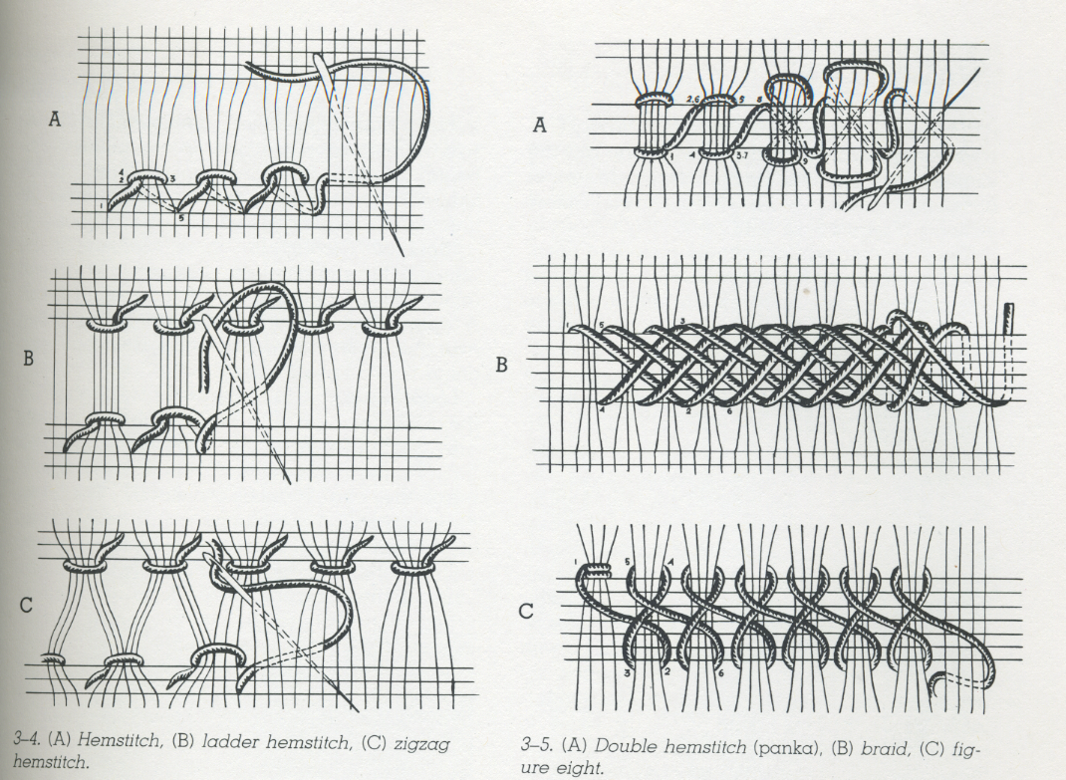
RUSSIAN OPENWORK
Klimova, Nina p 35

Slide 6
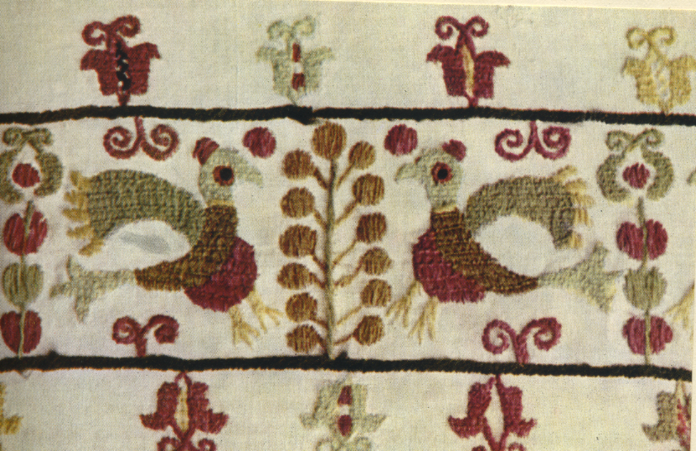
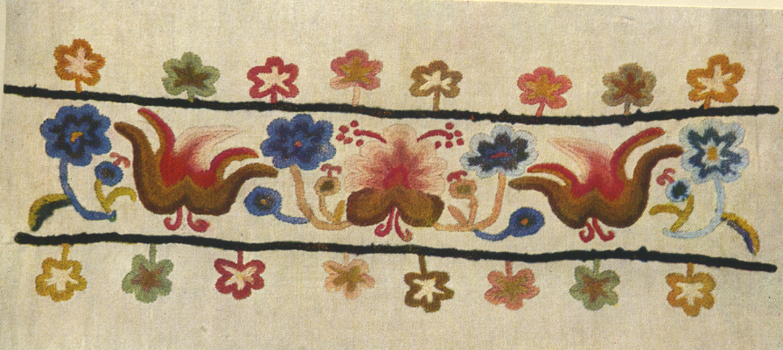
HUNGARIAN EMBROIDERY

Slide 7
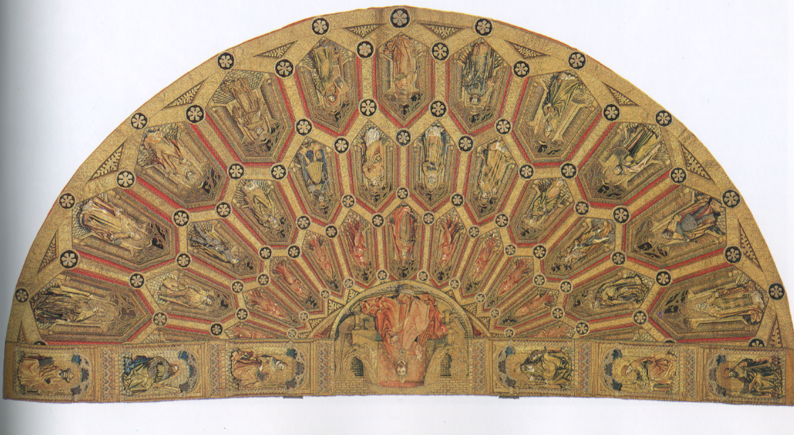
MEDIEVAL EMBROIDERY

Slide 8
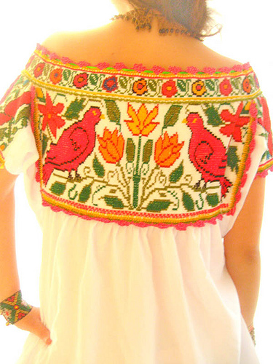
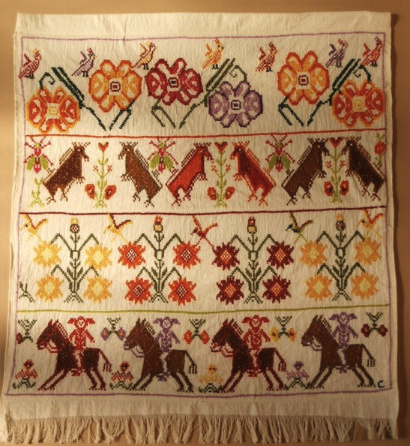
Mexican Textile Pattern Database
MEXICAN EMBROIDERY

Slide 9
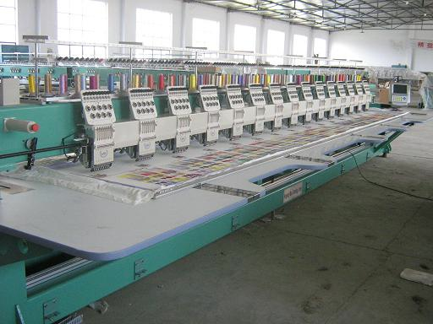
MACHINE EMBROIDERY
THIS AINT YOUR AVERAGE SORORITY SWEATER
Machines at Work

Slide 10
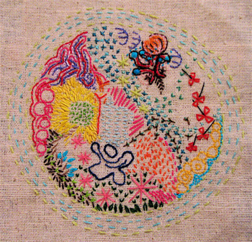
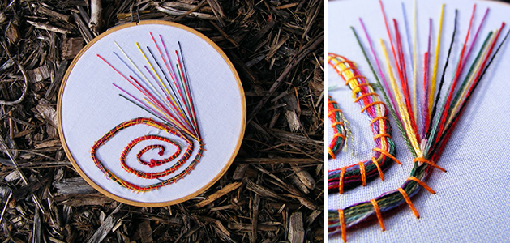
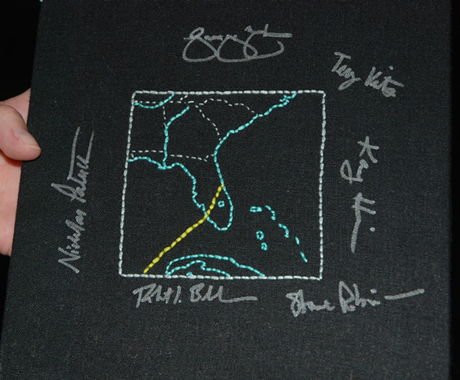
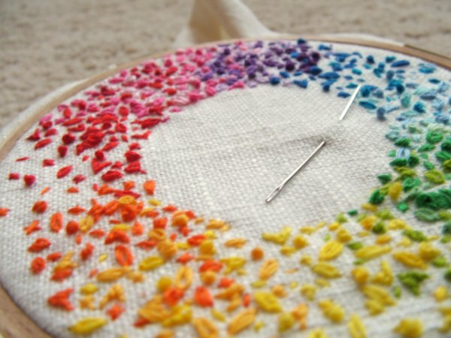

Slide 11
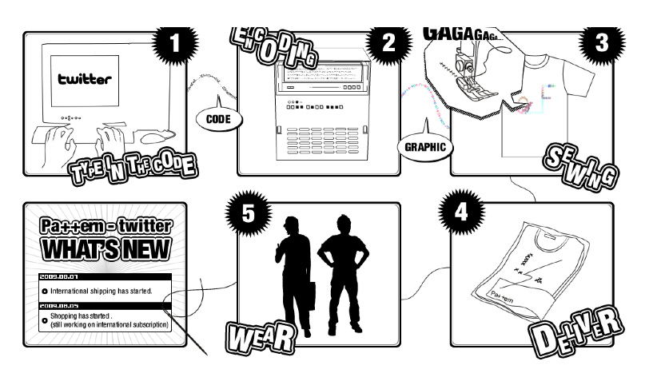
PA ++ERN
A project by artists Daito Manabe + Motoi Ishibashi, which takes posts from twitter and creates wearable embroidery designs based on a formula or data.
Website

Slide 12
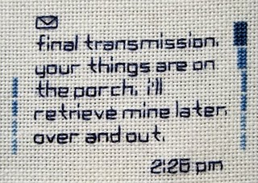
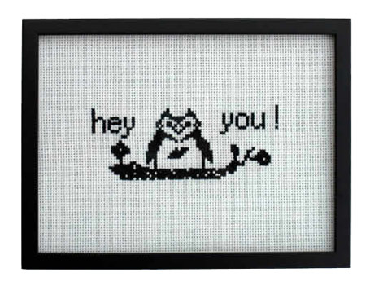
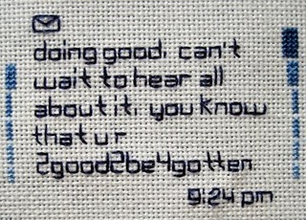
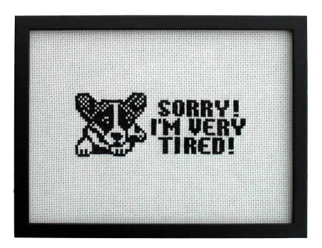
Kate Pemberton
Ginger Anyhow
SMS Project
Website
EMS Project

Slide 13
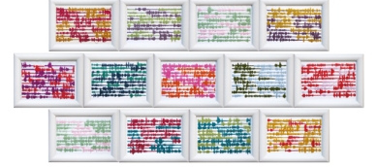
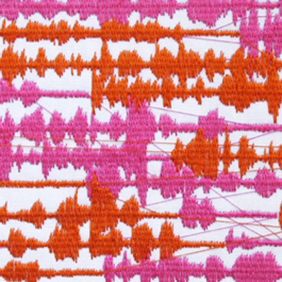
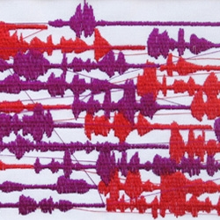
LOUISA BUFARDECI
This project is a blend of embroidery, technology, and information visualization. Shown is an example from 13 one minute telephone conversations
Louisa Bufardeci's Website

Slide 14
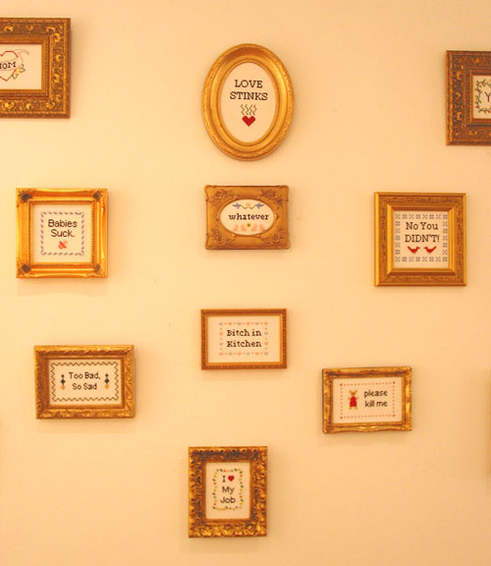
JULIE JACKSON
Traditional techniques + modern content = Subversive Cross Stitch
Alternative Stitching Database

Slide 15
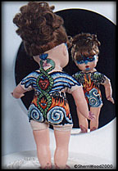
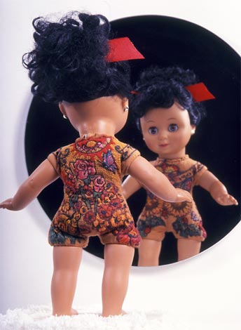
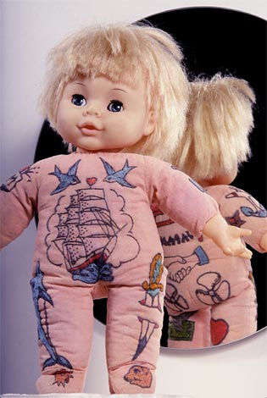
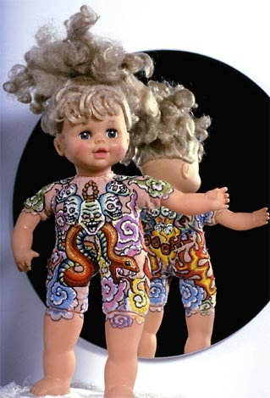
DAINTY TIME PROJECT drawn by various female tattoo artists-embroidered by Sherri Wood
Statement by Denise de la Cerda, tattoo artist:
“Somehow this chick has ceased to be merely anyone's baby doll and has taken hold of the steering wheel of her own life and become her own person. Refusing to comb her hair or wash the ballpoint pen marks off her face, she toddled into my shop one day demanding to be needled…”
Website

Slide 16
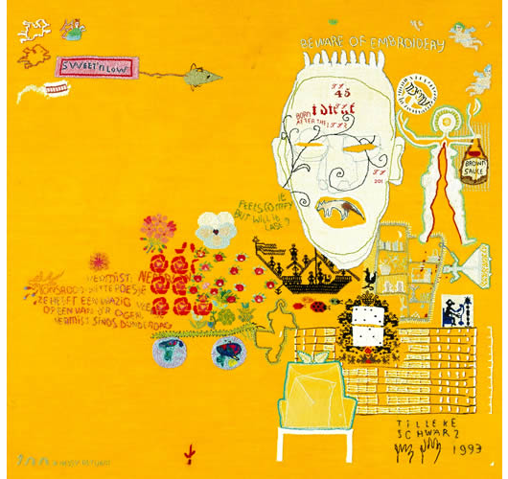
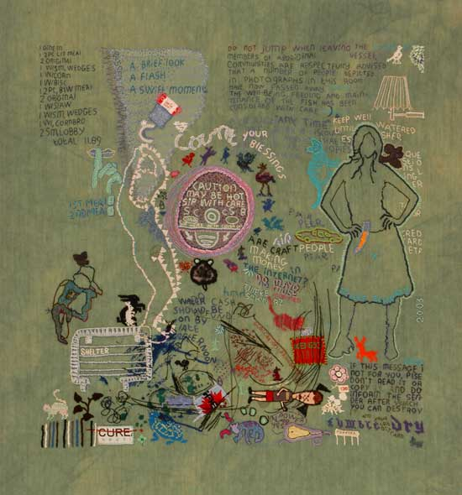
TILLEKE SCHWARZ
Embroidery Sketchbooks are created without a “plan” to document ideas
“Beware of Embroidery”
“Count Your Blessings”
Website

Slide 17
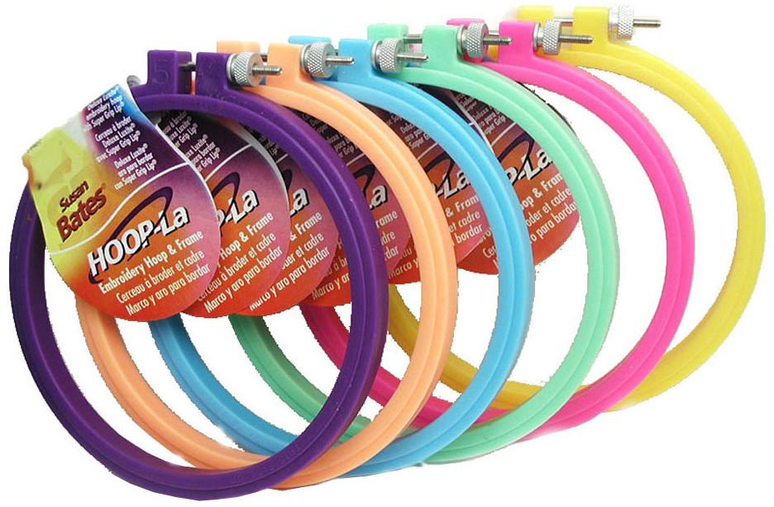
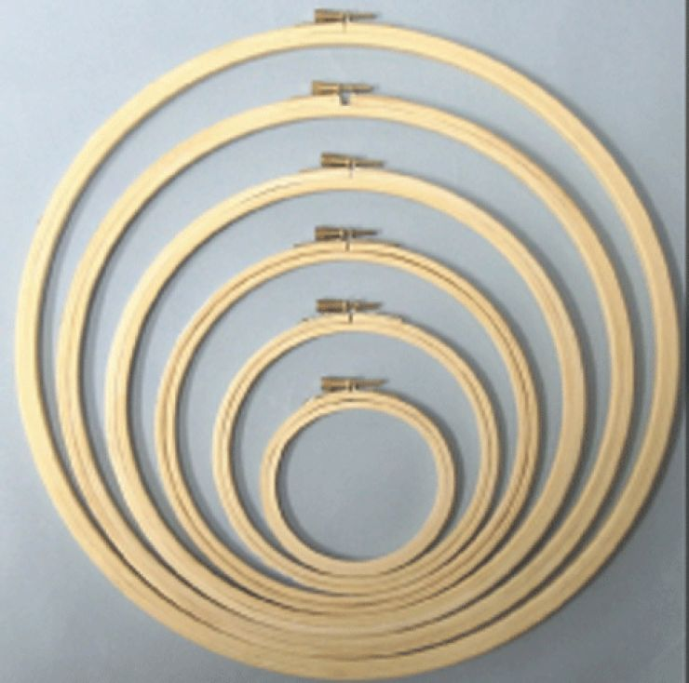
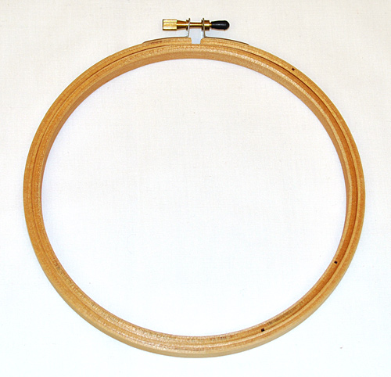
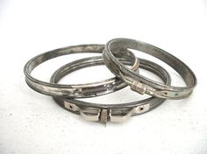
THE BASICS: Embroidery Hoops
Hoops help to keep your fabric taught and keep your stitches even.
Every person will have their own preference in material, size and shape.
Remove your hoop at the end of the day to prevent creasing!
MATERIALS
SIZES
SHAPES
Larger than the image
Smaller than the fabric

Slide 18
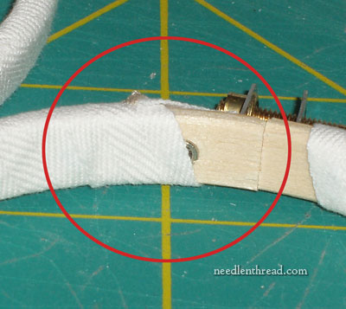
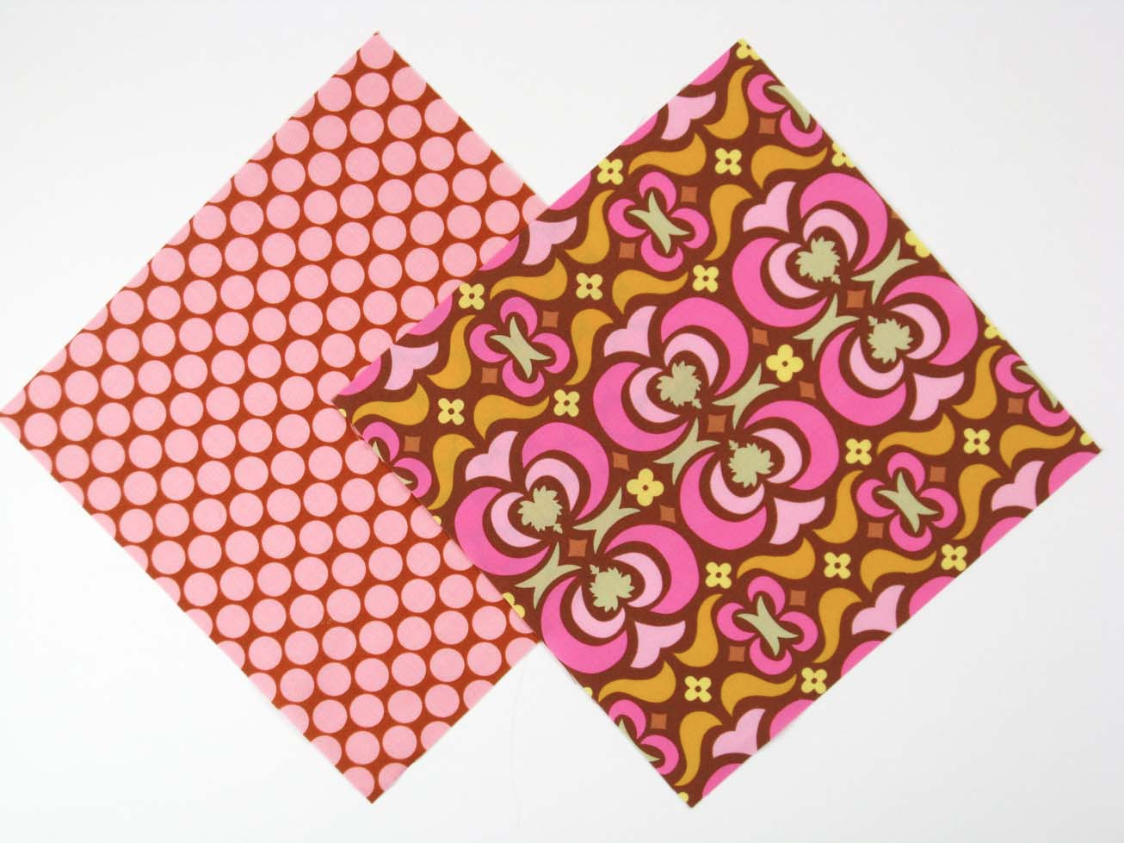
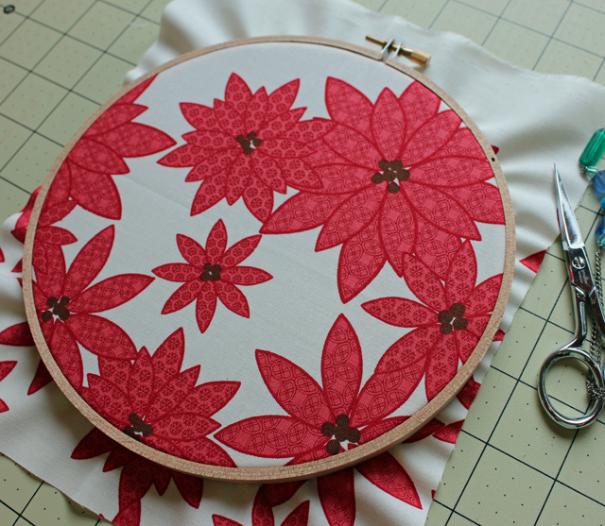
THE BASICS: Embroidery Hoops
If using a non-lipped embroidery hoop wrapping the inside circle can help to prevent the fabric from slipping.
Video Tutorial
1.
Place INSIDE hoop down
2.
Place fabric piece ON TOP
3.
Tighten hoop and Tug edges

Slide 19
THE BASICS: Fabric Choice
COTTON
BURLAP
WOOL TWEED
JEANS
SILK
RAYON POLYESTER

Slide 20
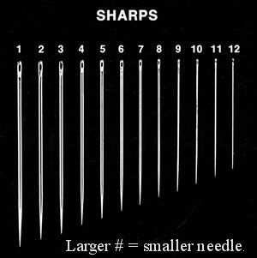
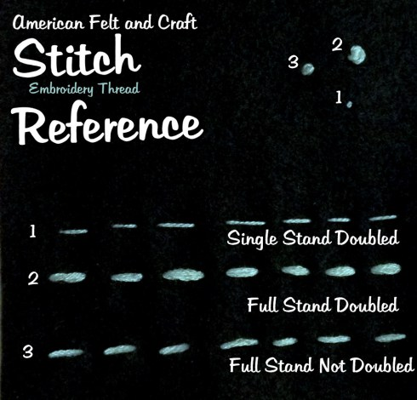
THE BASICS: Needle Types
If splitting the floss- wet the strand first
Start with a double knot at the end
Trim the fray- it will pop up onto the front
Tips

Slide 21
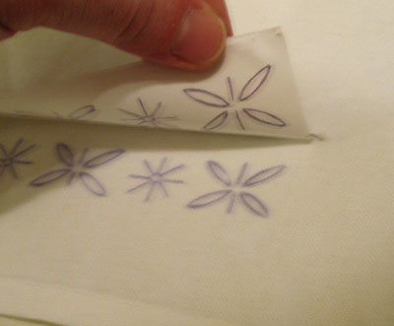
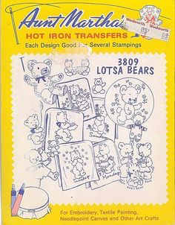
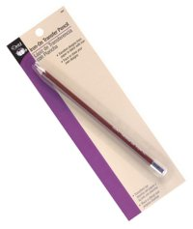
THE BASICS: Transferring the Image
Transfer Stitchery
Outline Transfer
Iron-On Transfer
Iron-On Pencil
Printable Transfer Paper

Slide 22
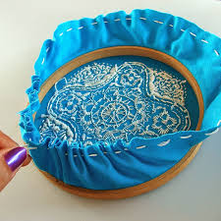
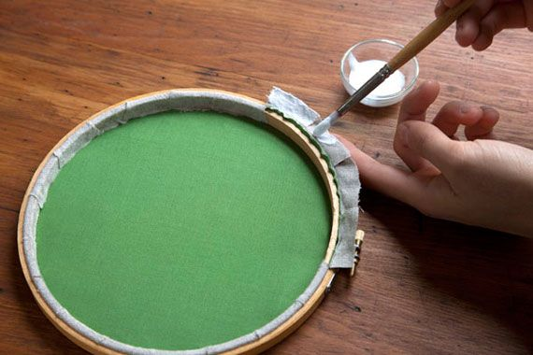
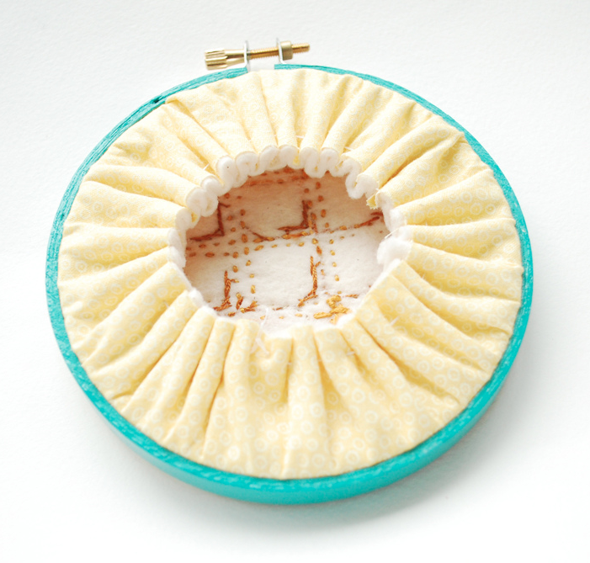
THE BASICS: Finishing
Use a running stitch to pull the extra fabric tight
OR
Cut the fabric short and wrap/glue around hoop

Slide 23
TECHNIQUES

Slide 24
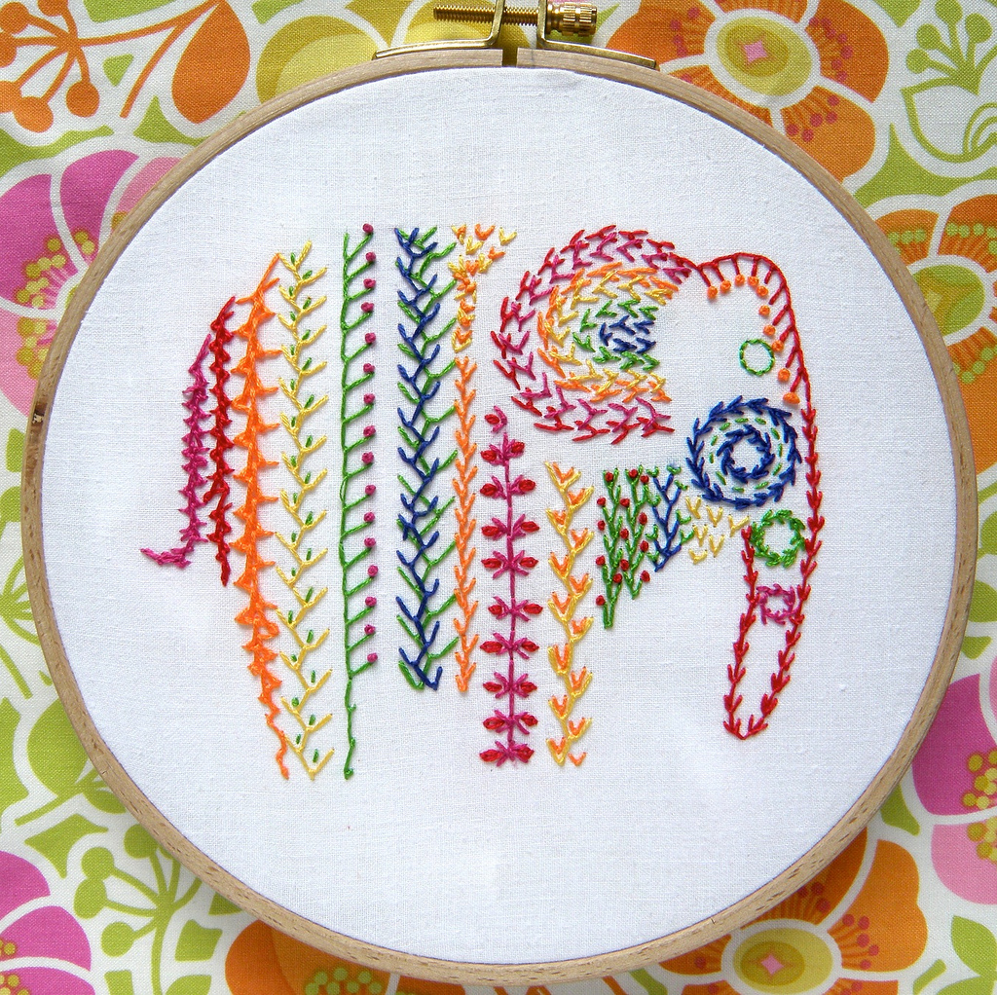
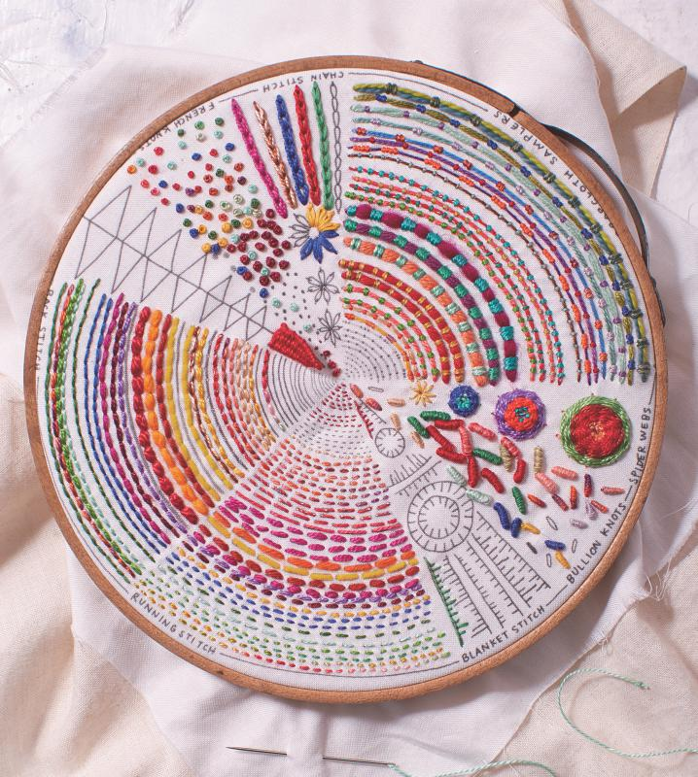
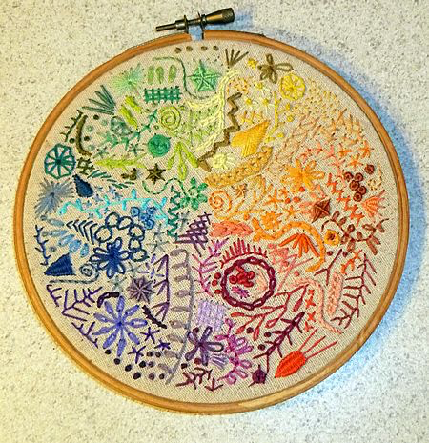
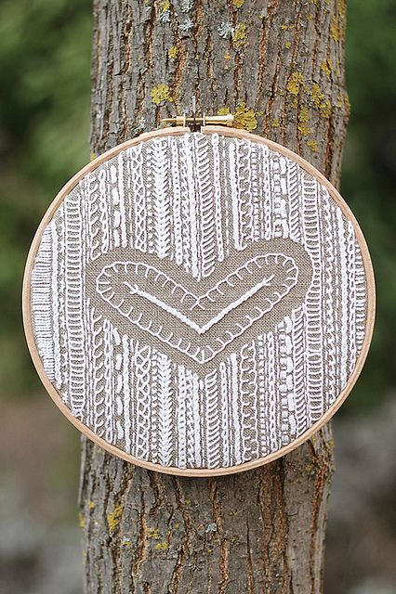
STITCH SAMPLERS:

Slide 25
RUNNING STITCH
Tutorial

Slide 26
BACK STITCH
British Tutorial
Tutorial

Slide 27
CHAIN STITCH
Tutorial
Tutorial

Slide 28
SPLIT STITCH
Bring the thread through to the front and put in to a new stitch
Take the needle backwards to bring it up in the middle of the two stitches
Take the needle in between the thread, splitting it into half.
Repeat steps 1-3
Single Thread Tutorial
Doubled Thread Tutorial

Slide 30
HERRINGBONE
Bring your thread to the front on the bottom line. With your thread below the needle, take the needle from right to left on the upper line picking up approximately 1/16 inch of fabric.
Pull the needle through. With the thread above the needle, take your needle from right to left on the bottom line, picking up 1/16 inch of fabric and spacing it the same distance away as your first stitch.
Pull the needle through and continue working evenly-spaced stitches, alternating between the upper and lower lines.
DOUBLE HERRINGBONE

Slide 31
EXAMPLES

Slide 32
FRENCH KNOT
Wrap the thread tightly around the needle’s tip 3+ times
Place the tip of the needle where the knot should be
Push the thread to the end of the needle
Pierce the fabric with the needle and pull carefully through

Slide 34
EXTRAS: Spider Web
Draw a circle on the fabric with 5* evenly spaced points place around the circumference
From the center connect the 5 points with thread
Use the needle to weave in and out of the 5 points of the circle. Continue this action.
To tie off take the thread underneath the outer-most layer and back through the fabric
* need to have an odd number

Slide 35
EXAMPLES

Slide 36
EXTRAS: Interlaced Running
Begin with a running stitch in a straight line.
Add another color or thread to it starting on the right.
Weave in and out through the running stitch by bringing the thread through top to bottom and then bottom to top until you reach the end. Don’t pierce the fabric.
Go back through the stitches in the opposite direction. When you get back to the beginning put the thread back through the first hole.

Slide 37
EXTRAS: Up and Down Button Hole
Begin on the bottom line and pull the thread through. Pierce the fabric from top to bottom and pull through making sure the needle is over the previous thread.
Holding the thread to the side come back up through the fabric along side the first stitch. Pull through with an up ward motion. As you pull the loop at the bottom will tighten.
Take the thread back down through that loop. You are now back to the first step of the stitch.
REPEAT! REPEAT!
This stitch is great for edges and curves

Slide 38
EXTRAS: Scroll Stitch
1.
2.
3.
4.
5.
Bring your thread to the front. Make a loop with your thread to the clockwise to the right
Take a tiny stitch from from top to bottom beginning slightly above the marked line and coming up on the line itself. *Make sure that the looped thread lays under both ends of the needle
3. Pull the thread firmly so the loop tightens around the needle.
4. Then pull the thread through to complete your first stitch.
5. Loop the thread to the right again and repeat.

Slide 39
EXTRAS: Wheateater Stitch
1. Pull the thread through left of the line and push into the middle line below the first
1.
2. Come back up through the fabric on the right line equidistant from the first stitch to make a “V” shape.
2.
3. Using the middle line pull the thread through about ¼ inch from the base of the “V”.
3.

Slide 40
EXTRAS: Wheateater Stitch
4. Slide your needle from right to left behind the previous two stitches at the base of the V, being careful not to pierce the fabric.
5. Take your needle back to same hole in the fabric and forming a loop under the point of the V. Bring the needle up to the left of the loop and in line with the beginning.
6. Repeat
4.
5.
6.

Slide 41
EXTRAS: Woven Filling also known as Queen Anne’s Stitch

