Slide 1
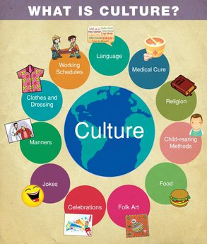
IDENTITY
… in your journal...
What cultural styles, regions or ideas do you associate with yourself?
What might be some reasons that defines who you are?
Notes:
Definition: the arts and other manifestations of human intellectual achievement regarded collectively.
"20th century popular culture"

Slide 2
STAND UP IF…
You have a YOUNGER sibling
You have ever ridden on a Motorcycle
You live in AMERICA
Favorite color
is BLUE
You’ve texted your family today
You’ve ever lived outside of Missouri

Slide 3
How do we create an IDENTITY?
In your SMALL FIRE groups list things that might make part up of an identity
Take turns listing these things on the board
Notes:
Occupations, social relationships, familial relationships, quasi-occupations (volunteer), affiliations (Yankees Fan), abilities/disabilities, salient attributes (thinker, good looking, honest), ,spirituality, etc.

Slide 4
Unit 2 Artists Explore Identity of Self & Others in Artwork
As part of this unit we will create 3-4 “mini projects” together to gain skills and insight
Mandalas
Caricatures
Self-Portrait Silhouettes
Blind Contour Drawings
You will then create an individual project in response to the theme
Imagine
Identify
Research
Plan
Create

Slide 5
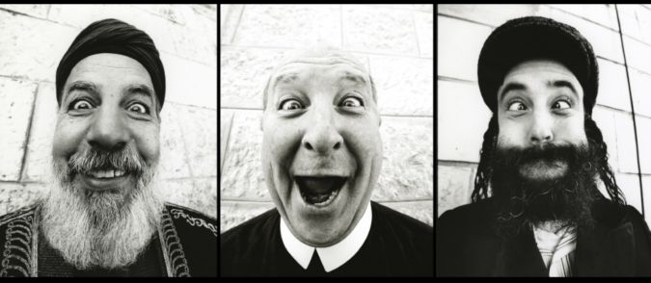
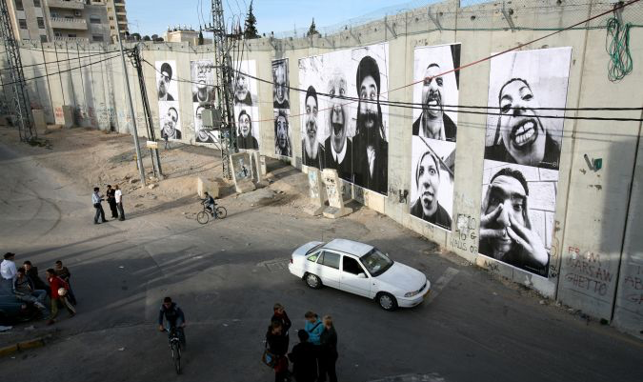
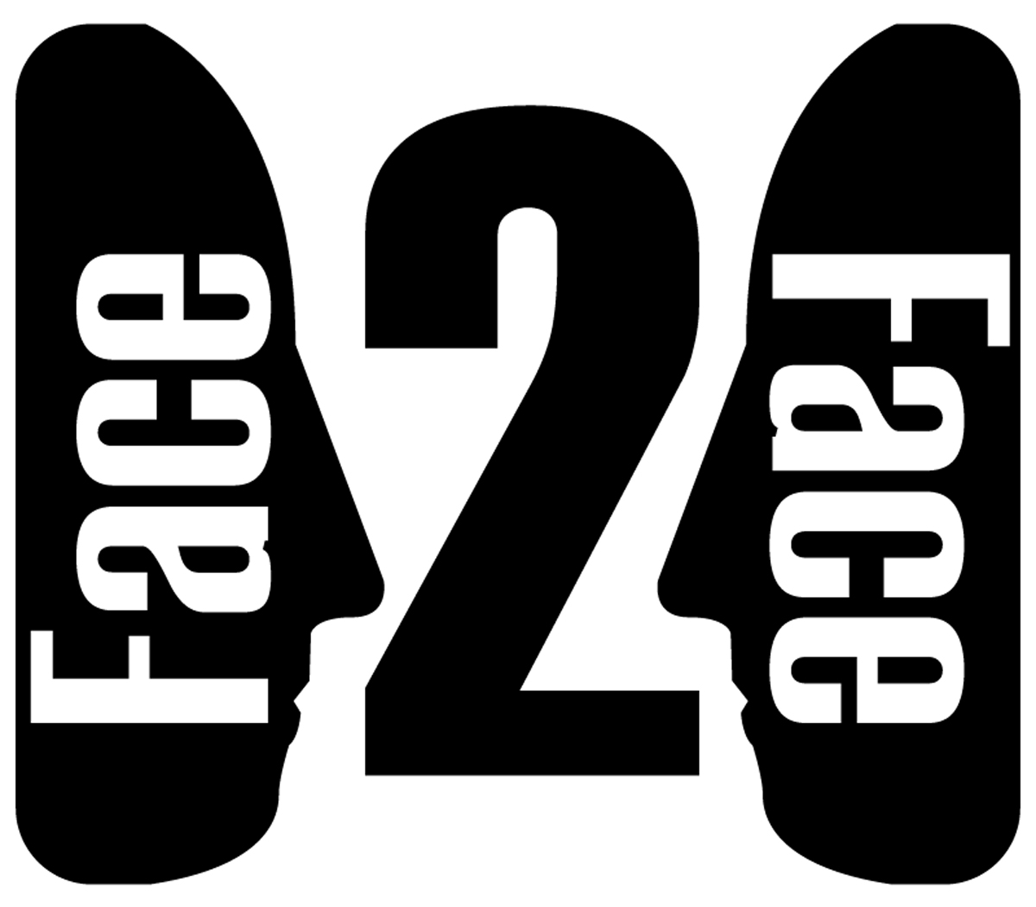
JR
Website
Notes:
JR is a French graffiti artist who creates illegal installations across the world including in Brazil, France, Israel, between the US and Mexico, etc. Face 2 Face was an installation in Israel that relates to a person’s religious affiliations. Religion and heritage divide this area into two sections: Israel and Palestine but the goal is to show the public similarities between people on both sides.

Slide 6
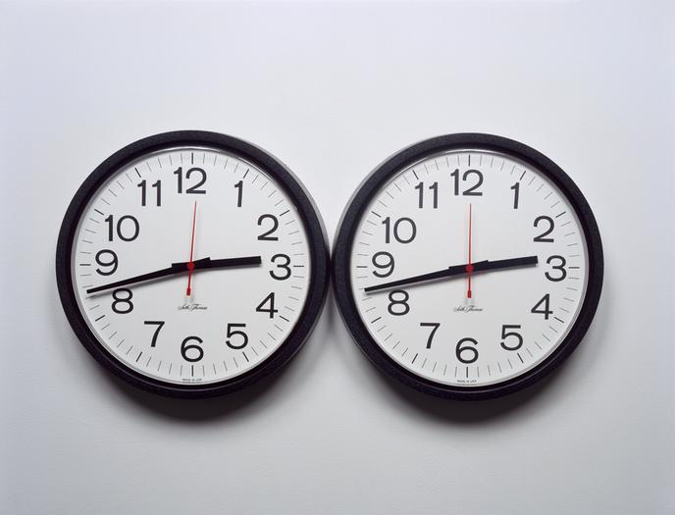
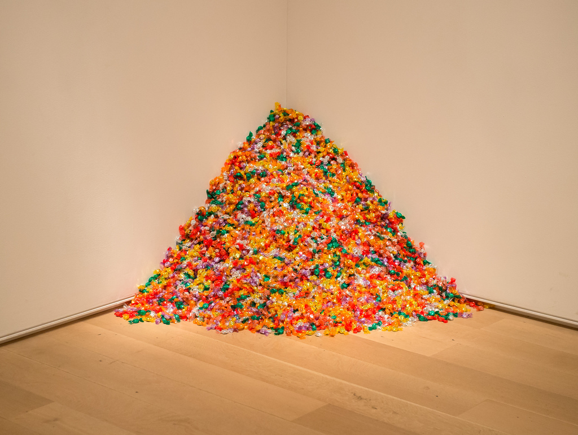
Felix Gonzalez-Torres
More Info
Notes:
Emotions are a big part of who we are as individuals. Artwork can be representative of your fears. This artwork entitled Perfect Lovers was made while Felix’s partner was dying of AIDS. It illustrates how two clocks while at one time aligned will eventually fall out of sink and the batteries will die.
He is probably more well known for his piece, untitled (Portrait of Ross in LA). How might this be a portrait? This image shows his identity as a Gay Male whose partner had AIDS. Museum goers are invited to gather a piece of candy from the pile; the slow depletion of candy represents the physical depletion of his partner’s health and body over his crisis with AIDS and the public’s complicit behavior.

Slide 7
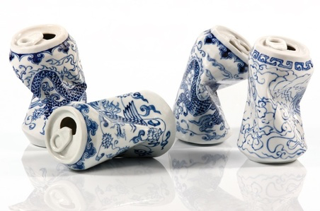
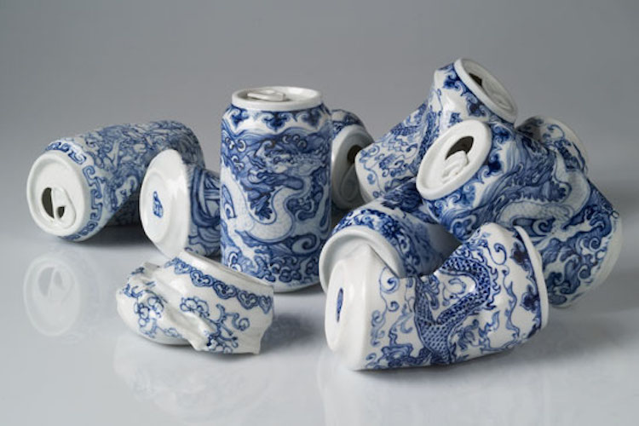
LEI XUE
More Info
Notes:
Lei Xue takes inspiration from her cultural heritage; These cans entitled “Drinking Tea” represent images from the Ming Dynasty (over 600 years ago). She observes the artwork of her fore-fathers in technique and applies modern knowledge/context.

Slide 8
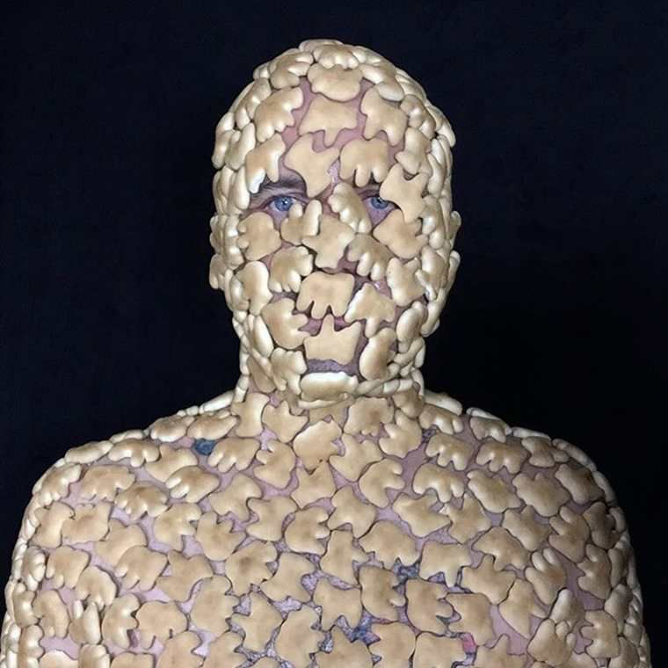
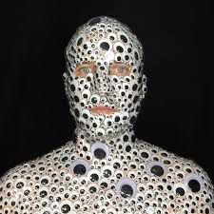
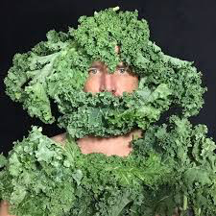
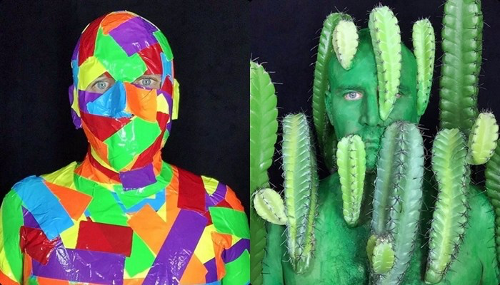
MICHAEL GUMP / BOB BUGS
Website
Video
Notes:
Maybe part of our identities is actually masking our identities.

Slide 9
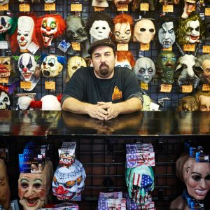
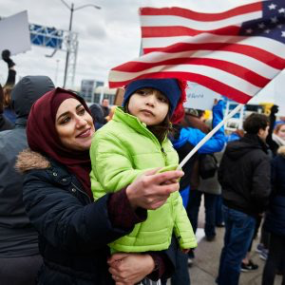
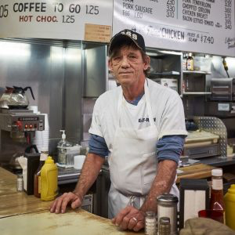
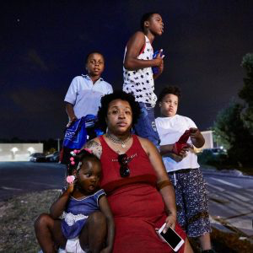
Theo Welling
Article
Notes:
Local artist Theo Welling takes snapshots of daily life in Saint Louis. With these portraits he attempts to capture the essence of each person’s identity in one photo. When we see these photos we can almost hear or smell these people and invent their names and stories. This is similar to the Humans of New York campaign discussed previously

Slide 10
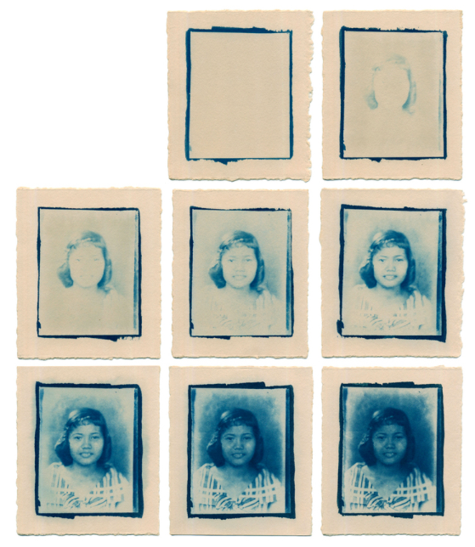
Janna Langholz
Website
Directory
Notes:
About the image: My family album was destroyed by typhoons in the Philippines before I was born. I had never met my grandmother or seen a photograph of her until I found an old film negative, taken when she was around the same age as me when I began exposing it. Spending time making the cyanotypes was a way of getting to meet her, beginning with a one-second exposure and ending with one five hours long. It was also a process of reconstructing my own identity and heritage; my blueprint from the past.
Janna is a person I went to elementary school with. She created the FilAm Directory which is a site listing as many of the Pilipino American artists she could find. This begs the question for these artists are they always creating in response to identity or is that simply a bi-product of the artwork.

Slide 11
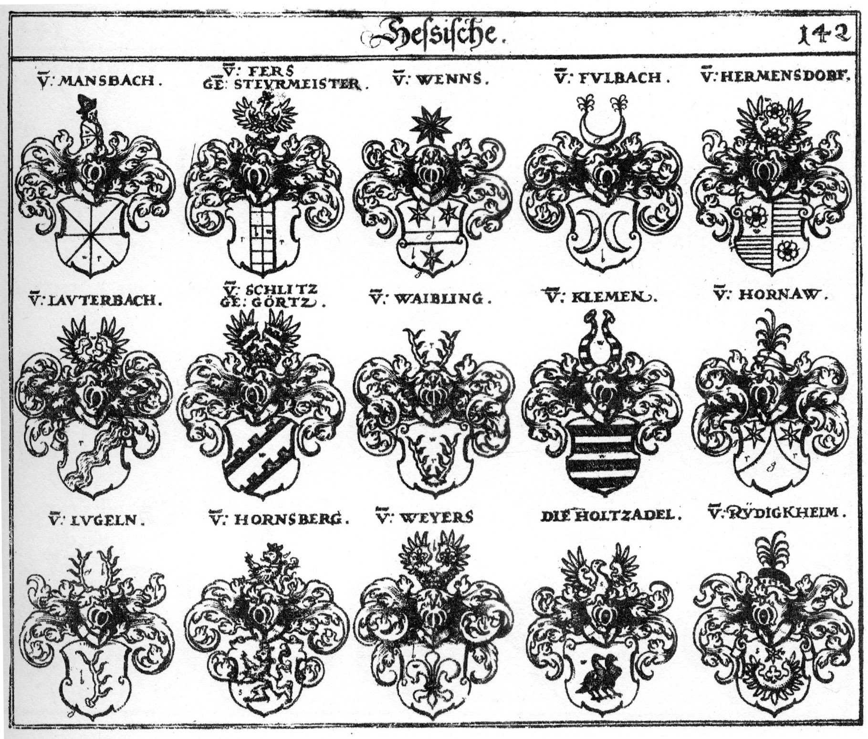
HERALDIC CRESTS
Website
Notes:
This dynamic symbol has been called the "logo of the family". Display the Coat of Arms for all to see the pride of your family. There are literally hundreds of different symbols (or charges) that can appear on coats of arms. The colors that are chosen and even the shape of the shield itself can have significance for the Family, Clan or Sept that was to bear the arms.

Slide 12
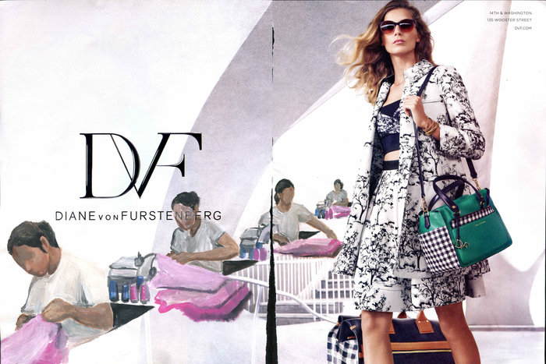
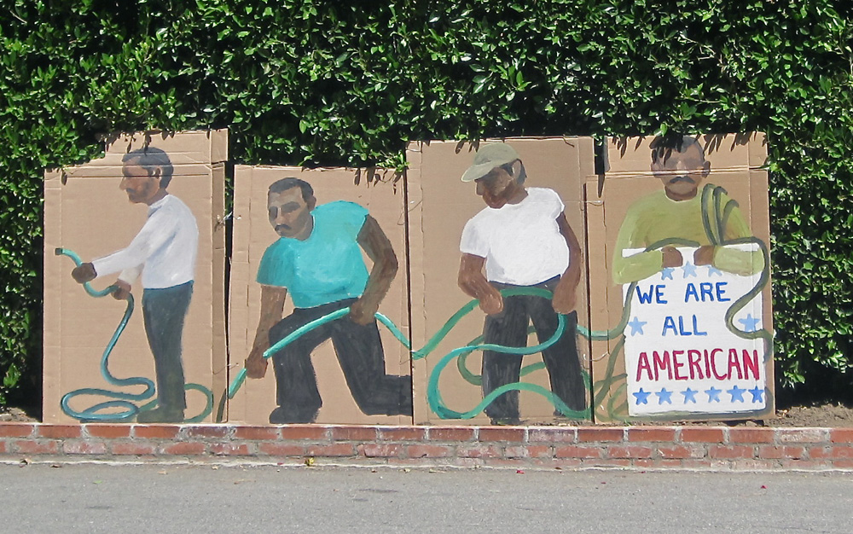
RAMIRO GOMEZ
Article
Notes:
As both a Mexican by heritage and US Citizen by birth Ramiro Gomez uses art to express the discrepancies between the working class (specifically minority laborers) and the elite of Hollywood. This takes form as sculptures in the lawns of Beverly Hills as well as traditional painting and drawings. He is often treated unequally, as someone who doesn’t belong, people may assume he is an illegal immigrant. These artworks highlight the inequality that he perceives on a daily basis.

Slide 13
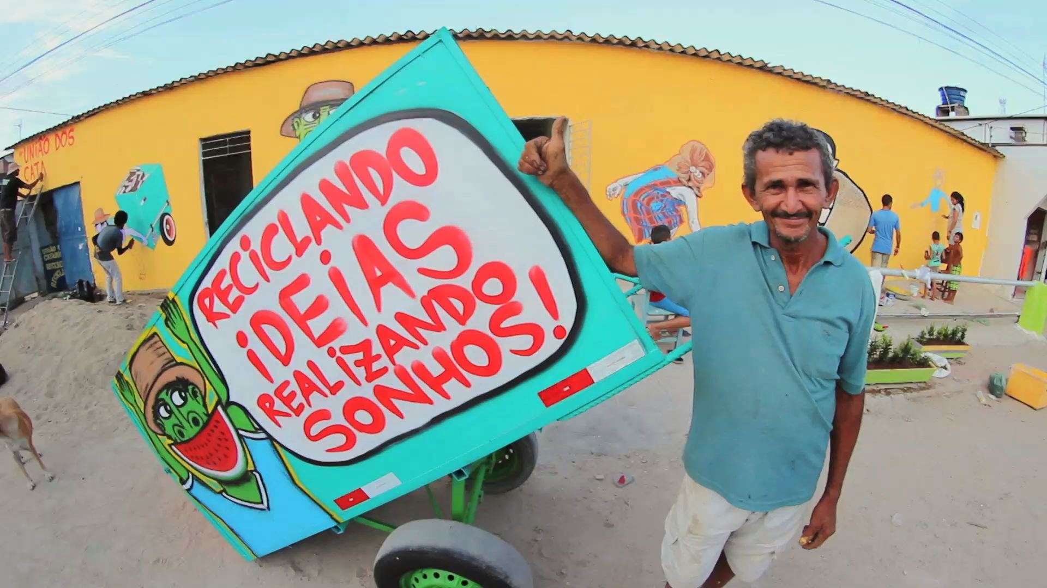
MUNDANO
Website
Video
Notes:
Brazilian graffiti artist Mundano started a project called “Pimp My Carroca” to honor local catadores who collect junk and recyclables. This shows how we can identify with our careers, professions, jobs or other life-goals.

Slide 14
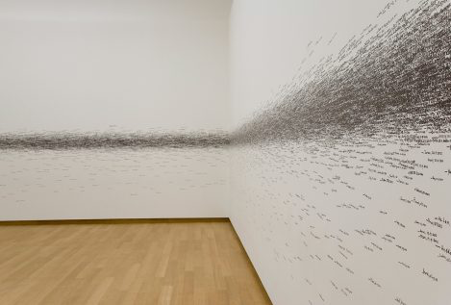
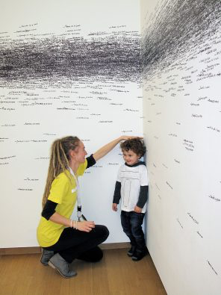
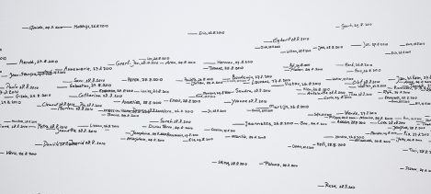
ROMAN ONDAK
More Info
Video
Notes:
This artwork and installation entitled “Measuring the Universe” takes into account our Universal traditions. As people participate we gather a collective identity. For example, we are ALL students, teenagers, mid-westerners, etc.

Slide 15
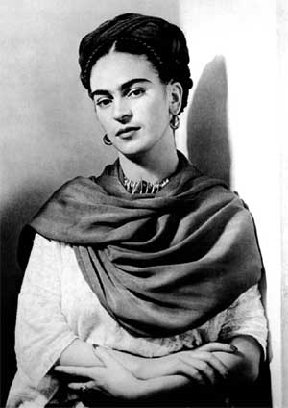
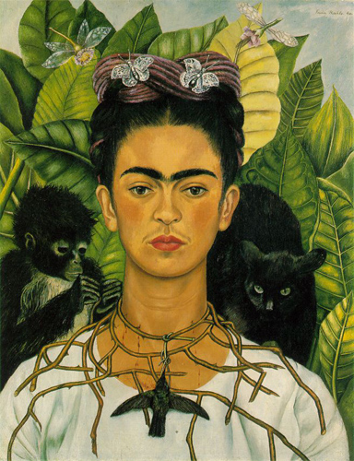
FRIDA KAHLO
Notes:
Mexican artist Frida Kahlo is remembered for her self-portraits, pain and passion, and bold, vibrant colors. She is celebrated in Mexico for her attention to Mexican and indigenous culture and by feminists for her depiction of the female experience and form

Slide 16
Unit 2 Artists Explore Identity of Self & Others in Artwork
As part of this unit we will create 3-4 “mini projects” together to gain skills and insight
Mandalas
Caricatures
Self-Portrait Silhouettes
Blind Contour Drawings
You will then create an individual project in response to the theme
Imagine
Identify
Research
Plan
Create

Slide 17
Other Artist?
Look further/dig deeper into this topic on your own…
Use one of the artists mentioned as a starting point. Research of roominate on the realizations we made about identiy and where it comes from this morning during brainstorm.
Notes:
Don’t worry, prior to starting our independent projects you will have a day to research. The next step, prior to creating your independent project is to research artists, topics, artworks, etc. that interest you. We will spend a day in the library beginning that research together as a group.

