Slide 1
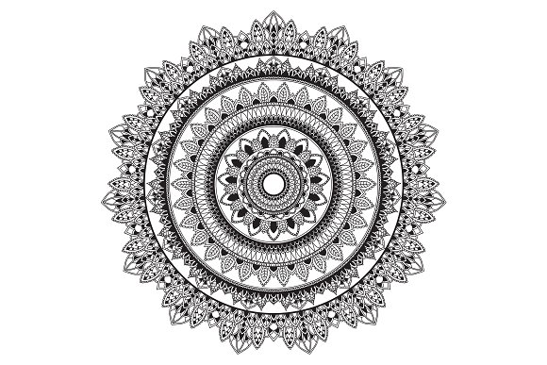
MANDALA
meaning circle in Sanskrit
Represents wholeness or oneness with oneself and eternity

Slide 2
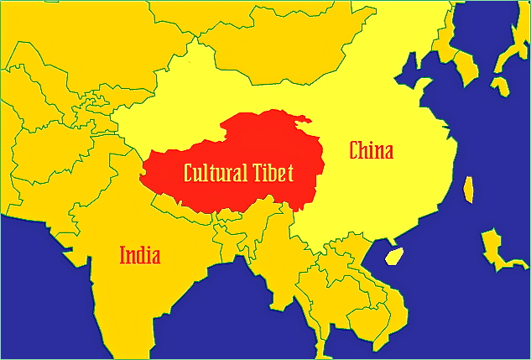
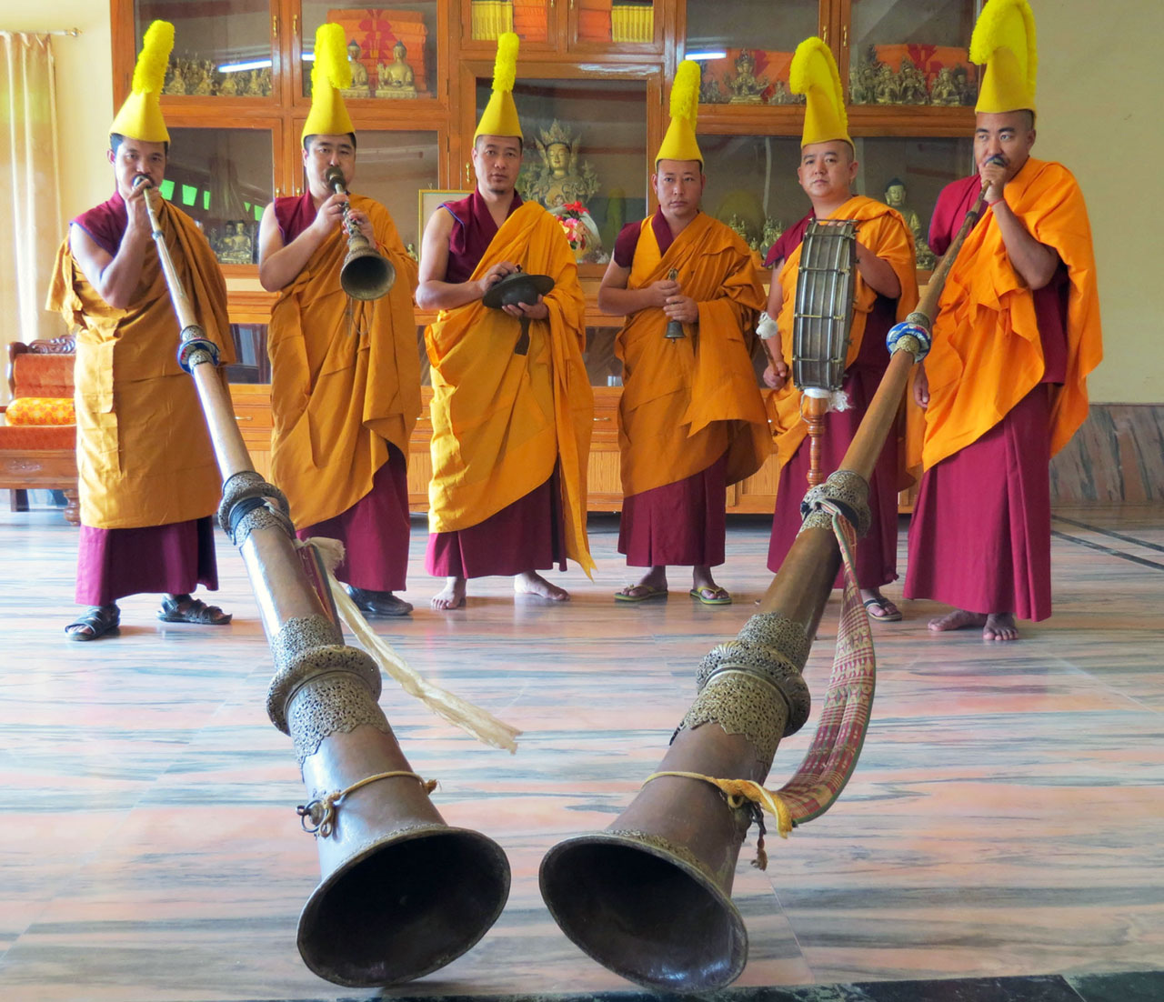
Tibetan Buddhist Monks
The tradition of Mandalas first began in Tibet through the cultural practices of Buddhist Monks.
Mandalas are an impermanent artwork created with multicolored sand. The Monks design elaborate images based on religious symbols which are carefully painted and then destroyed after a week or more of offered prayers. The sand is offered back to the earth by distribution in a nearby river to be carried to the corners of the earth.
Notes:
Side story: Modern Day Tibet is under the control of the Chinese government. Tibetan government (specifically the Dalai Lama) is currently in exile in India. They continue these practices despite their displacement.

Slide 3
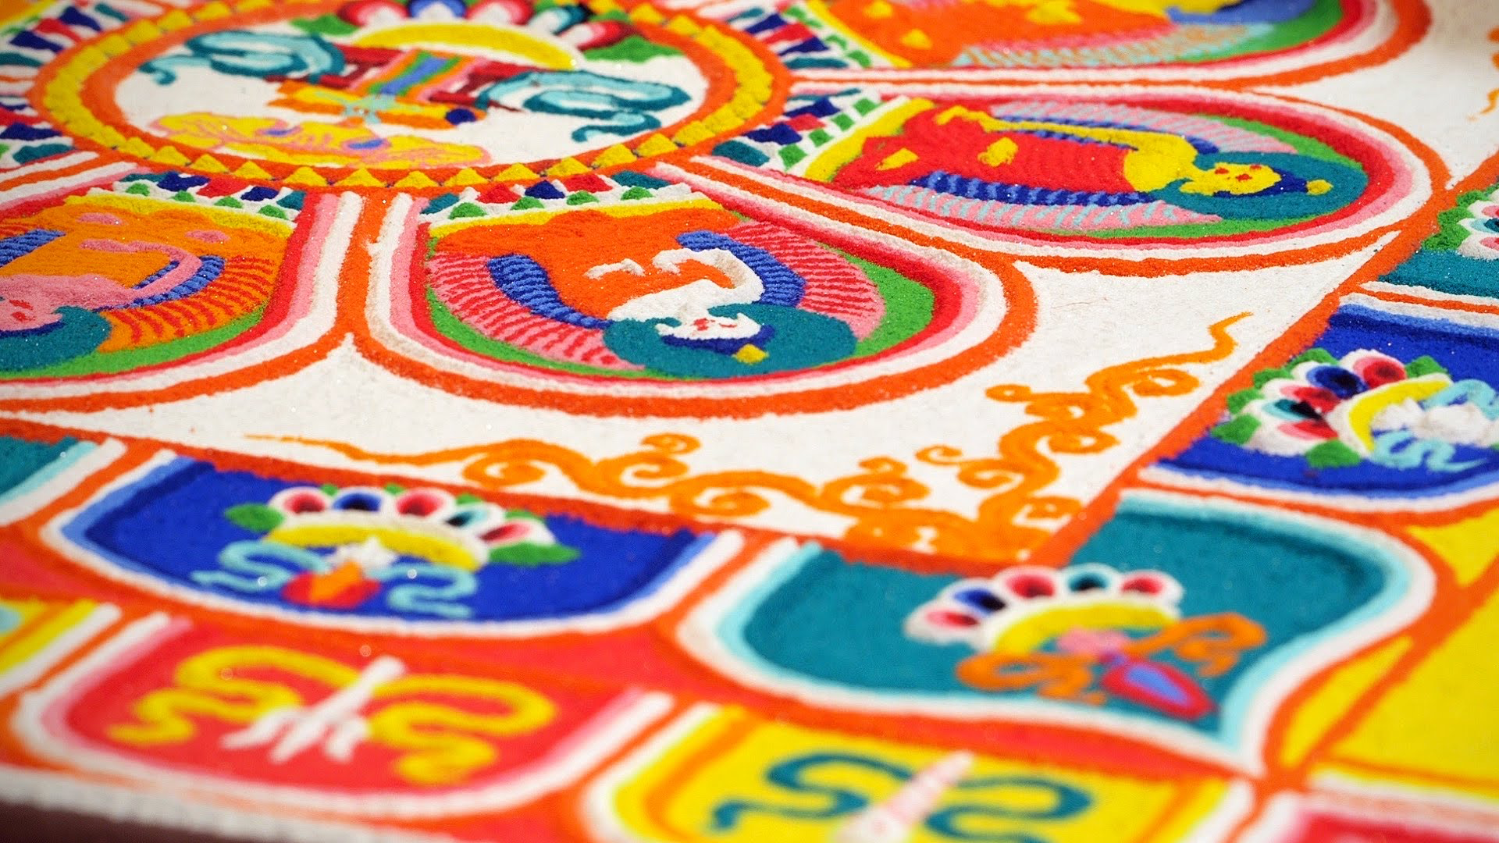
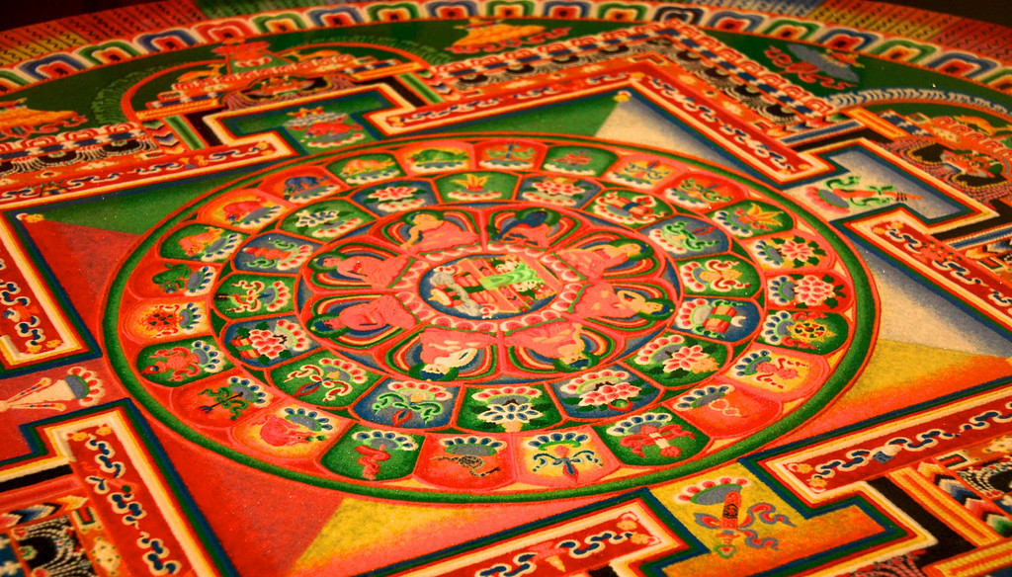
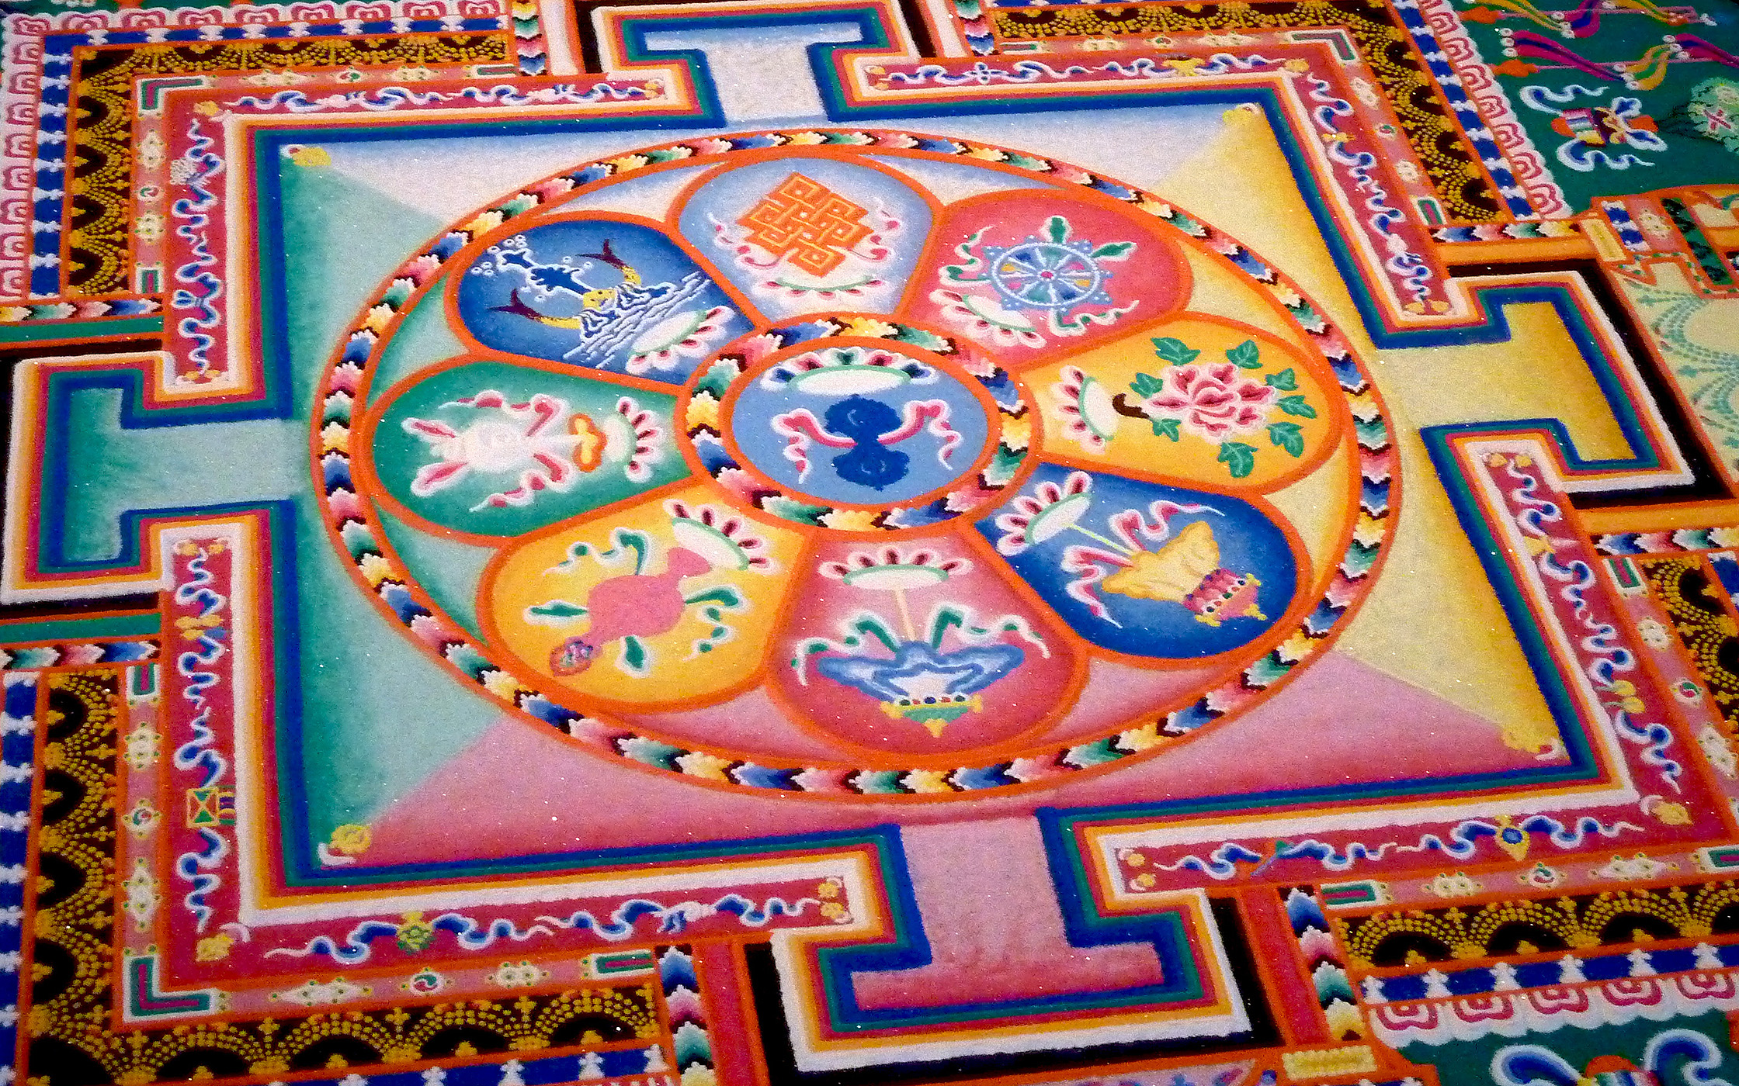
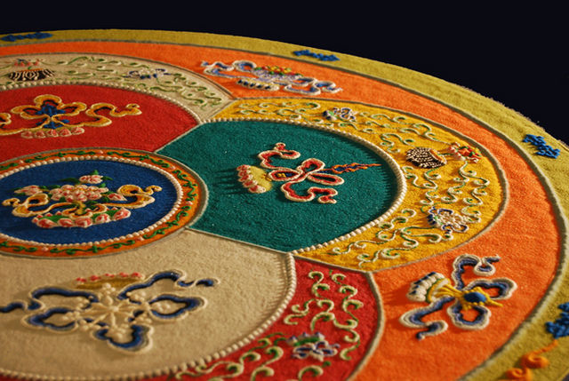
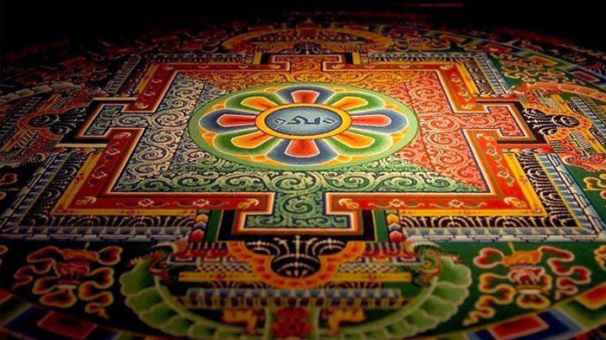
Notes:
These images represent some physical examples of sand painting created by Tibetan Monks.

Slide 4
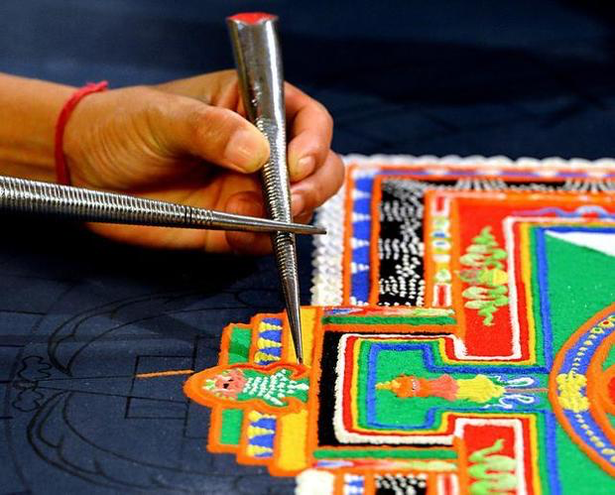
THE PROCESS
TIBETAN MONKS CREATE A MANDALA
Notes:
Watch video of Monks producing an image. The sand is ground, colored, dried and placed on a carefully measured and drawn mandala image (created with painted string and compasses), the sand is then applied by hand or with a conical tool.

Slide 5
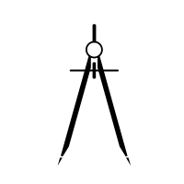
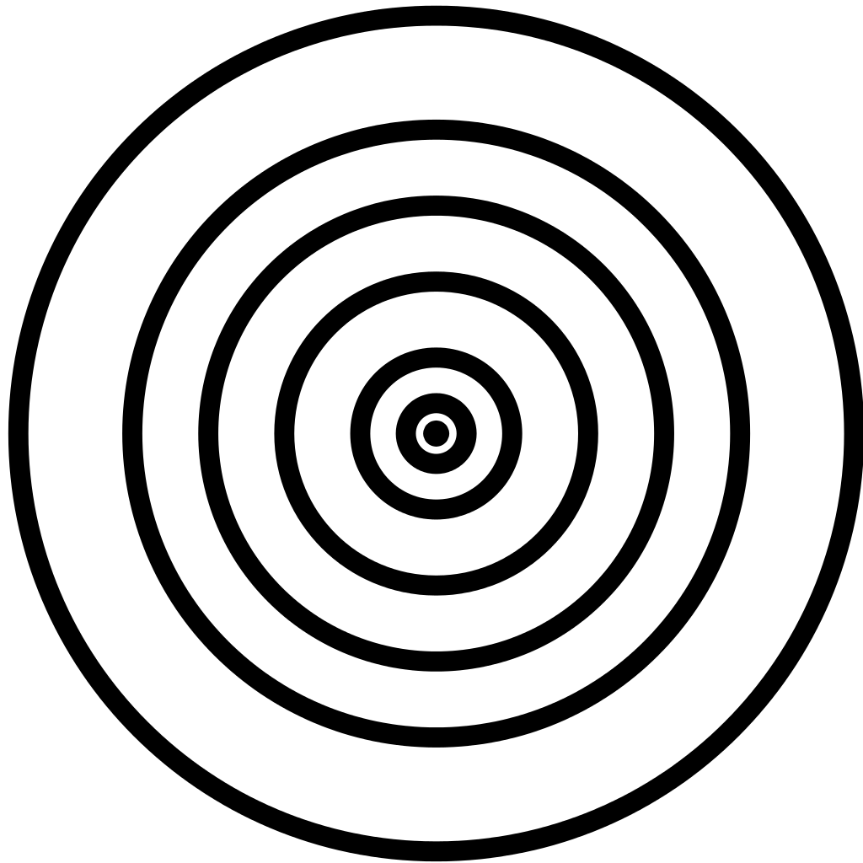
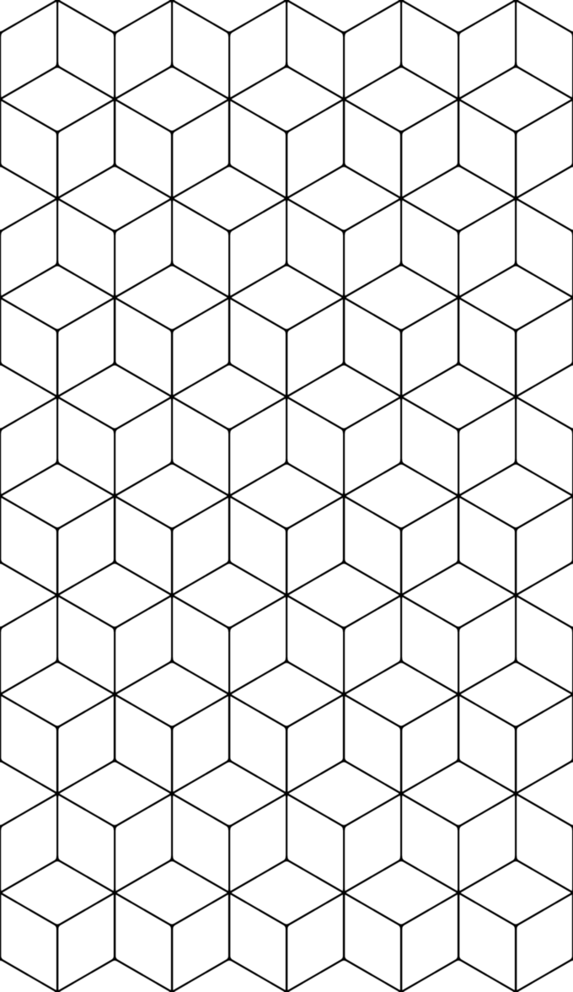
HOW TO DRAW A MANDALA
VIDEO TUTORIAL
Use a compass or stencils to create a series of concentric circles on paper
Apply a grid or other radial design measurement tool to the circles
Draw henna, mehndi or other zentangle-like designs to the grid
Notes:
A Mandala is fairly easy to draw if you break down the process step-by-step. We are going to start creating our Mandalas TODAY. This will be our first Mini-Project of our Unit 2.

Slide 6
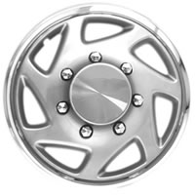
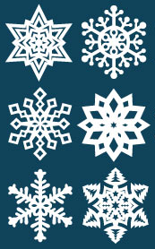
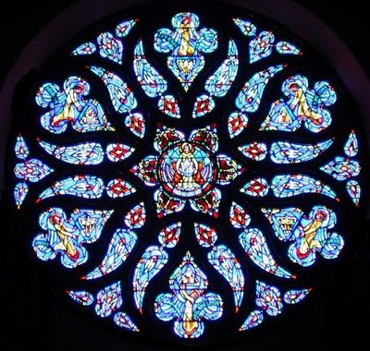
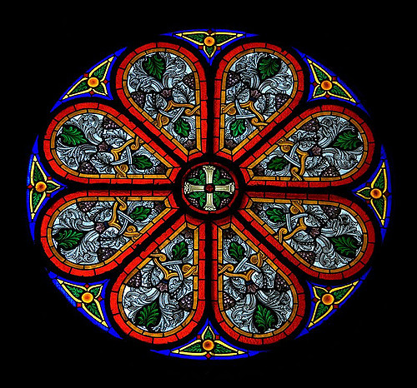
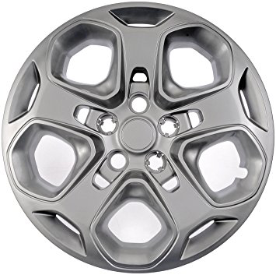
Notes:
To elaborate on the steps: Radial patterns are those that repeat in a circle around a central point. Some examples might be rose windows, hubcaps, snowflakes, etc.

Slide 7
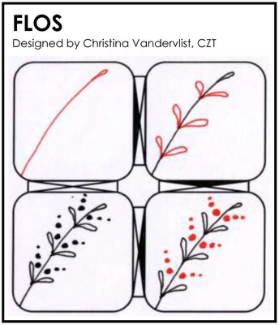
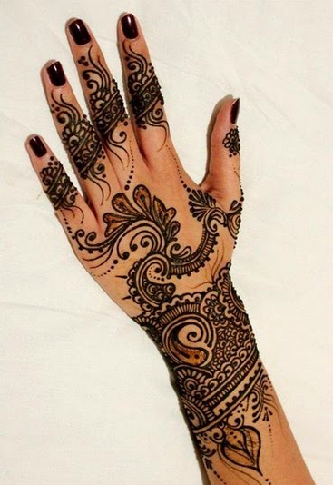
ZENTANGLES and MEHNDI/HENNA
Tutorials and images are available online for further research on designs to implement

Slide 8
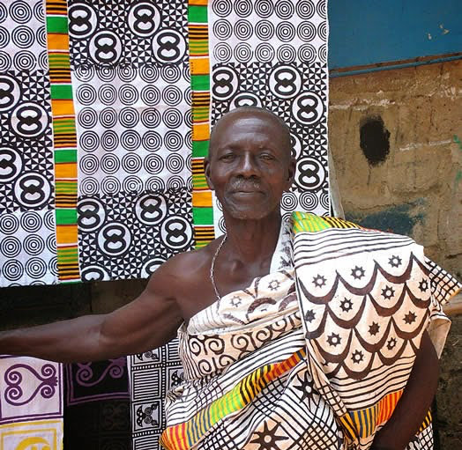
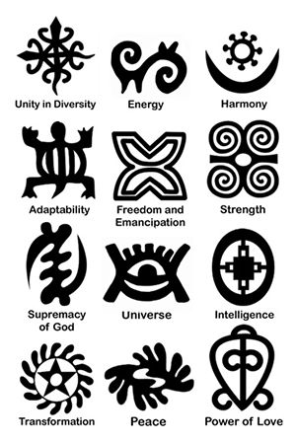
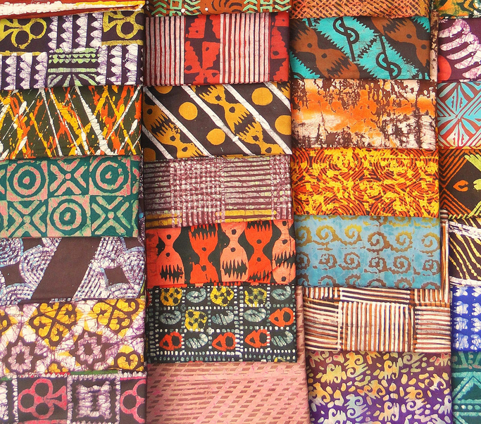
SYMBOLS with MEANING
Many cultures use sacred symbols in traditional designs
Notes:
Ghanaian Adinkra Cloth symbols are represented on the left as are printed onto religious textiles made for specific families. The fabric you wear represents your beliefs and your family’s heritage. These images are carved on to the surface of the calabash shell and printed with ink onto fabric.

Slide 9
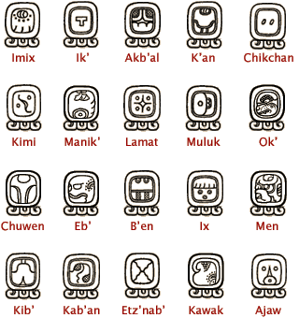
ANCIENT MAYAN SYMBOLS
Note how many of the images are radial in nature similar to the Mayan calendar we viewed
Notes:
First known Mayan writing was created in 250 BCE. The Mayans left hundreds of symbols carved on stone, which allow archeologists and other researchers to gain an understanding of their culture. In fact, Mayan writing consists of symbols called glyphs. We could also look at Native American symbols used in Medicine Wheels or on Parfleche bags and tanned hydes.

Slide 10
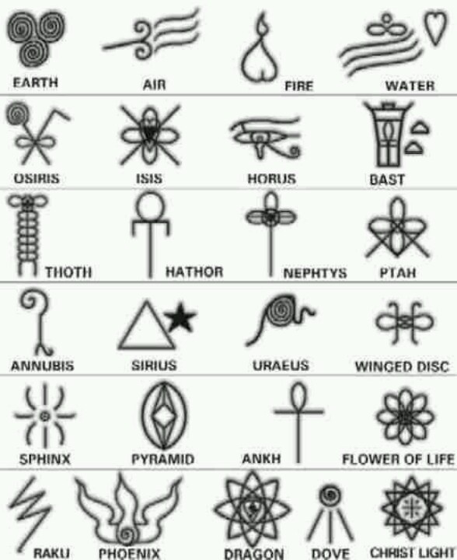
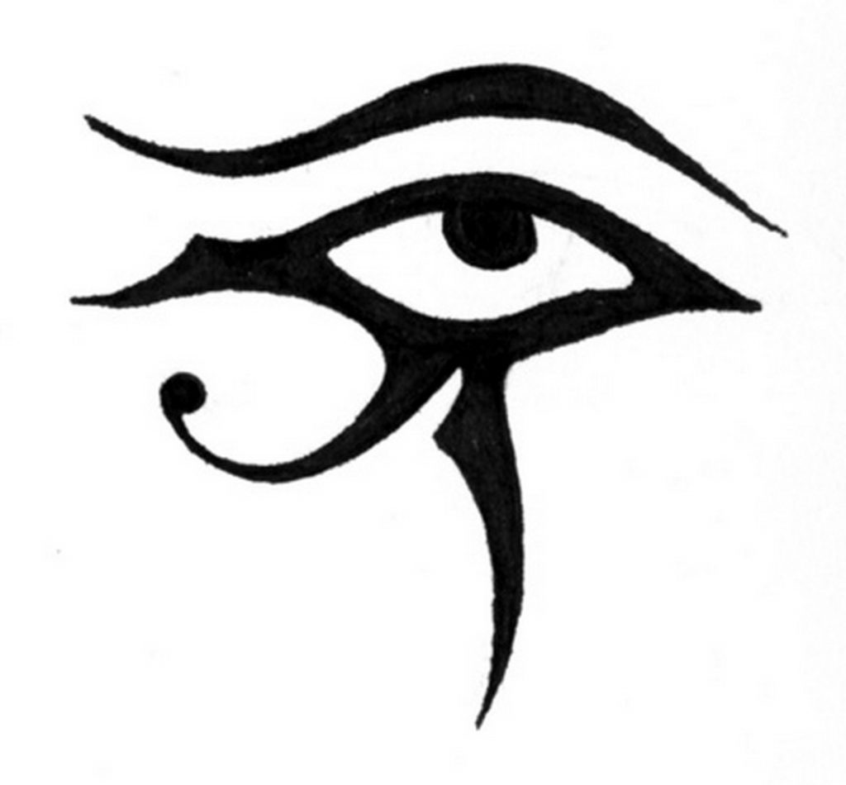
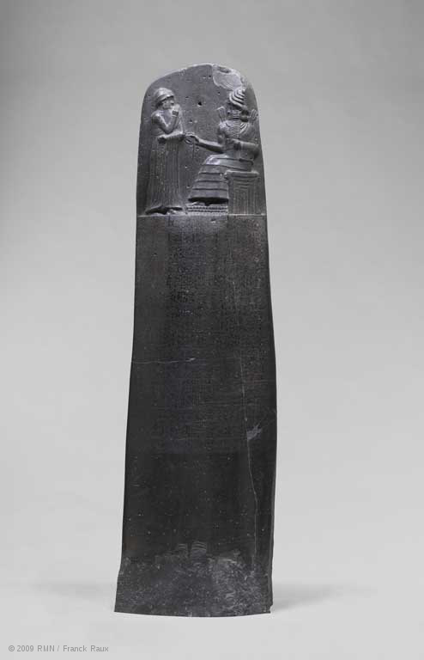
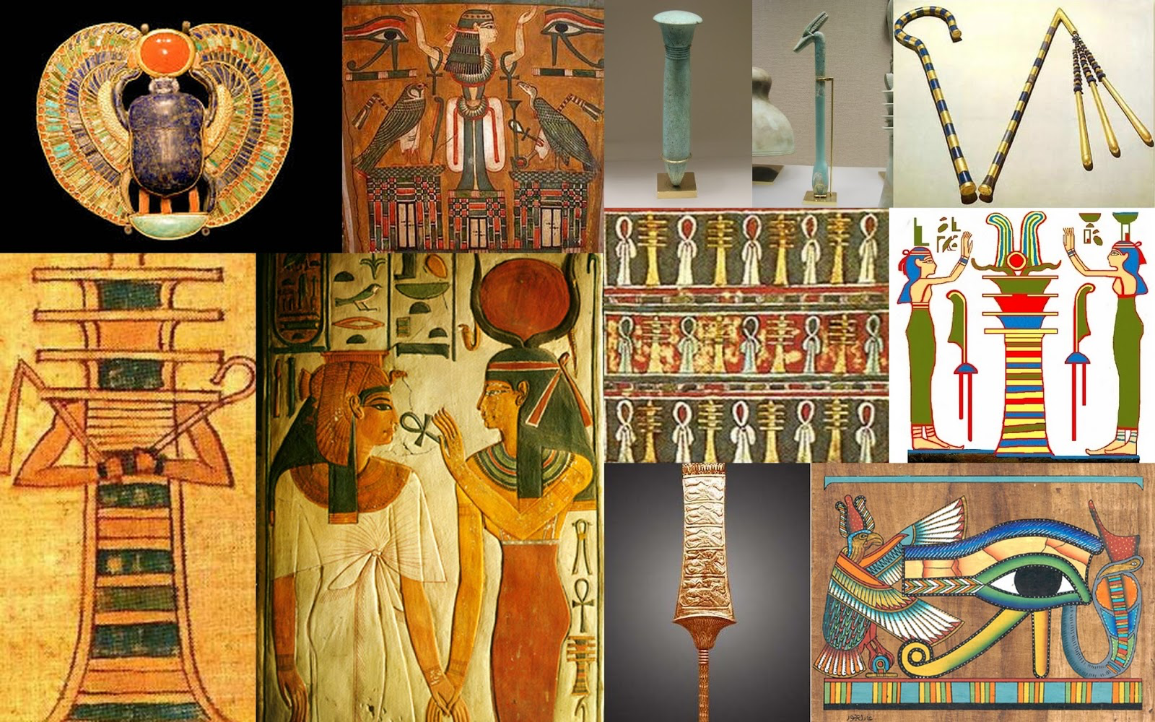
ANCIENT EGYPTIAN SYMBOLS
Notes:
The Egyptians were one of the first cultures to use glyphs as writing (the Mycenaeans being the first with cuneiform text). Their writings are labeled as heiroglyphs. The statue to the top left is an image of the Code of Himmurabi (now situated at the Louvre- I’ve seen it!) which is one of the best kept completed texts from the ancient Egytians dating back to the 18th Century BC or almost 4,000 years ago!

Slide 11
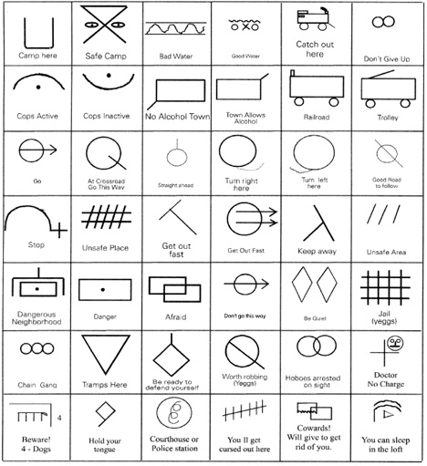
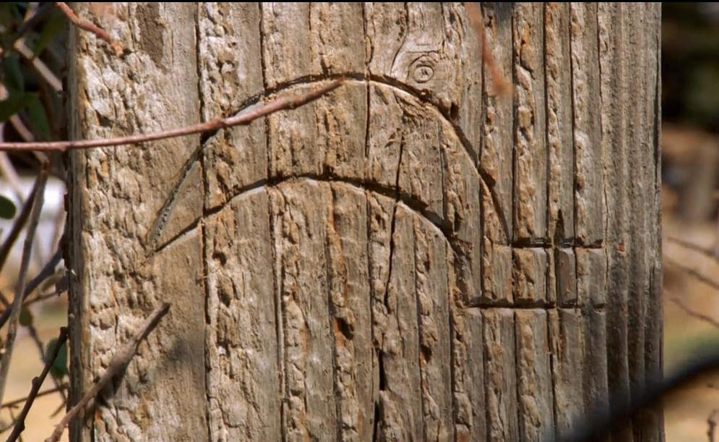
HOBO CODE
List of images
A code still exists today for modern hobos.
The use of hobo code was referenced in the TV show Mad Men (image above) showing the image meaning “a dishonest man lives here”
Notes:
Even Hobos have a code! Still, current estimates put around 20,000 people in the U.S. living the hobo lifestyle today. Today, the word hobo is often used interchangeably with “bum” or “drifter,” but hobos were a very specific type of homeless traveler. Hobos traveled around for the sole purpose of finding work in every new town they visited, having usually been forced from their homes by the lack of jobs there. A popular culture reference was even made in the TV show Madmen.

Slide 12
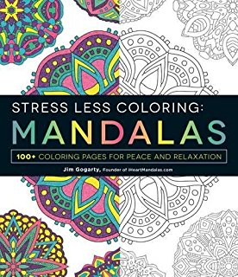
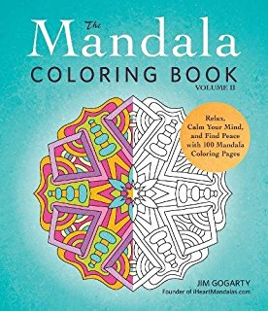
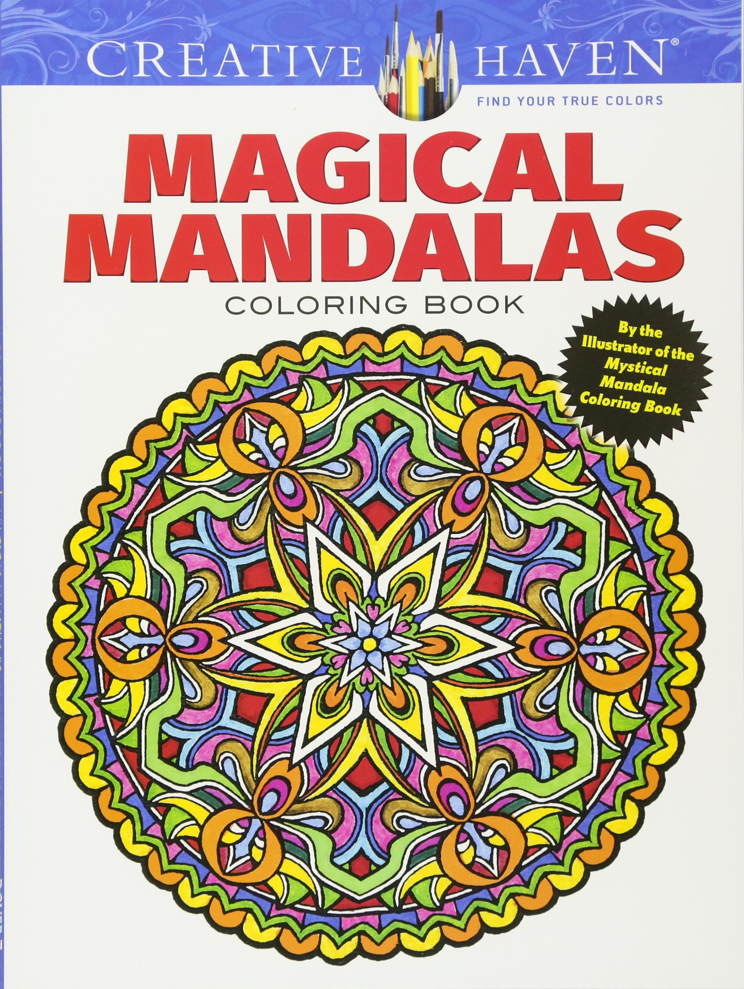
MANDALAS in POPULAR MEDIA
MANDALA COMPILATION
Notes:
Mandalas have become very popular and the meaning of the term has changed over time to represent something that represents the universe or even a relaxing or meditative coloring activitiy

Slide 13
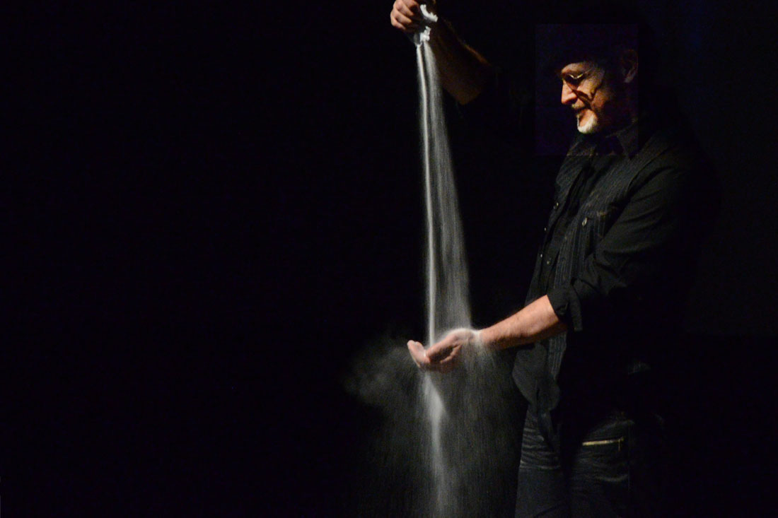
Sand Art Story Telling In Action
Joe Castillo Website
Notes:
Sand is an alternative material that can be used to create art many different ways. Apparently Joe Castillo is/was a finalist on America’s Got Talent but I first saw him on TED Talks as a story teller and sand-art creator. He’s one of many artists who create art with sand. You can follow the links for more information about his work.

Slide 14
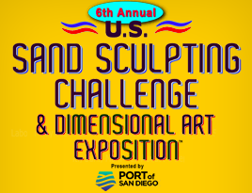
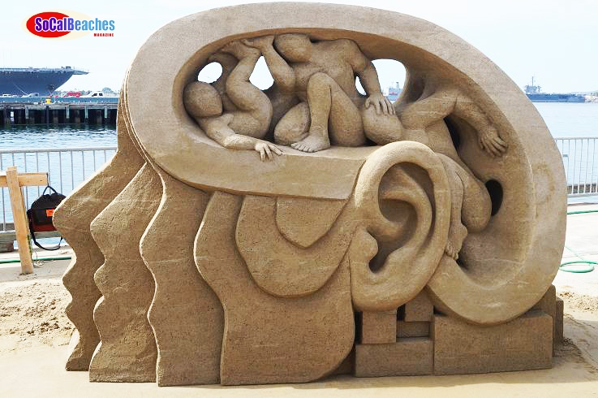
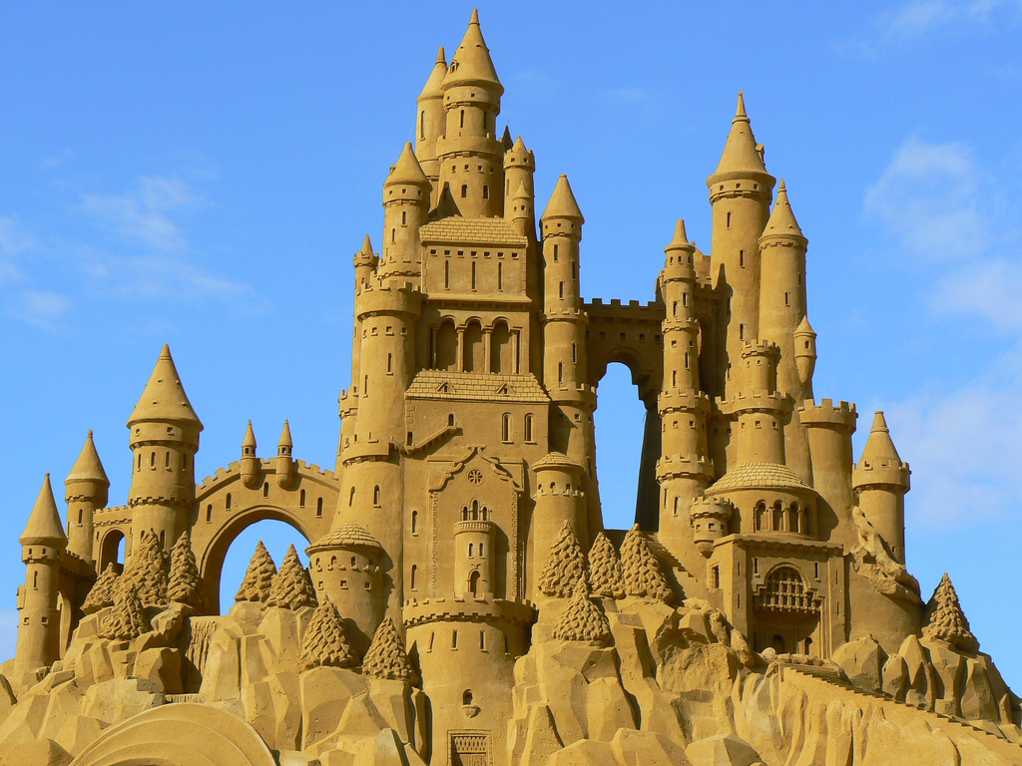
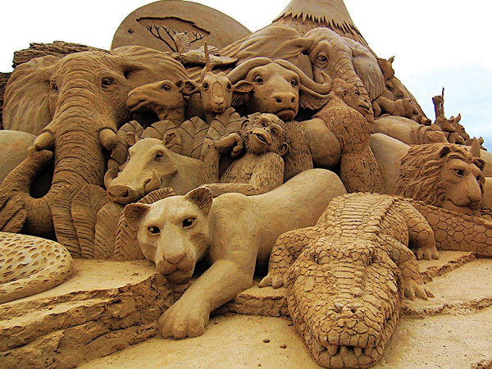
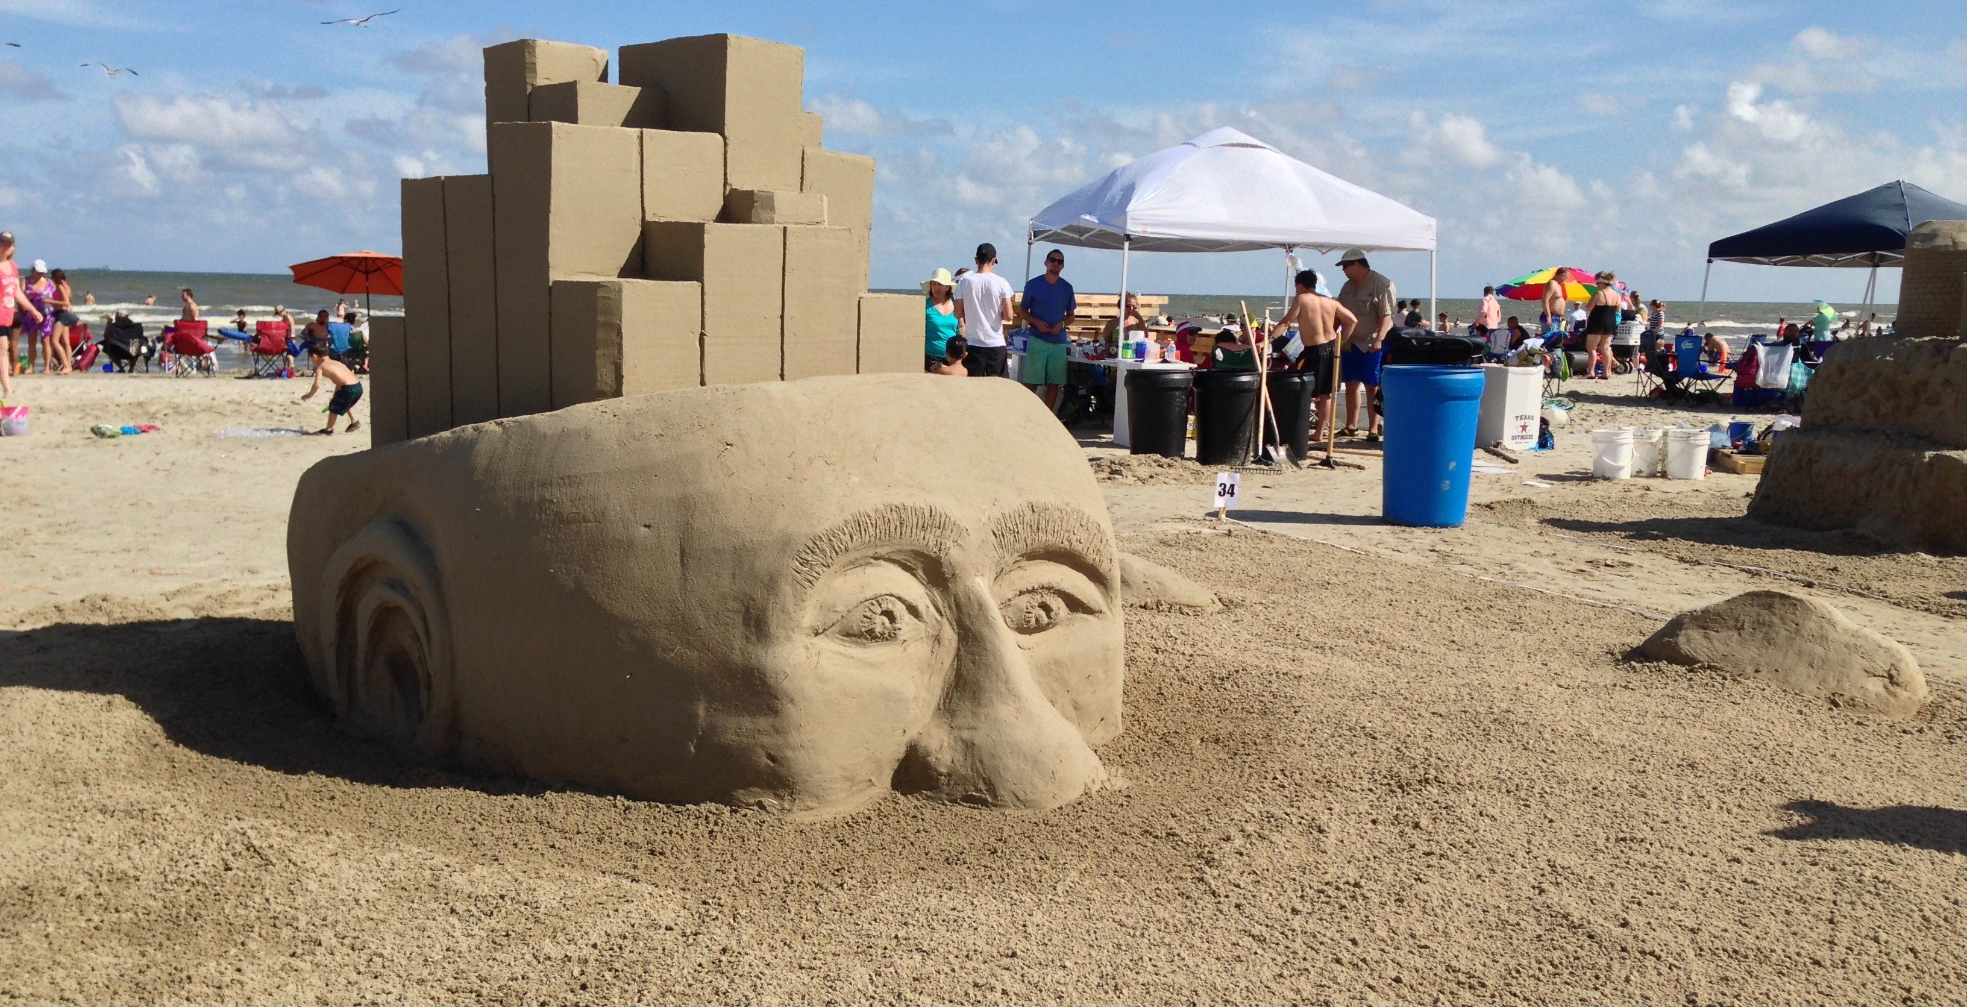
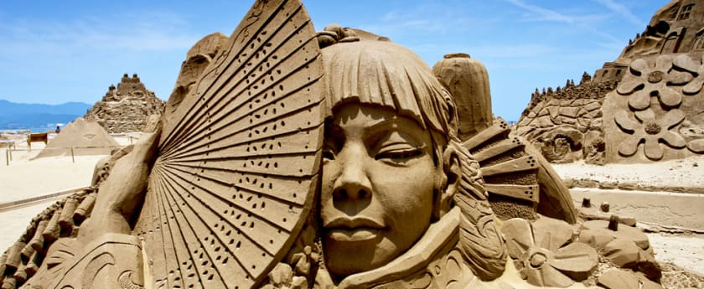
Sand Sculpting Challenge Website
Notes:
Sand can also be used to create 3Dimensional artwork similar to how clay or other materials can be used.

Slide 15
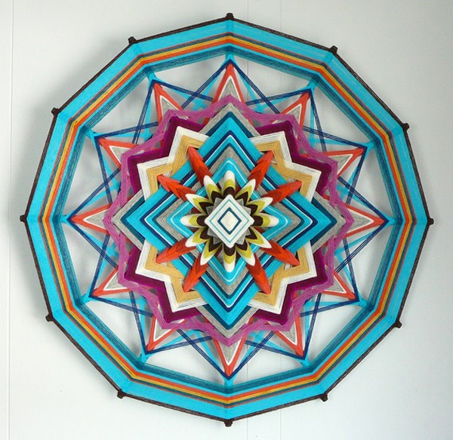
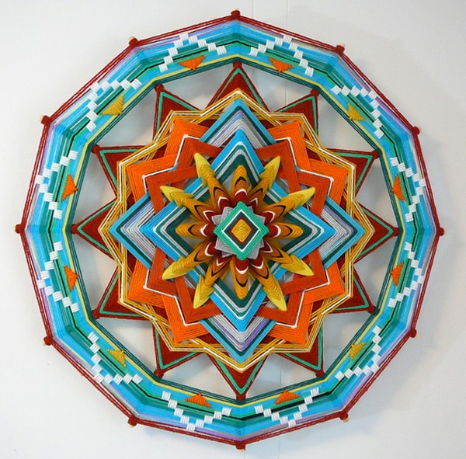
OJOS DE DIOS
GOD’s EYES
Yarn-wrapped sticks create a radial design
Notes:
Speaking of southern climates, Ojos de Dios are created by people of Huichol Heritage, a tribe of Native Americans in modern-day Mexico. There were created, similarly to the mandala, as a process of prayer and reflection. The Ojos de Dios is begun when a child is born and patterns are repeated yearly until the child is 5. This represents all the good energy and prayer put into the child’s life and becomes a shield to protect them in God’s eyes.

Slide 16
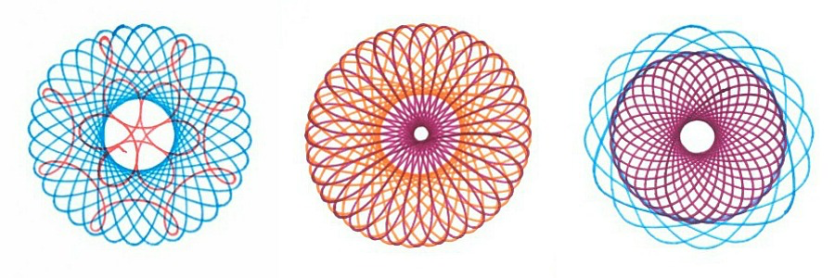
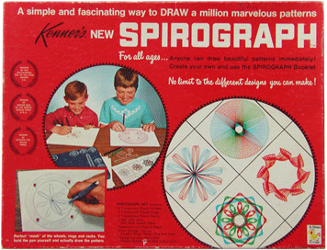
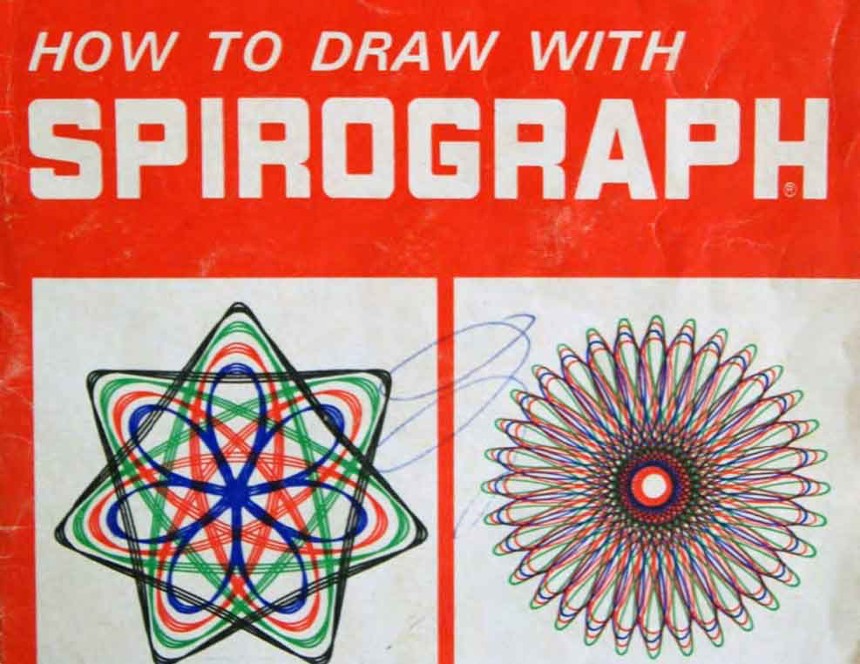
SPIROGRAPH
Spirograph in action
Notes:
A Toy first created in 1965 which perfects a mathematic repetition known as hypotrochoids and epitrochoids made with 2 different plastic rings with toothed gears on the inside and outside of the toy.

