Slide 1
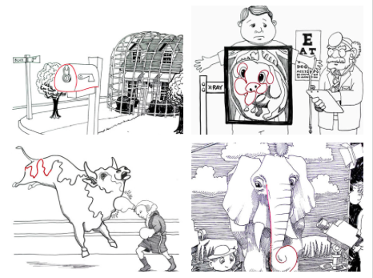
CREATIVITY: Squiggle Champion
Hand your journal to neighbor. Draw a random line in your neighbor’s journal. Pass it back.
Use that random line to create a completed scene or drawing in your journal
Matthew Lively was declared the squiggle Champion of the World. Above are examples of his work
Notes:
This is a journal entry (should take 5-10 minutes to complete). Show online first and then transition to this slide.
Being able to draw something from what could be seen as a wasted paper, a mistake or otherwise is the ultimate test of creativity. Again, the goal today is to start being open about our process or creating and thinking about drawing in a new light.

Slide 2
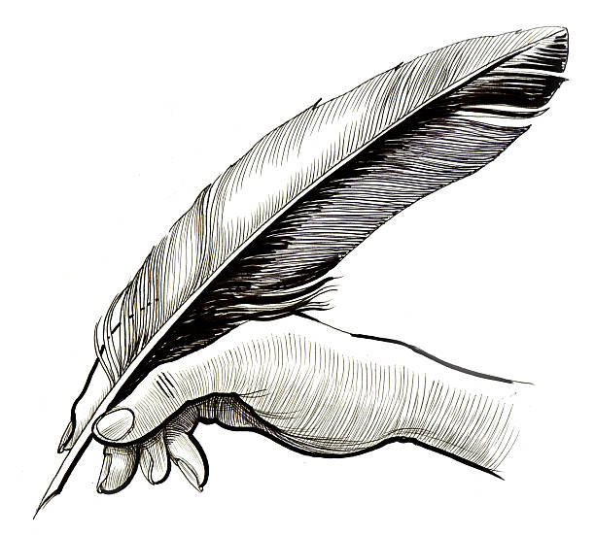
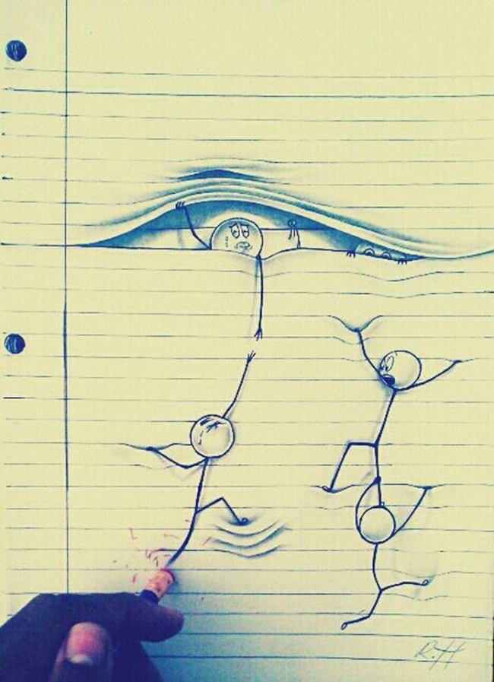
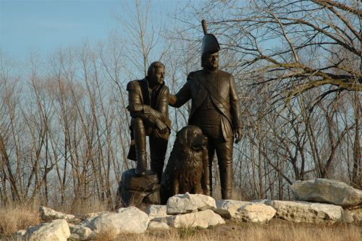
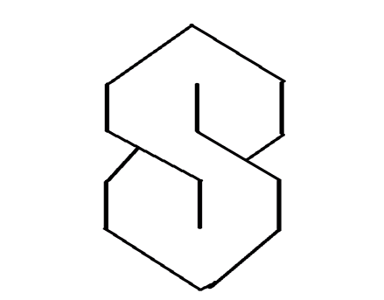
STAND UP IF
you’ve written with a quill pen
You’ve ever doodled in a notebook before
You’ve drawn one of these
You’ve seen this statue of Lewis & Clark in St. Charles, MO.
You enjoy coffee…
Notes:
Statue by Pat Kennedy 2003

Slide 3
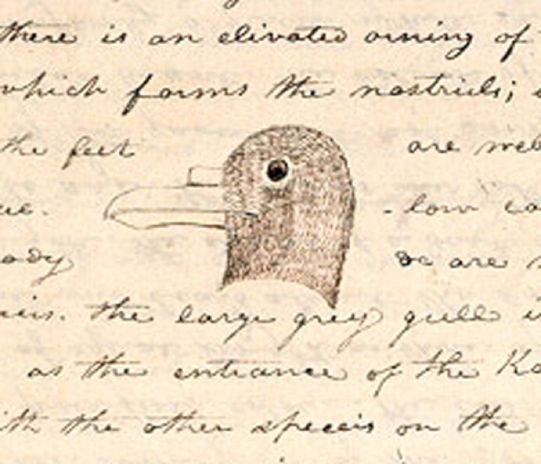
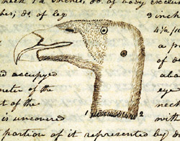
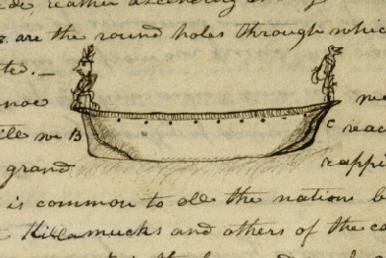
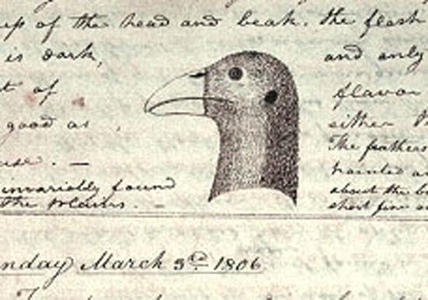
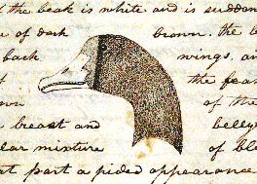
Meriwether Lewis & William Clark
Notes:
We think of Lewis & Clark as explorers, adventurers, scientists, and humanitarians but what people often forget is that these two folks are actually artists as well! While traveling West Lewis & Clark were charged with documenting new rock formations, flora, fauna and persons of interest. They used journals to complete drawings and writings to observe the West and communicate what they’d seen with other settlers in the East.

Slide 4
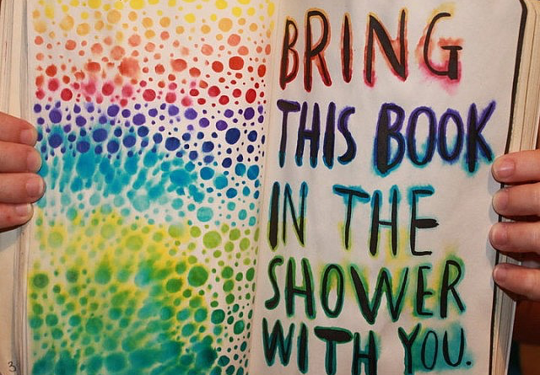
WHAT IS IT?
Wreck this Journal
Notes:
So I’ve decided that everyone who posts their sketchbooks online cannot truly be real. A sketchbook is for practice. It’s often filled with failures and weird ½ thoughts, not perfected drawings and illustrations. Wreck this journal is a really cool and inspirational workbook to try if you’re interested in expanding your drawing skills

Slide 5
SKETCHBOOKS for PRACTICE
Notes:
Our journals/sketchbooks are to be used for practice. Remember they are graded for completion and should include failed attempts at drawing or painting an object.

Slide 6
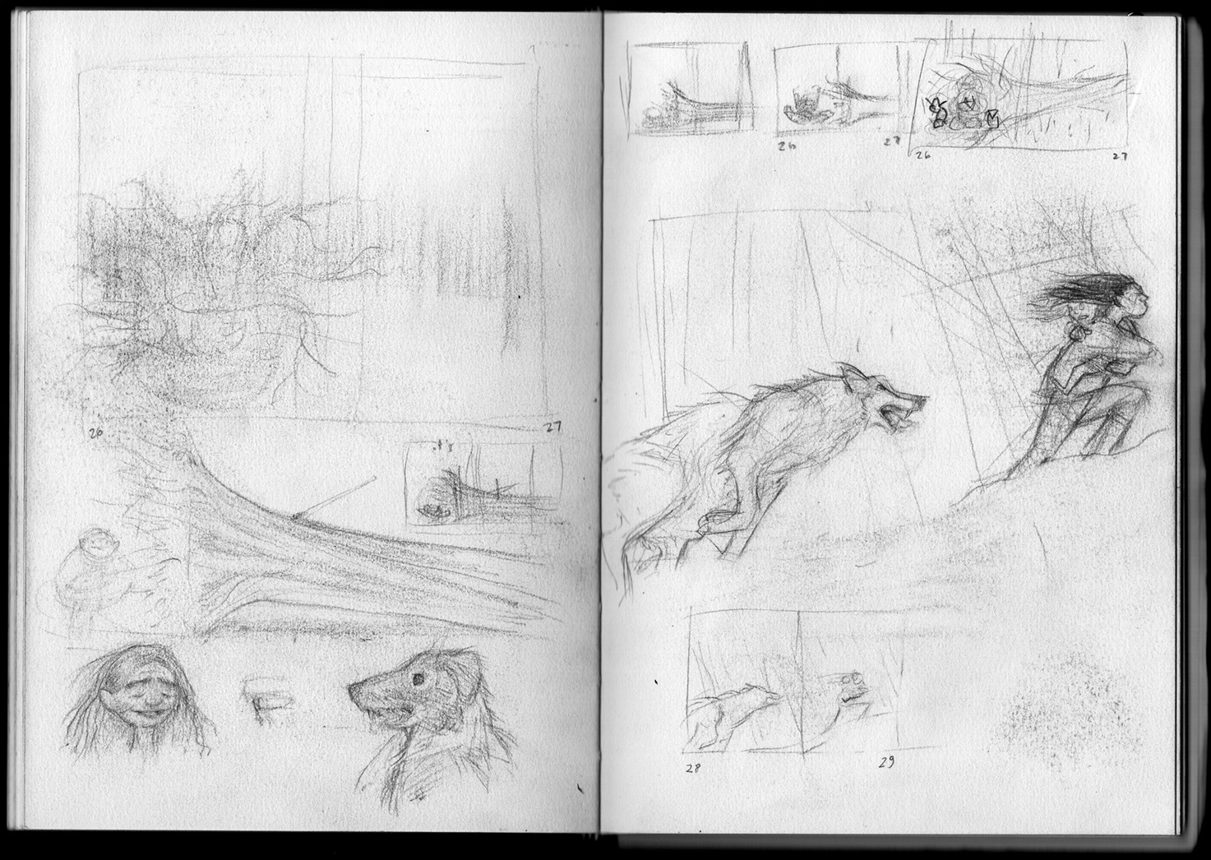
CHARACTERISTICS of a SKETCH
Unfinished pieces of art that an artist draws quickly (sometimes in seconds)
Done to
record an observation
develop an idea for later
communicate an idea
practice for a final image
Can be done with any material… But traditionally completed in pencil or pen
Notes:
These are the characteristics of a sketch. Turn to the GREEN portion of your journal and write down these attributes for future use. Remember your journal is your greatest resource. You are going to keep notes on all of the materials and processes that we use so that you can use the independently in the future.

Slide 7
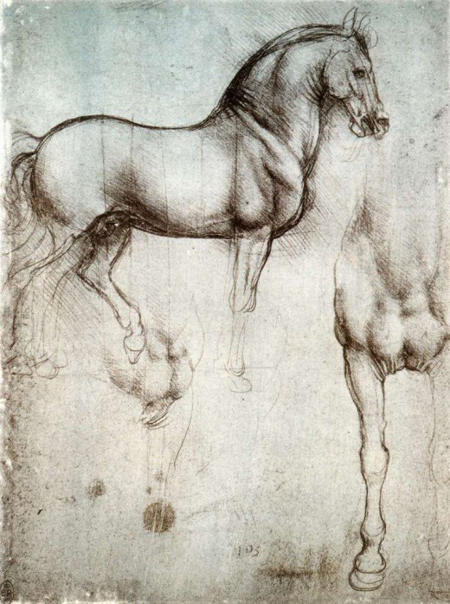
Leonardo DaVinci
STAND UP
…
LINE UP
How many total pages did Da Vinci sketch?
Least # by the door and Highest # by the windows
Download Sketchbooks Here
Notes:
Leonardo DaVinci is one of the famous artists we reviewed who based much of his artwork on observation. Fun facts: Leonardo DaVinci created over 50 journals and 20,000 pages of sketches. Many of these were used later as important resources for anatomy and physiology studies. He was left handed and wrote much of his sketchbooks backwards (mirror writing); scholars are not sure if it was meant as code because he worked on a number of military machines or if he was simply dyslexic. Follow the link to download a translated version of DaVinci’s compiled sketches. Get into groups of 2-3.

Slide 8
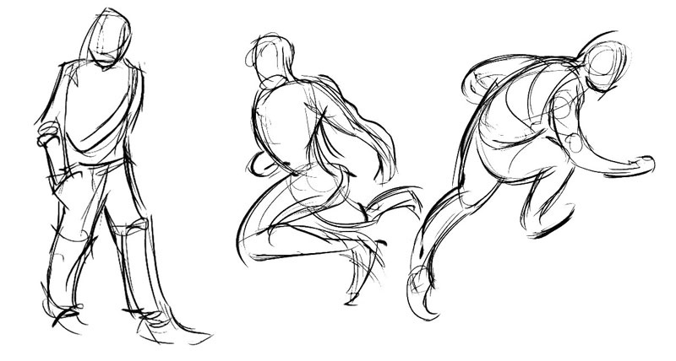
GESTURE DRAWING
A quick drawing that captures the movement of a person
Randomly Generated Poses
Notes:
Graphic artists, animators and artists that focus on portraiture will often create quick, “gesture drawings” of people as a sketch to show their movement. We are going to complete 5 now as a group. (Pass out newsprint). Fold your paper in ½ twice… You can visit quickposes.com to view randomly generated poses; of which we will do 2. These are EXTREMELY QUICK. First get a sense of the overall pose by drawing one long line down the center of the body. Use quick, loose lines to describe the outer shape of the body (these should vary in thickness/weight), and remember do not add detail (like eyes, nose, mouth, shoes, etc.) Now you will pose for each other. The person with the shortest arms will go first this time. I will time you at 1 minute per drawing. On the back of the paper do 1 large gesture drawing.

Slide 9
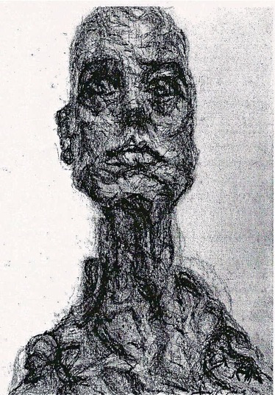
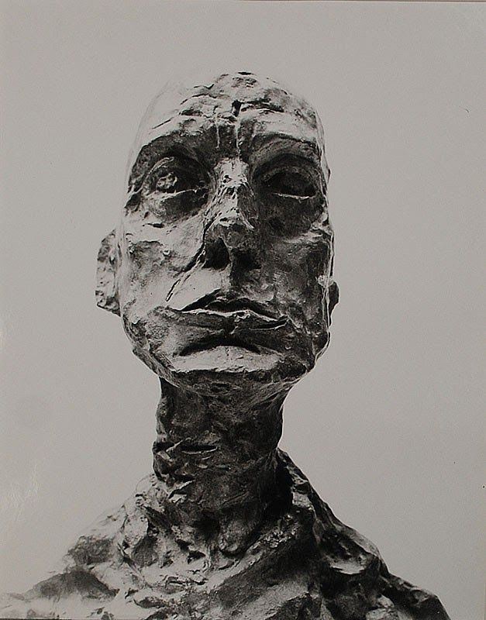
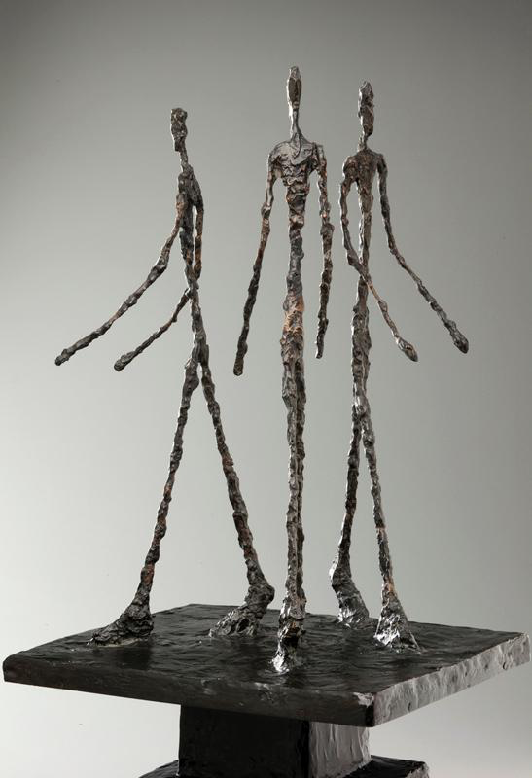
ALBERTO GIACOMETTI
Sculptor and painter, Giacometti created gestural pieces which give a sense of movement to the human form
Notes:
Alberto Giacometti is an artist who focuses on gesture. What is a gesture (use hands); Gesture is a movement that communicates an idea, emotion or meaning. Turn to your partner and trade off sharing gestures. Person 1 will mime a gesture; Person 2 will guess the meaning. Then Person 2 will mime a gesture; Person 1 will guess the meaning. The person with the longest arms goes first.
PS. If you go to SLAM you’ll find both paintings and sculptures by Giacometti. COOL!

Slide 10
MINI PROJECT: Sketching
Choose a fairly complex 3 Dimensional object to draw for each of the following prompts
YES:
Toy car or animal
Wooden mannequin or your hand
Plant or flower
NO:
Anything on a screen
Book, Laptop or cell phone (boooring)
Complete all of the drawings suggested based on the directions given (label each on your paper)…
The goal is to explore new techniques and expand our technical knowledge, giving us a new way to think about drawing
Your attitude is MORE important than the final drawing. Explore. Try. Fail. You’re learning!... Don’t expect these to look perfect.
Notes:
Thank your partner. Now you may go back to your seat. We are going to do some more sketching exercises to increase our ability and widen our thought process on what drawing can be. Please open your journal to a new page. At the top label, Mini Project: Sketching and continue to label all of our subsequent drawings. All mini projects make up 30% of your final grade. Please take this seriously and follow along with the group. Choose an object in the room or in your backpack; choose wisely… you are going to do a million trillion examples of this FYI.

Slide 11
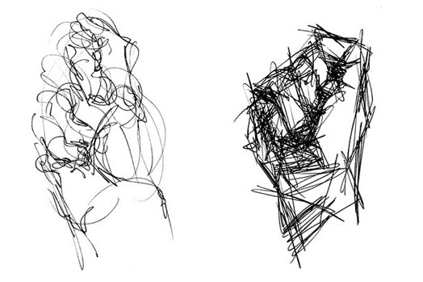
NON DOMINANT HAND
1.
Draw your object with your non-dominant hand.
Notes:
Attempting to draw with your non-dominant hand is very difficult. I like to start with this drawing because it reminds you to loosen up; some of these sketches aren’t going to look “good” in the traditional sense. You will have 3 minutes to complete this drawing. GO
Students are going to have to place 8 drawings on 1 side of the paper (about the size of a fist)

Slide 12
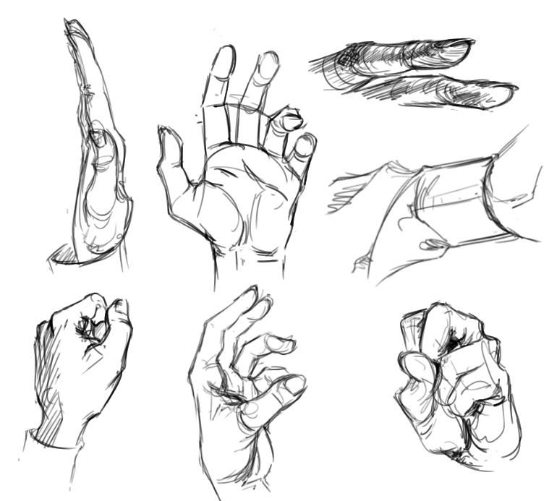
SKETCHING
2.
Complete a series of sketches.
You will be timed at 1 minute per drawing to complete a total of 5 sketches.
A sketch should be:
Quickly drawn
Loosely drawn
Lightly drawn
No editing/erasing
Notes:
In the beginning of the class we mentioned that sketches are quick and loosely drawn. To encourage quickness I am going to time you at 1 minute per sketch of your object. We are going to do this 5 different times. GO (remember to label each of these drawings as we complete them (2. Sketching) AND write down the characteristics of a sketch in the GREEN section of your journal.

Slide 13
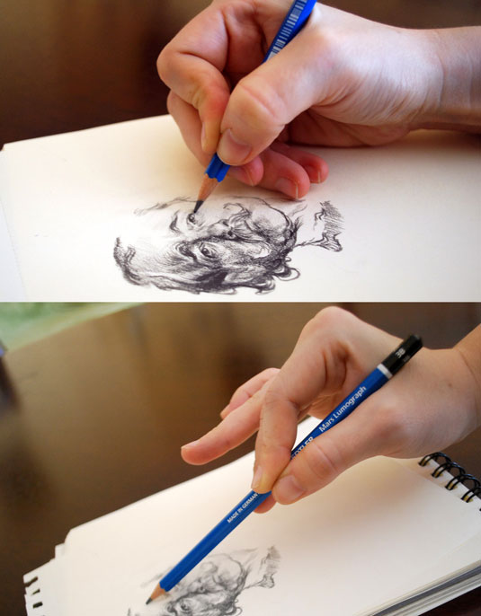
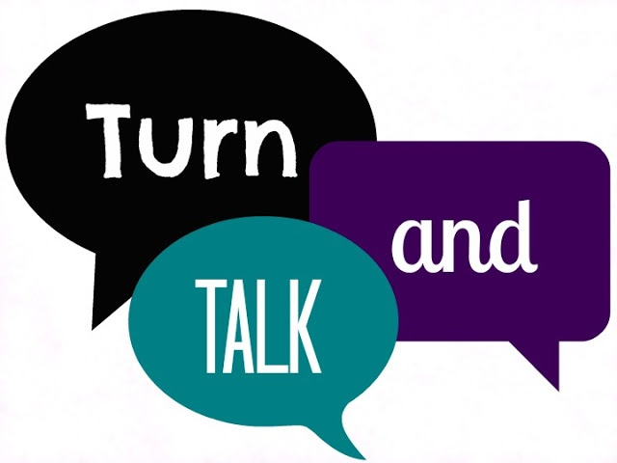
HOLDING YOUR PENCIL
3.
Draw your object by holding your pencil all the way at the point (5min).
4.
Draw your object by holding your pencil as close to the end as possible (5min).
Did this make a difference in the types of marks you could make?
Notes:
We are going to try holding our pencils in a different way. Turn and talk to your neighbor; show your neighbor your 2 drawings… Do they look different? How did changing your grip on the pencil change the mark making? In general the closer you are to the point of the pencil the darker and more specific your mark making. Some artists even experiment with using their feet, knees or mouths to draw!

Slide 14
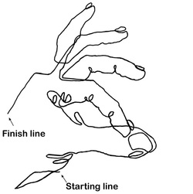
CONTINUOUS CONTOUR
5.
Draw your object using continuous contour;
an outline (that also shows some inner detail) made using only one continuous line.
Tutorial
Notes:
Continuous contour is one of the simplest looking drawings but actually one of the hardest to do... (Demonstrate on the board and talk about the important qualities of a CC drawing) CC must have one LONG line creating an outline as well as some internal details of your object. Because of this there will be some lines connecting things that you wouldn’t normally see (that’s ok). You also want to try your hardest not to go back over the same line 1,000 times to get back to a new spot. If you want to learn more about CC go to the website and view this tutorial.

Slide 15
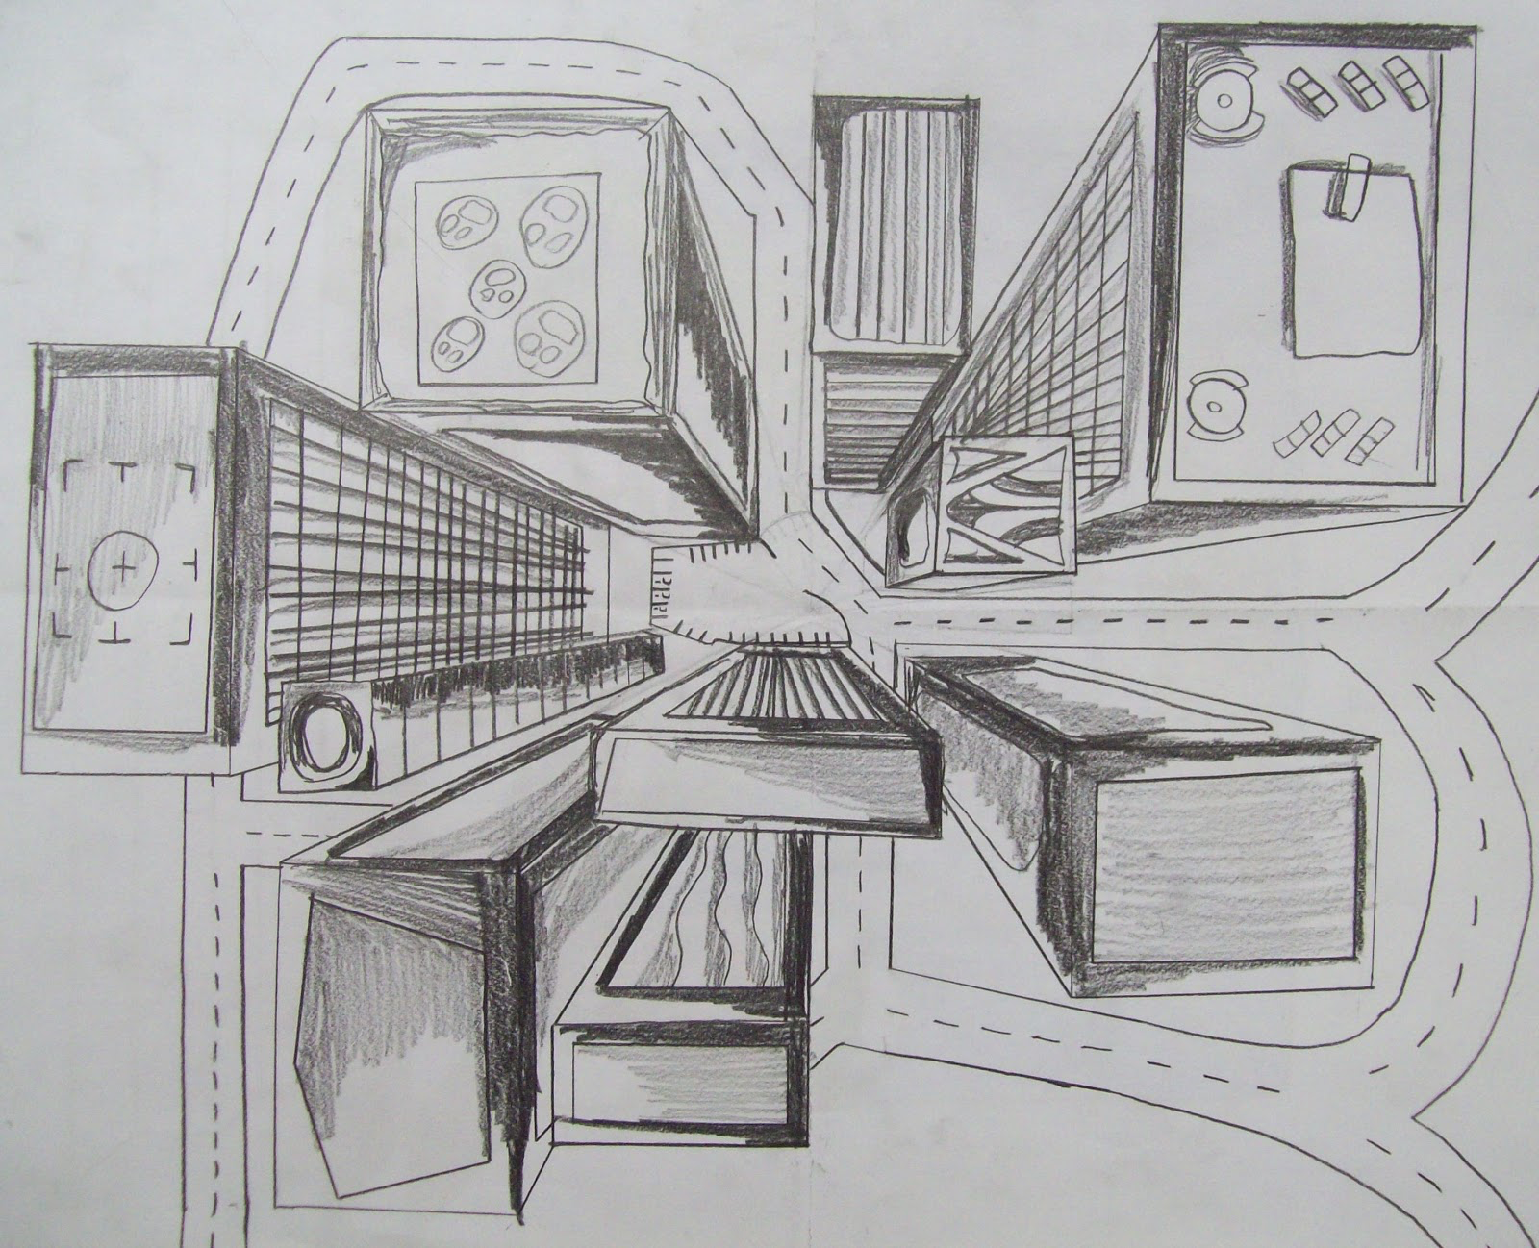
POINT OF VIEW
6.
STAND UP
Draw your object from a new point of view; a bird’s eye perspective
Notes:
Chances are, as you’ve been drawing… You’ve drawn your object from the same point of view EVERY TIME. This is a trap that many artists fall into (if you haven’t silently give yourself a pat on the back now). Let’s change our point of view to an ariel or bird’s eye view of your object; everyone stand up. You have 3 minutes to draw your object from this angle. GO

Slide 16
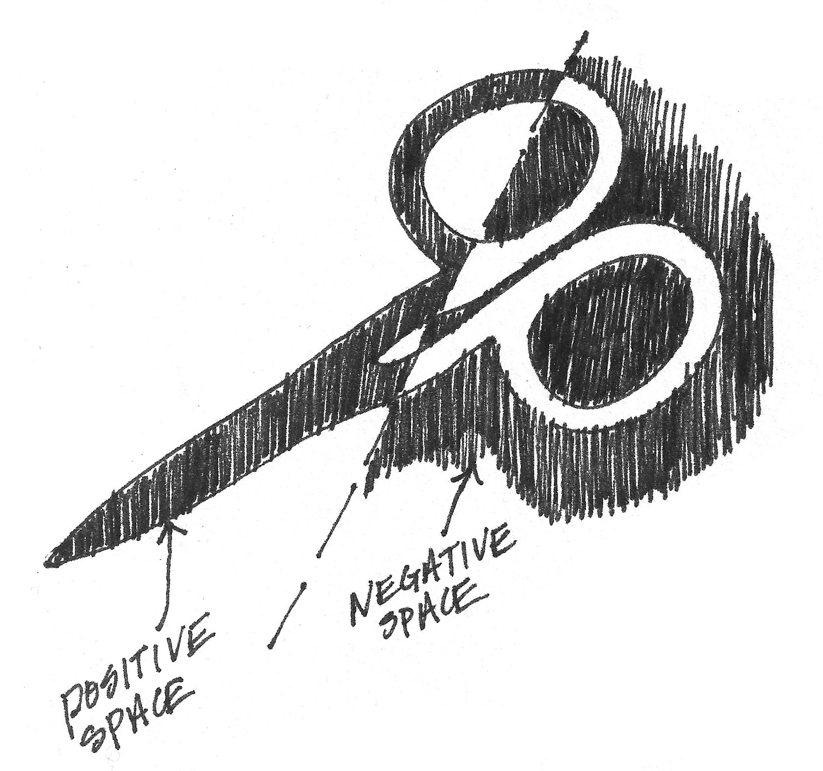
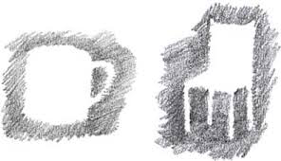
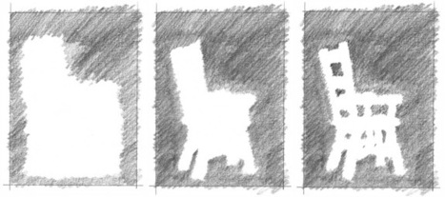
NEGATIVE SPACE
7.
Draw the space around your object using the side of your pencil
Notes:
Similar to contour drawing… Negative space can be hard to see and relay in a drawing. You are NOT going to outline your drawing with a line but instead shade (using the side of your pencil) the negative space (or space around) your object. GO

Slide 17
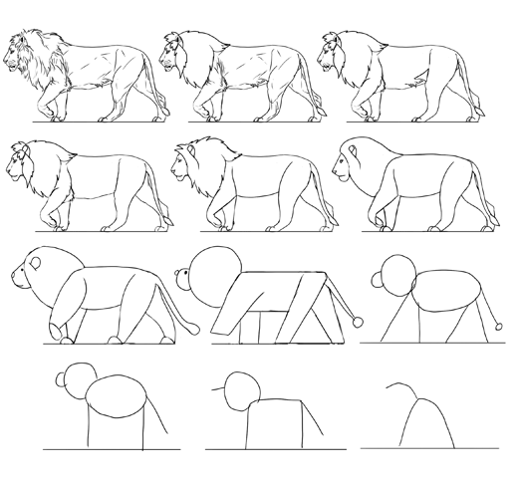
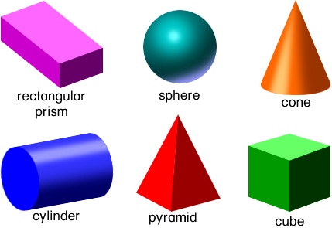
SIMPLIFY into SHAPES
8.
Draw your object using simplified shapes.
Remember that all real life objects have some combination of forms. Forms are:
Tutorial
Notes:
Any “How to Draw” tutorial will show you how to draw an object by first breaking it down into shapes and forms. For example, this ______ can be broken into what shapes or forms when drawing… Take a look at your object; what simple shapes or forms can you see in the object? Again, if this is something you’re interested in learning I’ve linked a YouTube tutorial explaining the process (by show of hands, who would like to watch this now). Your drawing for this should look like the 5th in the lion series.

Slide 18
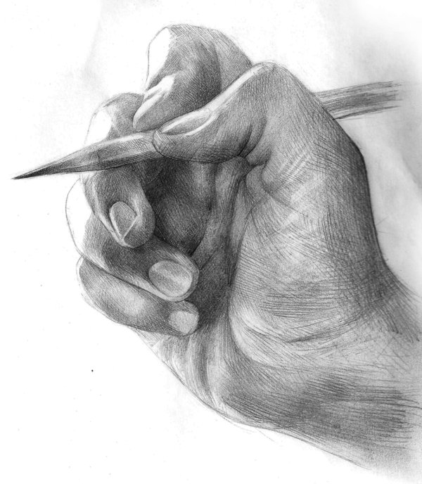
DETAILED DRAWING
9.
Draw your object with as much detail as you can.
Start with a light sketch, break your object into shapes/forms, then use shading and texture to create realistic form & complete the image
You will have 30 minutes to complete this drawing on a 9x12 piece of paper
Notes:
While the previous 8 drawings (including your gesture drawing paper) will count towards your final mini project grade but this is the BIG KAHUNA. You will have 30 minutes to use some/all of the skills we practiced today to complete a detailed drawing of your object on 9x12 drawing paper.

