Slide 1
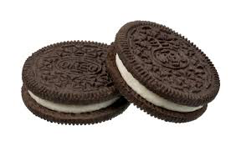
POSITIVE & NEGATIVE SPACE
A Review
HOW MANY LINES DO YOU SEE BELOW?
1+1=3 …
There are 3 different lines in this image. The 2 black lines are positive space and the white line that is created with the negative space between them.
REMEMBER TO POST ABOUT YOUR OREO BEFORE EATING IT
@tbhs_artz #deletethiscookie
Notes:
Use your fingers to hold up the number of lines you see in this image. Did you know that 1+1=3? Yep.

Slide 2
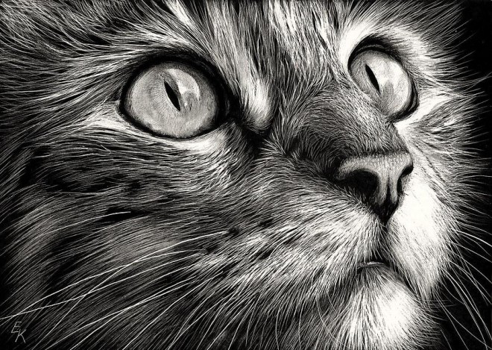
HOW?
Notes:
As a final assignment to your sketches we attempted to draw a detailed image of your object. This is REALLY HARD. I look at images like this adorable kitty and I’m like “wow… “and then I’m like “HOW?” Well It’s actually easier than you think.

Slide 3
FIRST
Notes:
If you’ve ever followed a step by step tutorial you’ll notice that the first thing they do is to break that difficult object into palatable shapes. For example our arms are cylinders and our heads are spheres (loosely).

Slide 4
SECOND
Notes:
Once you identify the shapes present, an Artists need to know how to translate that 2 Dimensional shape into a 3 Dimensional form. To do this they must create an optical illusion.

Slide 5
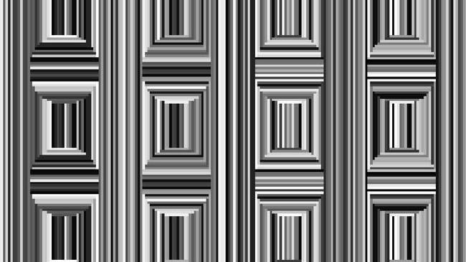
OPTICAL ILLUSION
Do you see the circles?
Notes:
This illusion is called the Coffer Illusion and happens because our brains initially detect corners instead of curves; they are more common in our daily environment.

Slide 6
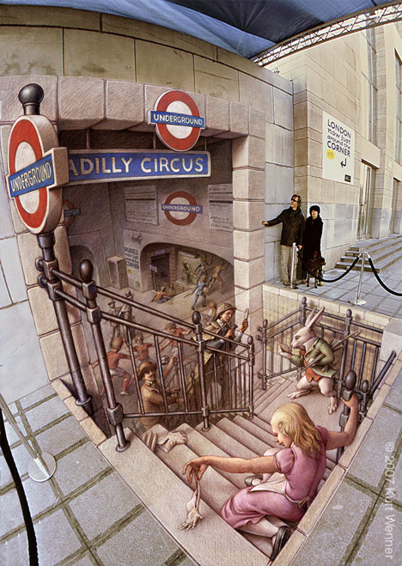
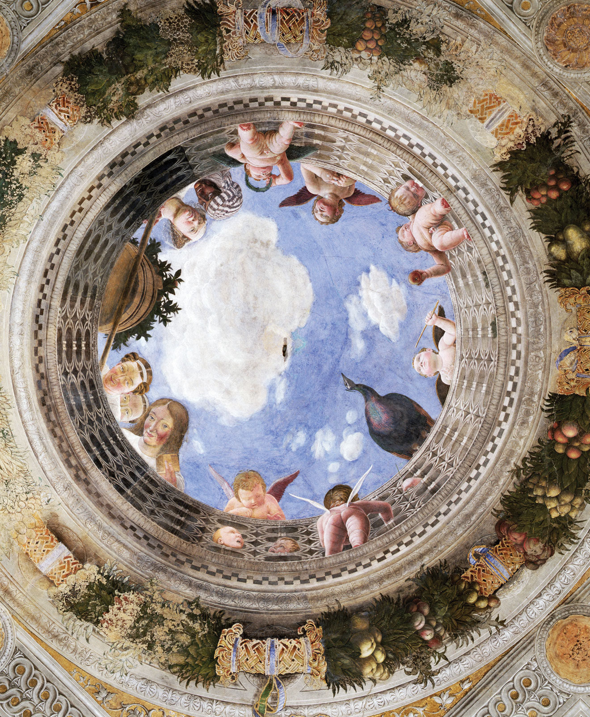
TROMPE D’OEIL
Trick of the Eye
Loop Arts Fest
Notes:
In fact the term for hyper realistic European paintings in the mid 1500s (like the Renaissance painting to the left) was “Trompe D’Oeil” which literally translates to “Trick of the Eye” in French. These have continued to be popular, as shown by the 3D chalk drawing on the right. Has anyone ever seen a chalk drawing like this in real life? If not, I highly suggest that you go to the “Loop Arts Fest” next year; I’ve linked their website to this PPT. They have a yearly professional chalk competition that covers the sidewalks, parking lots and streets (students can even participate/compete).

Slide 7
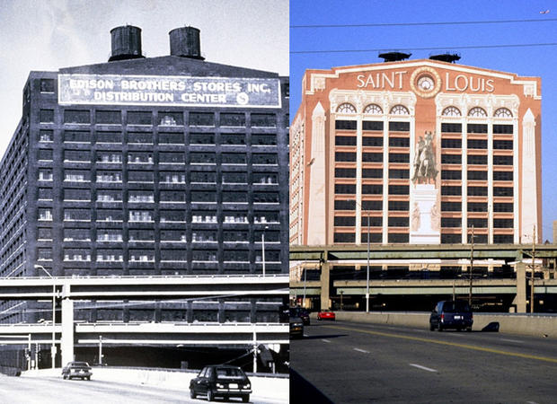
RICHARD HAAS
Notes:
Another optical illusion we have in STL is one by Richard Haas, a contemporary New York artist who paints the exteriors of buildings in Tromp L’Oeil (write in green portion of journal). Has anyone seen this building from 40? I digress… Back to the question, HOW does an artist create a hyper-realistic image in the first place. What were the first two steps? (students respond)

Slide 8
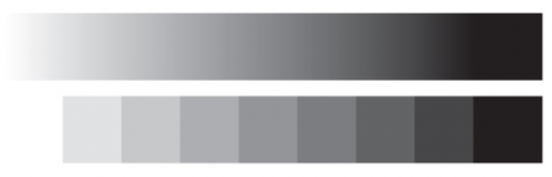
THIRD VALUE SCALE
Value is the lightness or darkness in an image; usually referenced as a scale or spectrum
LIGHT
DARK
Notes:
The third step in the trick artists use to create realistic drawings, is to change the values within the shape. Value is the lightness or darkness in an image. It can be created with any material but for our purposes today it is created when you press harder or softer with a pencil. Let’s ALL practice that in our journals… Now flip to the GREEN portion of your journal and write down the definition of VALUE.

Slide 9
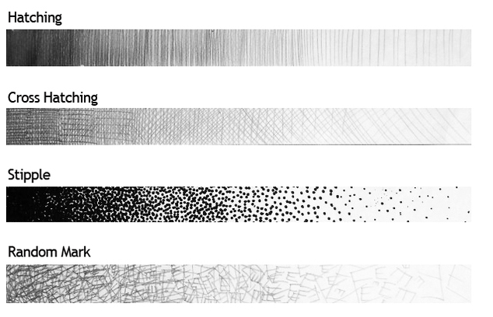
METHODS
Notes:
Blending is what people traditionally think of when I say value scale or shading… But it’s actually only one method to create a value scale. These are also terms I would like you to know and write in the back of your journal. CREATE a WS to be glued into the back of the journal in the GREEN section.

Slide 10
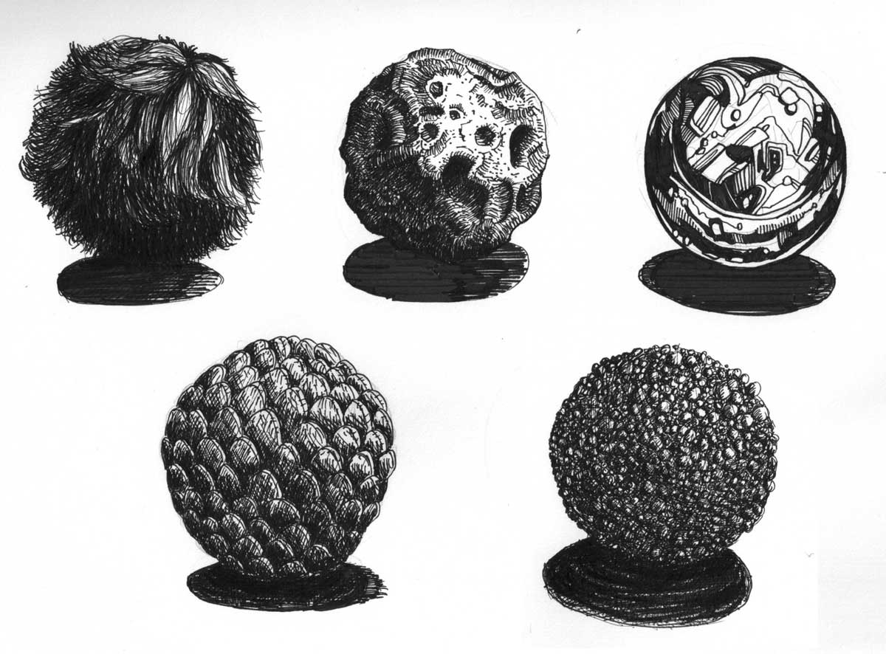
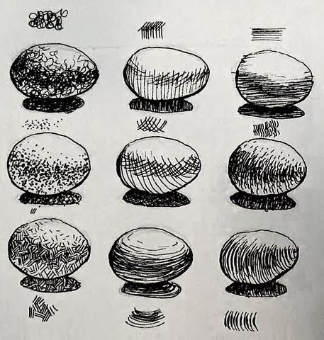
In Your Journal…
Tutorial
Notes:
Together as a group we are going to attempt drawing these 9 eggs in our journals using pencil following this tutorial (please use pen or marker-no erasing). These are basic techniques for creating the illusion of form that also help create texture and can be elaborated on in order to create more complex forms for future drawings.

Slide 11
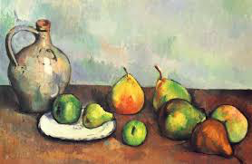
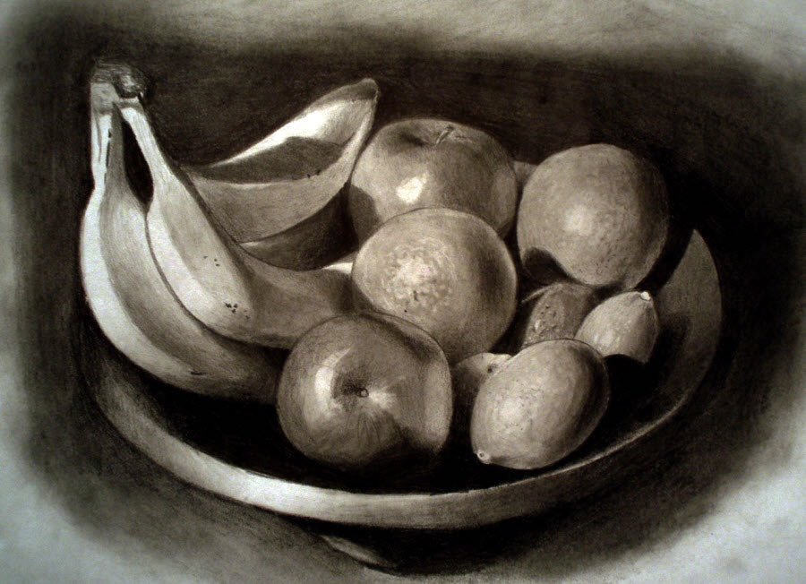
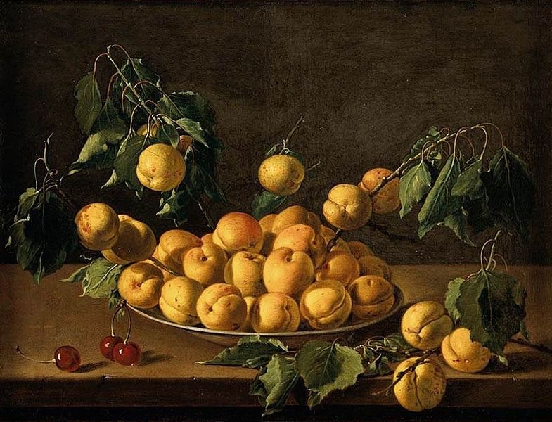
STILL LIFE
Combining items in a display for the purpose of drawing or painting the items from life. This can be completed with a variety of items and materials.
Notes:
For many artists a still life is a practice piece that they may complete in their studios to prepare for other artworks. For others like Paul Cezanne it was a main focus of his artwork (top right). Paul Cezanne is an impressionist artist who worked in oil paint during the late 1800s; if you like his work then write his name down in the RED portion of your notebook.

Slide 12
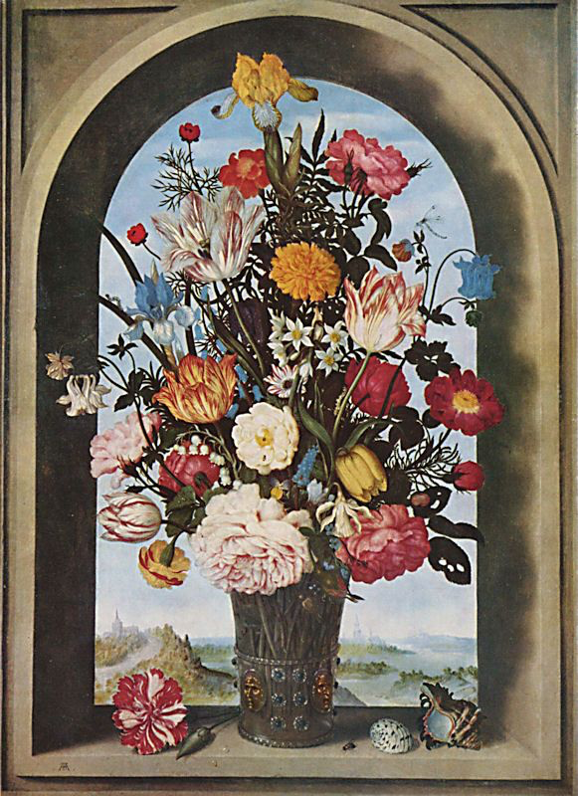
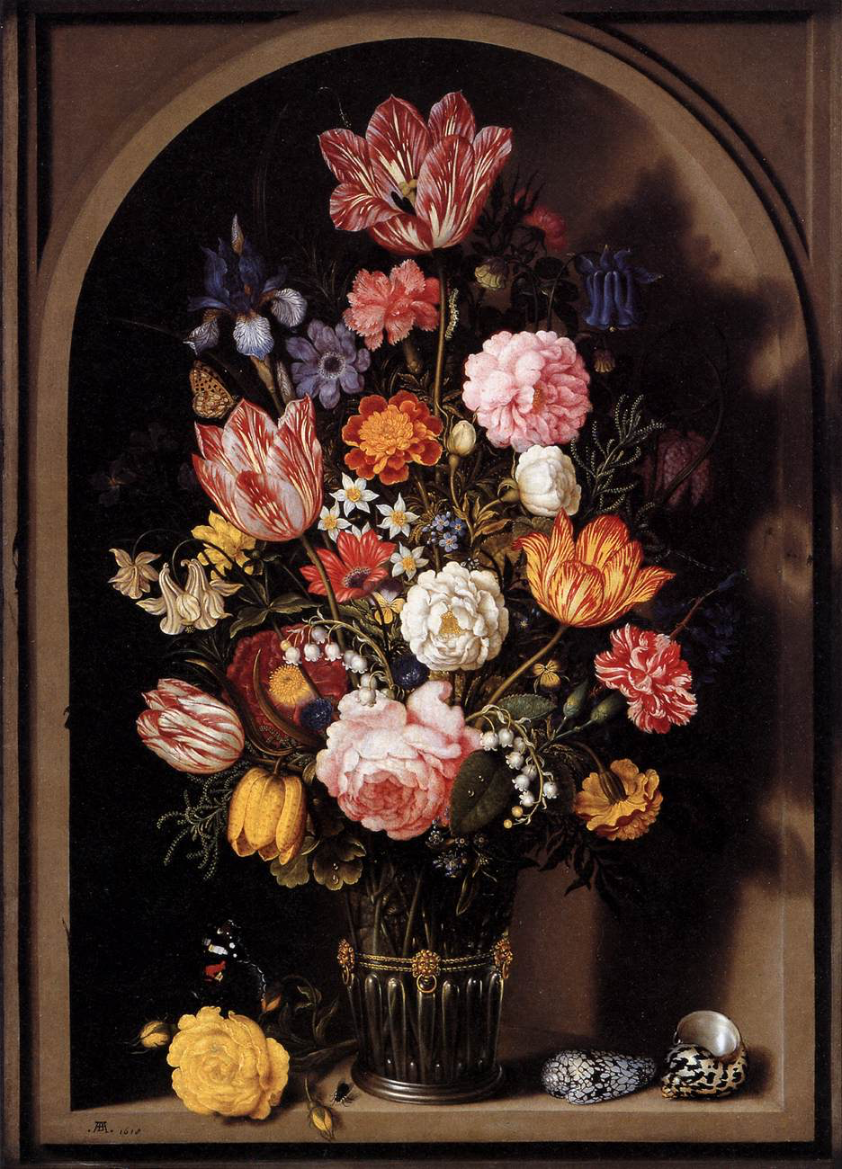
AMBROSIUS BOSSCHAERT the Elder
Notes:
Completed most of his career in Amsterdam as a Still Life Flower Painter in the early 1600s.

Slide 13
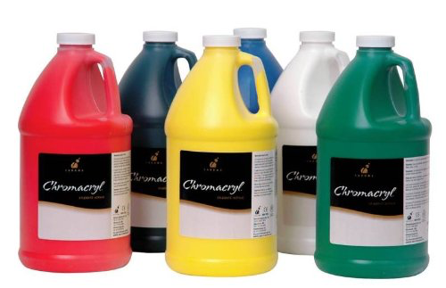
MINI PROJECT: STILL LIFE
GOAL: To create a variety of 3D forms on a 2 Dimensional surface using multiple media
Notes:
We are going to focus on creating spheres and cubes in class. If this is a topic you’re interested in, or if you want to score in the “excellent category for this mini category you can try to create cylinders and cones as well as combine form drawings.

Slide 14
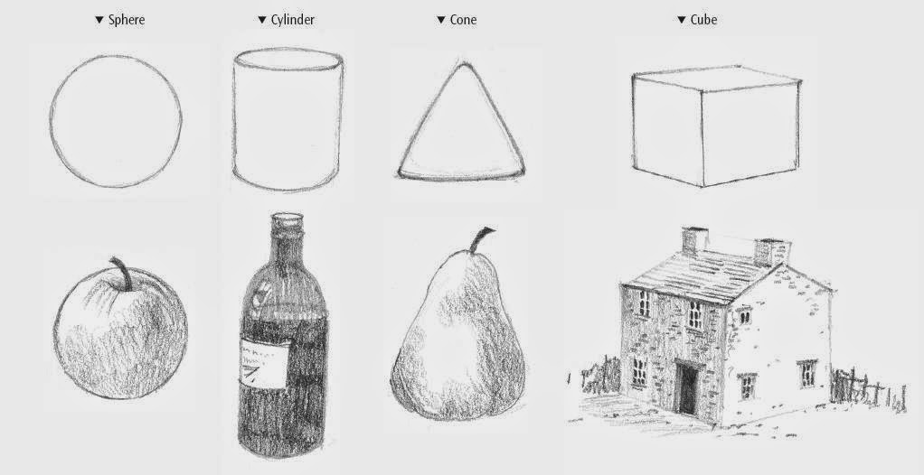
NOW
Many people have the goal of drawing realistically… These tips/tutorials will help you

Slide 15
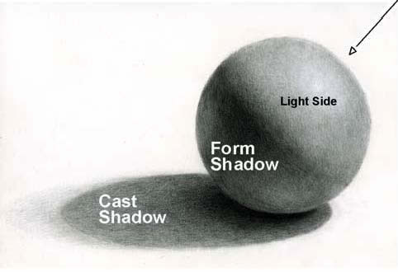
WORK TIME
Follow along with me while we create our first form using pencil

Slide 16
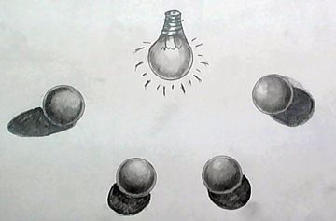
SIDE 2: LIGHT SOURCE
Light Sources

Slide 17
PRO TIPS YO!
These are things you write in the GREEN section of your journal
WHEN SHADING WITH A PENCIL
lightly label the highlights and shadows
start light & add value slowly by pressing harder on the pencil
use the side of the pencil not the tip
work in small circles or curves to follow the object
put a piece of paper under your palm to prevent smudges
be very careful to reserve the white areas; erase if need-be
AFTER YOU FEEL LIKE YOUR DONE
use ebony pencil to increase the dark areas
use a blending stump* or tissue to smooth your shading
don’t forget to add a shadow or surface on which your object is sitting
(*blending stumps are rolled paper and used similarly to pencils)
Notes:
Although we are going to complete this drawing as a group and I will be explaining these tips as we go… It might be helpful for you to have these written in your journal for future reference on your independent project. I will put this up again at the end of class for you to copy into your journal

Slide 18
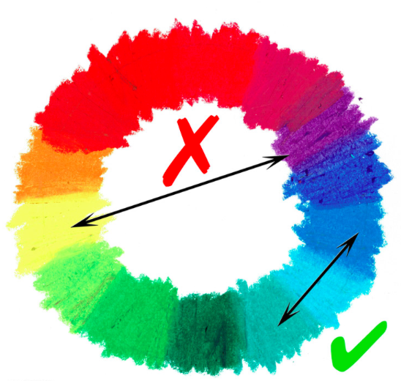
PRO TIPS YO!
WHEN USING OIL PASTEL
can be used lightly or heavily on paper
if lightly, place colors next to each other and blend with finger
if heavily, overlap colors to blend (use L/D/L)
use white or tan to blend colors
use analogous colors (color families) for shading/modeling
spray with matte fixative when finished
to get oil pastel off of paper use a blade or fingernail to scratch
use a slick sheet of paper under hand to prevent smearing
Tutorial on Easy Peasy Art School
WARNING:
This material is very messy! It is hard to get out of clothes, off the floor or even off of your paper… Treat with care!

Slide 19
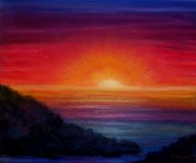
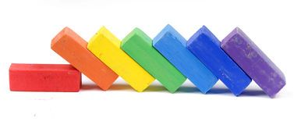
PRO TIPS YO!
WHEN USING CHALK PASTEL
use the sharp corner to create detail or line (these stay)
use the side to create large areas of color
Broken chalk pastels work just the same!
wipe them on scrap paper before using to remove old stuff
need layers to create a vibrant area of color
use a little not a lot (press lightly)
kneaded eraser to remove unwanted chalk
blend with finger or tissue (if necessary)
can blend with water
blow away dust (do NOT wipe…it will smear)
wipe down table and fingers during AND after use
cat tutorial
Sunset tutorial

Slide 20
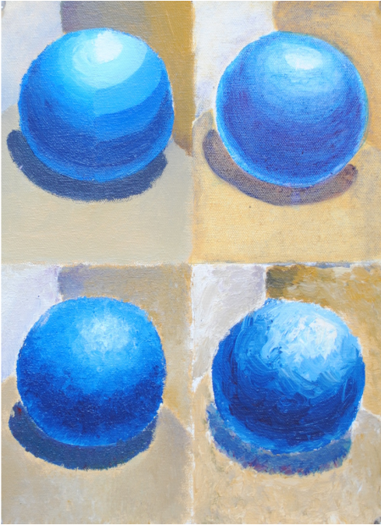
PRO TIPS YO!
WHEN PAINTING WITH TEMPERA
gather only a little bit of paint to start
choose at least 2 brushes of varying size
ALWAYS mix the dark color into the light
paint the lightest areas first
use a dry/wet brush to blend
use black and white to shade or model*
(*this is a monochromatic color scheme)
WARNING:
This material is “washable” only with some fabrics and only if treated immediately

Slide 21
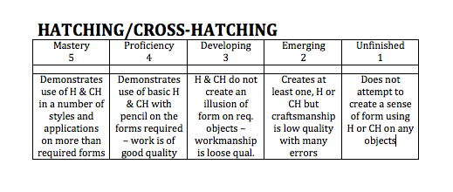
RUBRIC
You will be graded based on your application of technical skill demonstrated
All “mini projects” compose a total of 30% of your final grade
Below is an example of the rubric scale used for every mini project:
If you receive a 5 for “Mastery” you’ve gone ABOVE & BEYOND what I’ve demonstrated in class to further your knowledge. You may do this in your extra class time, after school during my office hours or at home.

