Slide 1
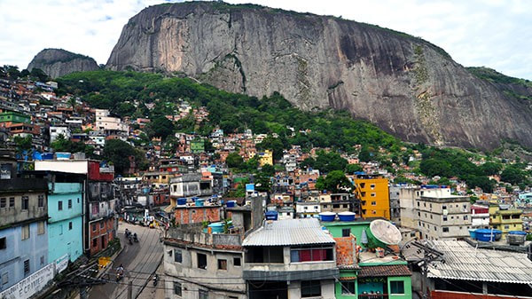
DETAILS IN A PICTURE
Below is an image of a Brazilian city. Your goal is to look closely at the image and list as many details in the image as possible. Your writing will be timed at 5 minutes. Continue to write the ENTIRE TIME.
Your thoughts do not have to go in order or make sense in a sentence.
Notes:
Shout out some of the things that you wrote down… Did anyone say window panes, red curtains, water tanks, tin roof, spanish tile roof, street signs...

Slide 2
FILL IN THE FOLLOWING SENTENCES
In the morning I am ________________ because ________________ .
My Aunt ______ is very ________________ when she ________________ .
I noticed when ______ drives they ________________ .
In general the world is becoming ______ I say that because ________________ .
It really bugs me when ________________ .
Today is ______ outside, it reminds me of this time when ________________ .
Notes:
In your journal to complete these sentences (use at least one word per blank). When you’re done pick your most interesting observation and write it on the board. Now tell your shoulder partner what you wrote down.

Slide 3
FIND A PARTNER
SHARE ONE of YOUR SENTENCES

Slide 4
OBSERVATION
Artists observe the world around them to respond or represent ideas visually
Notes:
Observation is our first UNIT in class: Artists observe and respond to the world

Slide 5
WHAT DO YOU THINK ARTISTS OBSERVE?
Make a list of things that you think artists might observe in your journal
Turn and talk with a neighbor to share your list.
Notes:
Create a list on the board of the appropriate items that students mention… Behaviors, emotions, cultures, clothing, relationships, colors, nature, lines, textures, shapes, patterns, light, etc.

Slide 6
UNIT 1: Artists Observe & Respond to the World
As part of this unit we will create 3-4 “mini projects” together to gain skills and insight
Sketching
Still Life
Observational Photography
Subtractive Pleine Air Drawing
You will then create an individual project in response to the theme
Imagine
Observe
Research
Plan
Create
…
REFLECT
Notes:
Use the following presentation to inform your research. If there’s an artist you’re interested in write their name in the RED section of your journal to review at a later date.

Slide 7
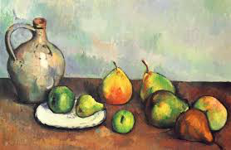
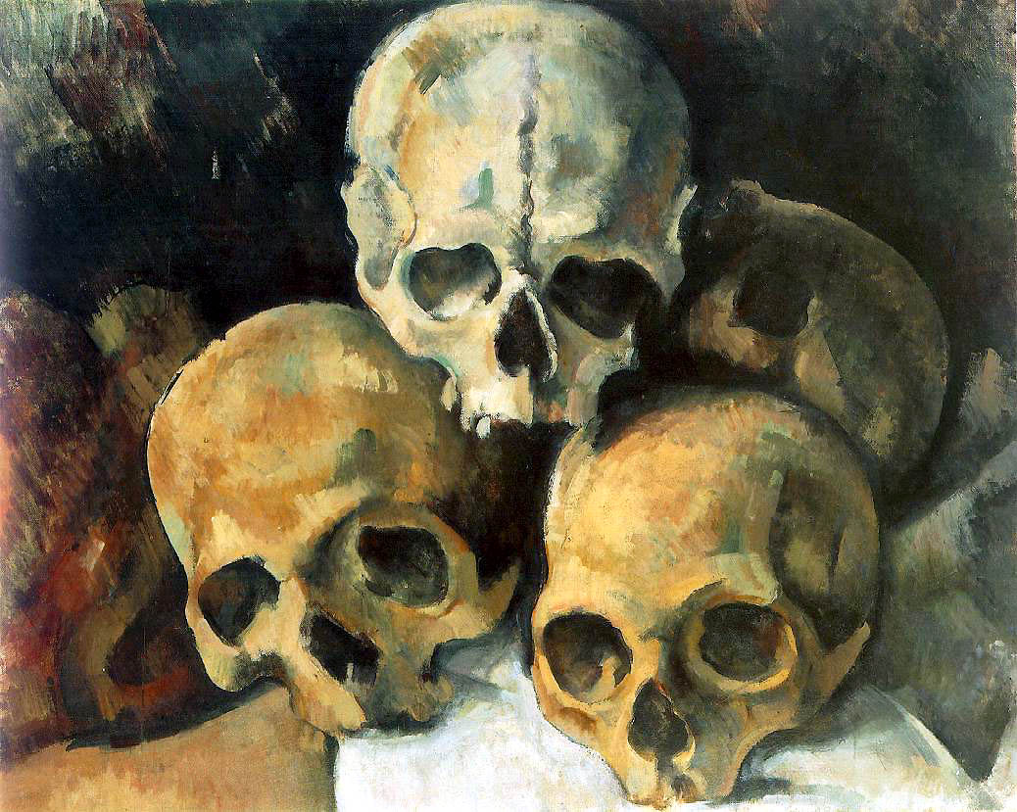
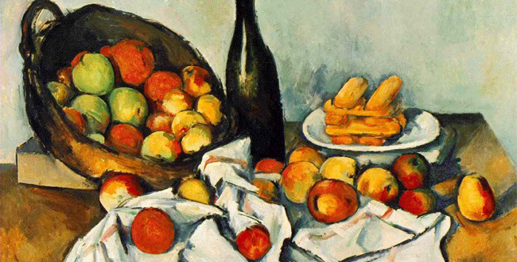
PAUL CEZANNE
Paul Cezanne is very well known for what are called, “Still Lives”
Notes:
I am going to introduce to you a number of artists who are known “observers.” If during the presentation you find someone’s artwork who is specifically interesting or enjoyable to you please make note in the back of your journal on the “RED” pages for future reference.
Paul Cezanne was well known for what are called “still lives;” where an artist will place objects on a table or area and try to replicate those objects using different materials.

Slide 8
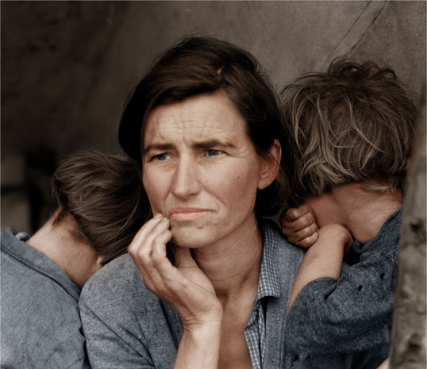
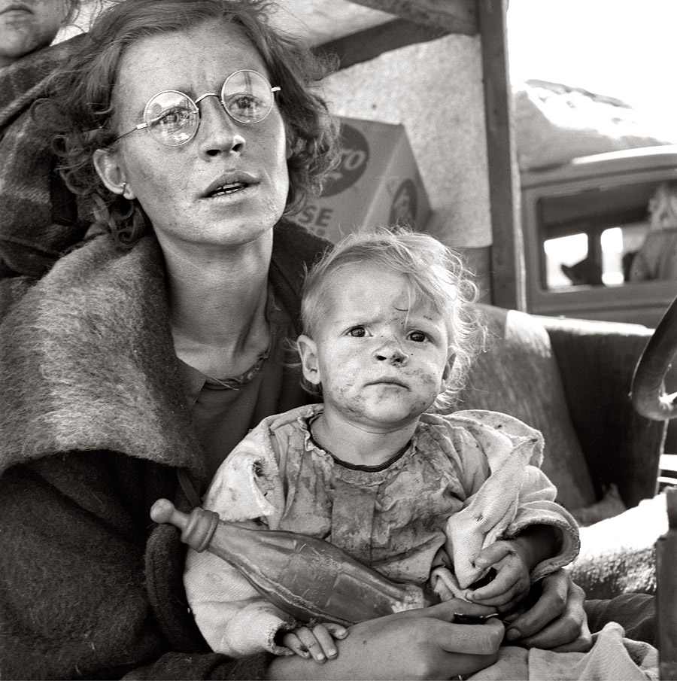
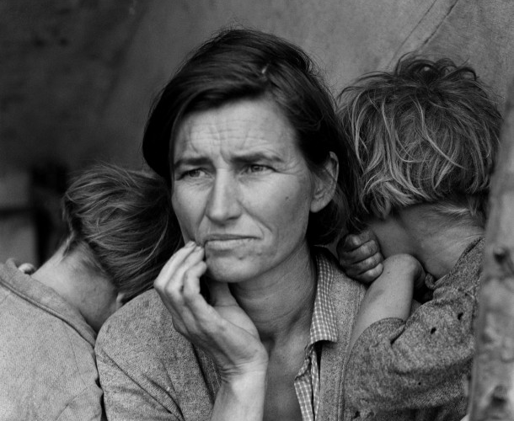
DOROTHEA LANGE
Dorothea Lange was employed as a photographer through the Works Progress Administration. She documented the daily life and hardships faced by many families during the Great Depression / Dust Bowl.
Colorizing Photos
Notes:
Created in 1935 by the American Federal government the Works Progress Administration to create jobs for citizens, specifically artists. Her photographs depicted and captured a scene of mid-western life that could then be viewed by people across the world and throughout time.
Artist Jordan Lloyd is colorizing photos like these; it makes the historic moment more reachable; the people look more real, current, etc. For more information about Lloyd’s work follow the link about colorizing photos.

Slide 9
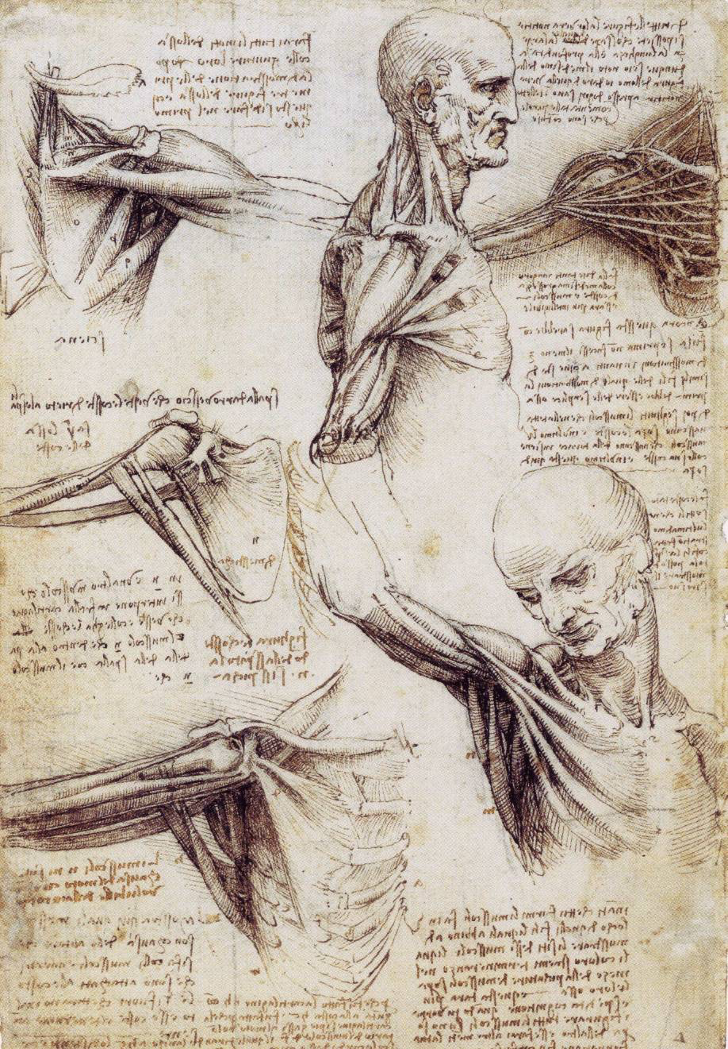
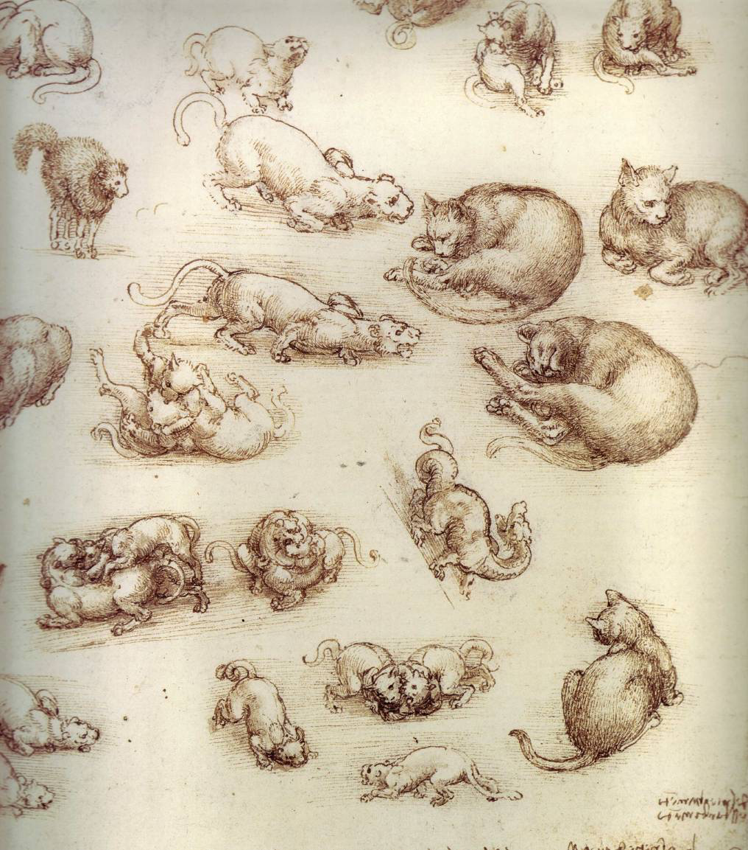
Leonardo DaVinci
In order to create his paintings DaVinci would study an item or person and create thousands of sketches in his notebook
Notes:
DaVinci created such famous works as the Mona Lisa, the Last Supper, and the Vitruvian Man. His paintings were hyper-realistic. To create this realism he would study living objects down to their skeletal structure. In fact his notes and drawings were so detailed for the year 1500 that they were used by professionals in anatomy and physiology.

Slide 10
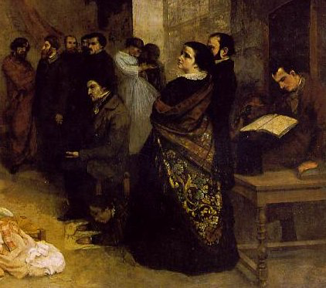
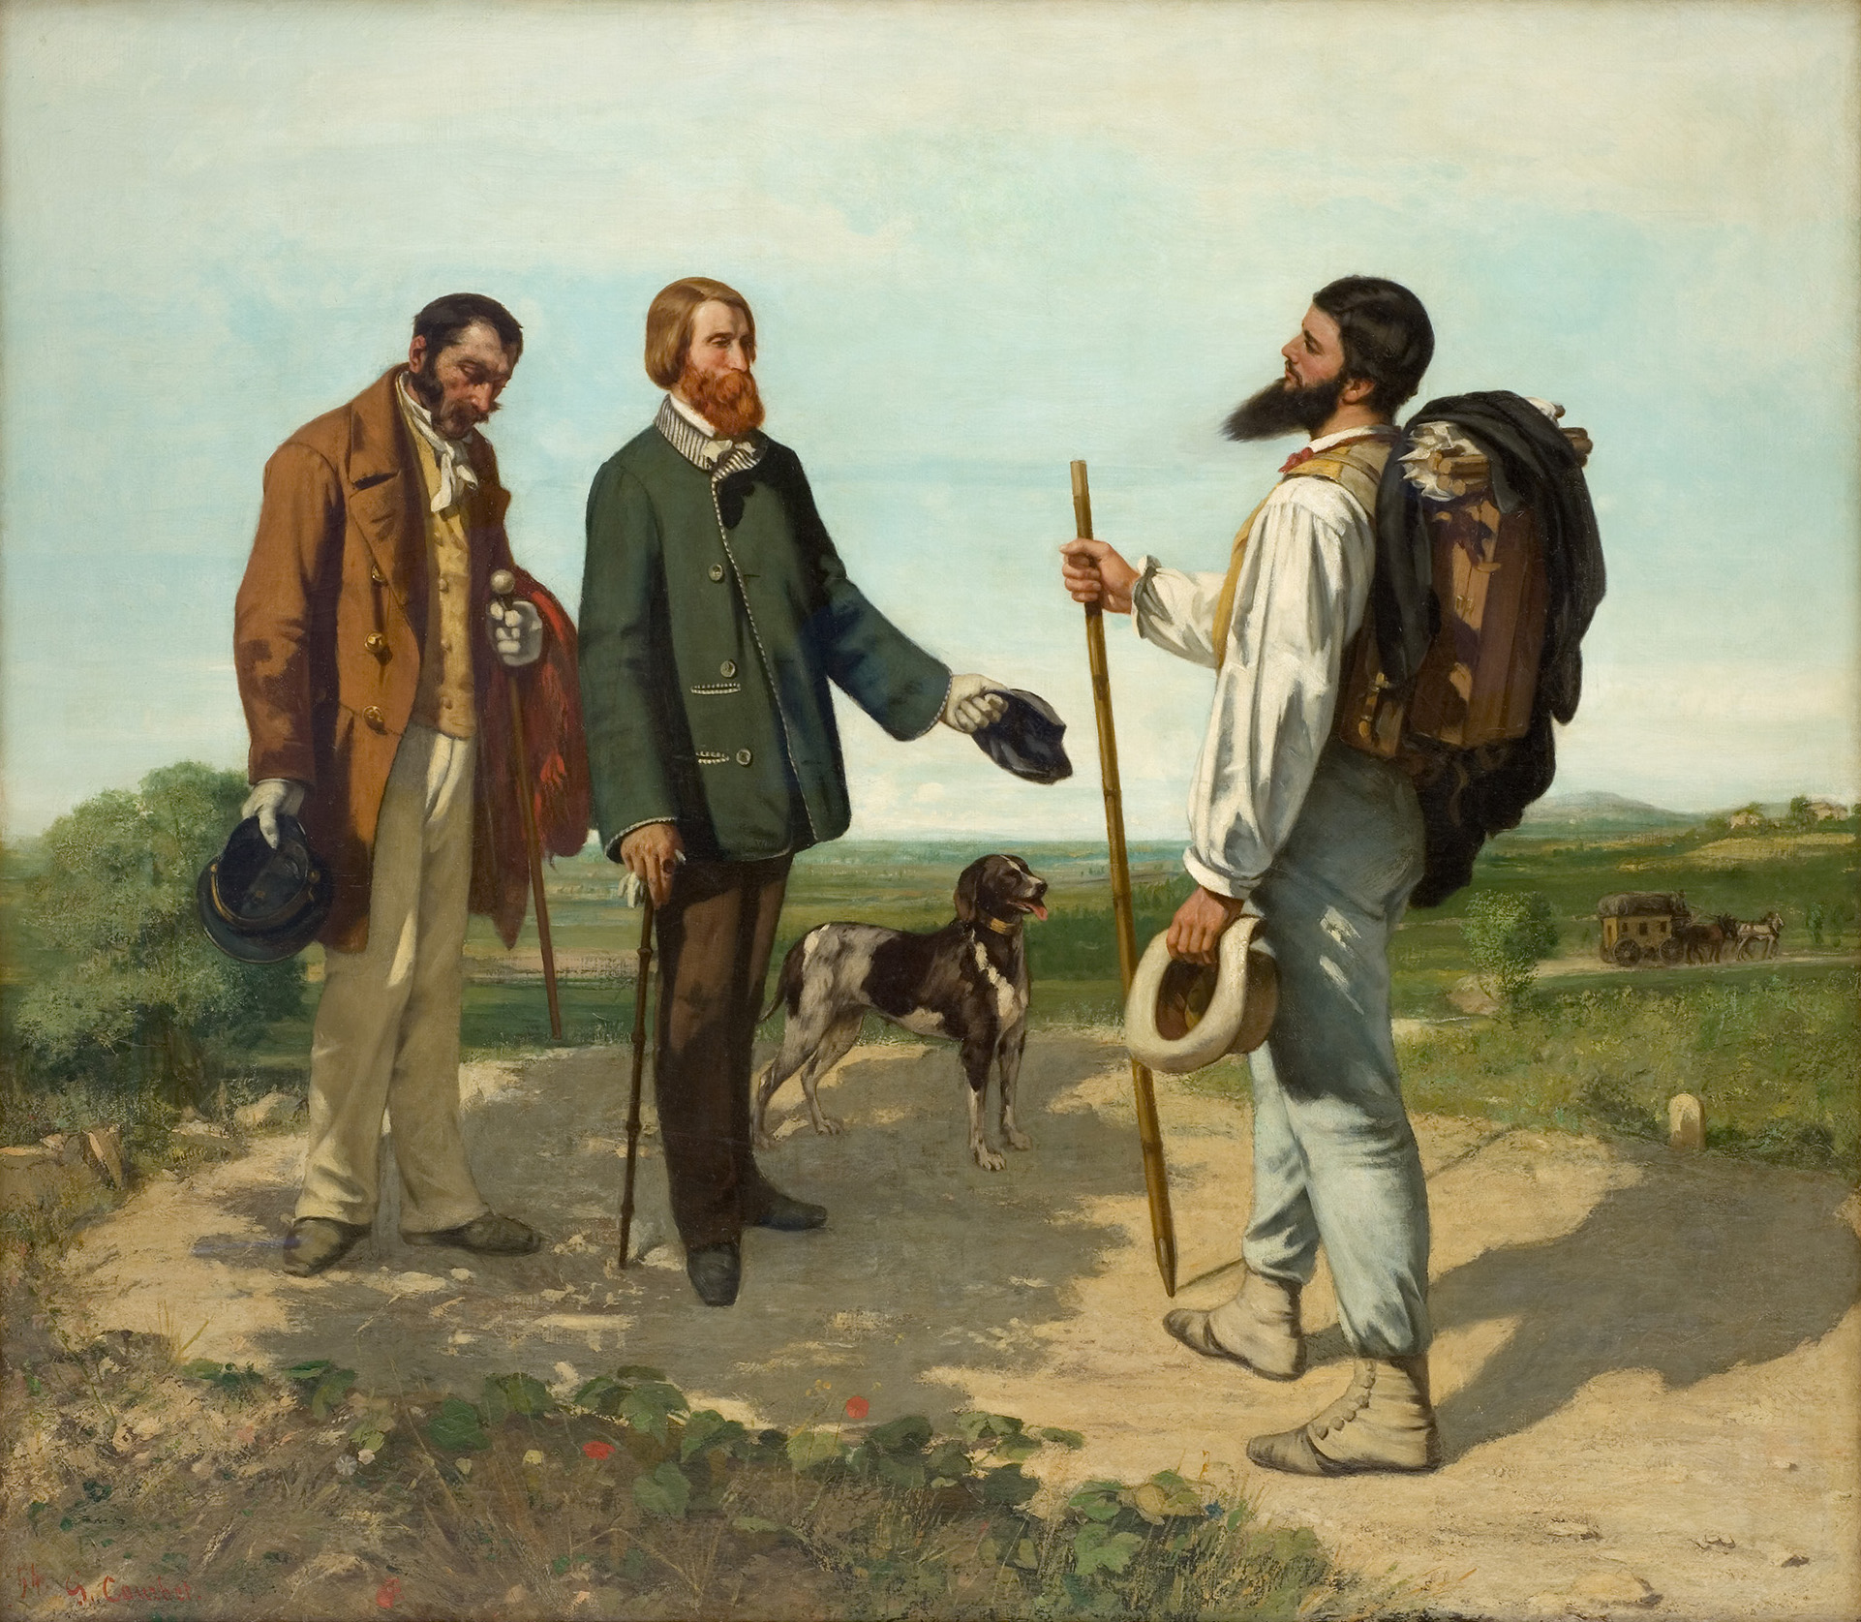
GUSTAVE COURBET
A Modern, Realist painter whose goal was to capture scenes of daily life. This was a switch in subject matter from the religious images and paintings of rich patrons.
Notes:
Taking the realistic style of painting further… Gustave Corubet and his “Realism” counterparts tried to portray a deeper realism. Instead of depicting nobility or the bourgeiousy they would depict everyday scenes with average people. This would include horrific scenes of people sometimes dying in the streets due to the horrible sanitation conditions in Europe during the mid to late 1800s.

Slide 11
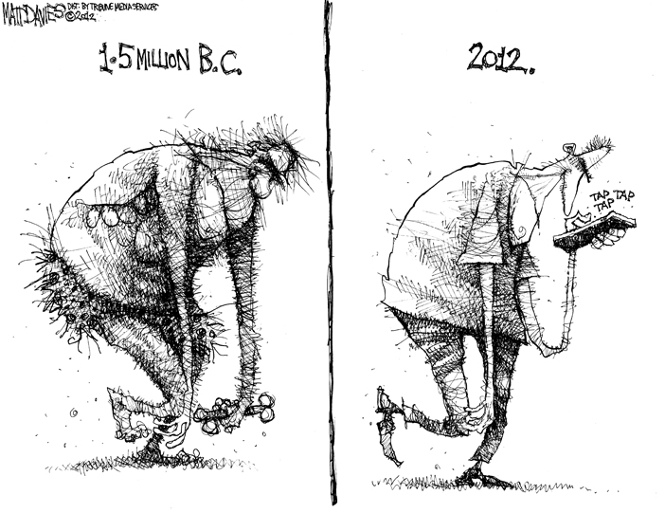
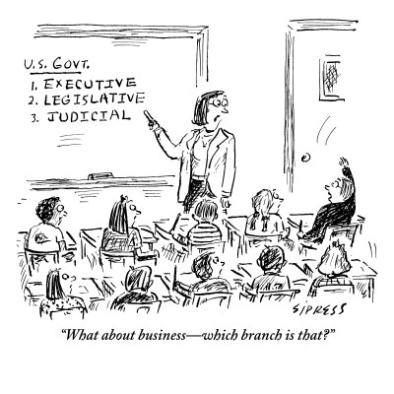
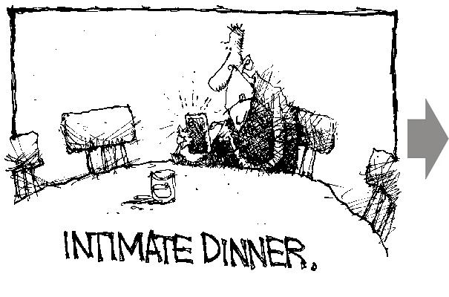
MATT DAVIES
Matt Davies draws simple comics to make comments on his cultural and political observations of society.
Notes:
Observation does not have to be a physical object or person. In fact, many times artists are trying to observe and communicate the unseen. Comedians and comic artists are similar in that they find a quirk or similarity in human behavior and exploit that for humor.

Slide 12
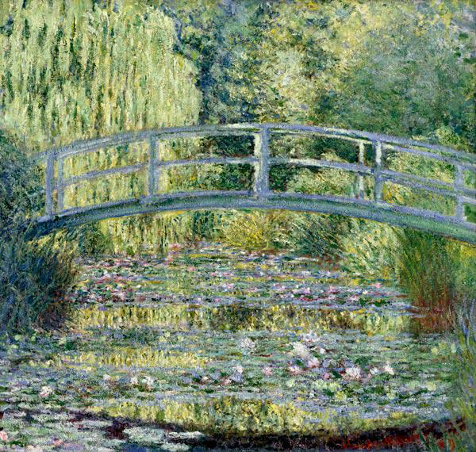
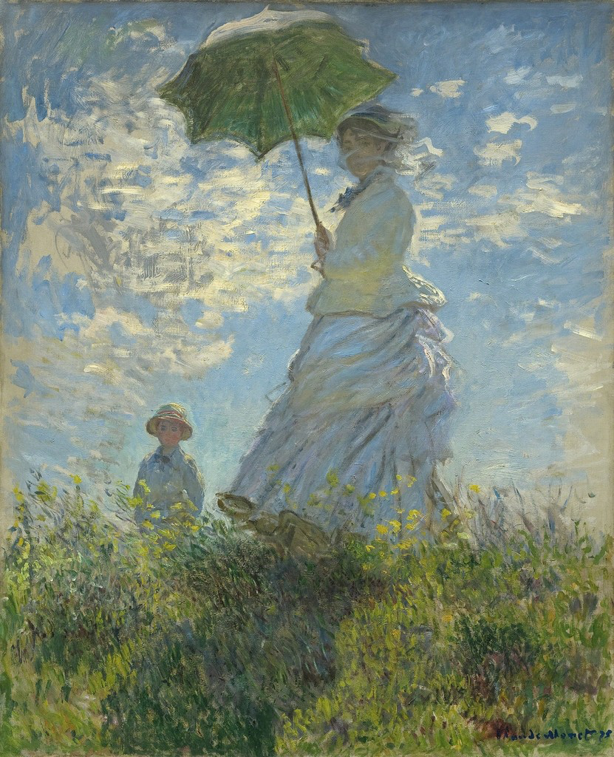
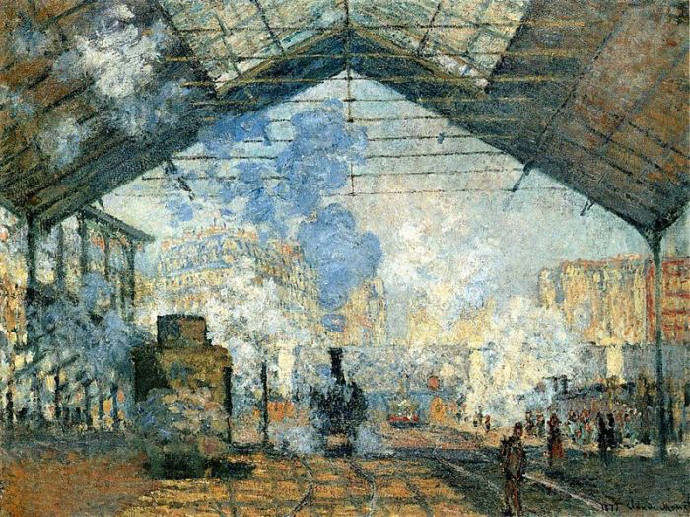
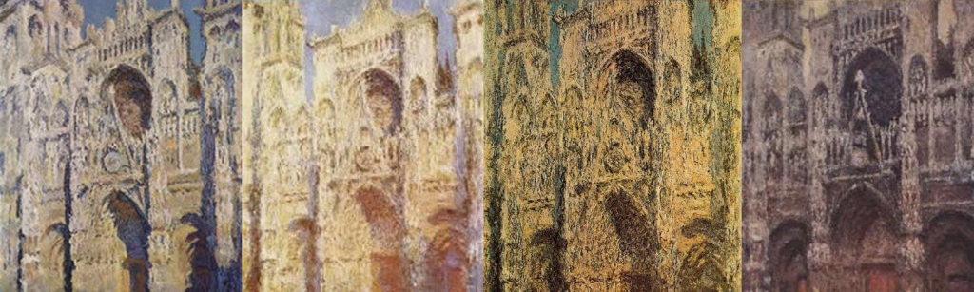
CLAUDE MONET
An impressionist painter who tried to capture the effect of light on a subject in a specific moment by painting from observation in pleine air. He was very prolific painting the same place.
Notes:
The impressionist artists like Van Gogh, Monet, Manet, Pissaro and Renoir all tried to capture a moment in time with their paintings. They would sit outside with their pallets and paint to create (quickly) exactly what they saw (this is call en pleine aire). Monet was specifically interested in light. He painted the image of Rouen Cathedral over 75 times from his apartment window across the street (obsessive? yes) but each of the images has a distinct feel of tone to it because of the way light is portrayed (7pm on a rainy day vs 12 noon on a sunny day).

Slide 13
PIET MONDRIAN
Artist Piet Mondrian’s fame was spurred by his move to New York City, where he observed the sights and sounds of traffic in the city. They inspired him to create these linear paintings.
Notes:
Piet Mondrian’s artwork is similar to that of Mark Rothko, often when people see it they are unimpressed because it is so simple. On the other hand I am WOWed because he is able to create an interesting image with only 4 colors and straight lines. That is a challenge. I was further impressed when I found out that it was supposed to represent the sights and sounds of a city. Can you see how this might represent a city?
The Saint Louis Art Museum has a Mondrian on view right now (3rd floor far left corner) if you’re interested.

Slide 14
Other Artist?
Look further/dig deeper into this topic on your own…
Use one of the artists mentioned as a starting point. Research of roominate on the observations your made at the beginning of the class. What things do we observe? What things do we overlook?
Notes:
Keep your minds open to observations over the next weeks and months as you will be expected to invent a project based on OBSERVATION.
Don’t worry, prior to starting our independent projects you will have a day to research. The next step, prior to creating your independent project is to research artists, topics, artworks, etc. that interest you. We will spend a day in the library beginning that research together as a group.

