Slide 1
Artist STATEMENT
or
what you tell people about your art so they’ll understand it better
Notes:
This is your TEST for the Unit 2 project on Personal and Cultural Identity; please focus on the information presented and ask questions to better understand the material.

Slide 2
WHY?
FOR EVERYONE:
Helps you clarify your own ideas about your artwork
Allows the public/viewer to understand your artwork better
FOR PROFESSIONAL ARTISTS:
Required to apply for…
graduate school, grant funding, teaching positions and exhibitions/shows
Useful for…
Blog writers, biographies for a program or a press release
TBHS ART STUDENTS:
Applicable in preparation for future statements of idealogoy like a cover letter
Notes:
It’s important to know WHY you might be doing something and how it’s going to be applicable to your future endeavors

Slide 3
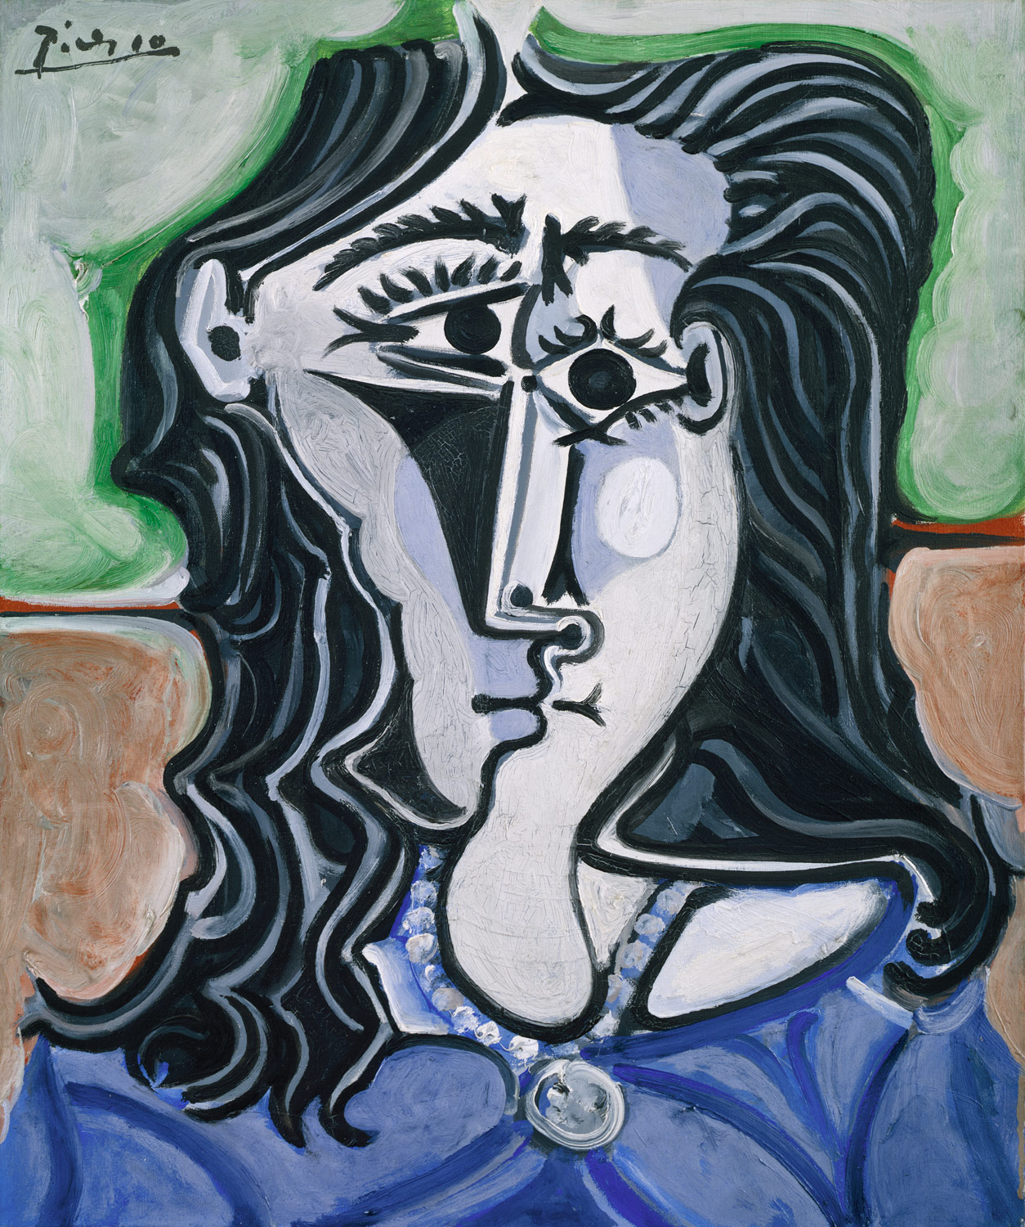
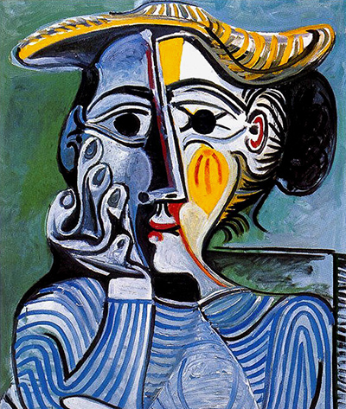
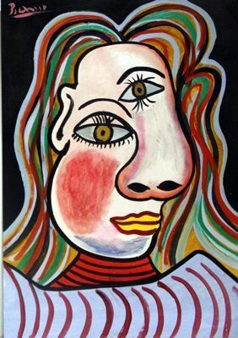
“The world today doesn’t make sense, so why should I paint pictures that do?”
Pablo Picasso
Notes:
A lot of modern art does need to be explained. We looked at the work of Mark Rothko at the beginning of the year and many of you thought that’s NOT art. An explaination of the meaning and thoughts behind a work can help to increase it’s quality and application.

Slide 4
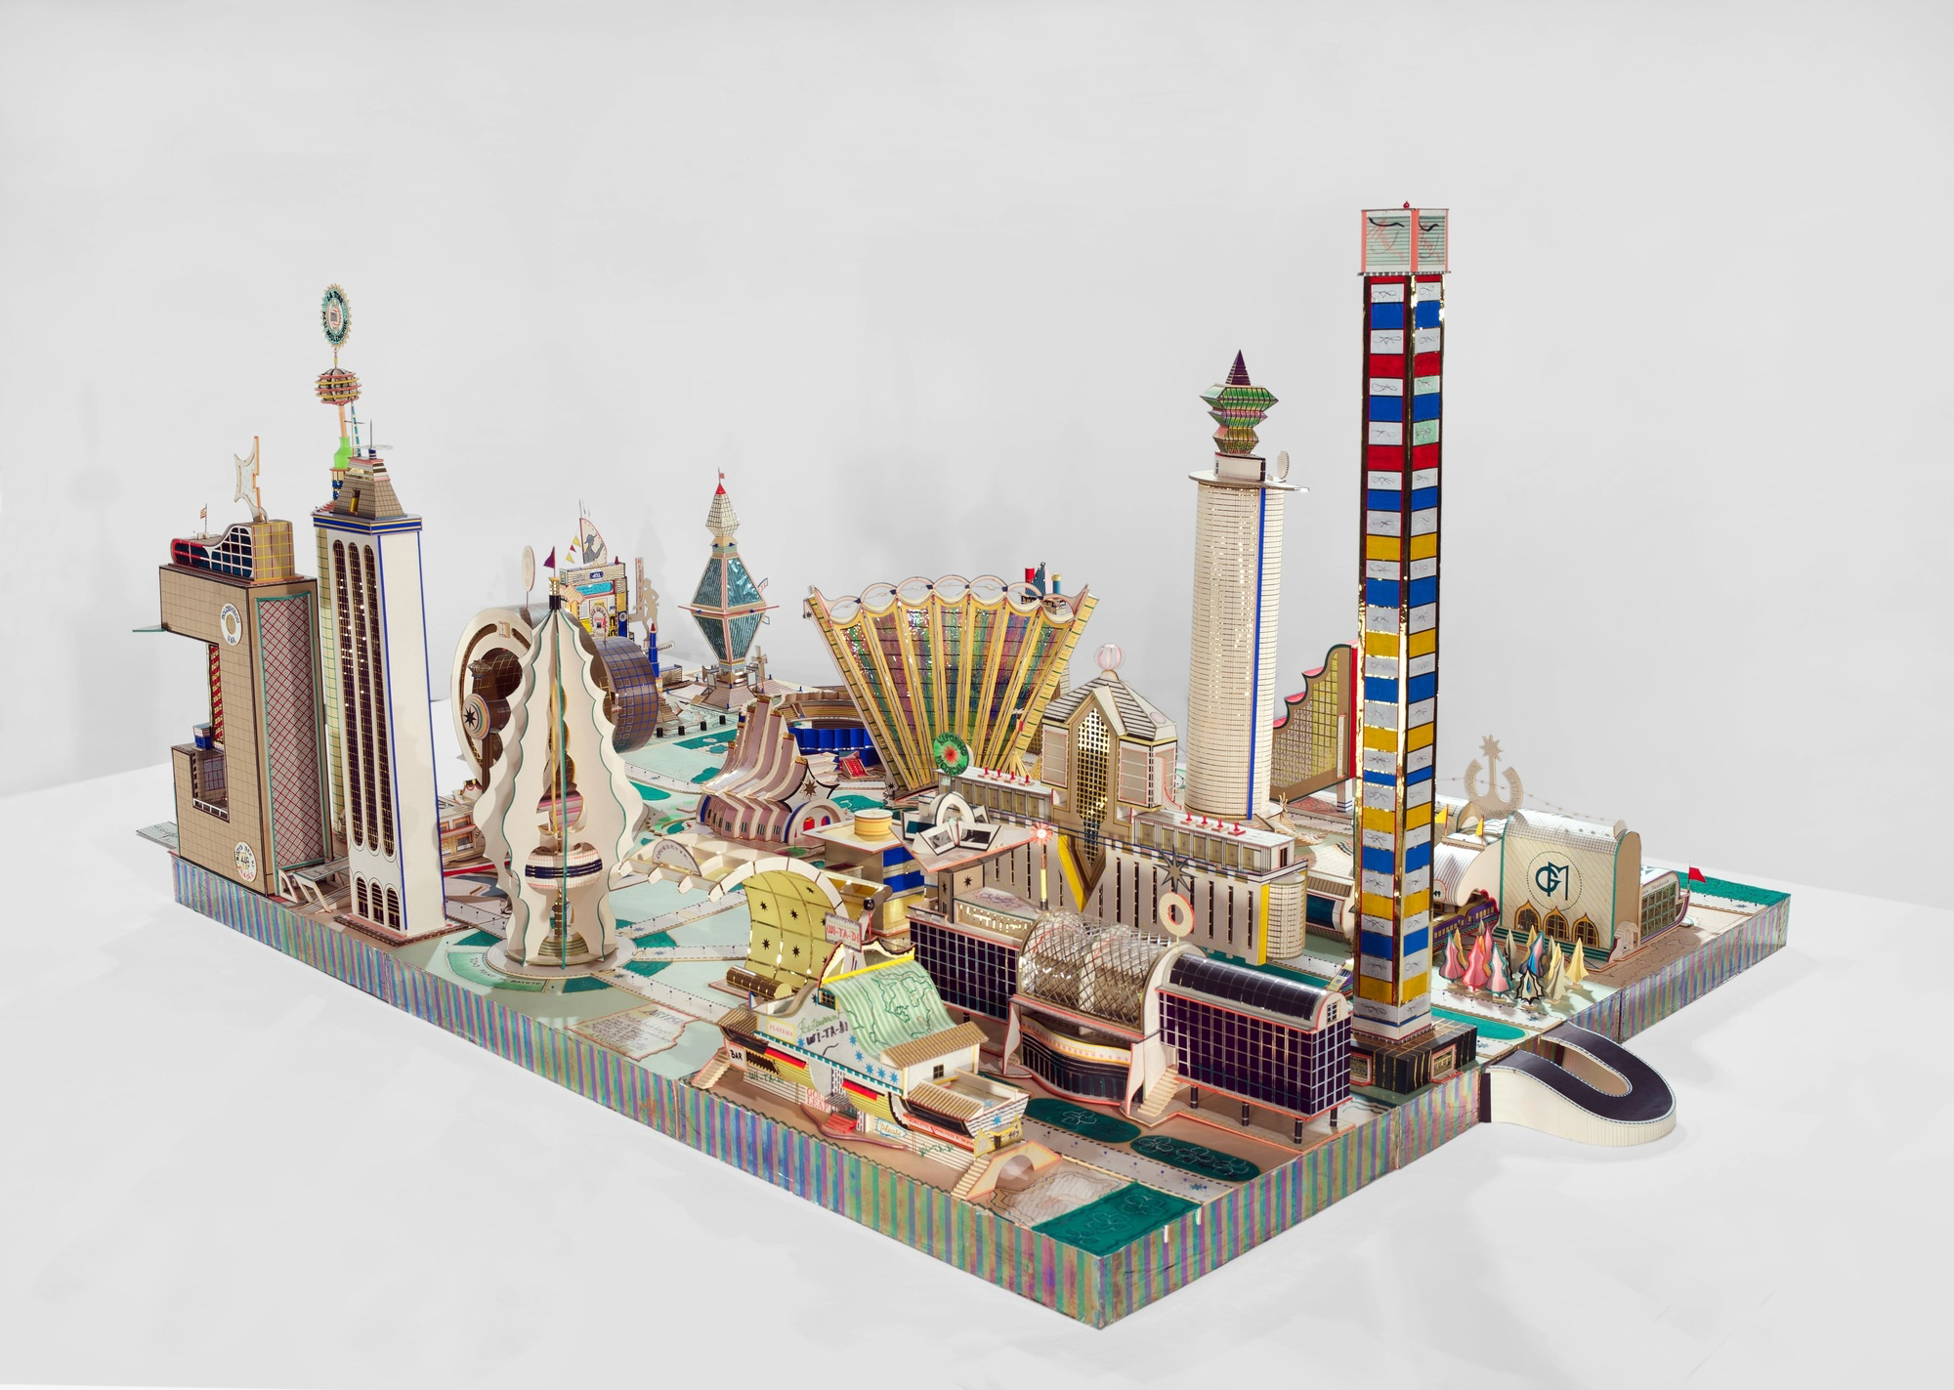
BODYS ISEK KINGELEZ
I make this most deeply imaginary, meticulous an d well considered work with the aim of having more influence over life
Notes:
What do you think this work is about? Congolese sculptor who worked with paper, commercial packaging, and materials from everyday life to create what he called “extreme maquettes” that encompass civic buildings, public monuments, and private pavilions. The installation captures his transition from single buildings to entire metropolises, culminating in a selection of Kingelez's large-scale cities, marked by soaring forms that characterize much of his late production. His models of entire cities reflect the sprawling and anarchic metropolis of Kinshasa or other African megacities, offering a futurist vision of the African city.^{[2]} His models frequently incorporate materials found in the urban world, such as bottle caps, corrugated cardboard or tinfoil. This mirrors the widespread practice of recycling found in Kinshasa or other African cities. Kingelez has called his art Extreme Models “I make this most deeply imaginary, meticulous and well considered work with the aim of having more influence over life.

Slide 5
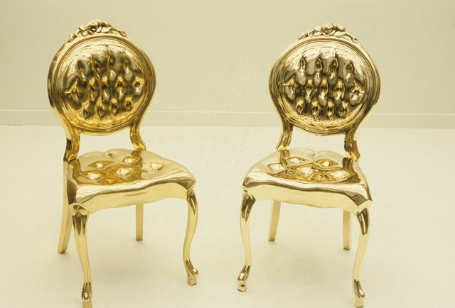
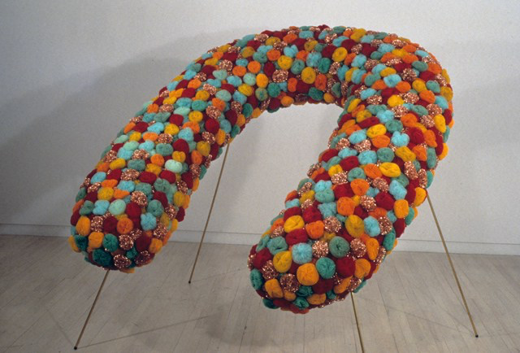
ANDY YODER
Many people take great comfort in the bathroom towels being the same color as the soap, toilet paper, and tiles. It means there is a connection between them, and an environment of order. Home is a place not only of comfort, but of control. This sense of order, in whatever form it takes, acts as a shield against the unpredictability and lurking chaos of the outside world.
My work is an examination of the different forms this shield takes, and the thinking that lies behind it. I use domestic objects as the common denominators of our personal environment. Altering them is a way of questioning the attitudes, fears and unwritten rules which have formed that environment and our behavior within it.
Notes:
Remember that you can still write any of these artists in your notebook under the red section. I hope that will continue to help you in future assignments

Slide 6
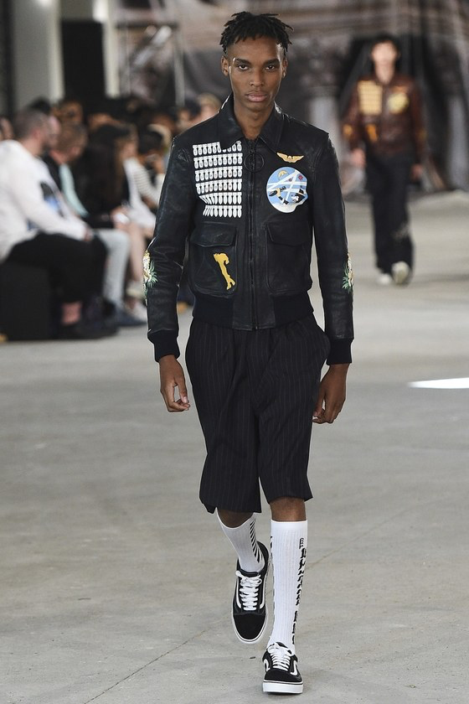
VIRGIL ABLOH
HYPEBEAST
Off-White
I LOVE TO INTELLECTUALIZE THE MUNDANE
It's about what's under the hood of Off-White. I have this overriding principle that streetwear could end up like disco. That it will be perceived well at the time but doesn't age well at all. In general I think that's because people look at streetwear and think it's lacking any sort of intellect or further meaning beyond its surface value. That scares me.
Notes:
Virgil also stated in an interview: I love to intellectualize the mundane. He is a fashion designer and the first African American person to have a complete retrospective display at the MOMA in Chicago. It’s interesting to think that even high fashion designers and clothing makers design a theme or a brand to go with their work. You are making yourself marketable to an audience.

Slide 7
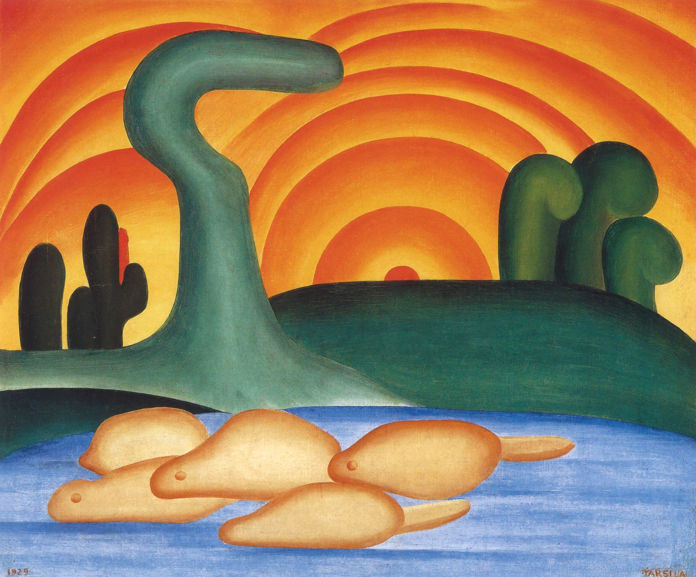
TARSILA DO AMARAL
Notes:
Fulfilling what she called her "military service in Cubism," ultimately arriving at her signature painterly style of synthetic lines and sensuous volumes depicting landscapes and vernacular scenes in a rich color palette.

Slide 8
ARTIST STATEMENTS ARE NEW…
Notes:
Prior to the application of contextual and contemporary art it really didn’t need to be explained. The ultimate goal was to depict a scene or person realistically or as in many Eastern countries art was used functionally or in traditional religious contexts. John Seed creates a silly book for art lovers that looks at some of those classic pieces and creates artist statements for them.

Slide 9
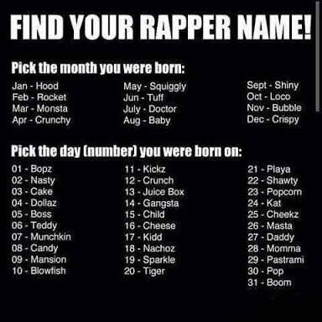
Statement 2000
Mission Statement
500 Letters
Arty Bollocks
Notes:
There are many silly name or other generators online that poke fun at Metal bands or rappers. Artist statements are the same. There are a few silly websites to the left that people have created. These websites use all sorts of arty jargon to make real-sounding artist statements. A lot of these sound really pretentious… That is not our goal.

Slide 10
HOW?
STEPS TO CREATING:
Determine what type of statement are you creating
Ask yourself important questions about your work
An artist statement should be no longer than 1 page total
CONSIDER THIS:
Who is your audience? This could effect your overall tone…
What will your statement be used for?
OVERALL STYLE:
Vary sentence structure and length
Avoid repetition of phrases or words
Be honest and try to capture your own voice
Use the 1st person “I”
Notes:
We will have a worksheet that walks you through some of these questions and sentence starters to write your artist statement

