Slide 1
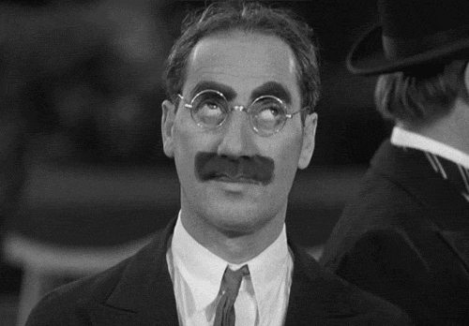
Research
SO FUN!
Notes:
Seriously though, school is one thing and “education” is another. Whether you’re in school or not, it’s always your job to get yourself an education. Find a passion and LEARN about it.

Slide 2
REFLECTION
At the end of Q1 you will be expected to complete a written reflection chronicling the process of:
  Research
  Brainstorming
  Experimentation
  Creation
Copies of your Unit 1 reflection are available upon request. The final reflection will be completed in class before the end of Quarter.

Slide 3
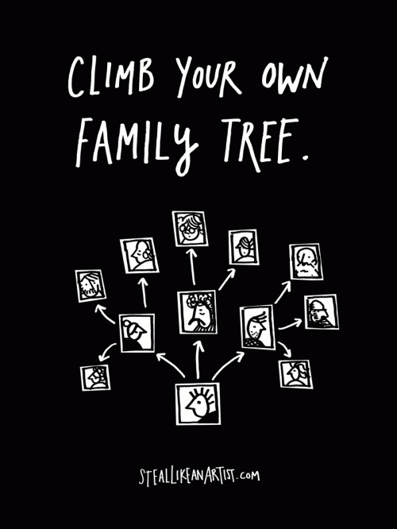
IDEA FAMILY TREE
Choose one “thinker”
  artist or style
  activist or role model
  writer or producer
Study everything there is to know about that thinker
Find three people that thinker loved and find everything out about them…
Continue
You are now a part of that creative lineage when you make a piece.
Notes:
First you want to figure out WHO to copy; Second you have to figure out WHAT to copy… But don’t just steal the style; steal the thinking behind the style. You don’t want to look like your heroes; you want to see like them.

Slide 4
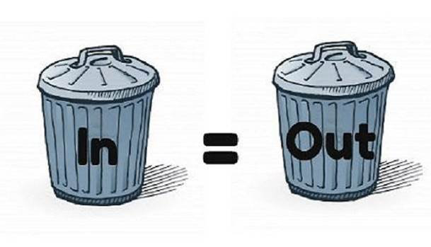
INSPIRATION
Surround yourself with inspirations that are worthwhile
Notes:
Similar to the ideas, “you are what you eat” you will project what you intake so make sure that it is worthwhile information and inspiration.

Slide 5
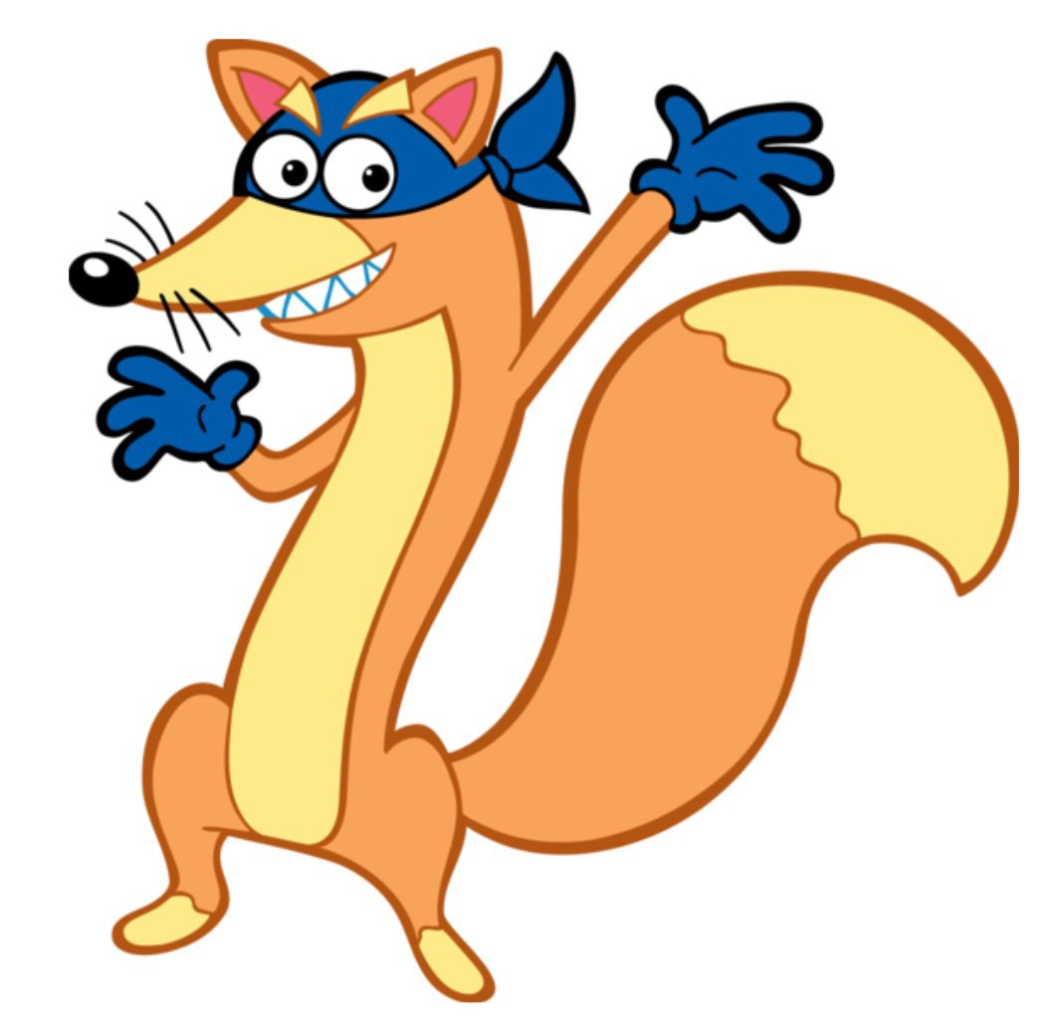

In the RED section of your journal…
This is where you will place:
Recordings of overheard conversations
Torn out images from various places
Favorite book passages/movie quotes
Artist names and/or styles
Major or current events of interest
These can all be inspirations for future projects. See something worth stealing? Put it in there. Need ideas? Open it up!
Notes:
Journals are used to gather and keep inspirations for the perfect moment. The red section of your journal will now be known as the “swipe file” as Austin Kleon says, “it’s important to steal like an artist”

Slide 6
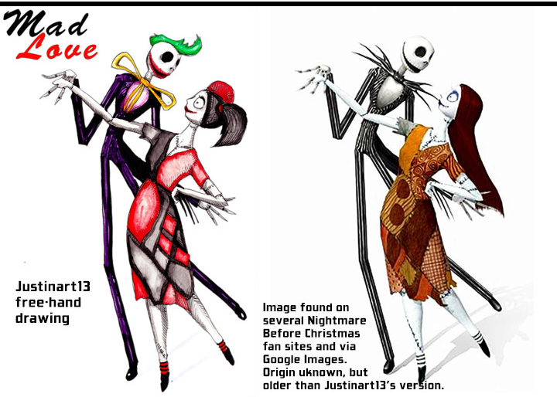
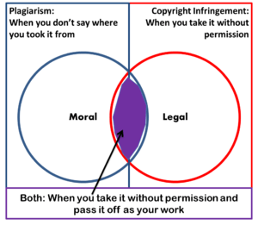
COPYRIGHT IN ART
I am an Art Theif
Avatar and Plagarism
Notes:
We can learn by copying; no one is born with their style or voice in art. But is copying plagiarism? What is the difference between these 2 images? Is it considered plagiarism? It’s important to note that plagiarism is trying to pass someone’s work off as your own (specifically for monetary or other gain). Copying is practicing in art; we learn to write by copying the alphabet, we learn to play music by copying scales, we learn to paint by reproducing masterpieces.

Slide 7
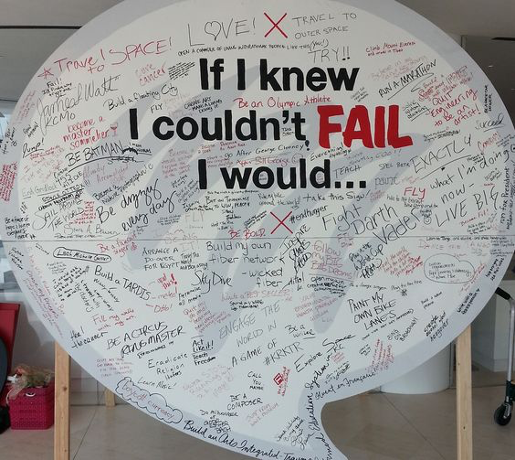
FAKE IT TIL YOU MAKE IT
TEDx Talk
Notes:
Fake it ‘til you make it. Nothing is more paralyzing than the idea of limitless possibilities… You’re probably scared to start your independent project. That’s natural! Don’t wait until you rknow what you want to do to start creating. It’s the act of making things and doing work that allows us to figure out who we are and what we want to do.

Slide 8
WHERE TO START
Use this WS or guide to help you get started researching.
The ultimate goal today is to determine the OBSERVATION you’d like to make.
We will continue to research and plan a way to VISUALLY represent or explicate your idea.

Slide 9
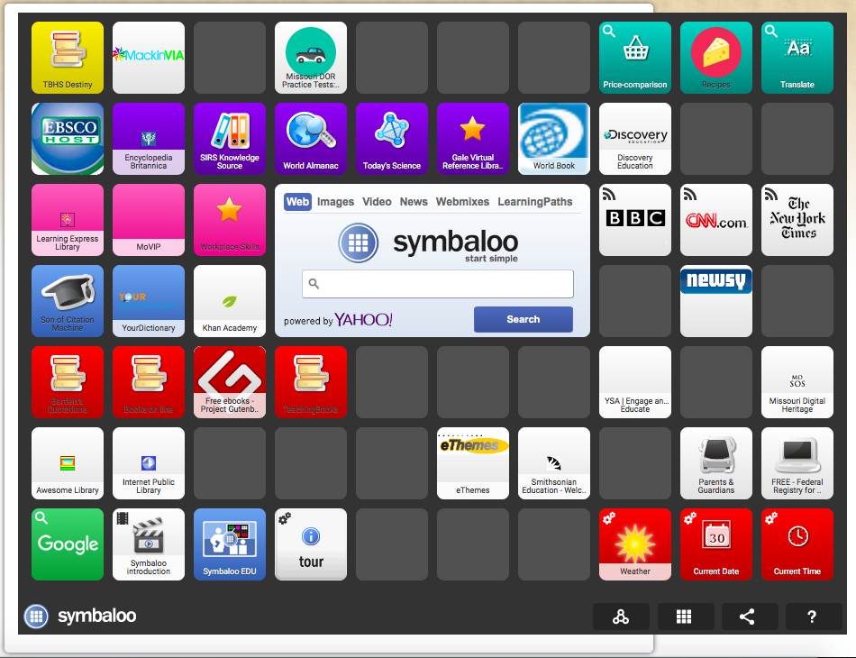




YOUR
BEST FRIENDS:
Notes:
Use all of the resources at your disposal (including myself) to gather information about your topic and other artists who are interested in the same thing!

