Slide 1
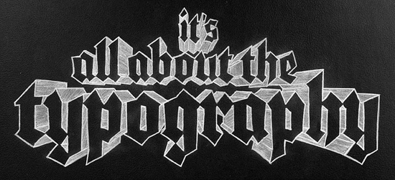
Typography is designing each letter (for example: fonts on the computer)
You NEED your JOURNAL today

Slide 2
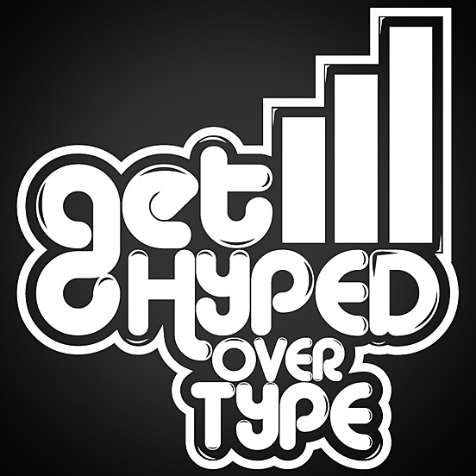
Neville Brody/Nick Poyner Clip from "Helvetica"

Slide 3
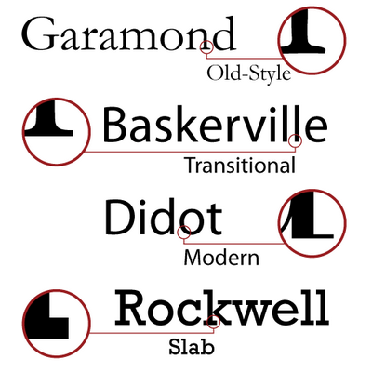
SERIF vs. SANS SERIF
A serif is a semi-structural detail (dash) at the end of some strokes of the letter/symbol. The most common serif font is Times New Roman.
A sans-serif font does not have these extra strokes at the ends of each symbol. “Sans” comes from the French word without. San serif fonts are slightly easier to read.

Slide 4
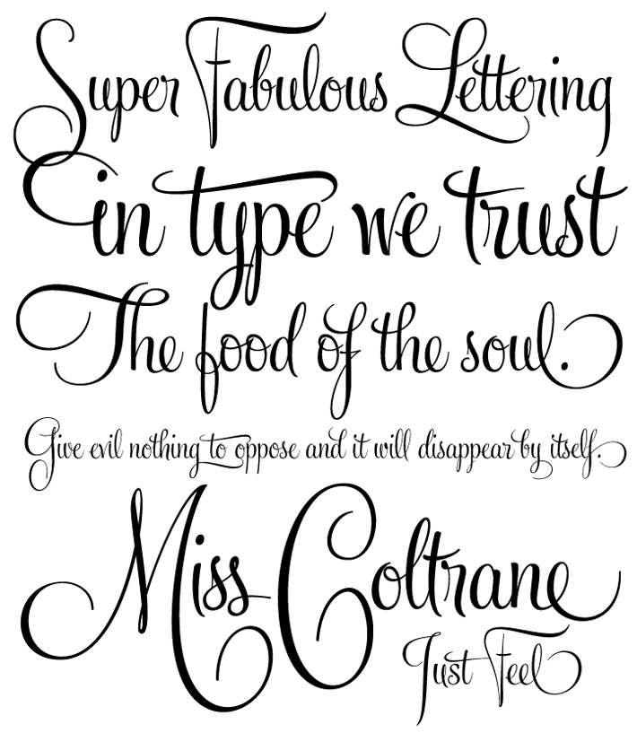
Script Fonts
Typefaces that are based on the varied and fluid strokes created by traditional handwriting. Now they are organized into highly regular types.
EXAMPLES:

Slide 5
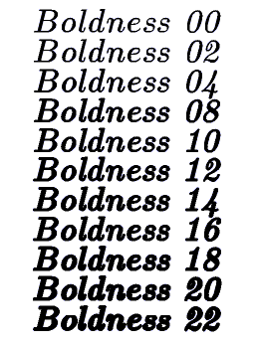
BOLD Fonts
Bold typefaces emphasize words in a text by using a differently styled font from the rest. Many fonts have their own versions of bold (usually thicker lined type).
EXAMPLES:

Slide 6
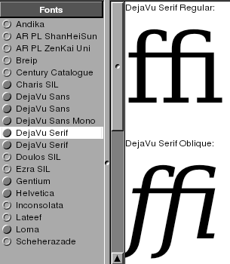
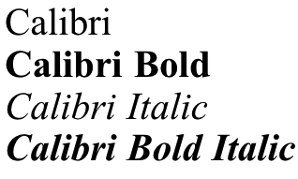
Slant or Italic Fonts
Italic typeface is a type of cursive slanted slightly to the right; it is based on traditional calligraphic handwriting. Italic fonts are used to exaggerate a specific idea, similar to bold typeface many fonts have their own version of italic.
EXAMPLES:

Slide 7
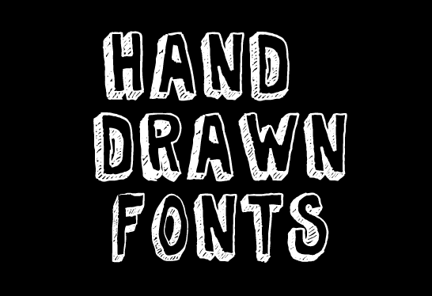
Handwritten fonts are usually unique in every letter. Although there are a number of hand drawn fonts that can be downloaded online for example:
http://kevinandamanda.com/fonts/fontsforpeas/

Slide 8
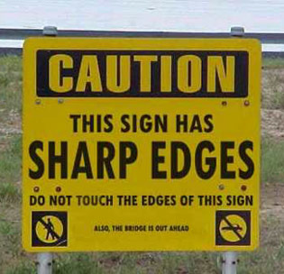
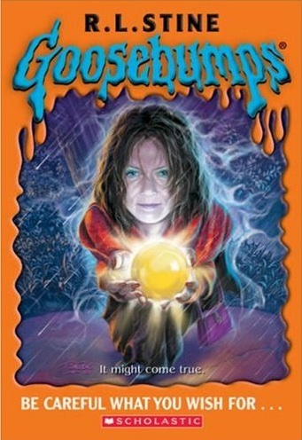
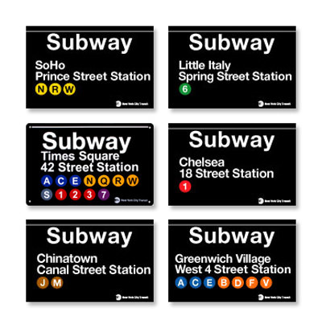
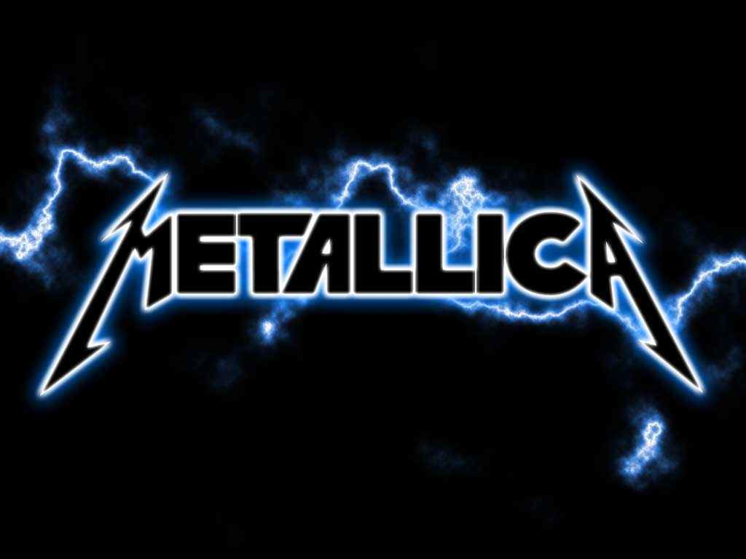

Slide 9
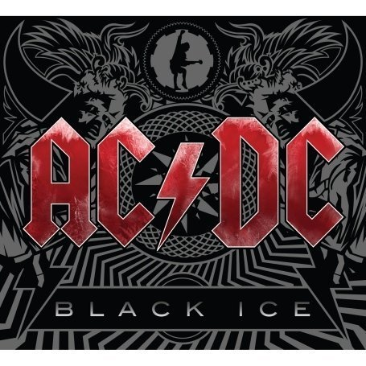
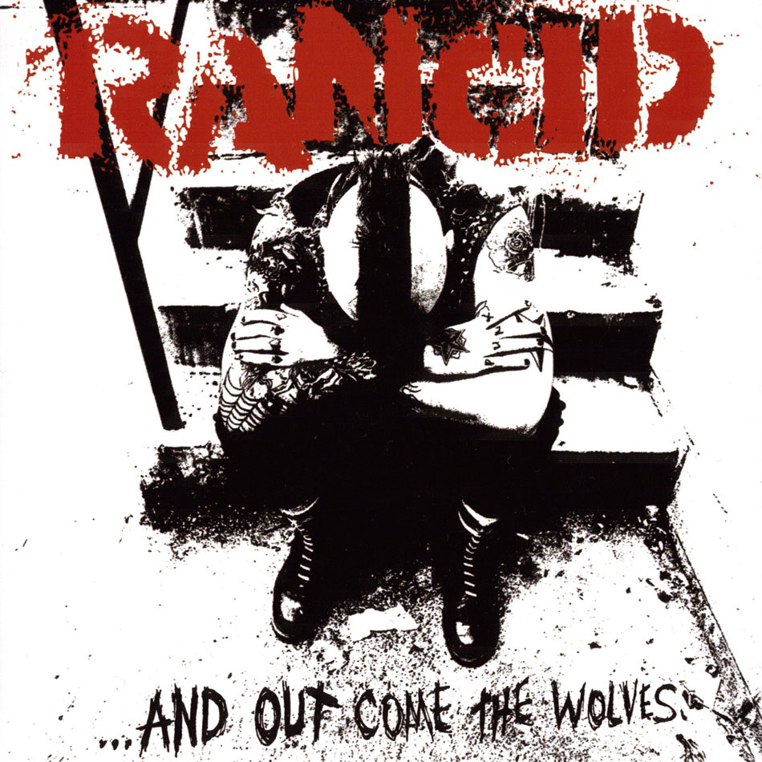
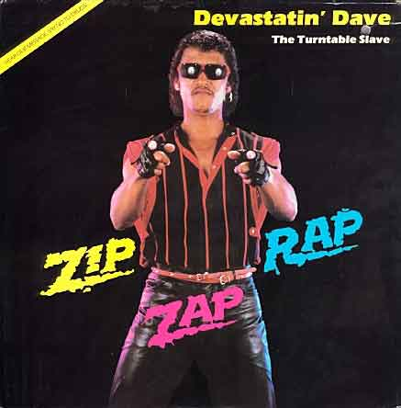
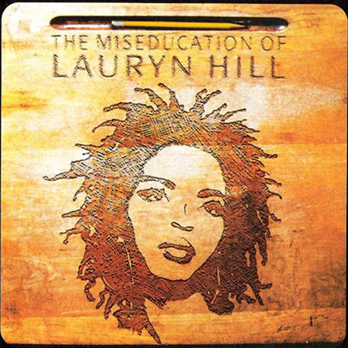
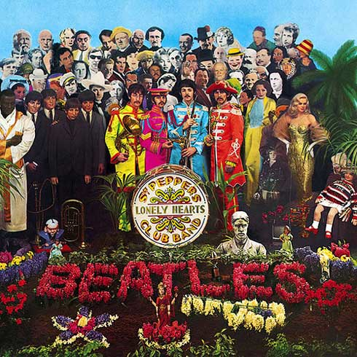

Slide 10
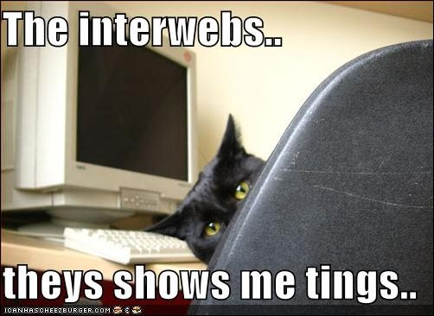
Websites to Check Out
Manipulating Type
Type is Art
Graffiti Creator
Typography Magazine
Font Database
I love Typography
Typography Served
Designing Type Projects

Slide 11
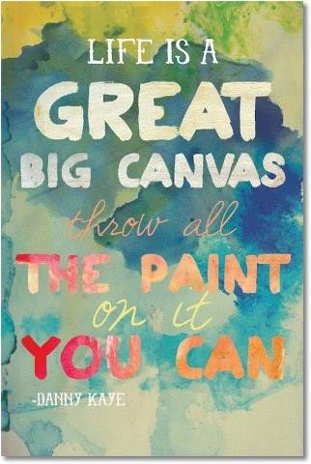
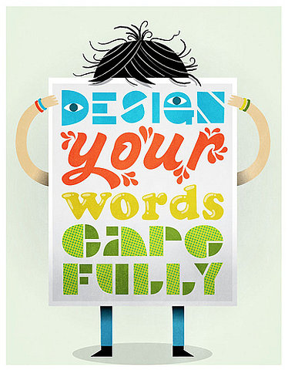

Slide 12
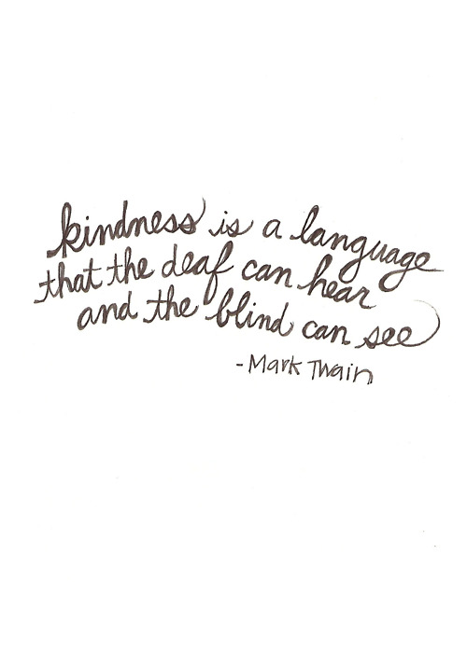
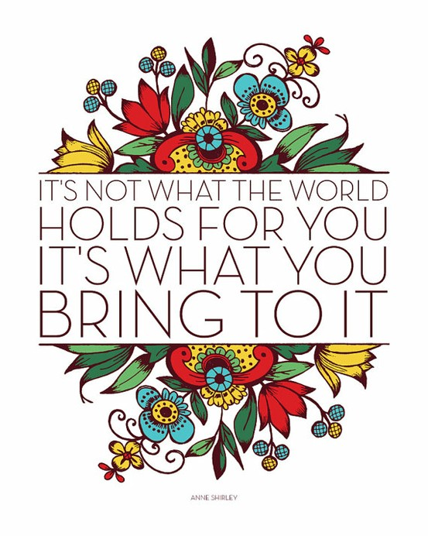
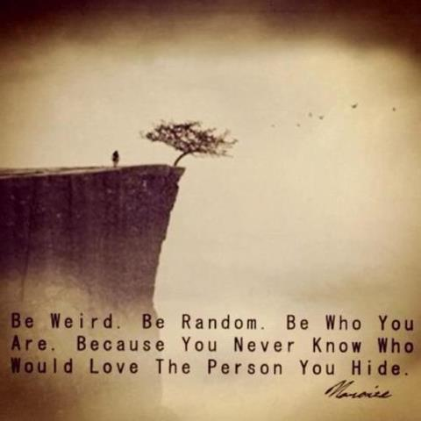

Slide 13
Hand Lettering Tutorial

Slide 14
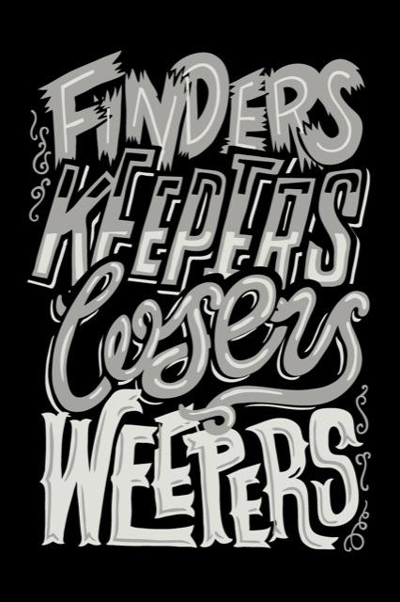
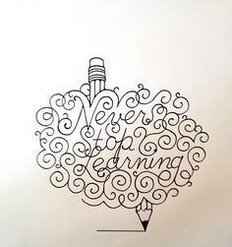
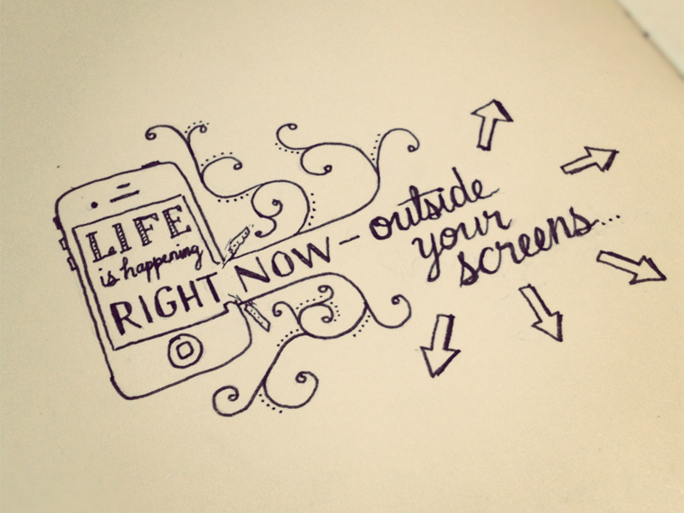

Slide 15
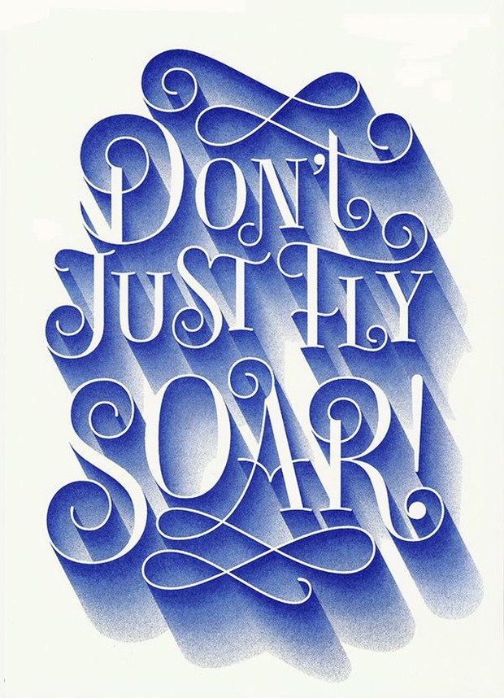
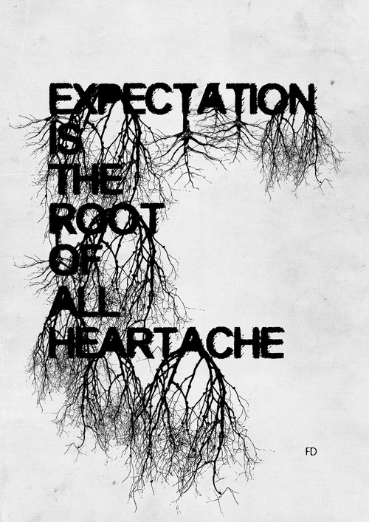

Slide 16
