Slide 1
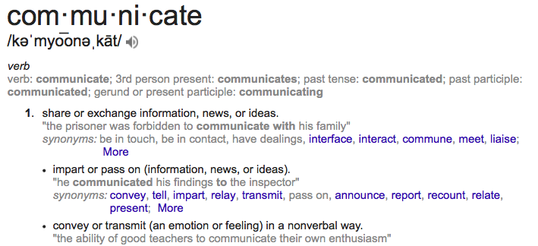
UNIT 4
Artists Collaborate and Communicate

Slide 2
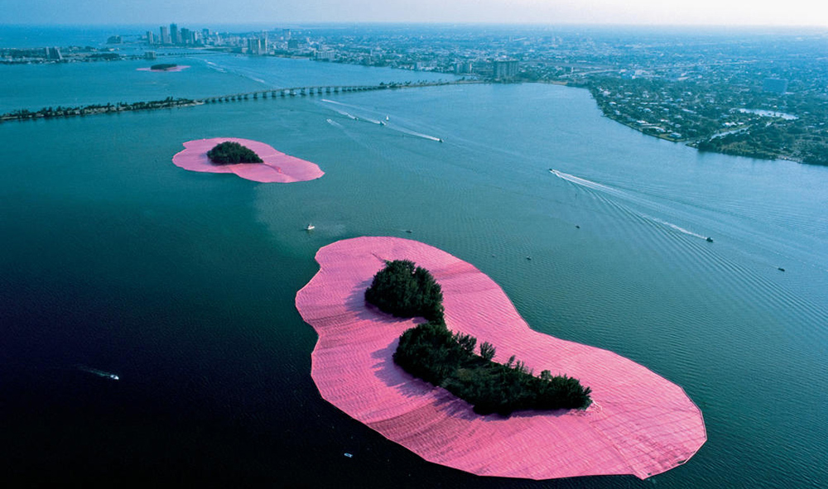
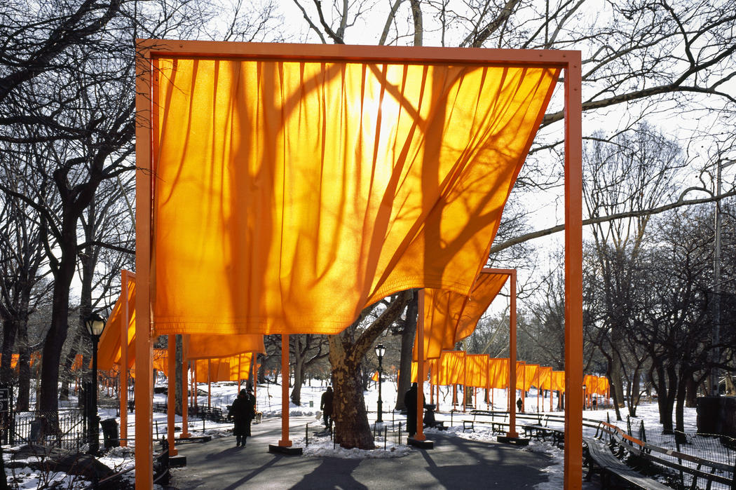
Christo and Jeanne-Claude
Website
Article
Notes:
HOW DO ARTISTS COLLABORATE? The Gates was installed in Central Park New York in 1975. It was a temporary piece meant to highlight the ways in which humans interact with their environment. The installations that this duo creates are self-funded and this one cost over 21 million dollars. In linked article: “Our works are temporary in order to endow the works of art with a feeling of urgency to be seen, and the love and tenderness brought by the fact that they will not last. Those feelings are usually reserved for other temporary things such as childhood and our own life. These are valued because we know that they will not last” [3] The second image is called surrounded islands.

Slide 3
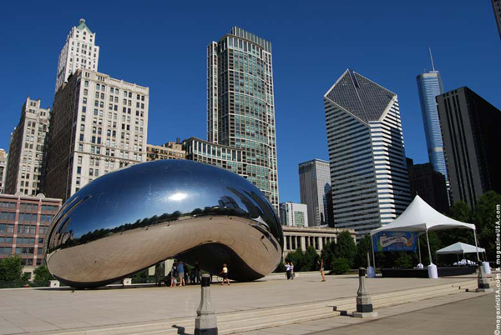
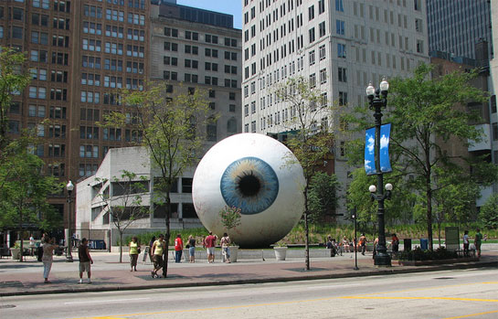
ANISH KAPOOR
TONY TASSET
Video
Notes:
Public art is any artwork that is placed specifically for ease of public access and view. Some other examples of public artwork might include: Anish Kapoor’s, Cloud Gate or Bean and Tony Tasset’s Eye both based in Chicago. The link for Tony Tasset’s new home: http://www.laumeiersculpturepark.org/tony-tasset-2007/

Slide 4
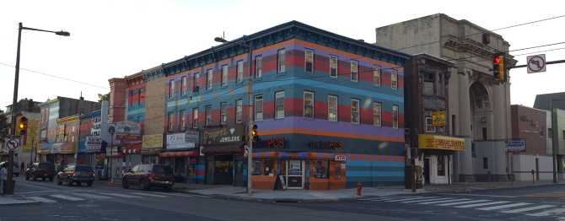
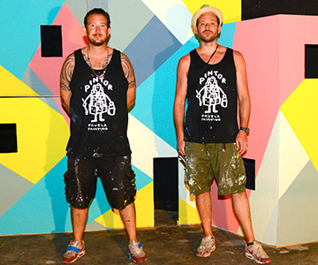
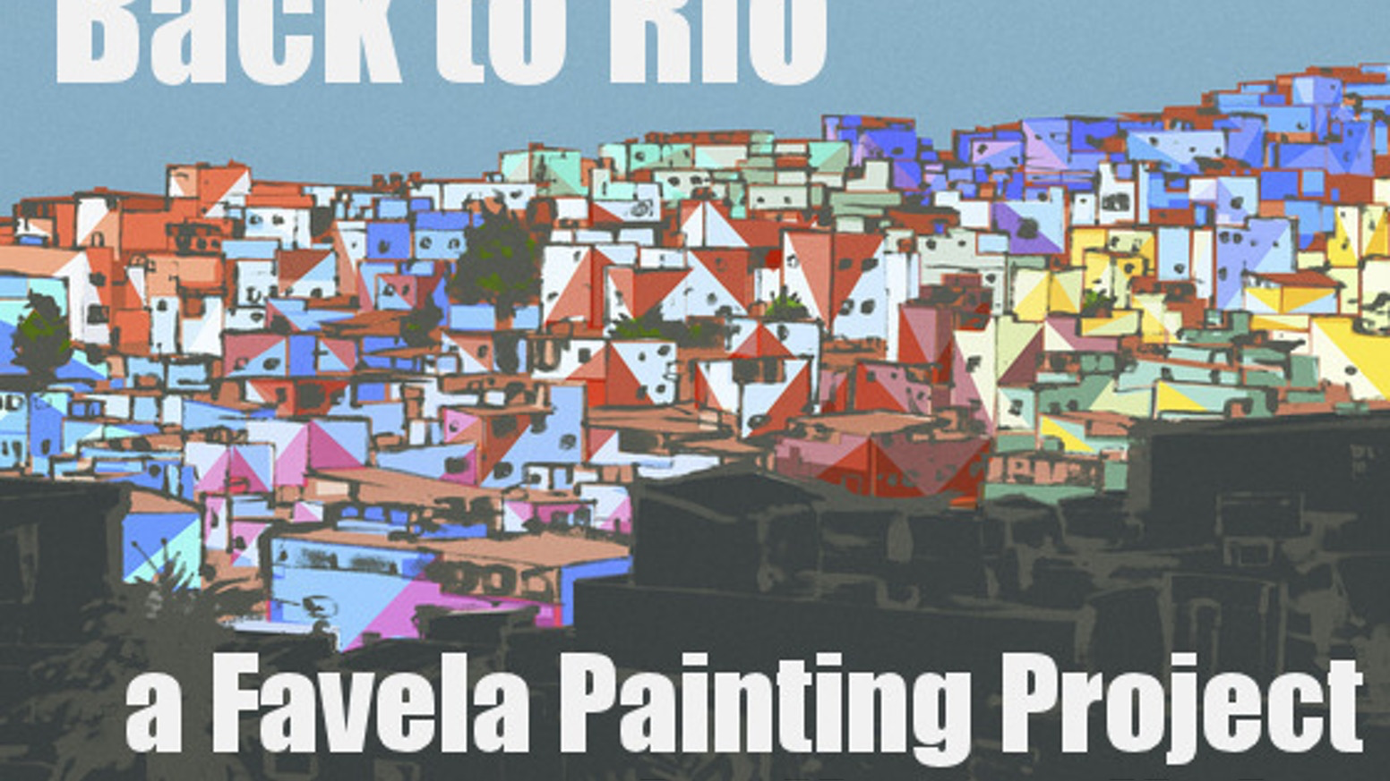
HAAS & HAHN
TEDx Video
Website
Notes:
Community Based Art: One way in which artists can collaborate is not only between each other but directly with the communities in which they work. This paves the way for free access to public art. Usually an event or activity in which all community members can participate. It is often claimed that public art helps to improve an area’s morale.

Slide 5
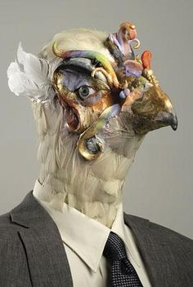
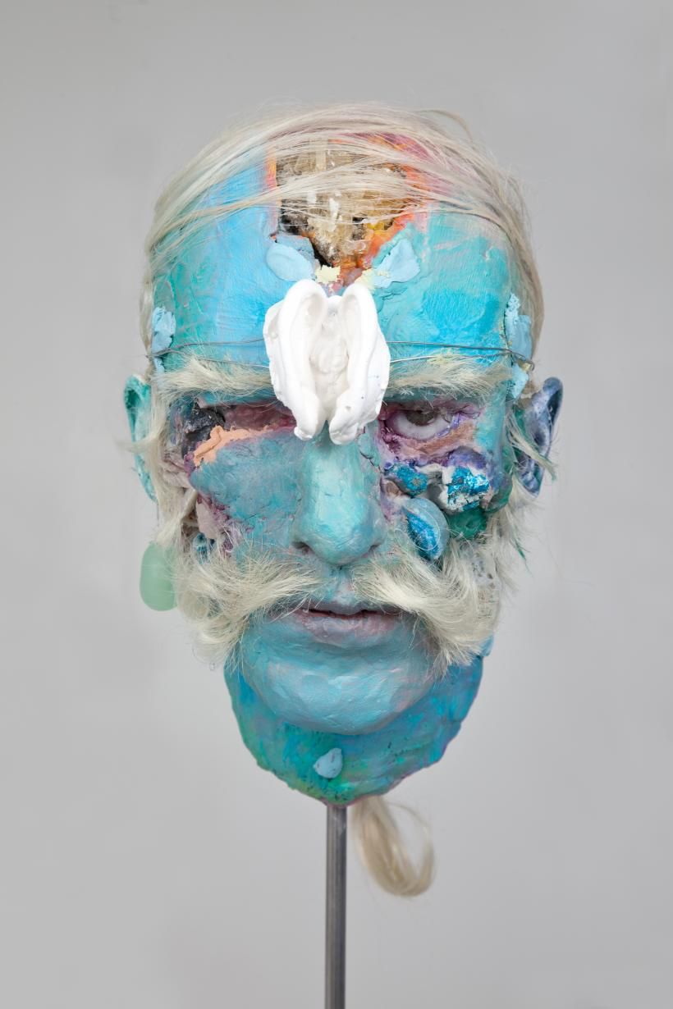
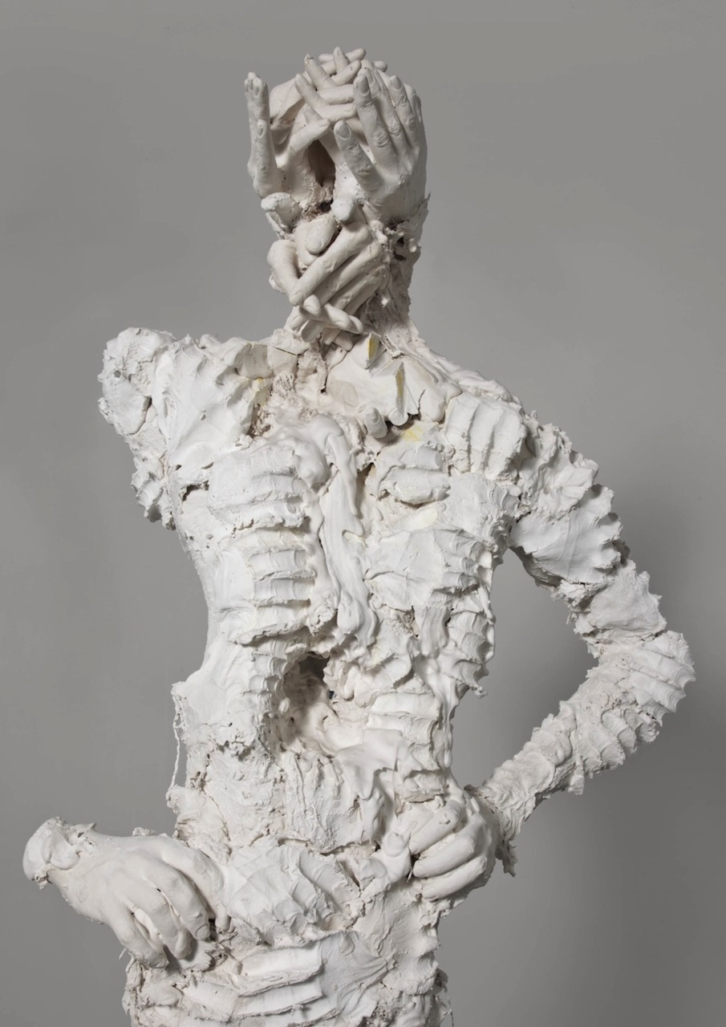
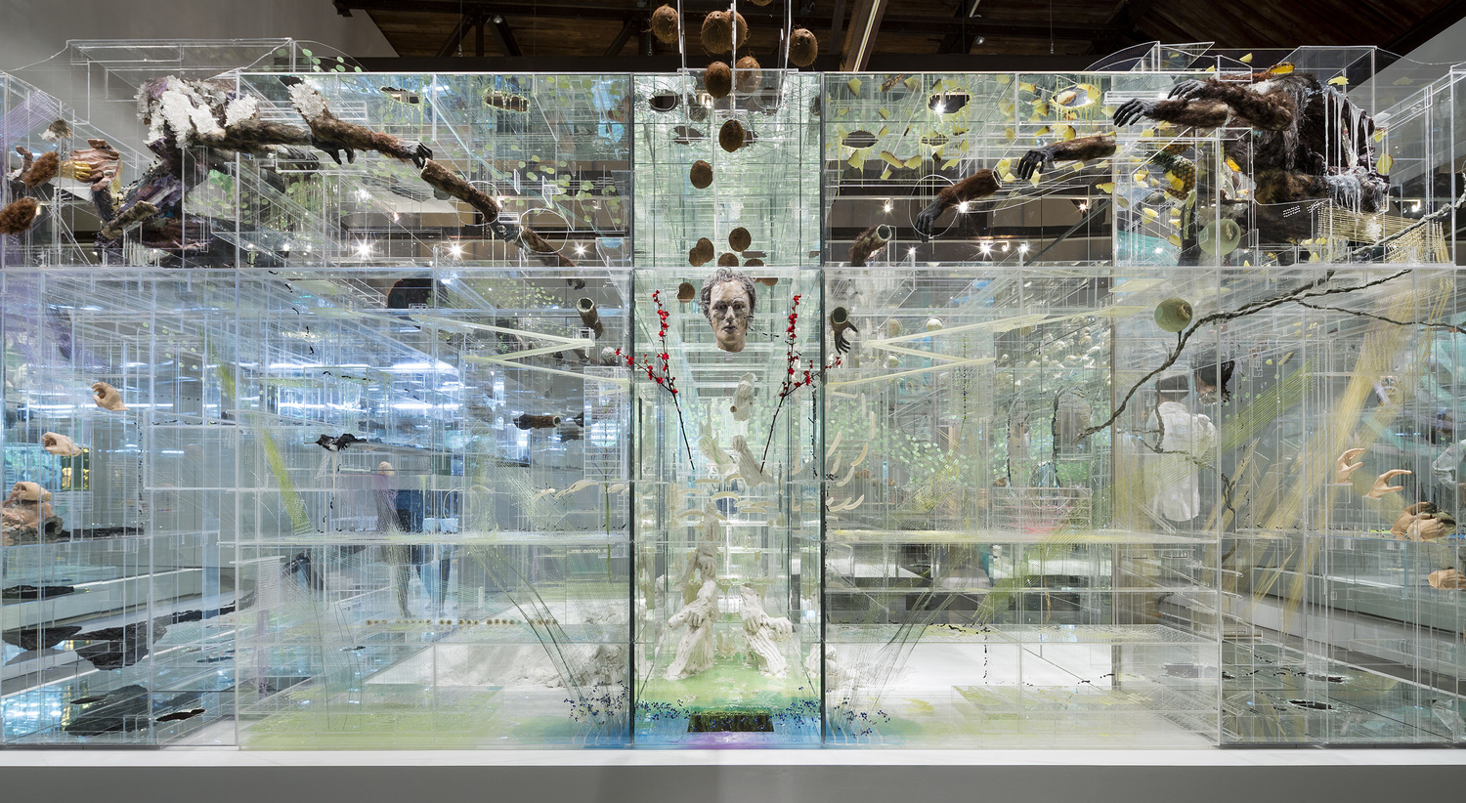
DAVID ALTMEJD
Video
Notes:
There are artists who take collaboration to a new level; where they do not physically create much of their own artwork. Of these persons, Nick Cave (creator of the sound suits) and Jeff Koons (sculptor of the balloon animals also use studio assistants to create much of their work.

Slide 6
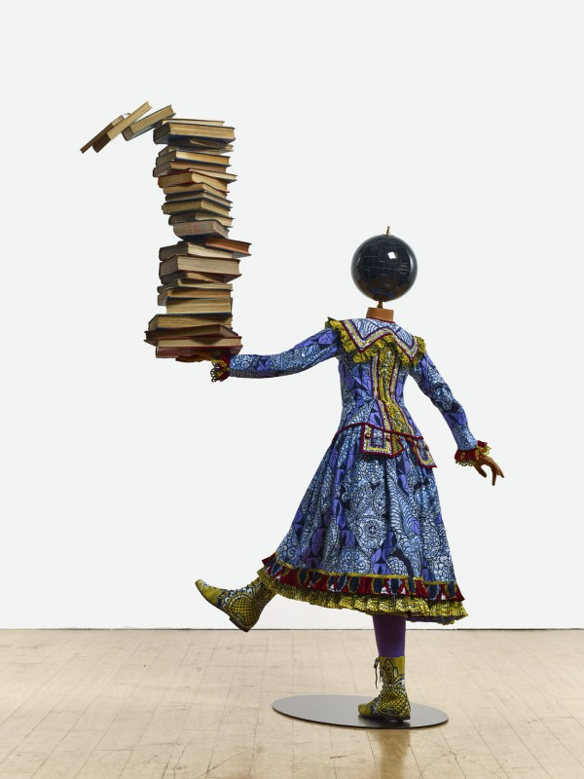
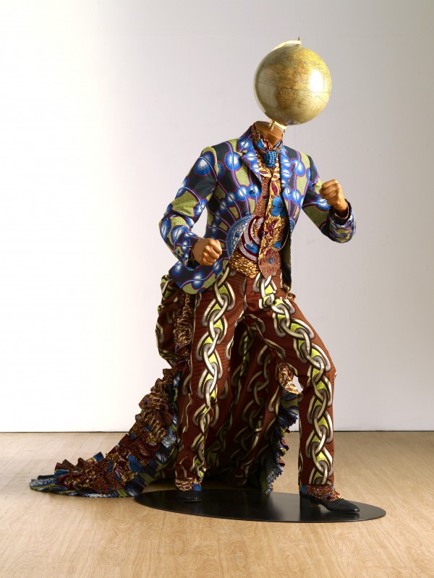
YINKA SHONIBARE
Website
Notes:
While travelling in Chicago I happened into the MoMA and found an intern on a ladder, intrigued I asked her what she was doing and she said that she was installing an artwork of Yinka Shonibare’s. He had sent directions for the painting and entrusted the museum to recreate the imagery according to his idea. This blew my mind! My first thought was, how do I get this gig?, my second thought, is this art?,
Shonibare’s work focuses on political commentary. Much of his work uses this ornate batik fabric he purchases in London which was originally created by the Dutch colonizers of Nigeria based on traditional fabrics and sold back to those persons in high power.

Slide 7
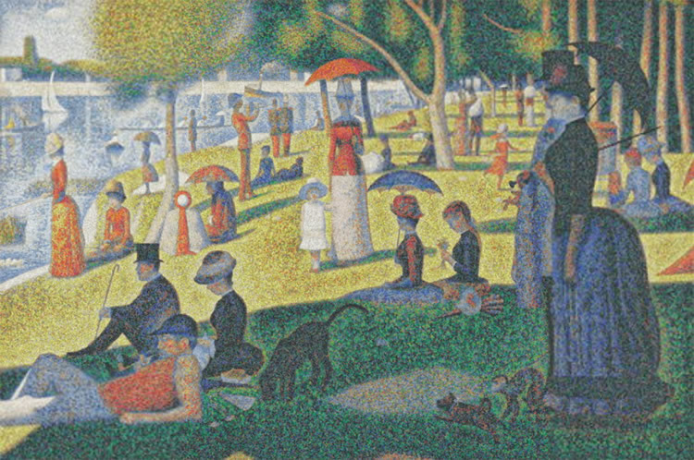
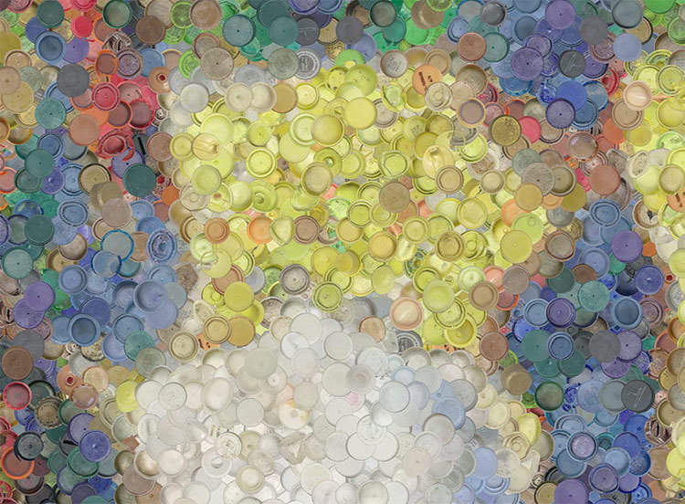
CHRIS JORDAN
Website
Notes:
This image was originally create by Georges Seurat but is recreated by Chris Jordan using plastic bottle caps. The artwork was made with 400,000 bottle caps, which is equal to the average number of plastic bottles consumed in the US every minute. Chris Jordan also creates other artwork out of trash.

Slide 8
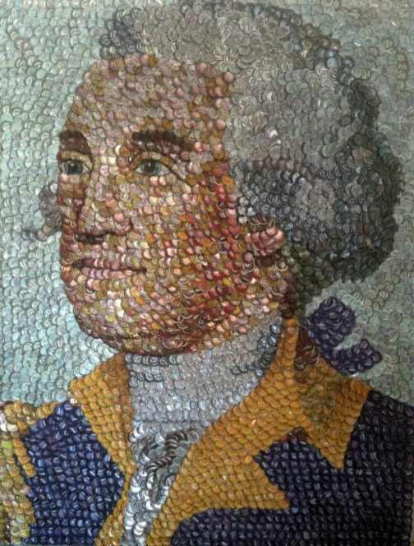
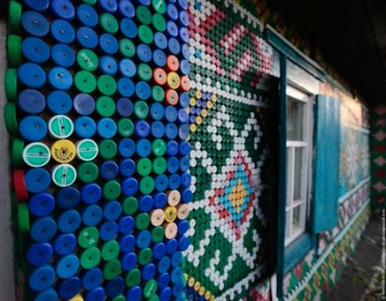
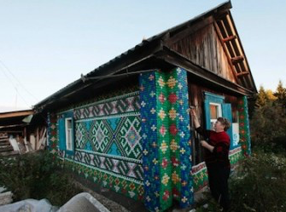
MOLLY B. RIGHT
Website
Notes:
To the right is a retired woman, Olga Kostina in Siberia who has used 1,000s of bottle caps to decorate her home.

Slide 9
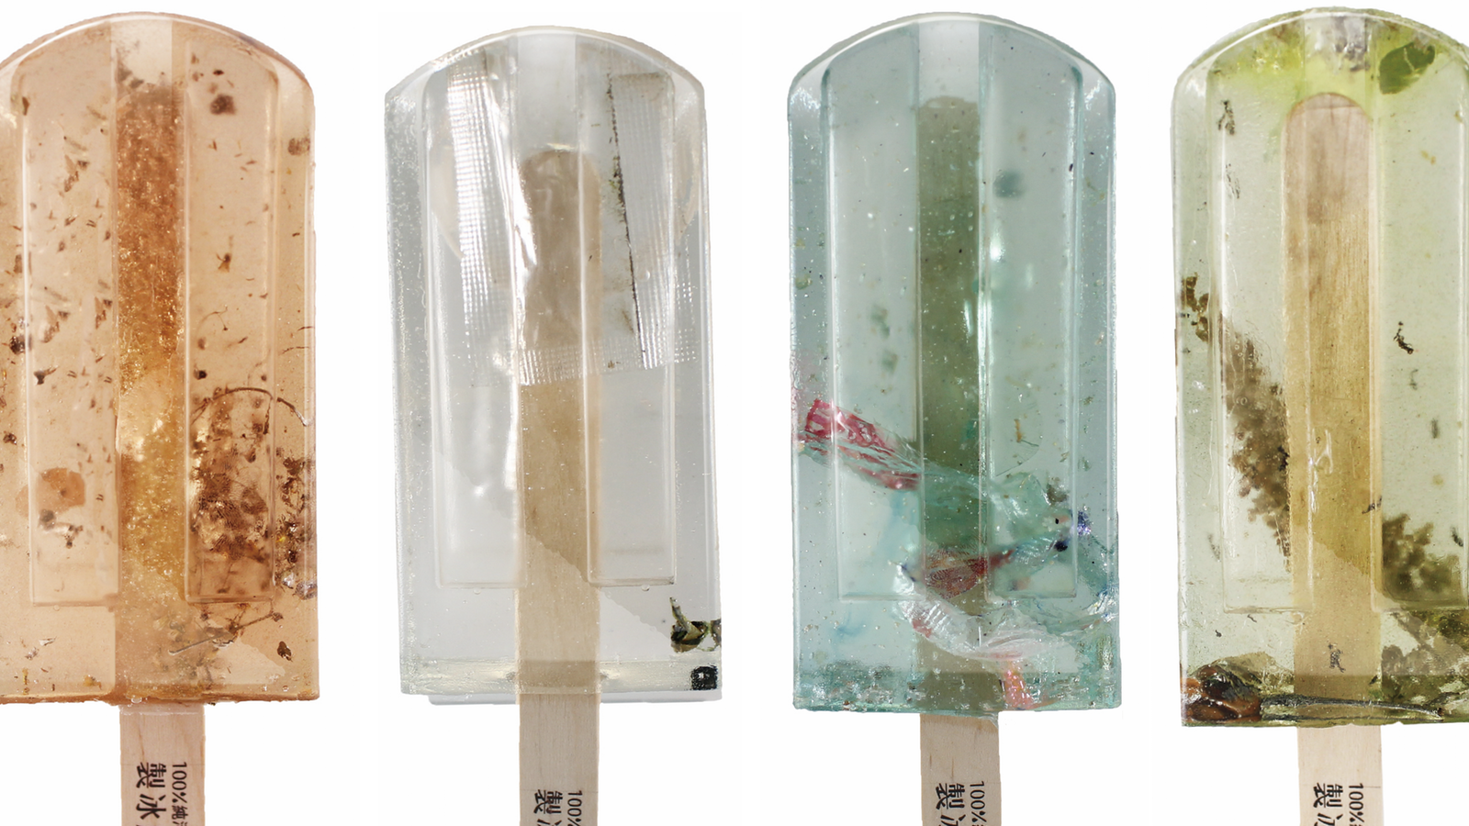
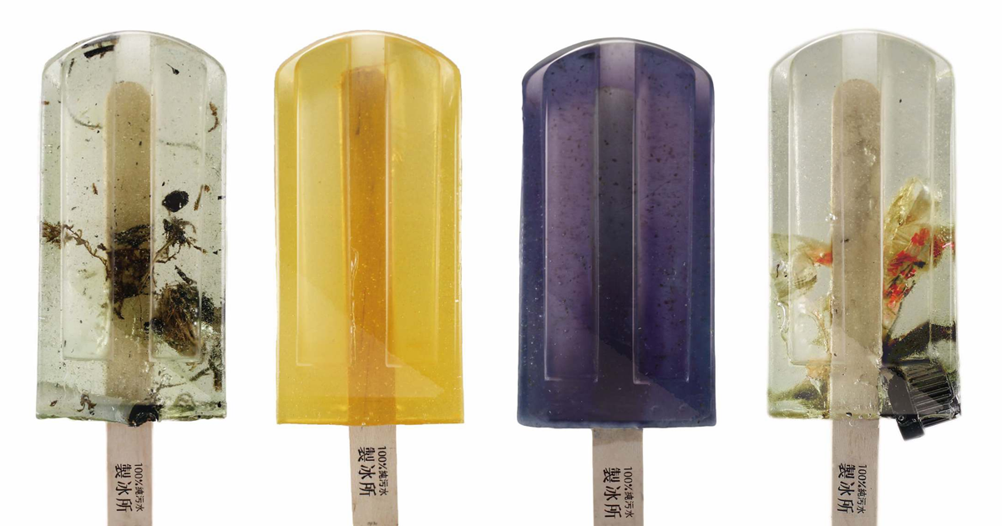
HONG YI-CHEN / GUO YI-HUI / CHENG YU-TI
"The water comes from 100 different polluted water sources in Taiwan, ranging from rivers to ports to ditches… We had this idea because we believe clean water resources for everyone is a very important thing," said Hong
Article
Notes:
There are certainly a lot of people who create artwork from found materials but it’s another thing to make a statement using the materials that you choose.

Slide 10
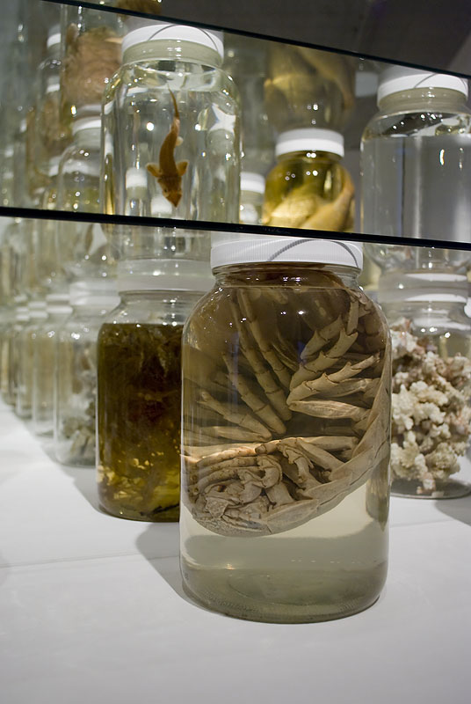
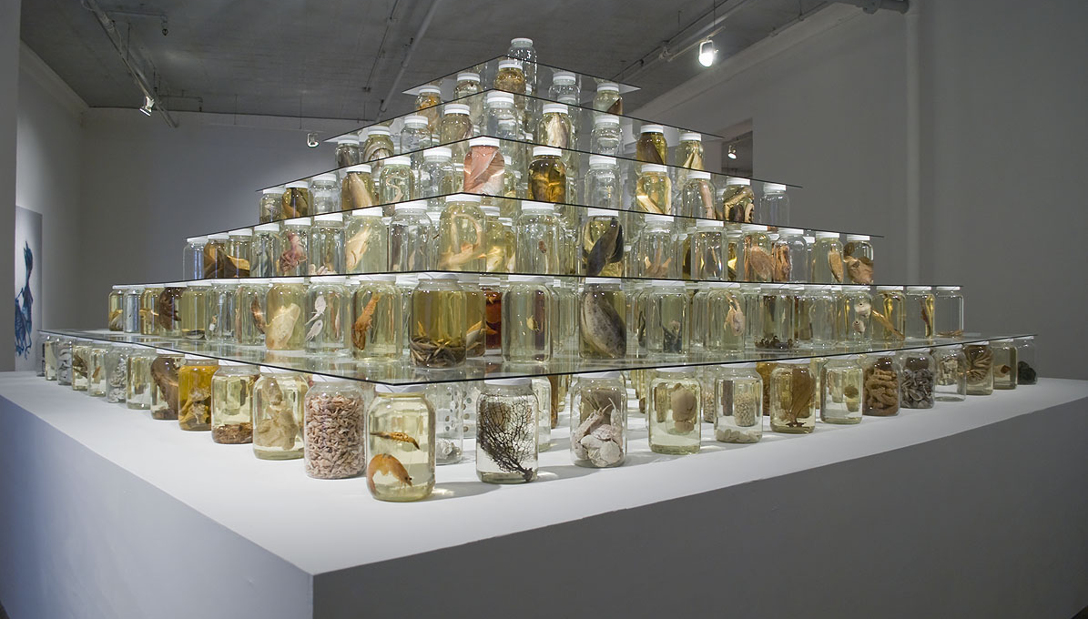
BRANDON BALENGEE
Website
Notes:
The artwork depicted is “Collapse” a collaborative work installed by Balengee which displays 162 preserved species from the Gulf region, and some in decline or extinct. Collapse responds to the global crisis of the world’s fisheries and the current threat for the unraveling of the Gulf of Mexico’s food-chain following the 2010 BP Deep Water Horizon oil spill.

Slide 11
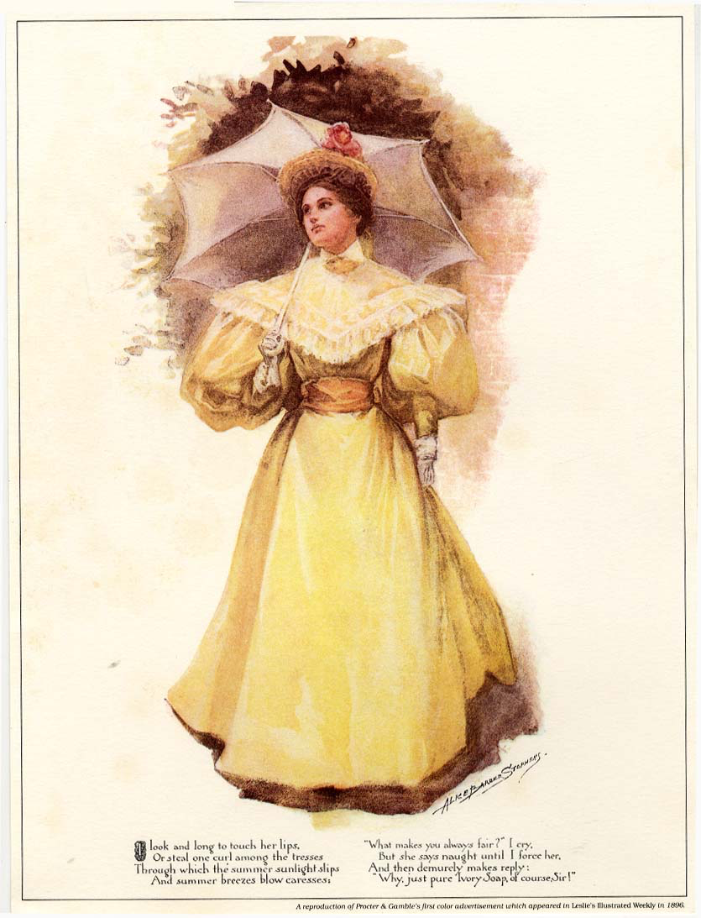
ADVERTISEMENT
Some say ads belong in a museum or library, because they are a form of art that is part of America’s history. Charles Sable states, “Advertising [is art that] appeals to the average person.”
Critics claim Ads in museums are an exploitation of America’s institutions of higher culture. David Lubers says, “You’re there to sell ideas or products…”
Is Advertising art? In what ways is it similar to art?
Article
Notes:
1896 Pamolive Advertisement found at (https://glover320.blogspot.com/2015/) showing a signed artwork. “Summer Breezes,” P&G’s first color advertisement, made its debut in Cosmopolitan magazine in 1896. It’s one of 5,000 print, TV and radio ads dating back to 1882 that P&G has given to the Smithsonian’s National Museum of American History.

Slide 12
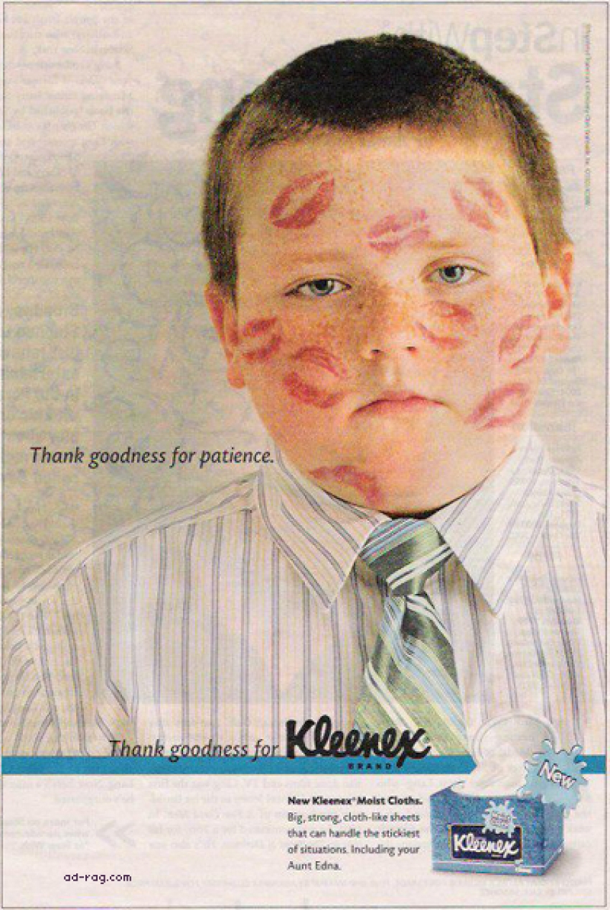
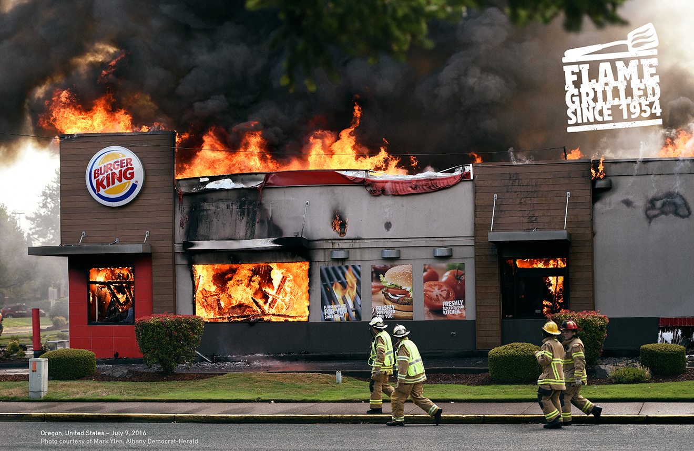
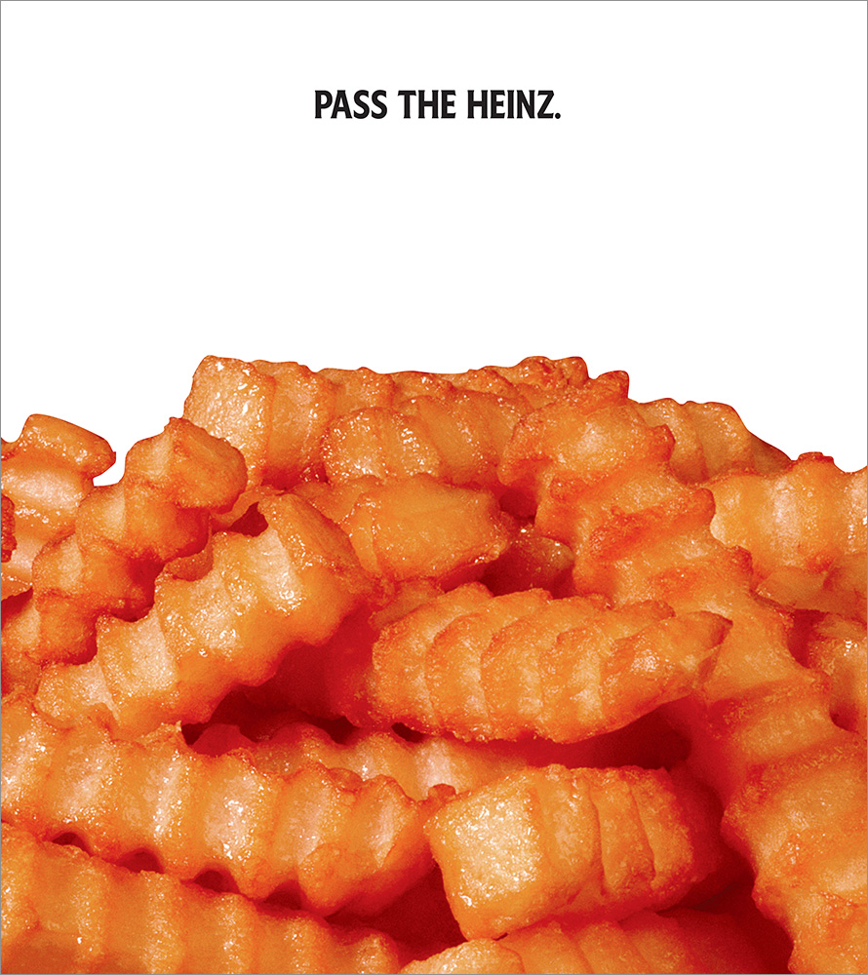
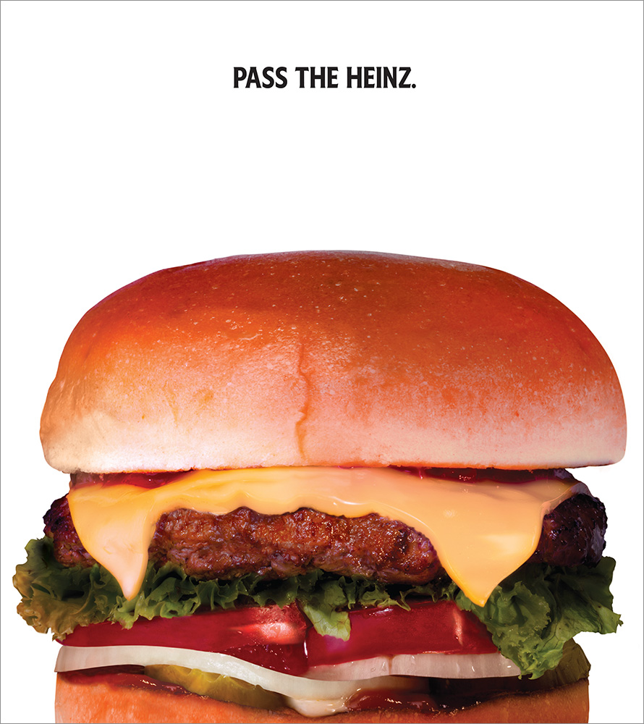
2017: MOST BEAUTIFUL ADS
Article
Notes:
AdWeek purports that the first two ads are high quality and deserving of recognition. Do ALL Ads qualify as Art just because someone made them? There’s good and bad art… Take these last two images as an example

Slide 13
HOW DO WE COMMUNICATE
Speech
Facial Expressions
Gestures
Pointing
Writing
Drawing
Using Equipment
Touch
Eye Contact
Beliefs and Values
Stories
Needs
Desires
Opinions
Ideas
Emotions/Feelings
WHAT DO WE COMMUNICATE

Slide 14
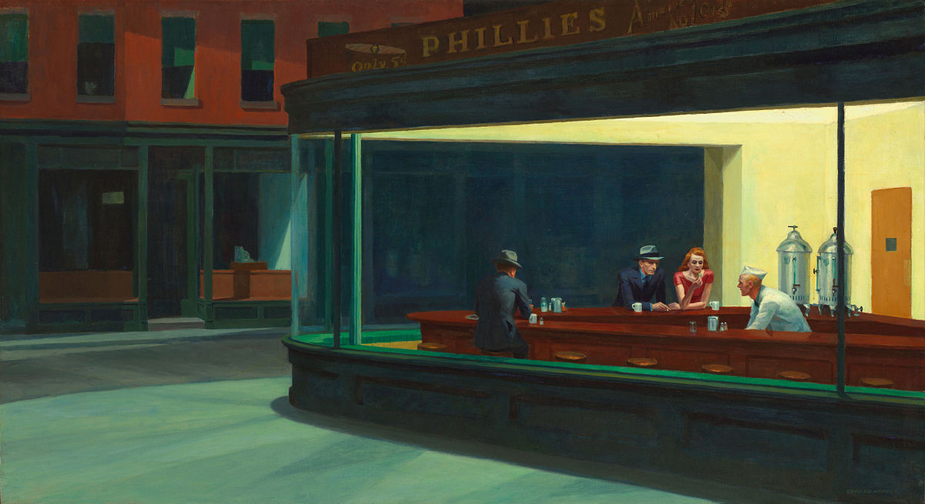
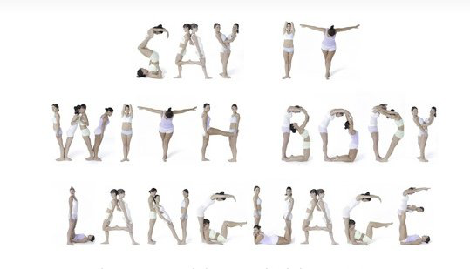
COMMUNICATION
How do we communicate with each other and ourselves
Body Language
Notes:
Edward Hopper’s Nighthawks & Edvard Munch’s Melancholy

Slide 15
UNIT 4: Collaborate & Communicate
MINI PROJECTS:
Directional Drawing
Advertisement
Community-Based Project
Zine
UNIT 4 PROJECT:
Create an original artwork based on the theme; Artists Collaborate and Communicate.

Slide 16
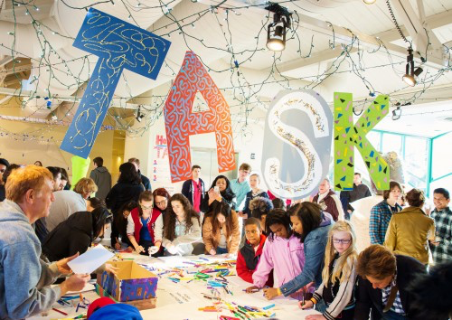
OLIVER HERRING
Website
Task Parties are an improvisational event with a simple structure and very few rules.
Art 21

Slide 17
HOW TO:

Slide 18
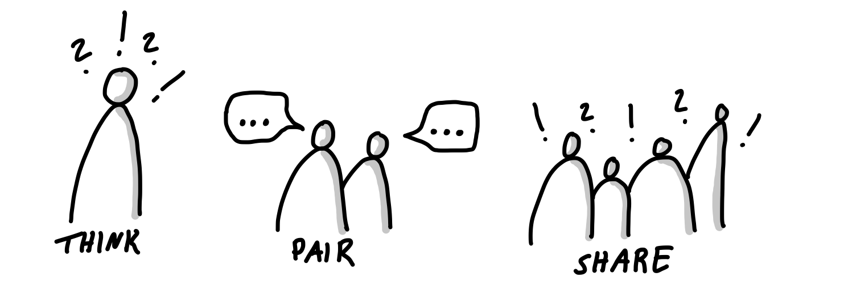
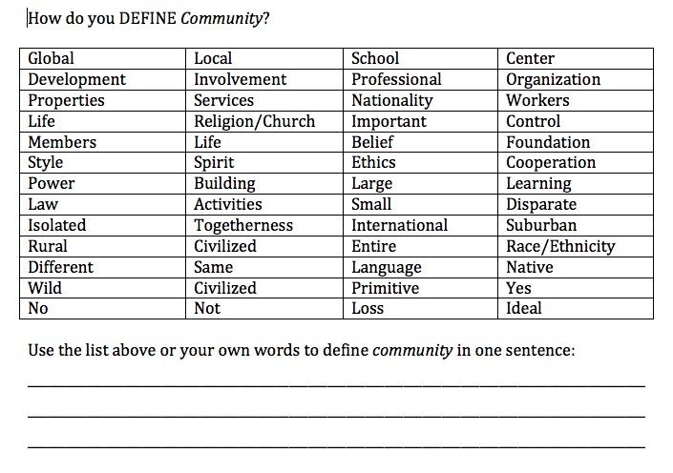
DEFINE COMMUNITY

