Slide 1
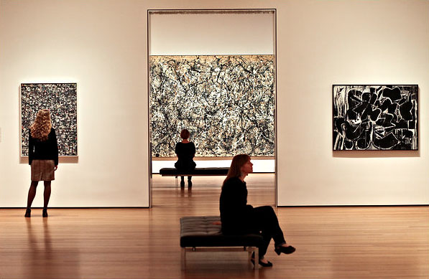
ART CRITIQUE

Slide 2
A Critique is…
A detailed evaluation or review
A criticism or critical comment on an idea, project or other piece of work

Slide 3
Therefore critiques can be verbal or written
Critique can be used for Group assessment, self-reflection, etc…
to help one improve the artwork or personal articulation/perceptions.

Slide 4
There are 4 parts to a critique

Slide 5
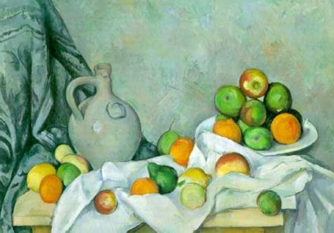
1. DESCRIPTION
Describe exactly what you see. Talk or write about the subject, media or materials, and official information (Title/Artist/date).

Slide 6
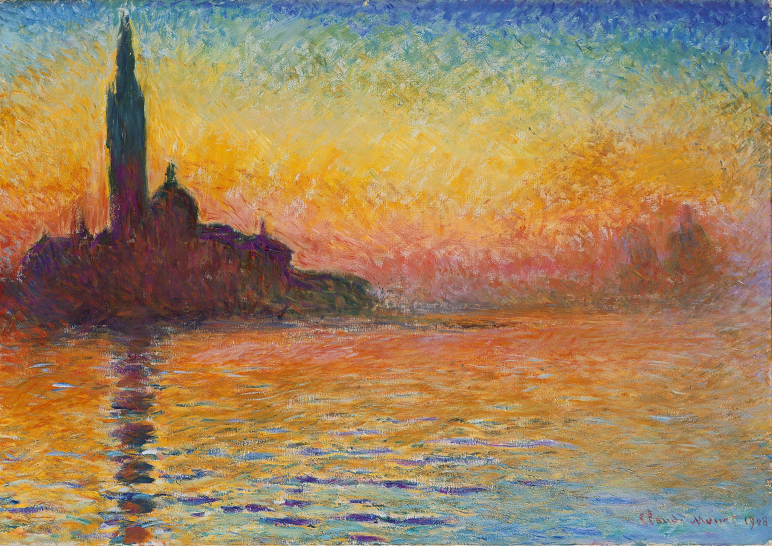
2. ANALYSIS
Relies on the critics knowledge of the Elements and Principles of Art as well as knowledge of common art vocabulary to analyze a work of art’s formal qualities.

Slide 7
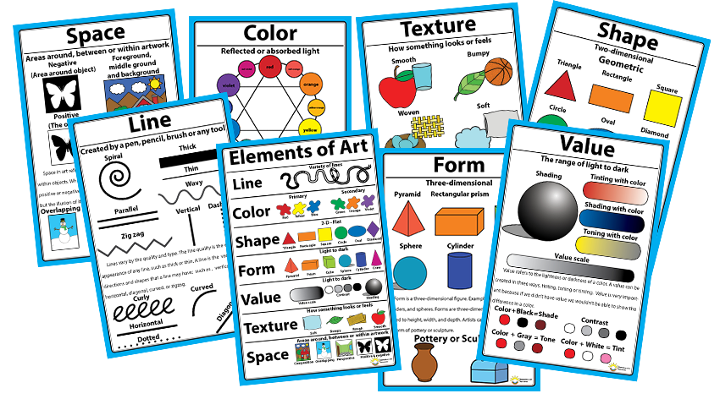
Elements of Art
The building block or techniques of art making

Slide 8
Principles of Art
The arrangement of the visual building blocks

Slide 9
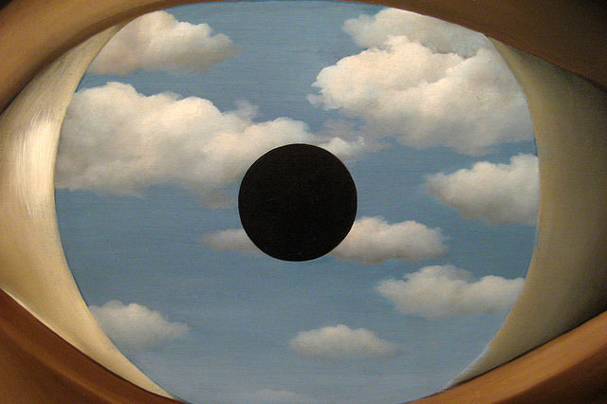
3. INTERPRETATION
This is where you place your ideas about:
What you think the artist was trying to express?
What does this work mean?
Compare and contrast this work with others

Slide 10
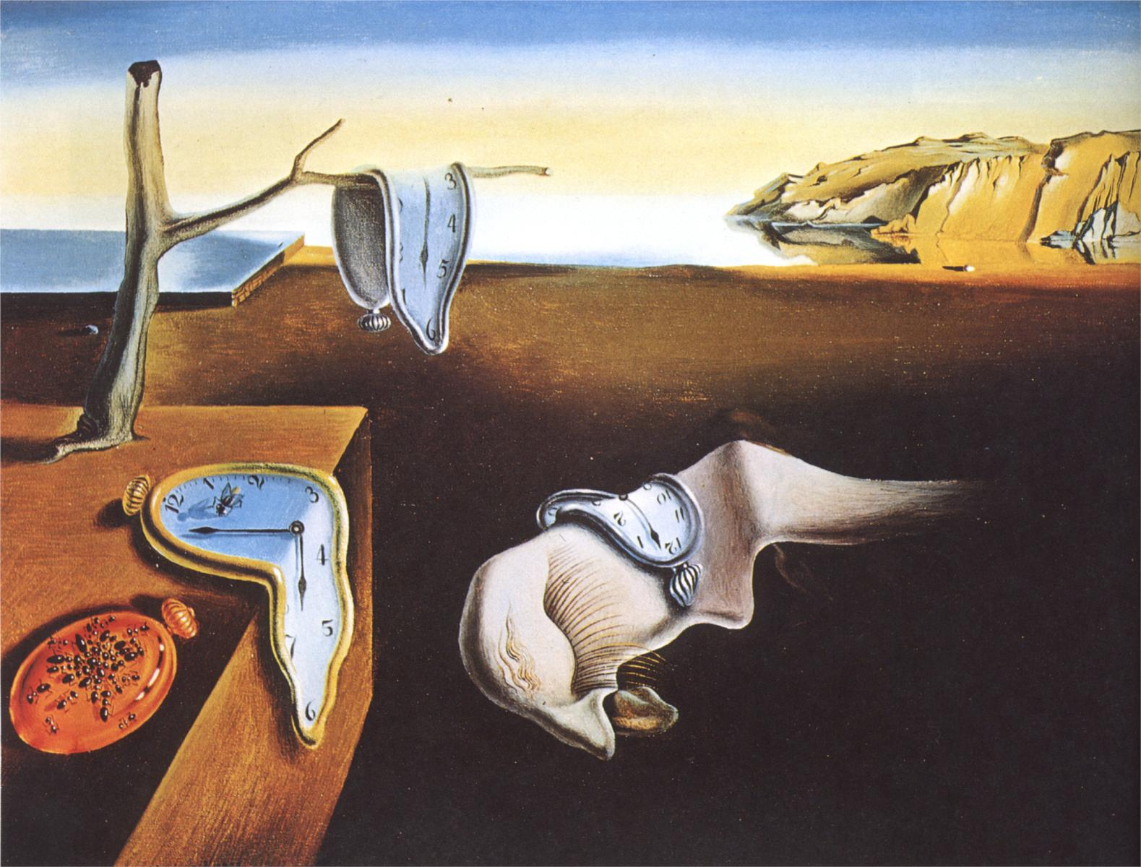
4. JUDGEMENT
Express your own opinions about a work of art. Develop an overall aesthetic response to the artwork.

Slide 11
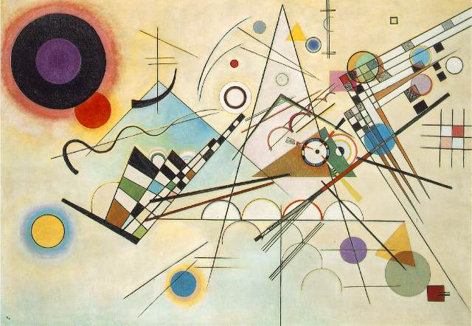
Wassily Kandinsky Composition VIII 1923

Slide 12
Katsushika Hokusai Red Fugi 1832

