Slide 1
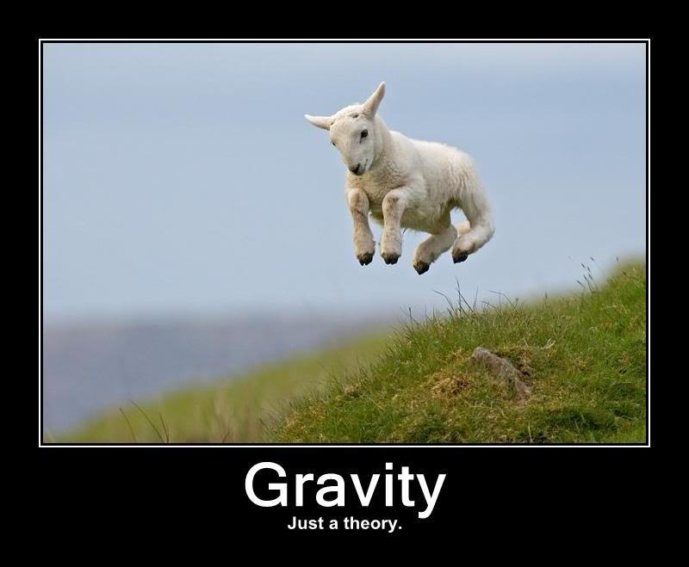
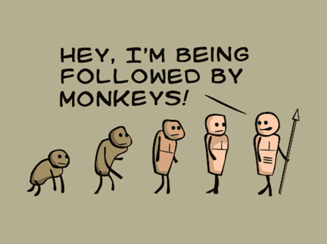
Newton’s Theory of Gravity?
WHAT ARE THEORIES?
Darwin’s Theory of Evolution?

Slide 2
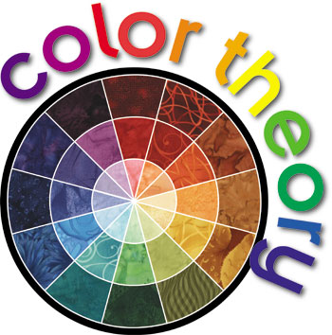
THEORY
A system of ideas used to explain something…
Color theory is formed from science and observation and is used to explain people’s reactions to color as well as a guide for color mixing.
The first recorded mention of color theory dates in the 1400s, followed by mention in the writings of both Da Vinci and Newton.
We are going to focus on theories that are applied to the color wheel (pictured to the right).

Slide 3
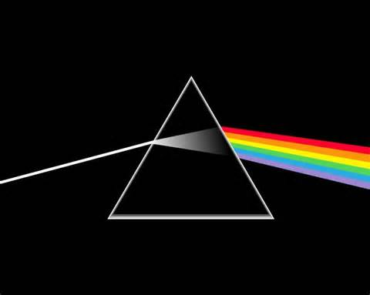
Color is simply the reflection of white light.
CC: Magic School Bus Makes a Rainbow

Slide 4
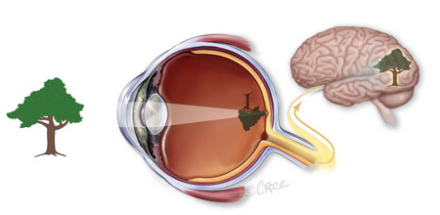
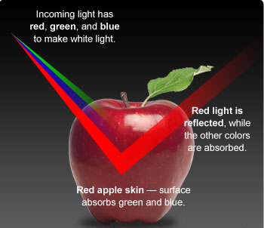
Your eye is like the lens of a camera. It absorbs and captures LIGHT and transfers that information to the brain.
Color Theory states that light is originally made up of 6 Basic colors:
Red
Orange
Yellow
Green
Blue
Violet
Color is the reflection of artificial or natural light. When the light strikes the surface of an object, it is either absorbed or reflected depending on the chemical make-up of the surface of the object. Reflected color is the color you see.

Slide 5
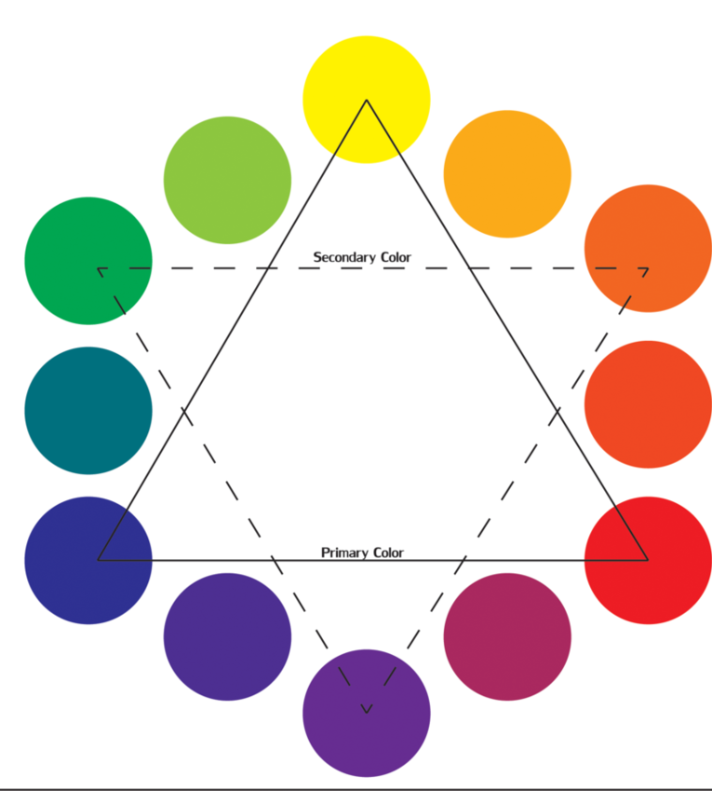
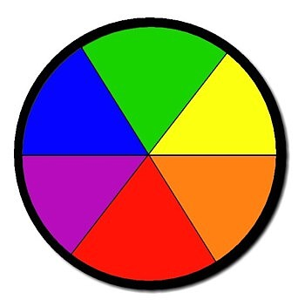
The COLOR WHEEL
An organization of colors around a circle
that shows the relationship between those colors

Slide 6
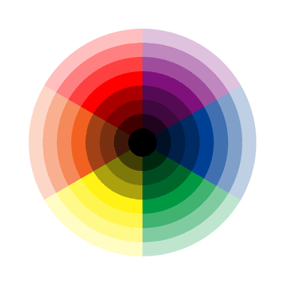
OUR
Color Wheel
This color wheel includes all of the hues as well as tints and shades

Slide 7
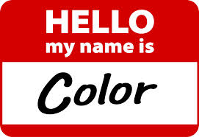
HUE
The specific NAME of a color

Slide 8
WHAT IS THIS GROUPING OF COLORS CALLED
?

Slide 9
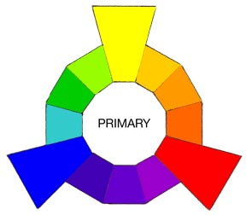
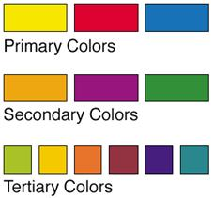
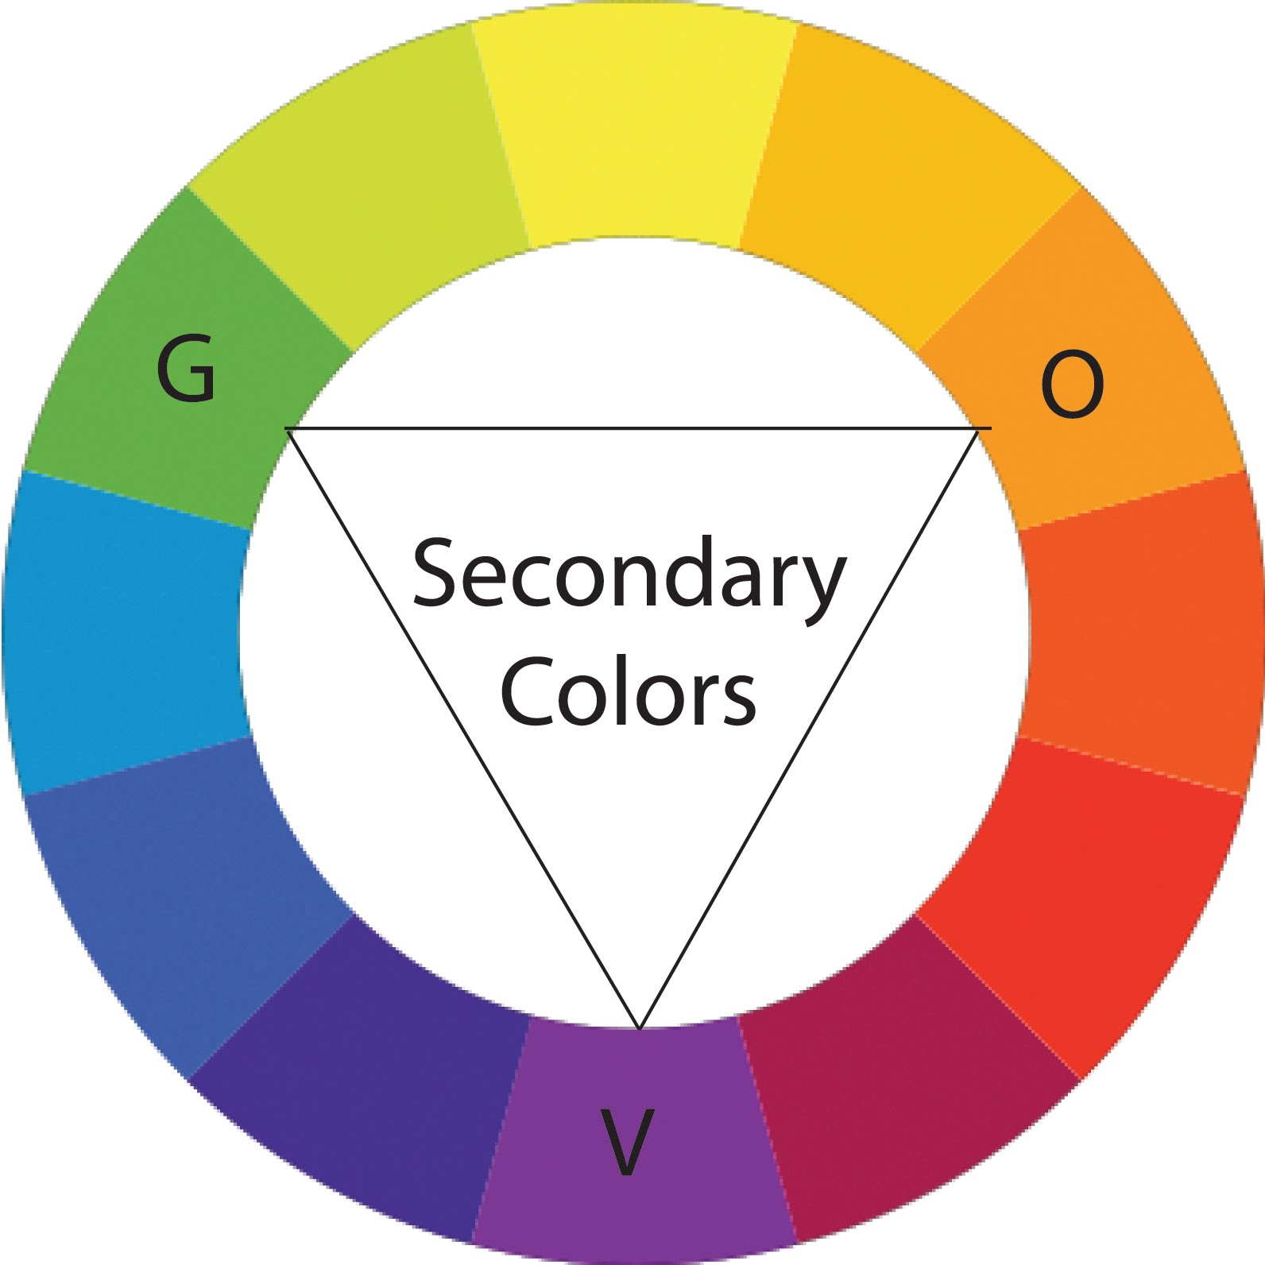
PRIMARY COLORS
A set of 3 colors used to create the rainbow
Notice their ARRANGEMENT on the Color Wheel
OK GO Primary Colors

Slide 10
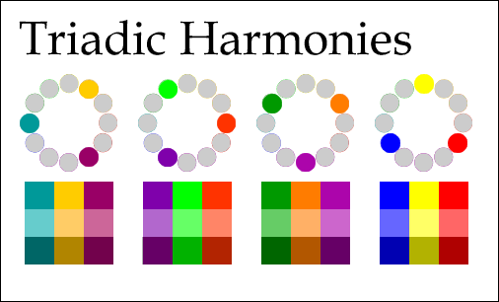
TRIADIC
Any 3 equally distant colors on the color wheel
Other TRI words:
Triangle, Trident, Tri-force,
Tricycle, Tripod, Triceratops

Slide 11
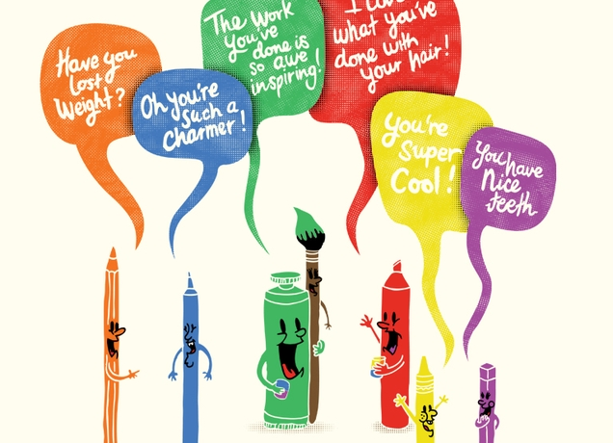

Slide 12
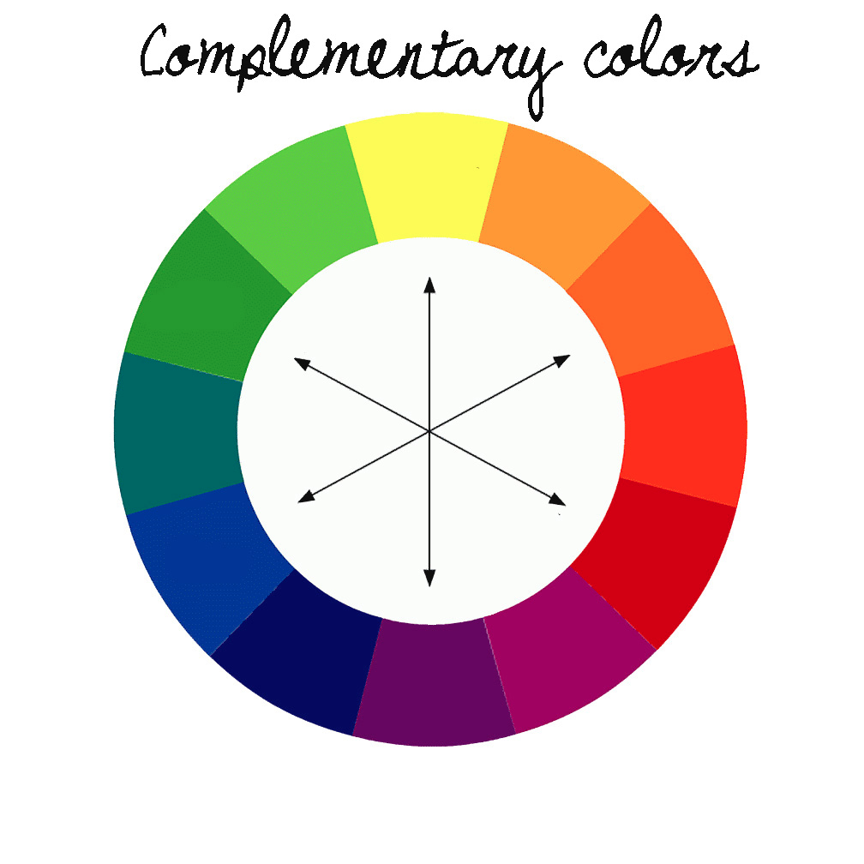

Slide 13
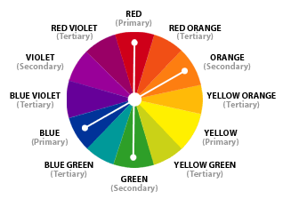
Double-Complementary
A set of adjacent colors and their complementary colors (a total of 4)

Slide 14
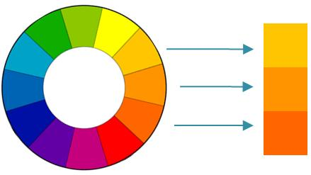
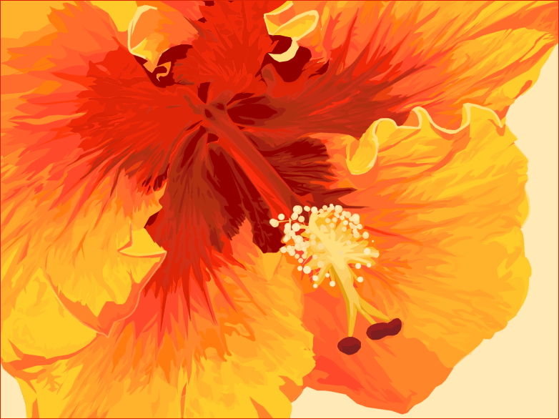
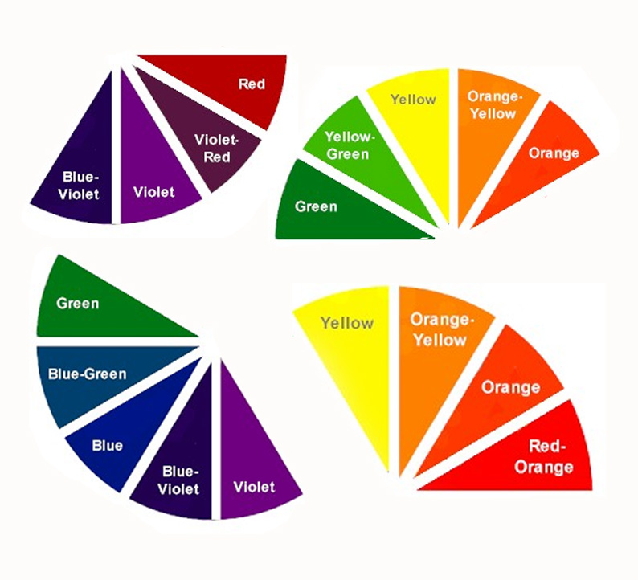
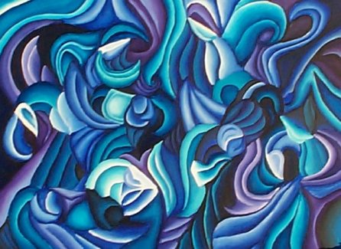
ANALOGOUS
Several adjacent colors
(side-by-side)
On the color wheel

Slide 15
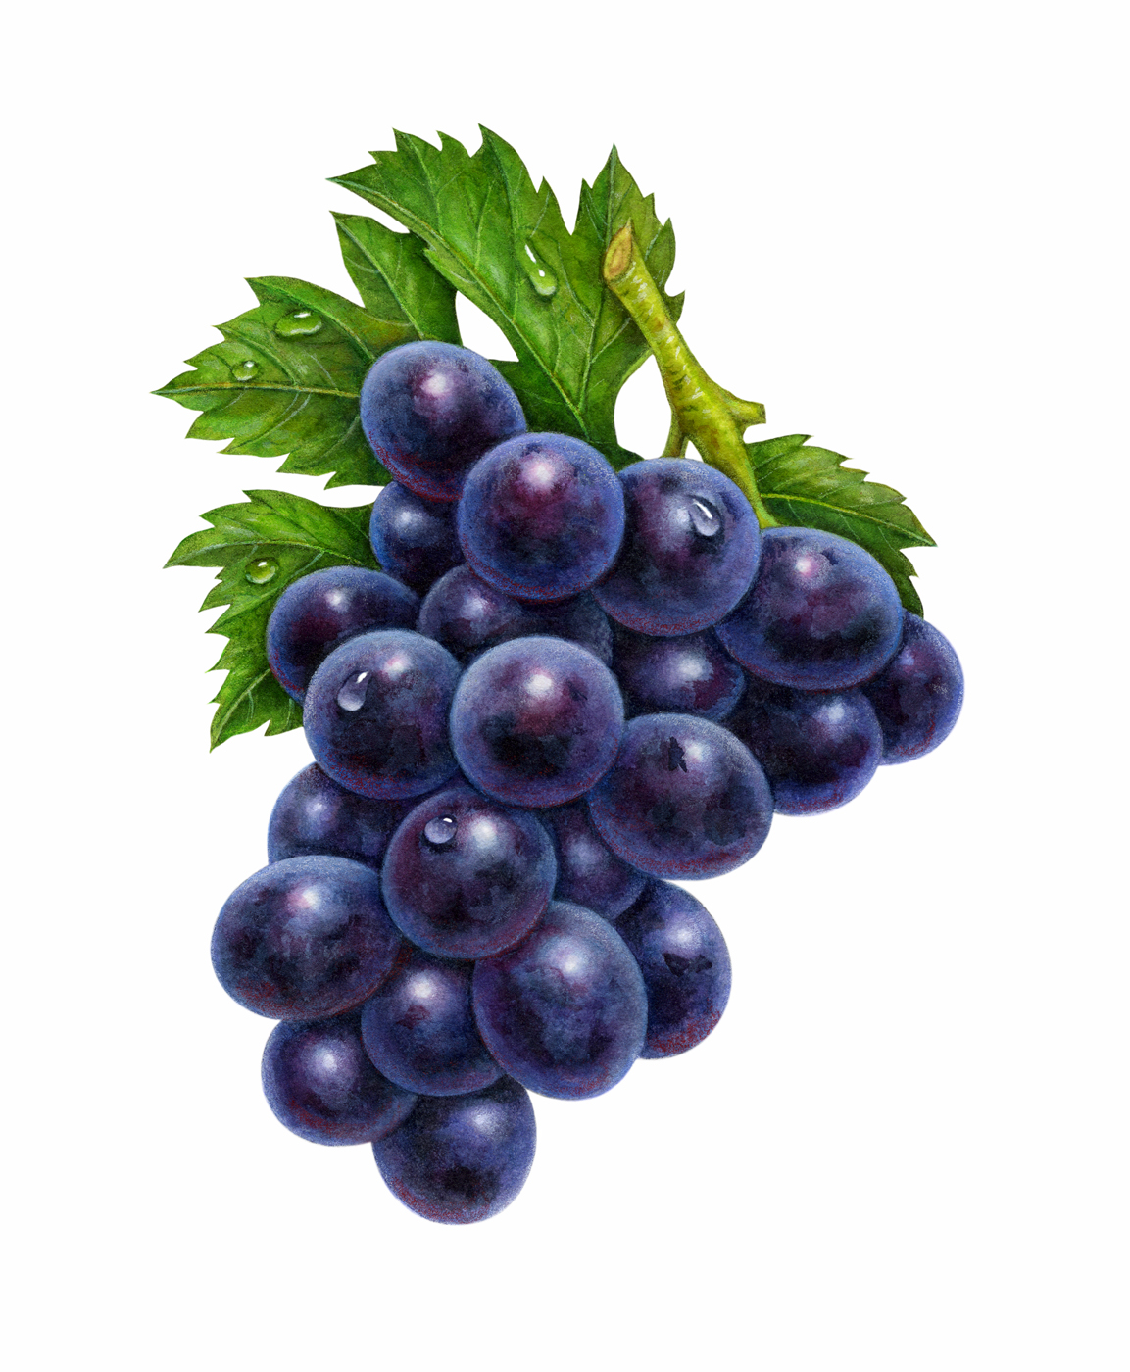
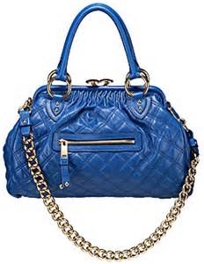
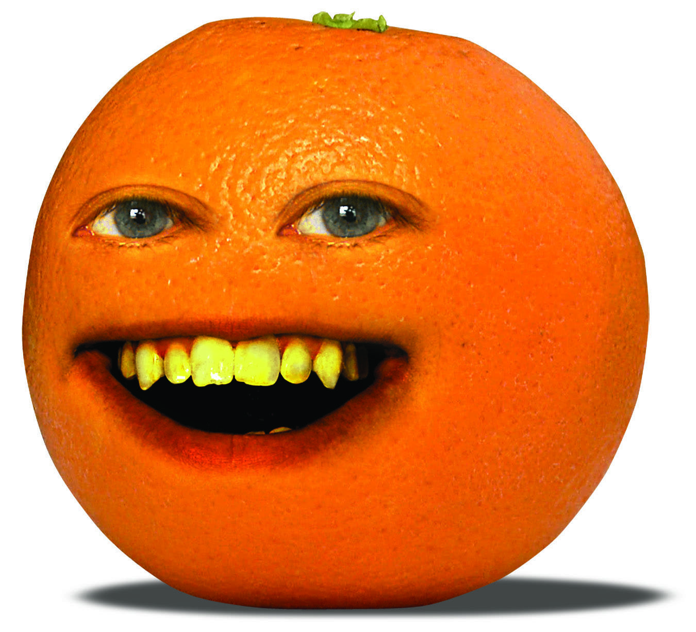
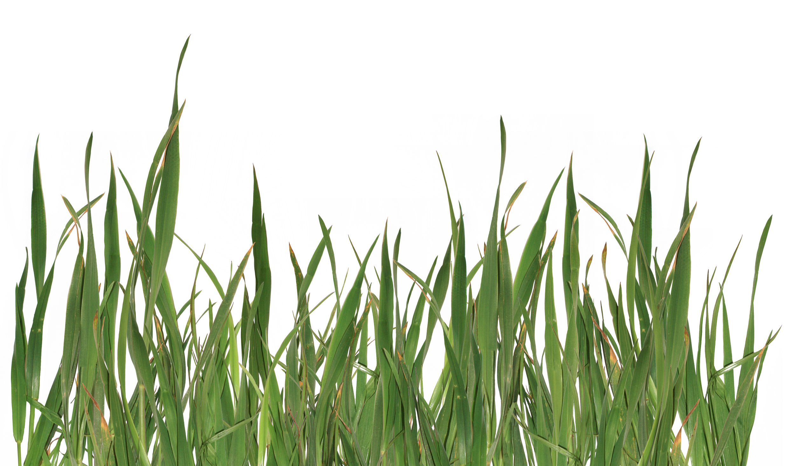
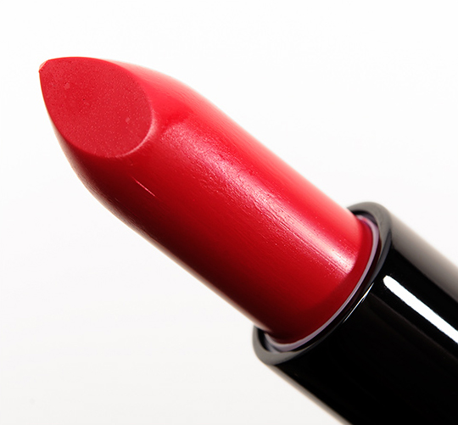
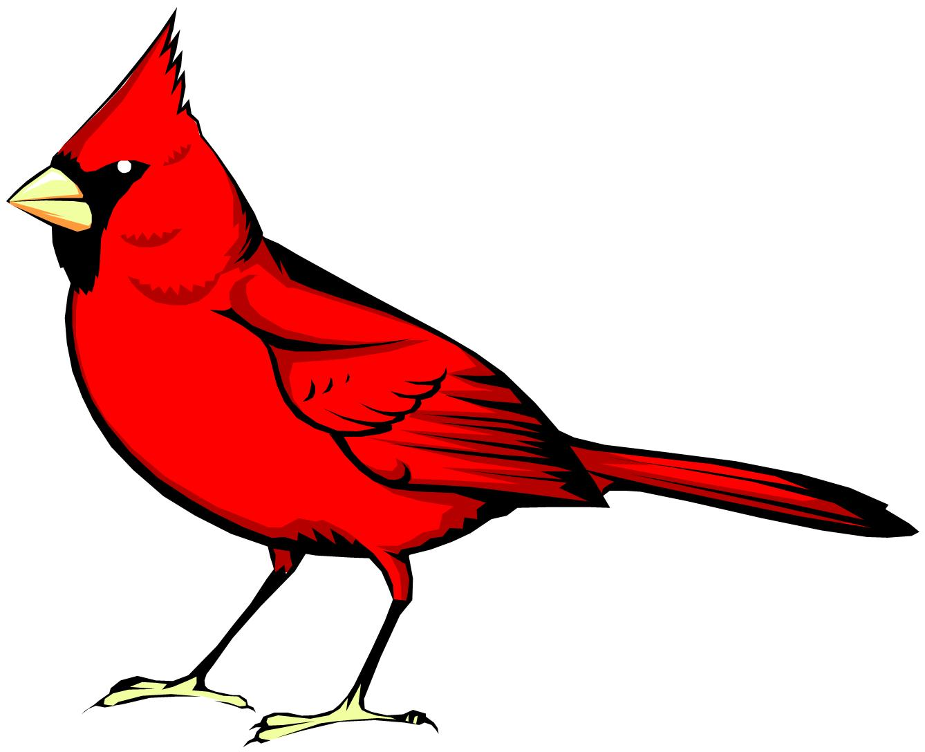
What’s the DIFFERENCE in Colors?

Slide 16
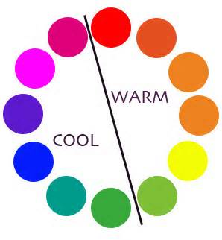
VS.

Slide 17
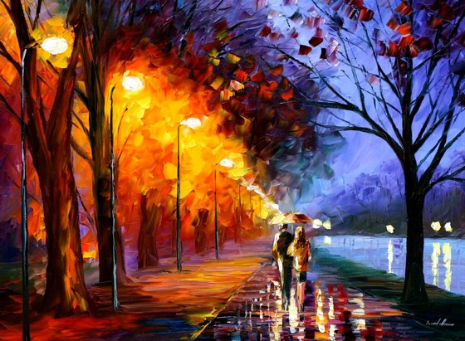
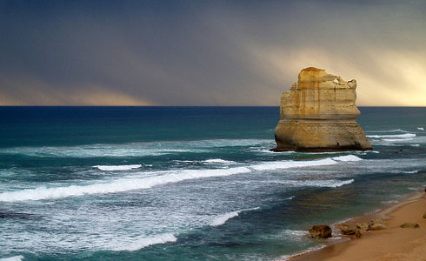
Warm Colors ADVANCE
Cool Colors RECEDE

Slide 18
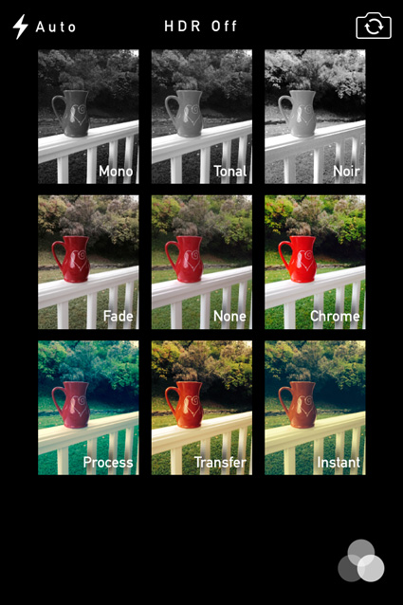
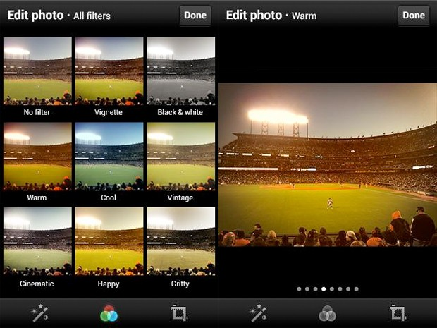
TONE
The general appearance of a color mixed with grey…
Many of you already USE this term

Slide 19
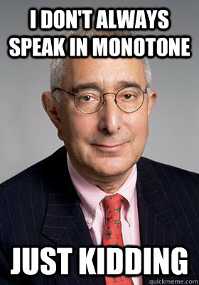
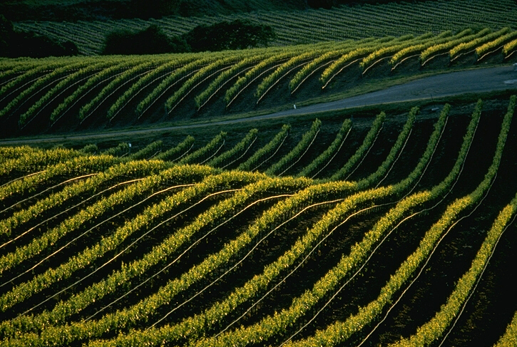
What does MONO Mean?
MONOCULTURE
MONOGRAM
MONOCLE

Slide 20
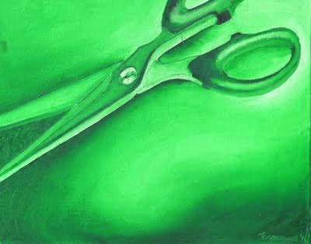
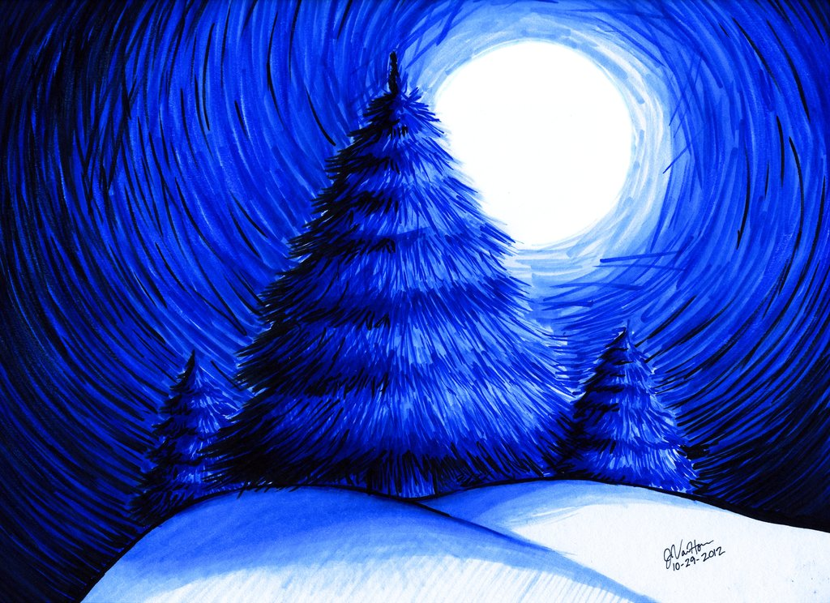
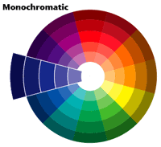
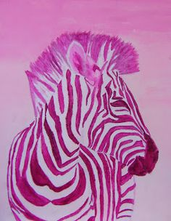
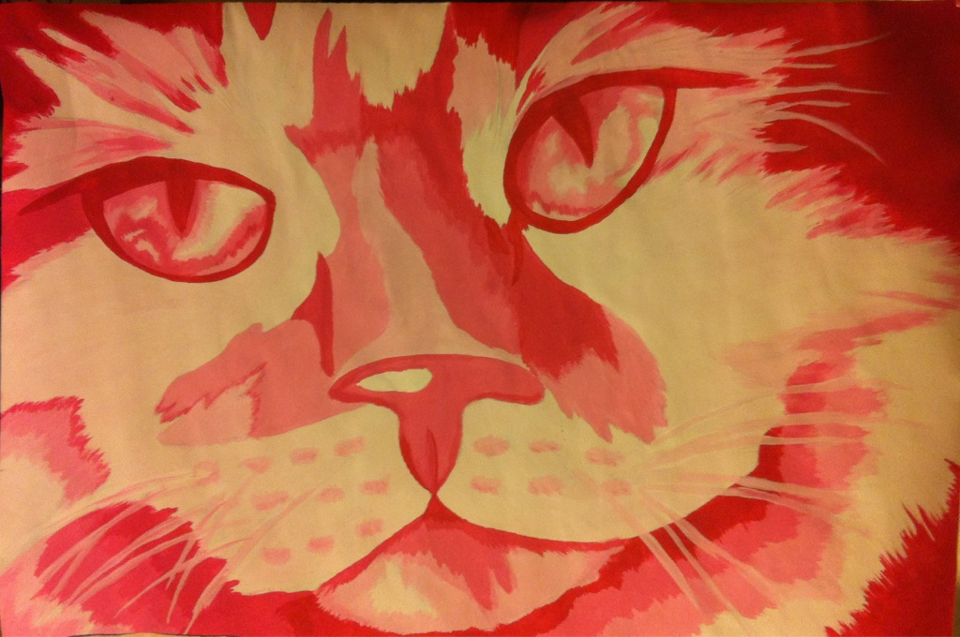
MONO-Chromatic
Containing or using only ONE COLOR

Slide 21
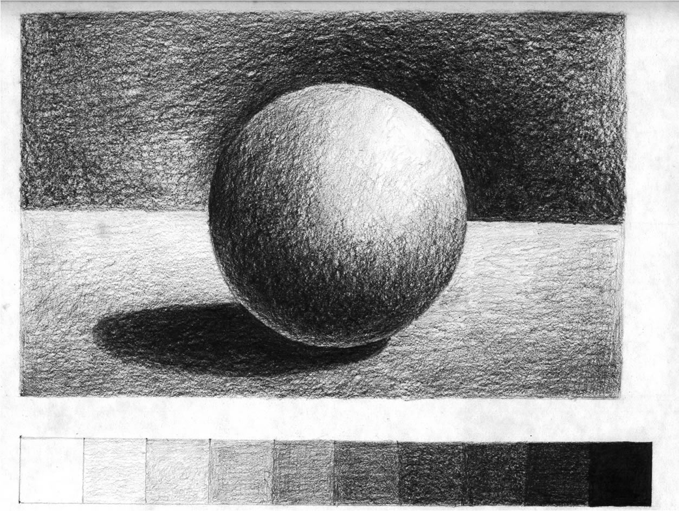
VALUE
The lightness or darkness of a color.
Add white to create a TINT; add black to create a SHADE

Slide 22
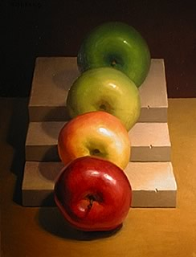
GRADATION
A gradual color change

Slide 24
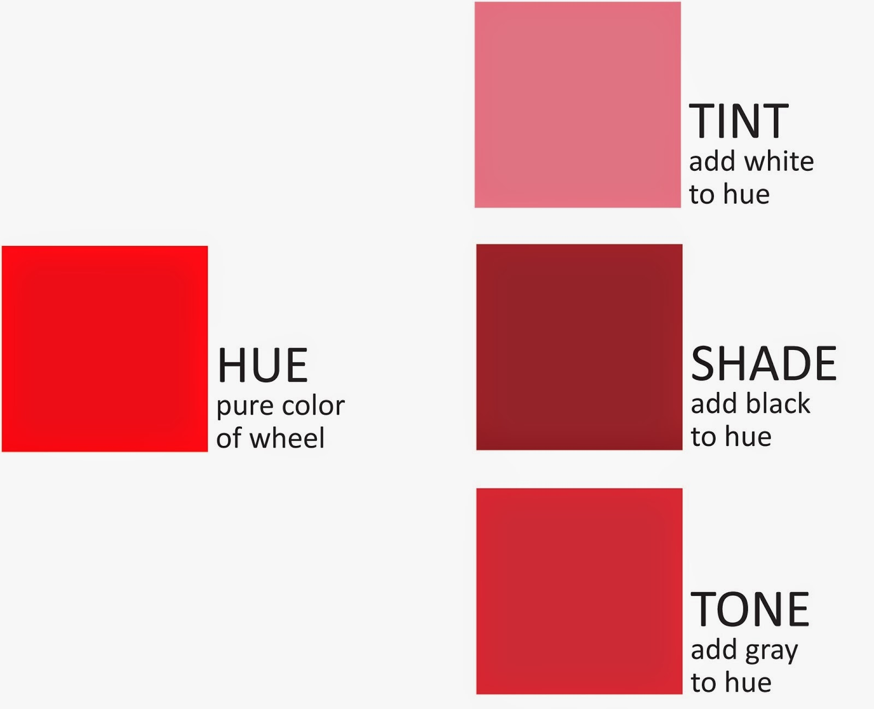
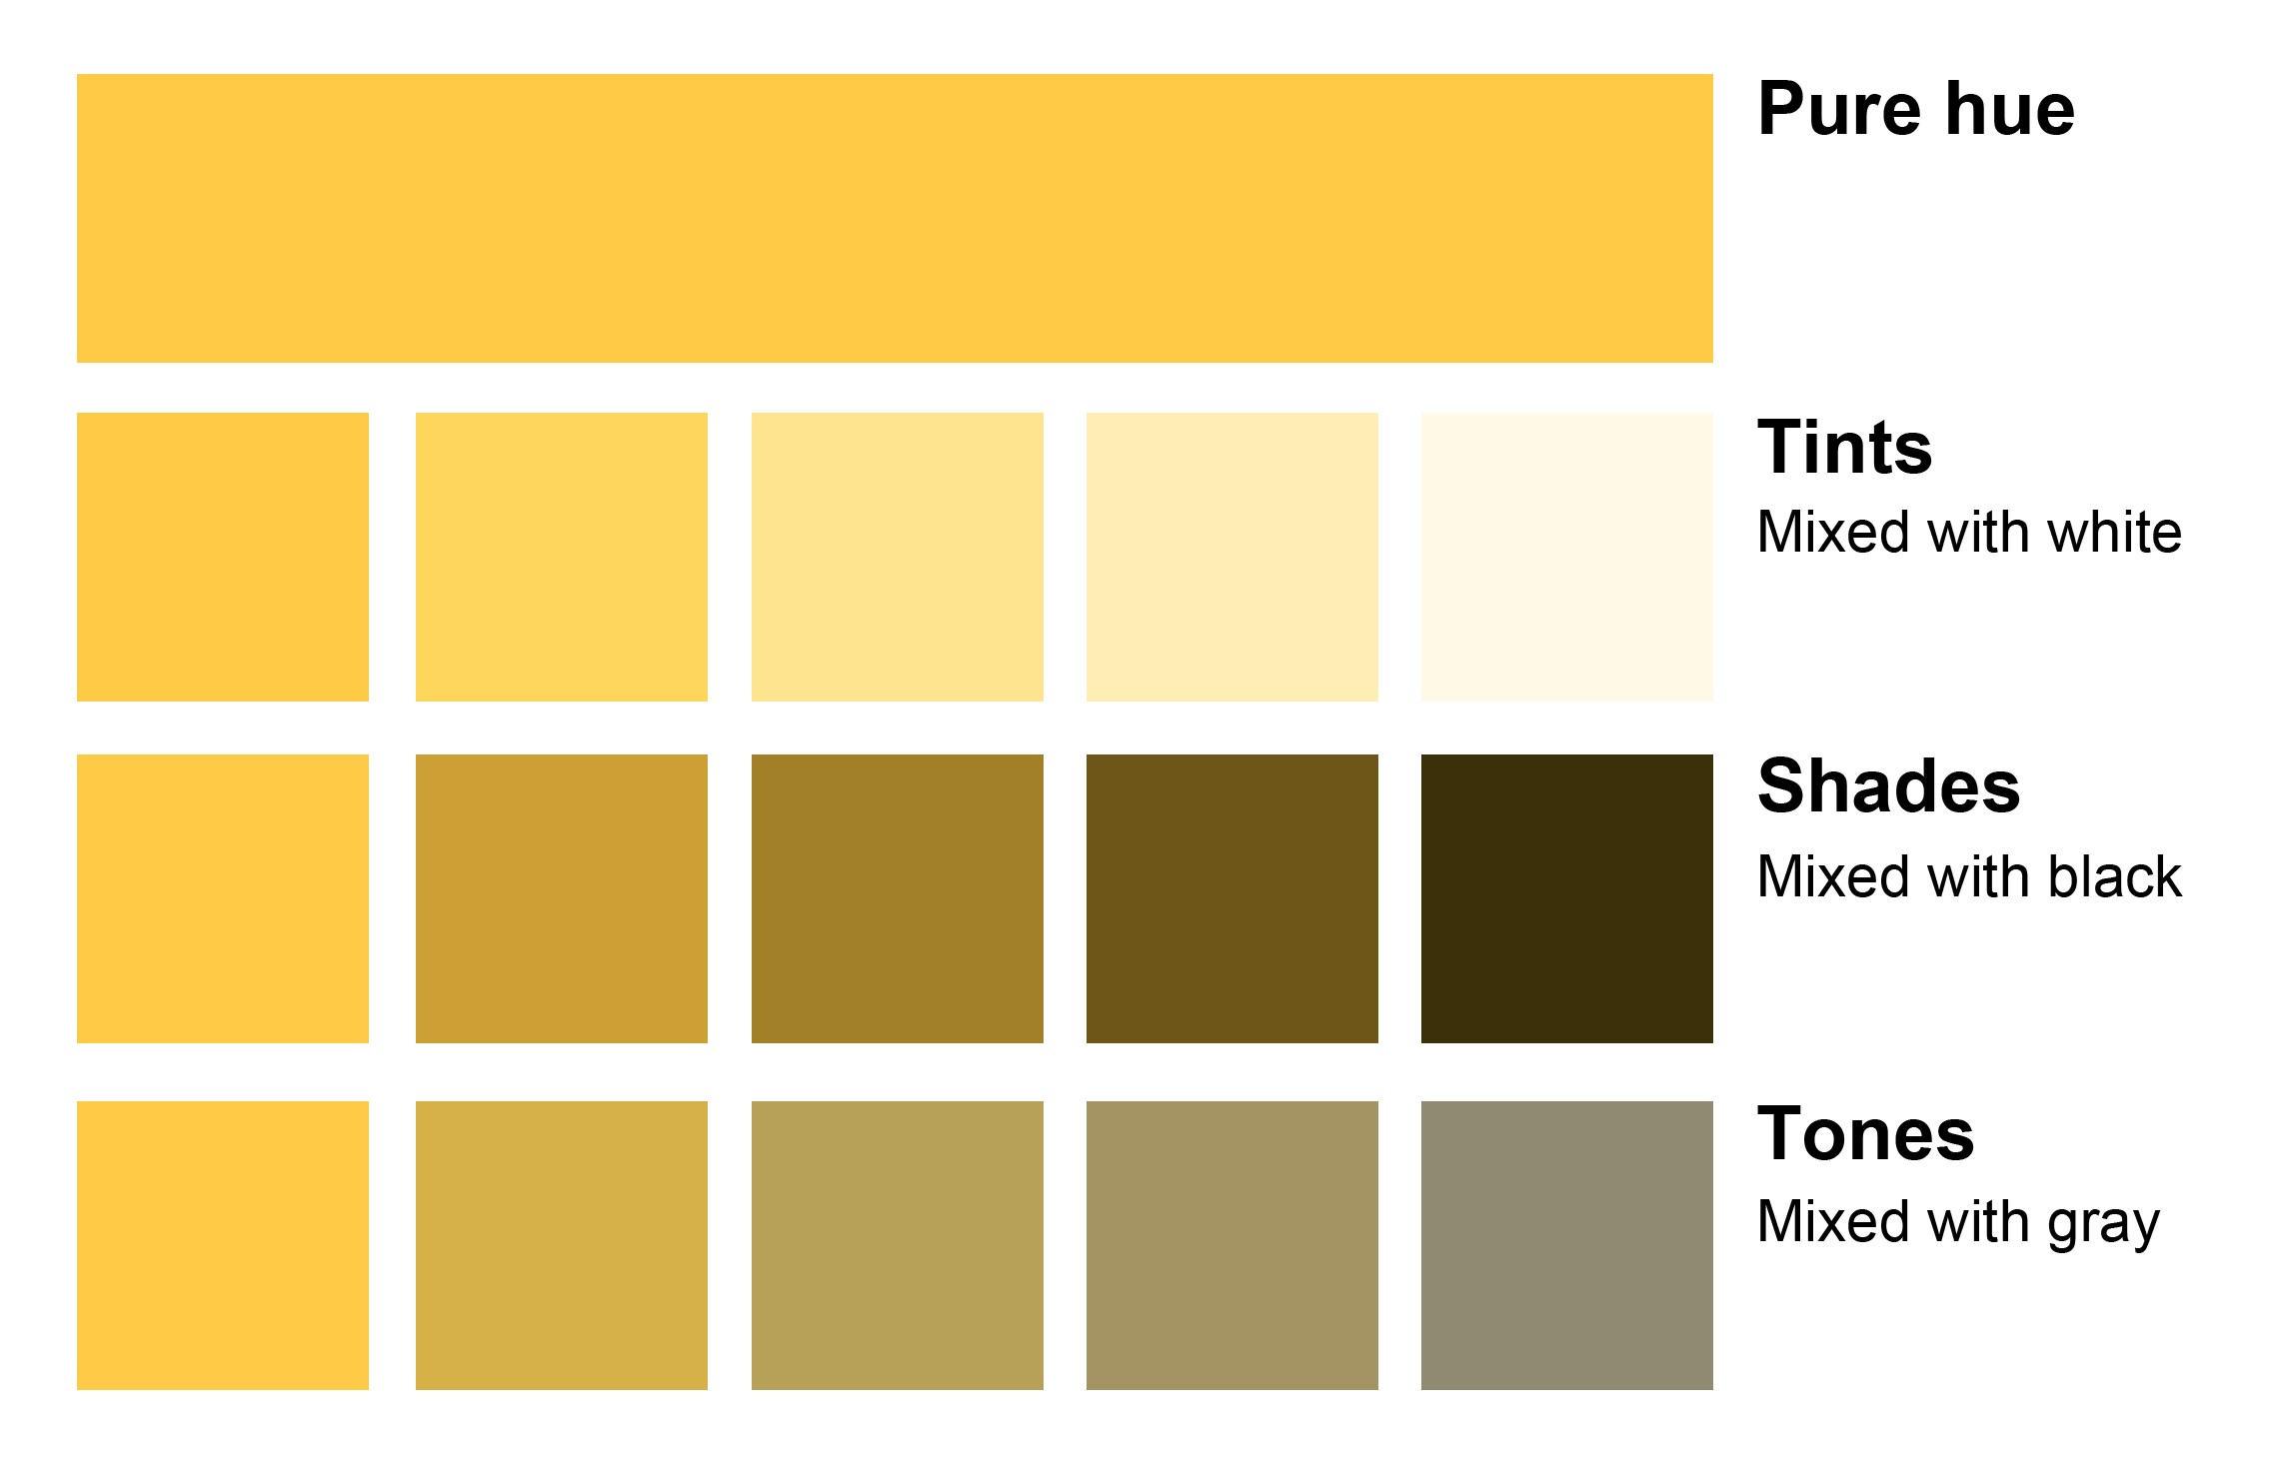
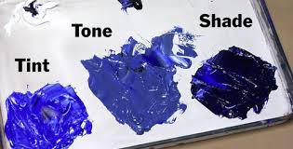
TINT = LIGHT
SHADE = DARK

Slide 25
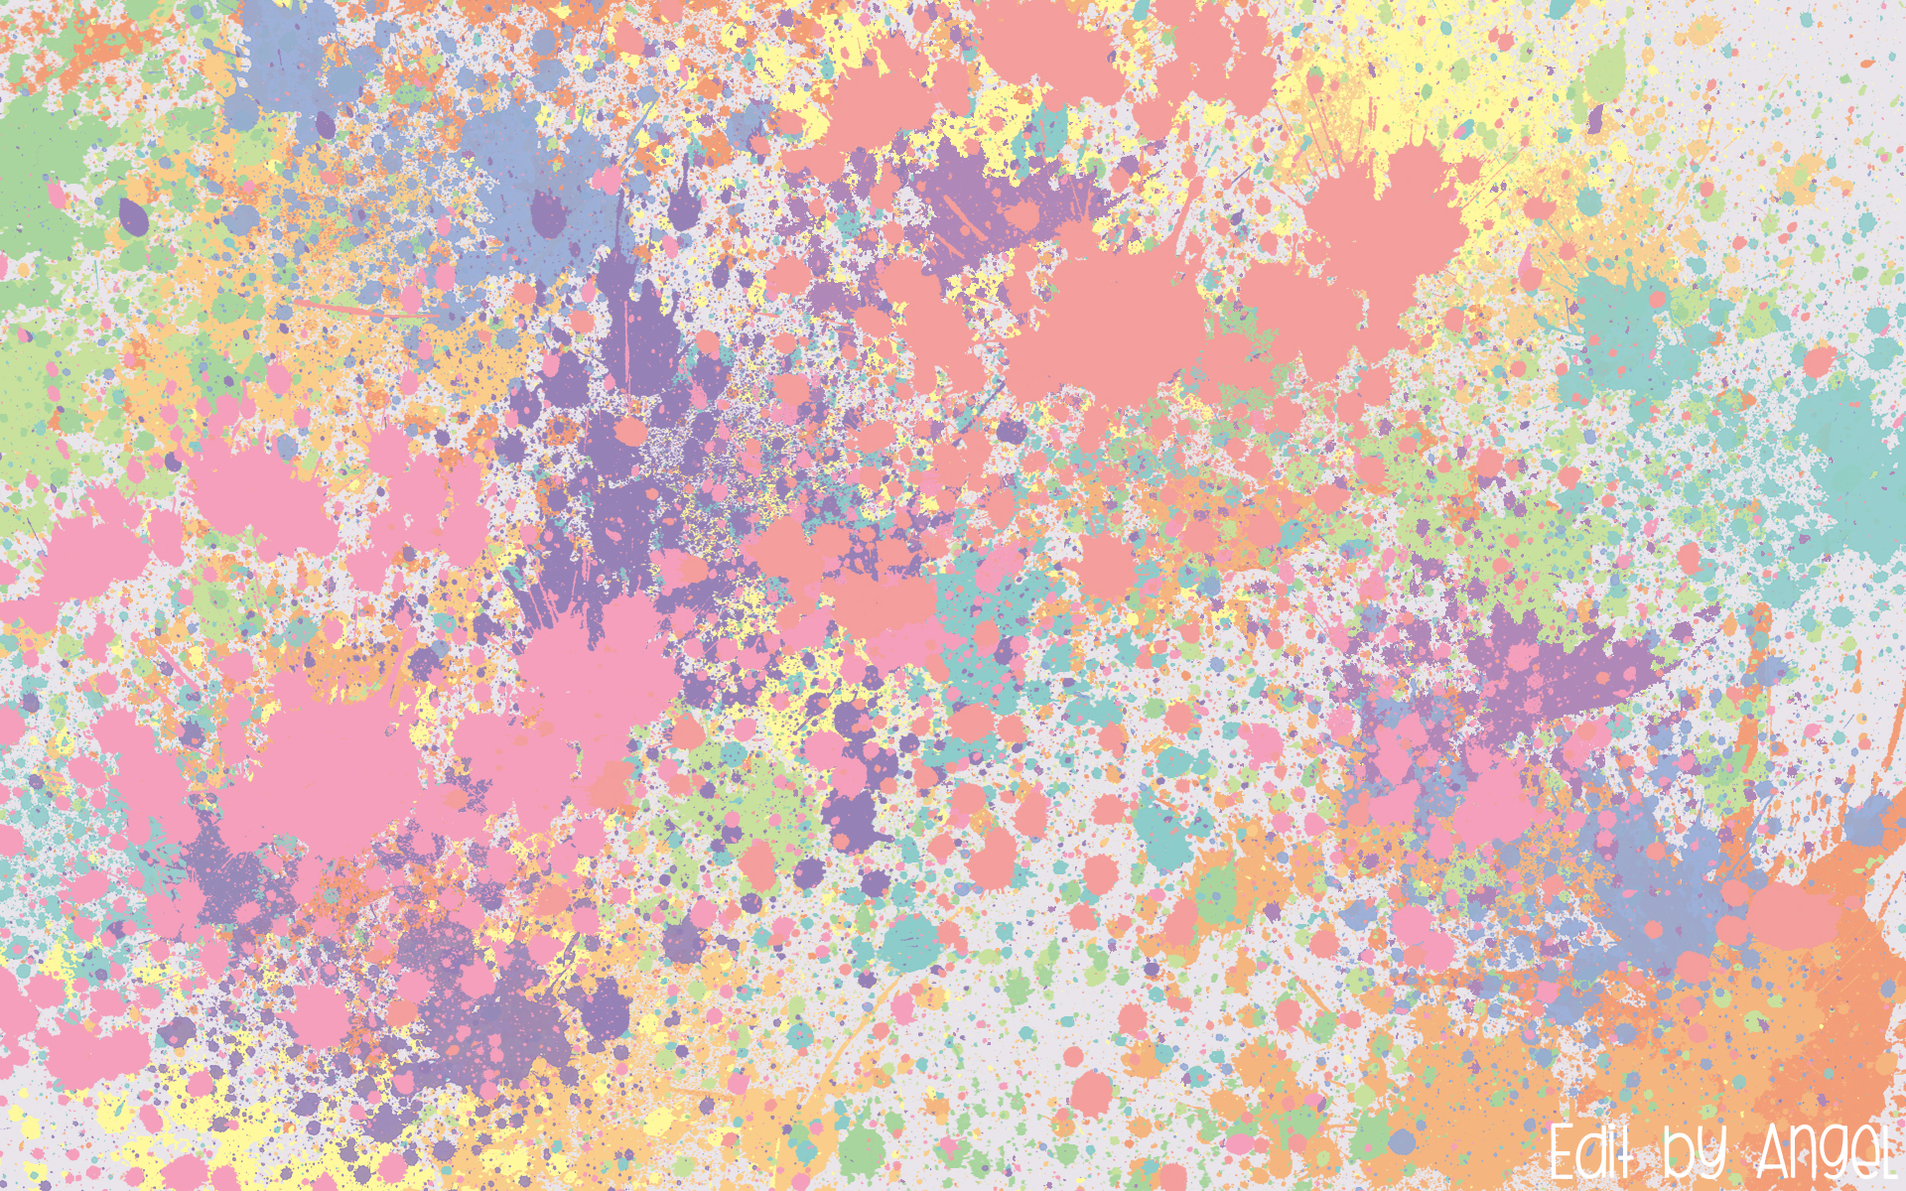
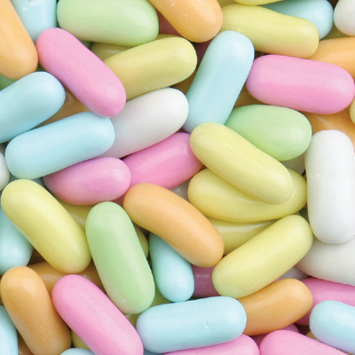
PASTEL
Another name for tinted colors: pink, pale blue, light purple…

Slide 26
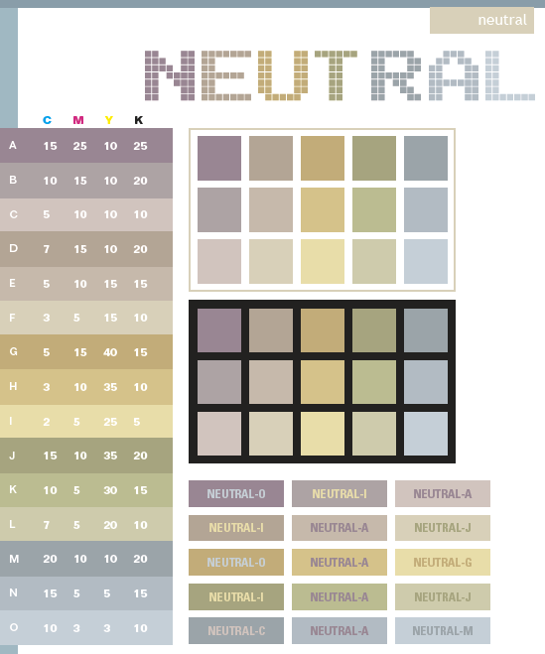
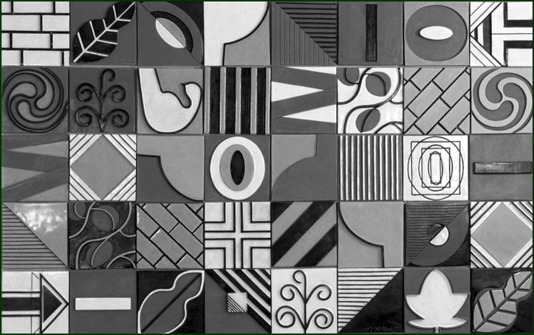
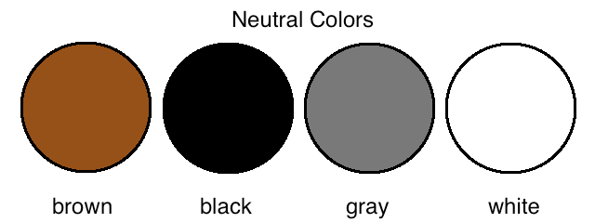
Neutral Colors

Slide 27
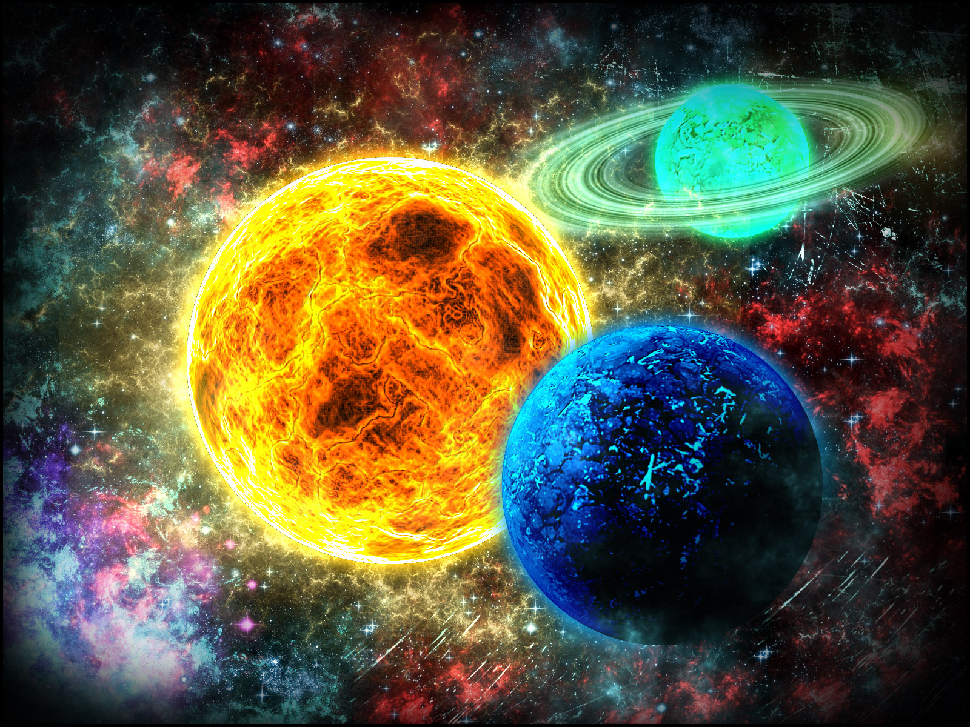
INTENSITY
The brightness or dullness of a color (increase by adding compliment)

Slide 28
Our Next Project

Slide 31
EXIT SLIP
What HUES are used in this photo?
How are those colors related on the COLOR WHEEL?
What is the overall saturation of this photo?
Any QUESTIONS on color?

