Slide 1
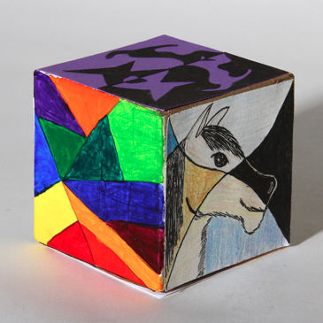
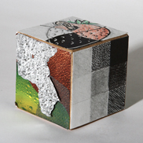
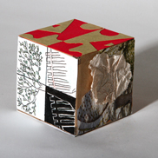
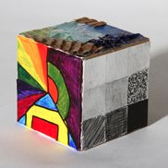
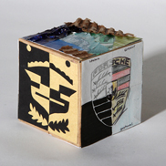
Elements of Art CUBE

Slide 2
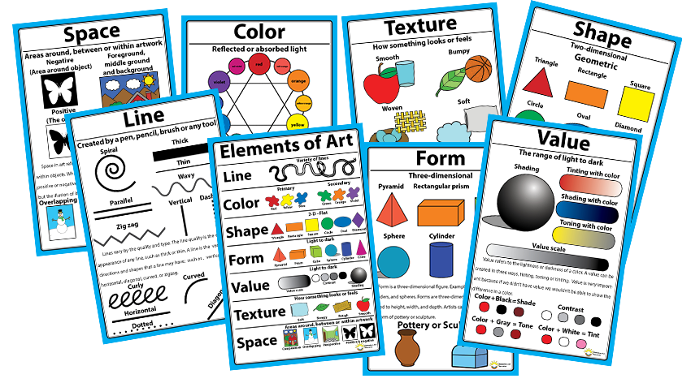
Elements of Art
The building block or techniques of art making

Slide 3
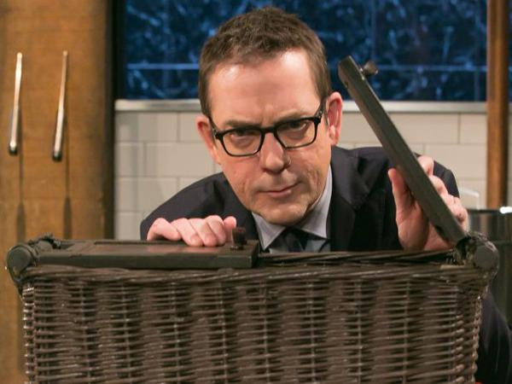
INGREDIENT: CUCUMBER
With your shoulder partner think of as many dishes as you can that use cucumber…

Slide 4
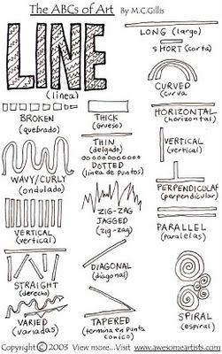
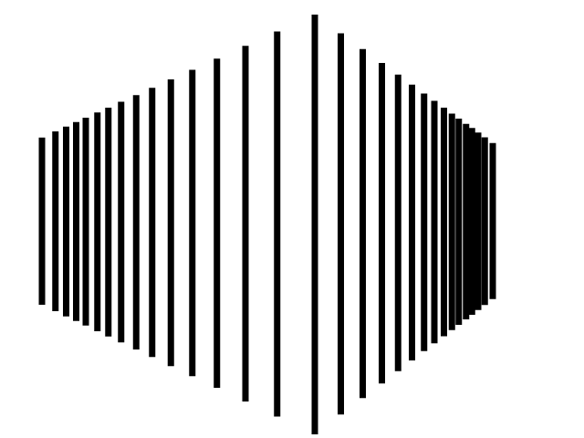
Lines an ELEMENT in Art
They are tools that artists use to create artwork. Artists pair the elements of art with the principles of art. The principles describe how the tools are used.
For example the image below demonstrates Line used with Rhythm/Repetition or Space.

Slide 5
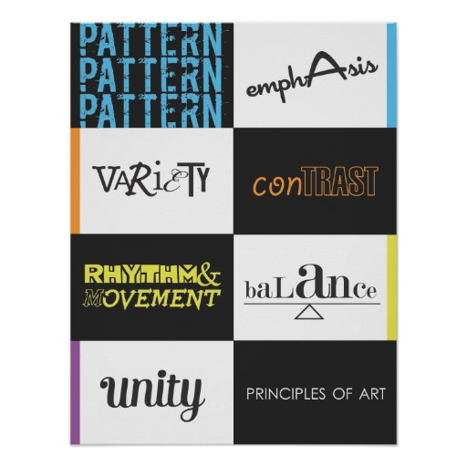
Principles of Art
The arrangement of the visual building blocks

Slide 6
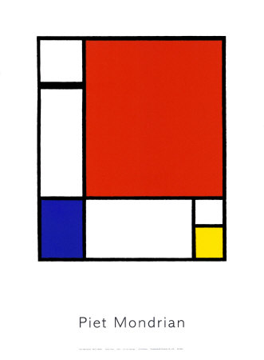
USE OF LINE
In your best estimation what PRINCIPLE of art does Piet Mondrian pair with the ELEMENT of line. What visual evidence do you have to back this up?

Slide 7
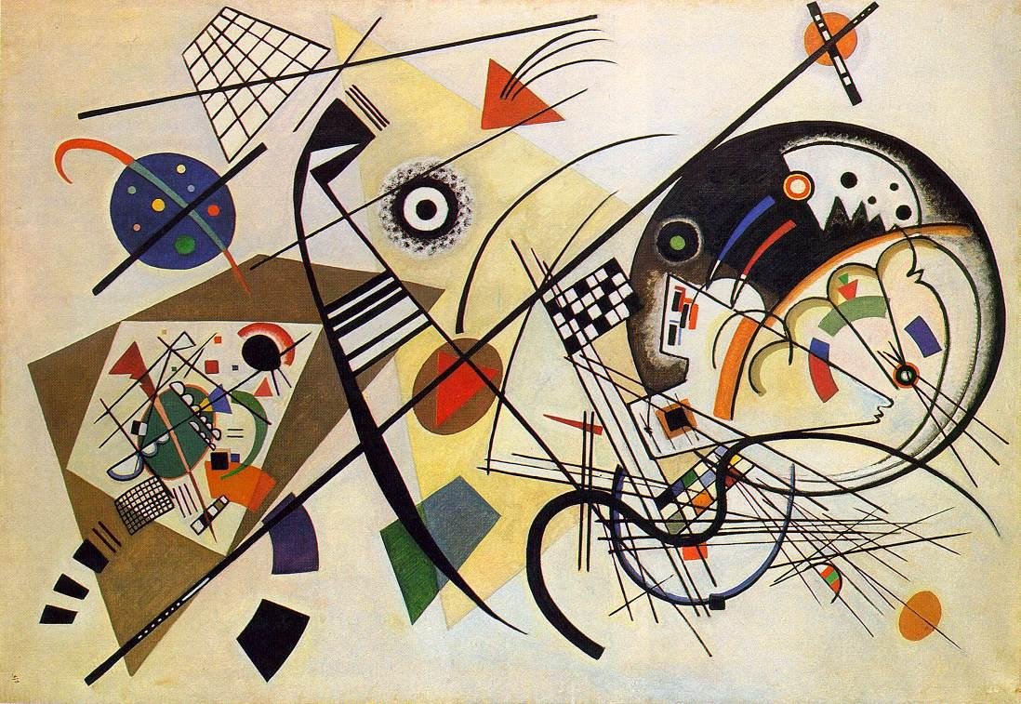
USE OF LINE
In your best estimation what PRINCIPLE of art does Wassily Kandinsky pair with the ELEMENT of line. What visual evidence do you have to back this up?

Slide 8
USE OF LINE
In your best estimation what PRINCIPLE of art does Bridget Riley pair with the ELEMENT of line. What visual evidence do you have to back this up?

Slide 9
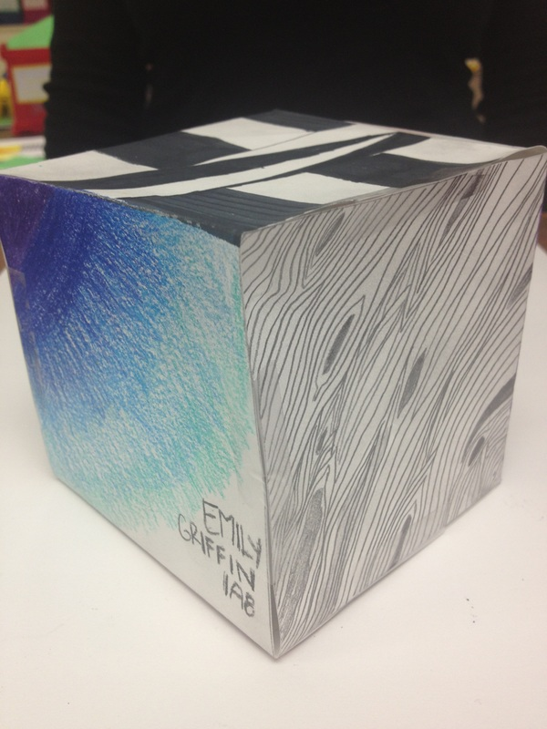
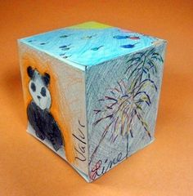
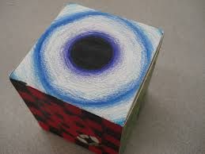
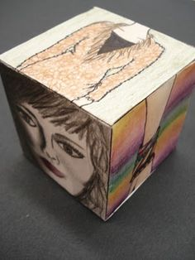
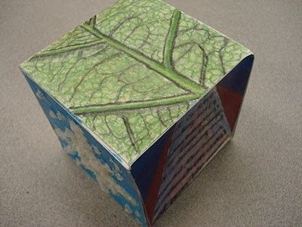
EXAMPLES

Slide 10
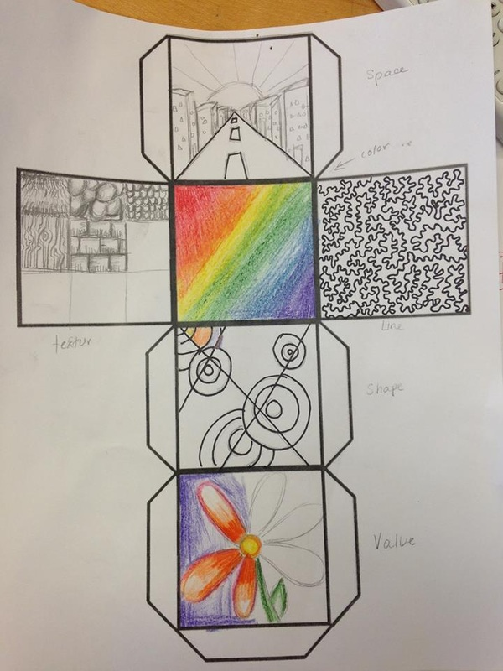
PRACTICE
We will fill out one side of the cube at a time after finishing each related lesson
You have a worksheet which should be used to brainstorm ideas as well as plan placement and media. The worksheet will be collected for a test grade.
Please begin work on the Elements of Art Cube WS.

