Slide 1
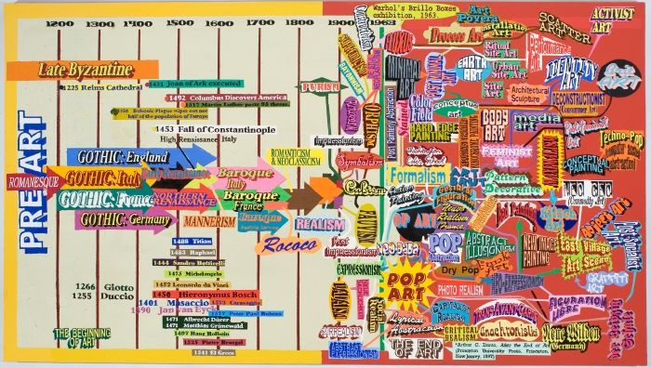
MOVEMENTS IN ART
Also known as the “ISMS”

Slide 2
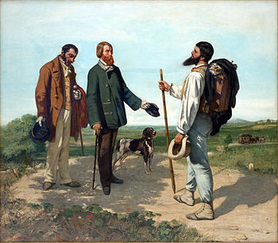
In your journal… Critique the Painting
Gustave Courbet,
Bonjour Monsieur Courbet,
1854

Slide 3
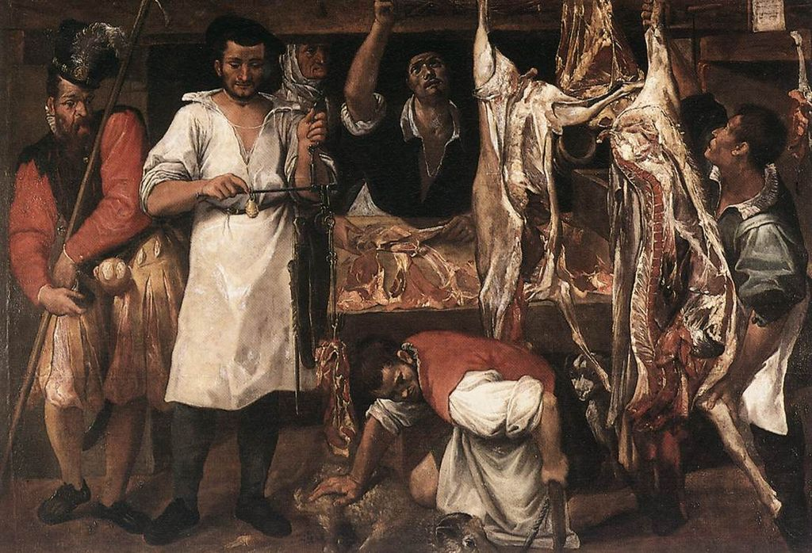
Annibale Carracci, The Butcher’s Shop, early 1580s

Slide 4
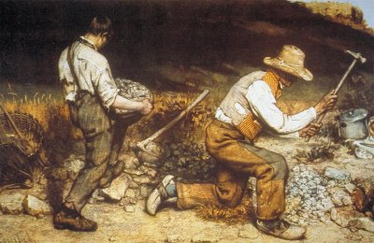
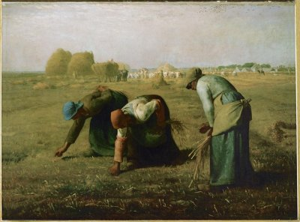
Any Similarities?
Think about the elements:
Line, Shape, Color, Texture, etc.
Gustave Courbet, Stonebreakers, 1849
Jean Francois Millet, The Gleaners, 1857

Slide 5
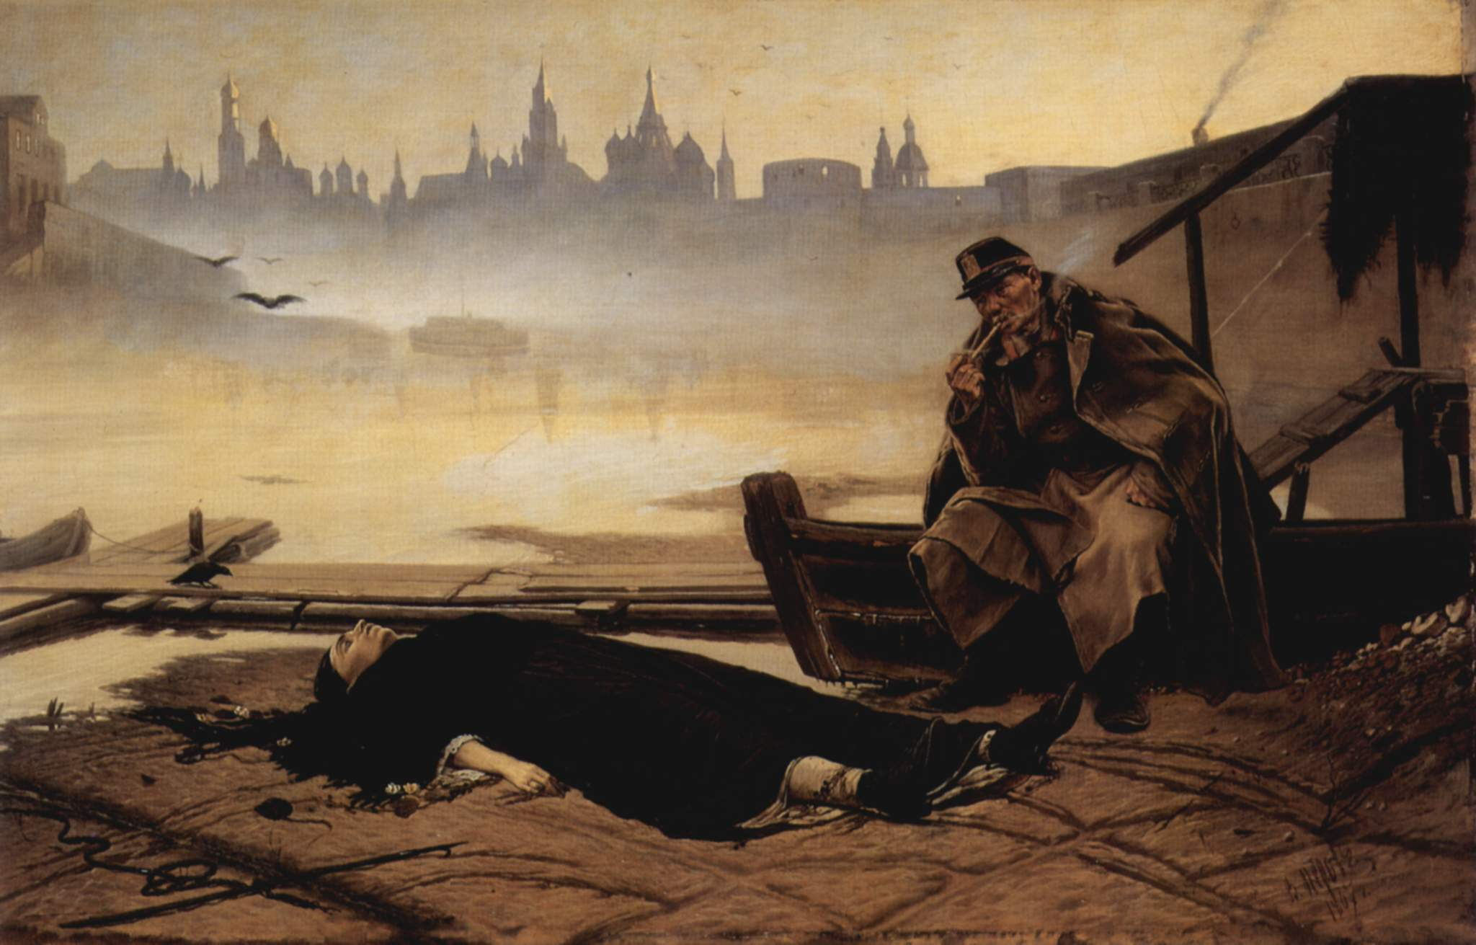
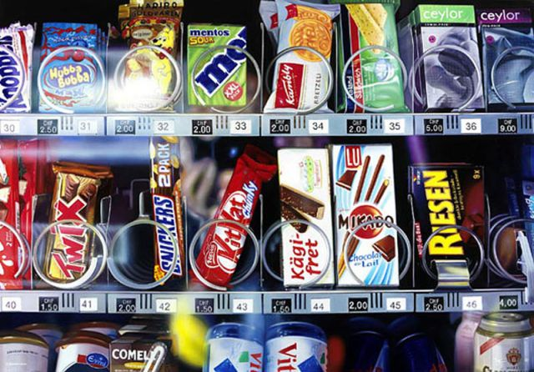
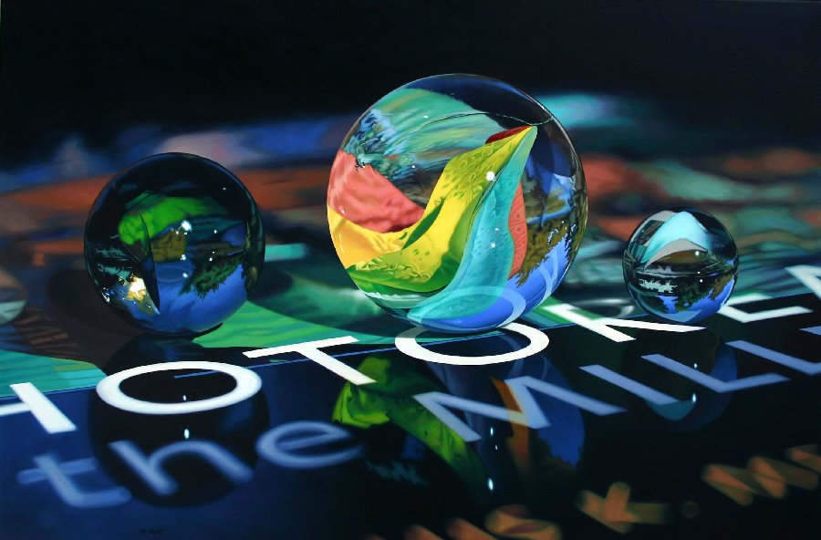
REALISM
The attempt to depict a subject realistically /truthfully
Photo - REALISM

Slide 6
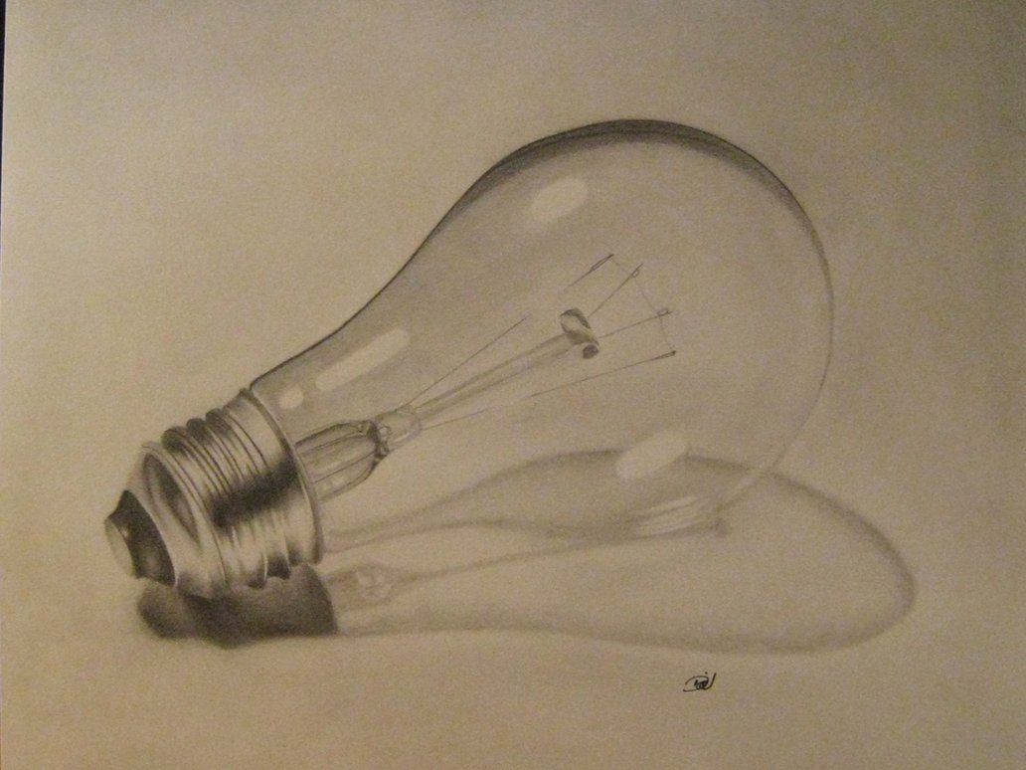
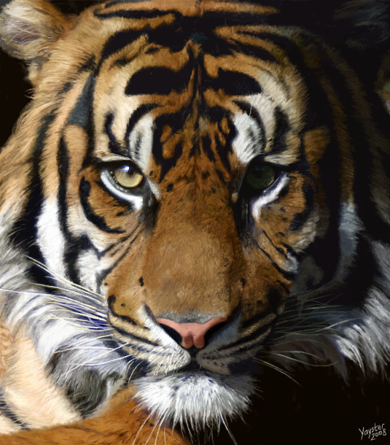
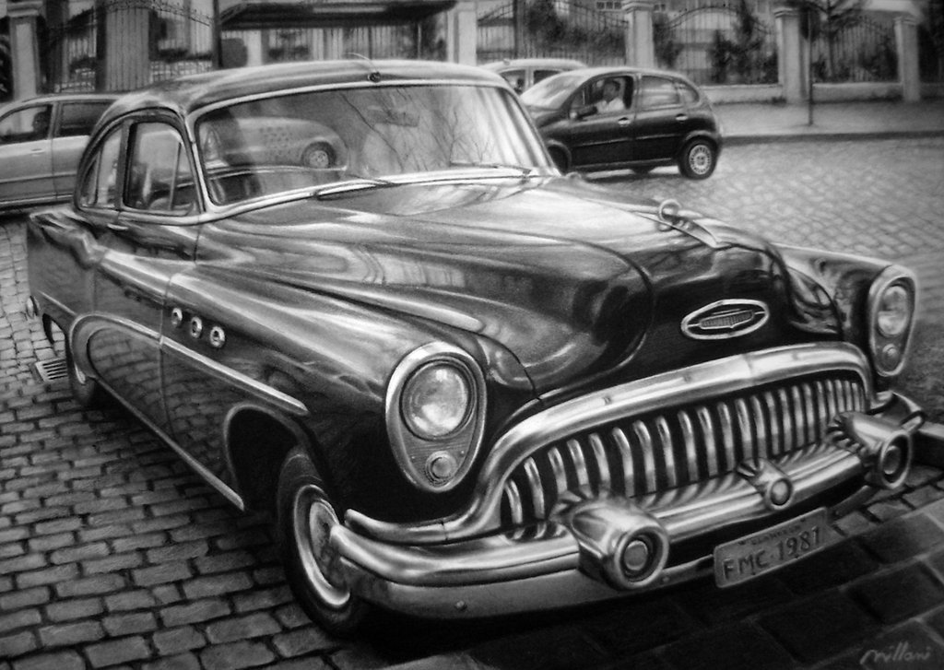
Examples of how it can be applied

Slide 7
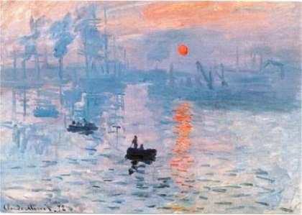
In your journal… Critique the Painting
Claude Monet, Impression Sunrise, 1874

Slide 8
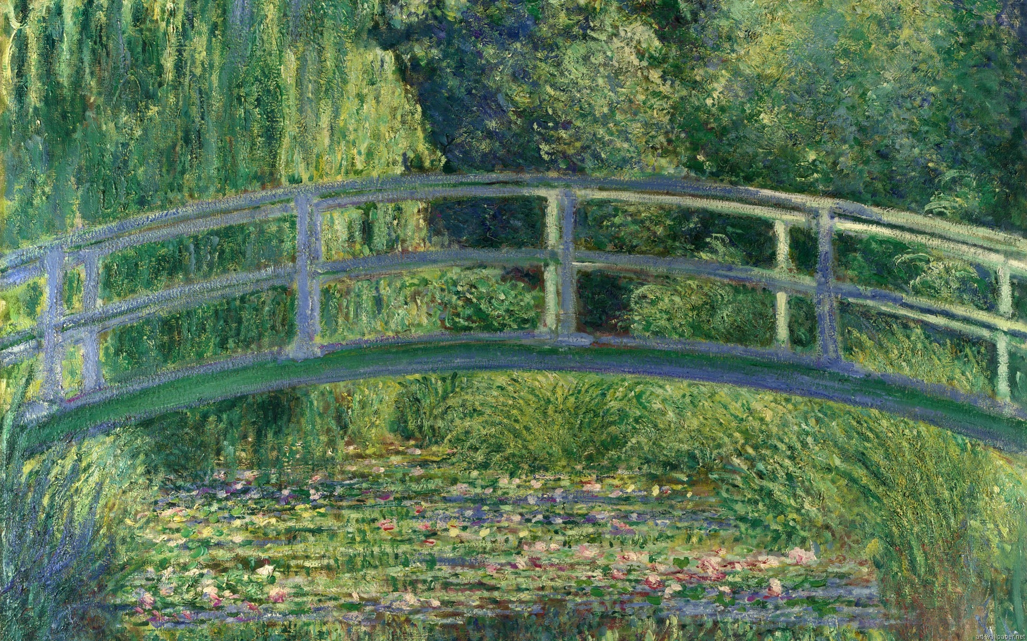
Claude Monet, The Water Lily Pond, 1899

Slide 9
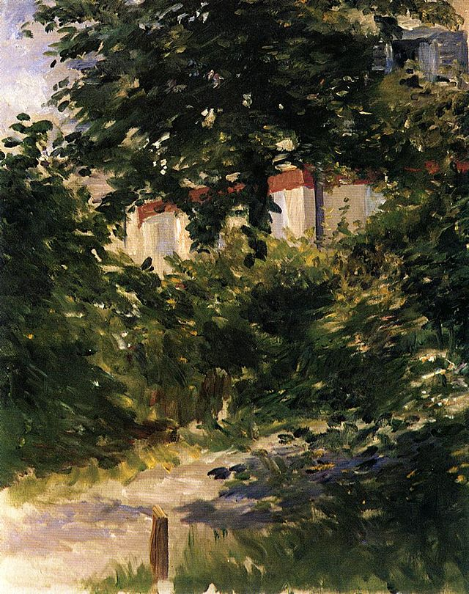
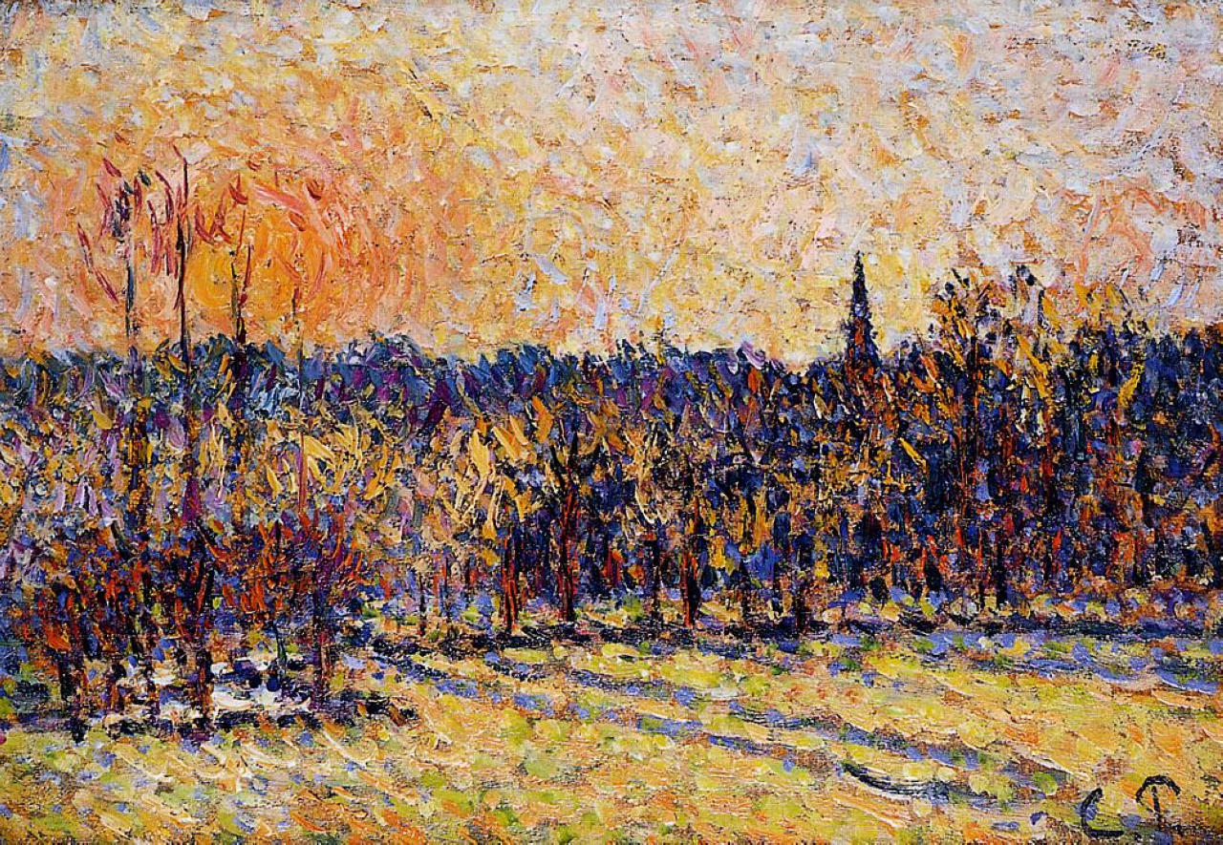
Any Similarities?
Think about the elements:
Line, Shape, Color, Texture, etc.
Eduard Manet, Garden Path in Rueil, 1882
Camille Pissarro, Sunset Brazincourt Steeple, 1890

Slide 10
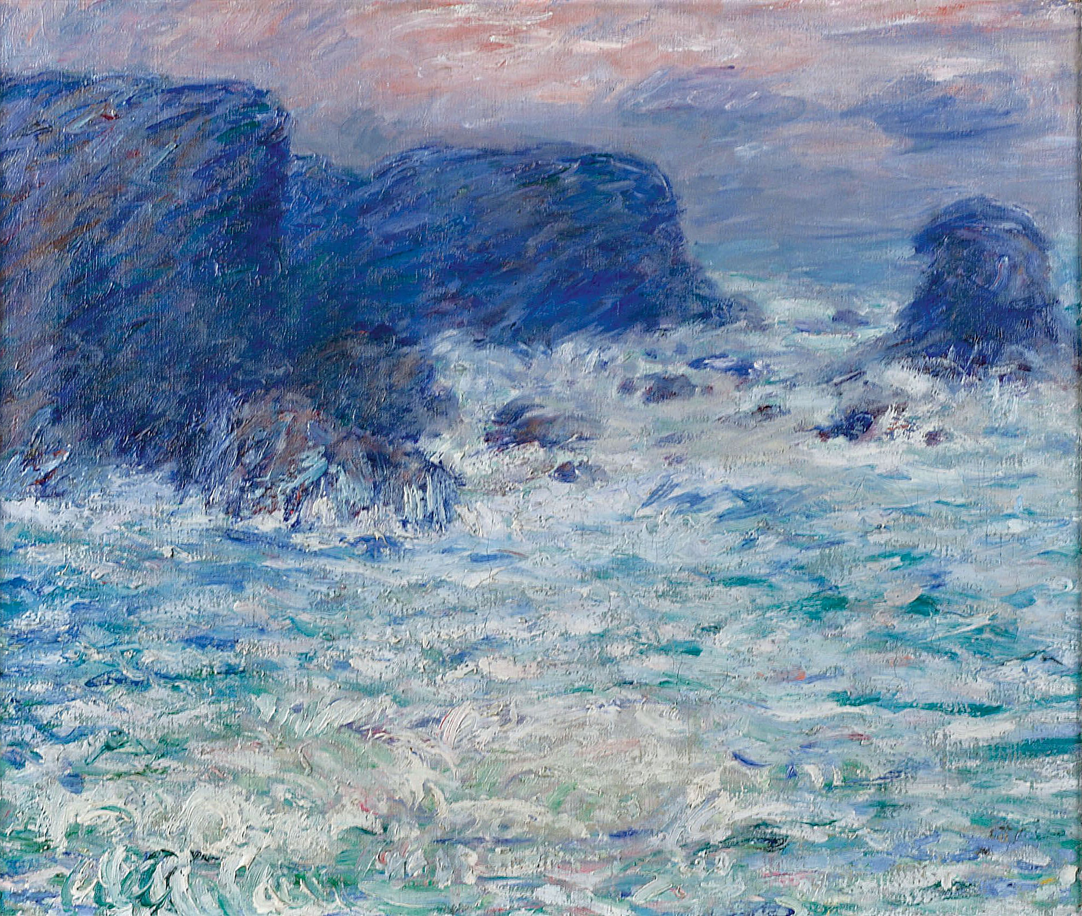
Impressionism
Rebelling against the “Academy”
Did not appreciate realism
Large/Loose brush strokes
Color mixing on canvas not pallet
Capture of light & movement
Want to depict a moment in time
Everyday scenes vs. Idealized

Slide 11
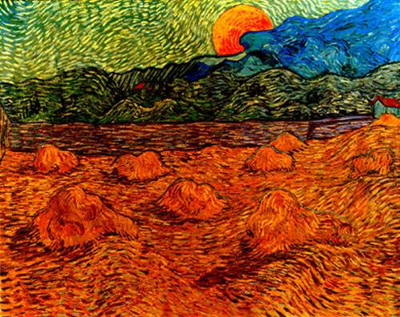
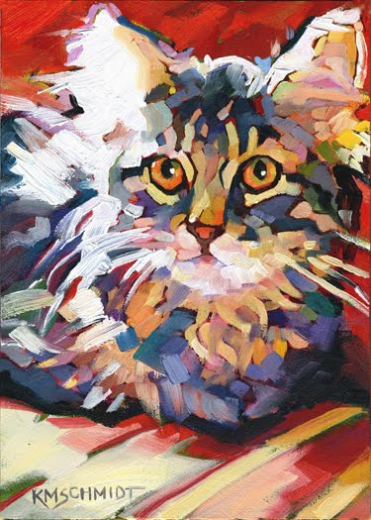
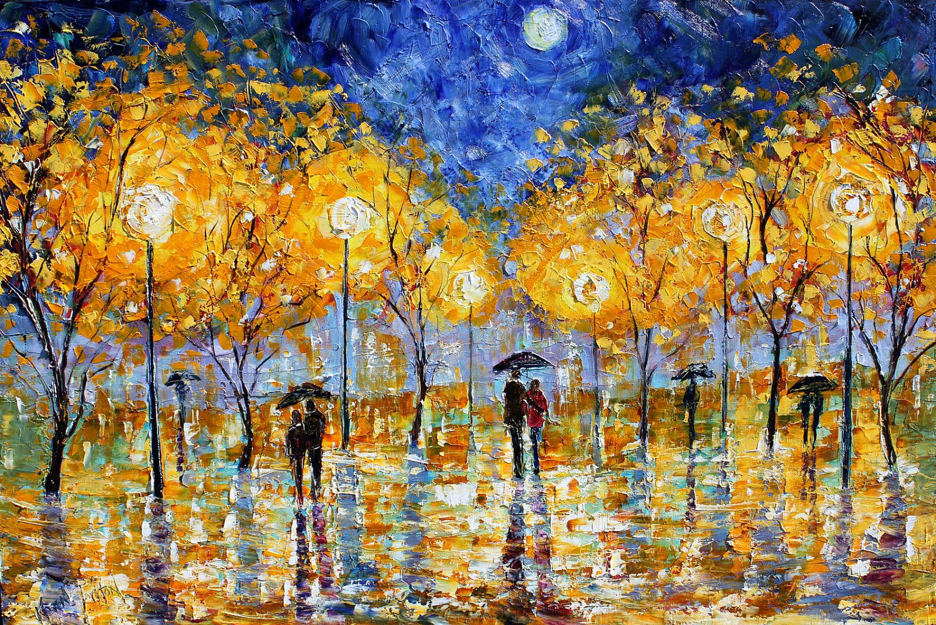
Examples of how it can be applied

Slide 12
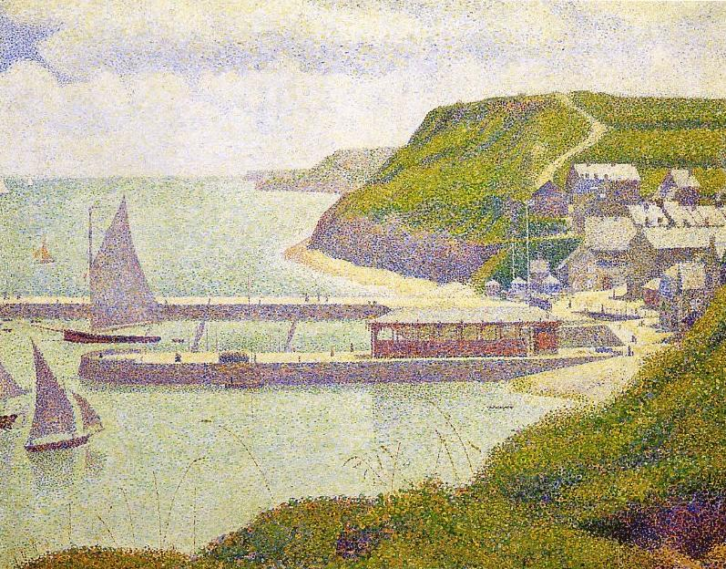
In your journal… Critique the Painting
Georges Seurat, Port en Bessin, 1888

Slide 13
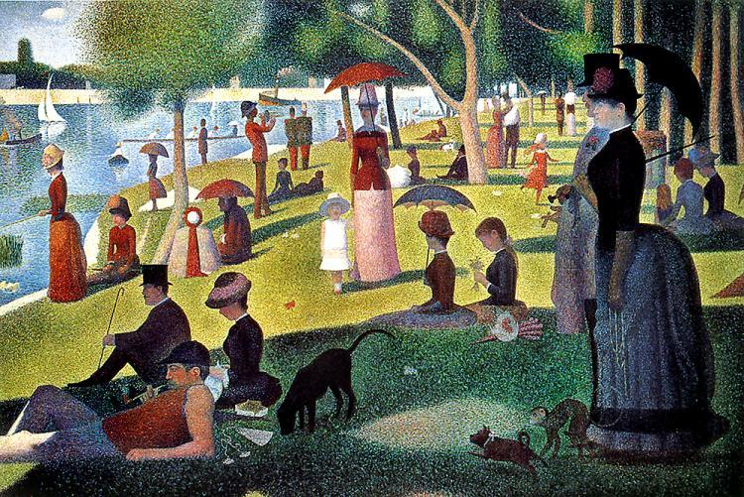
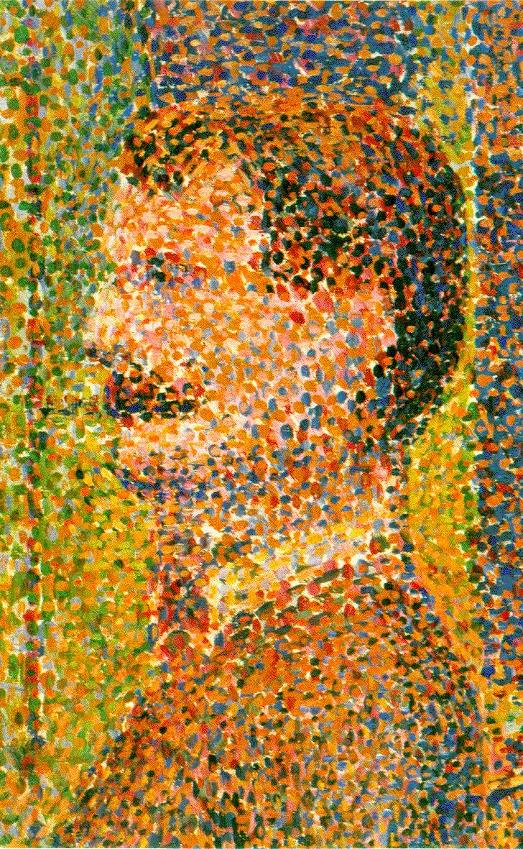
George Seurat, Sunday in the Park on La Grand Jette, 1884-6

Slide 14
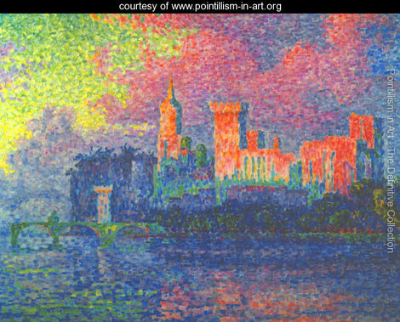
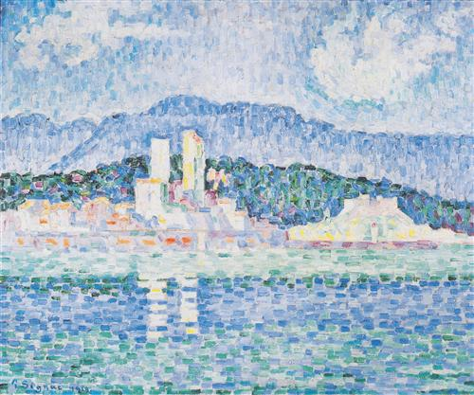
Any Similarities?
Think about the elements:
Line, Shape, Color, Texture, etc.
Paul Signac, The Papal Palace Avignon, 1900
Paul Signac, Antibes Thunderstorms, 1919

Slide 15
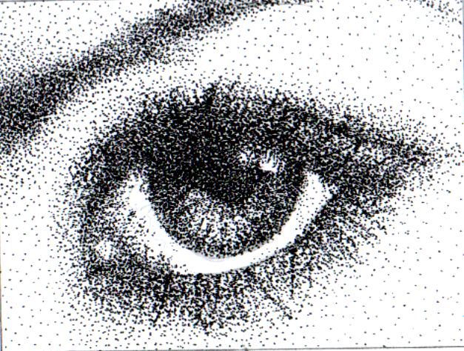
Pointillism
Truly concerned with color theory: the thought is that small dots of pure color when viewed from a distance become combined/altered automatically by the eye. It is not spontaneous like impressionism but measured and technical.
Making of a Hero
Sometimes people consider stippling in B & W a version of pointillism technically

Slide 16
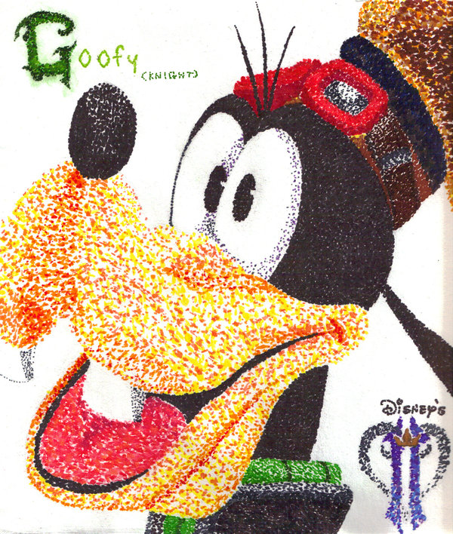
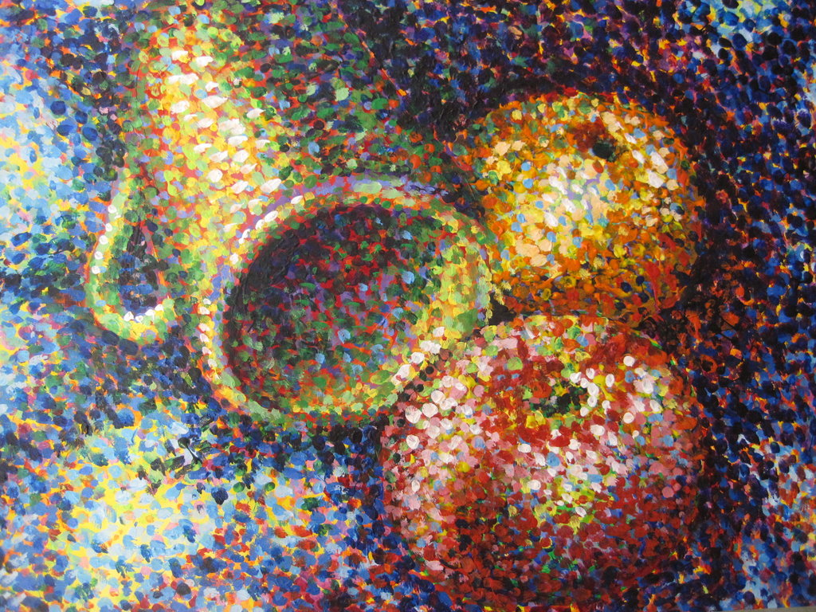
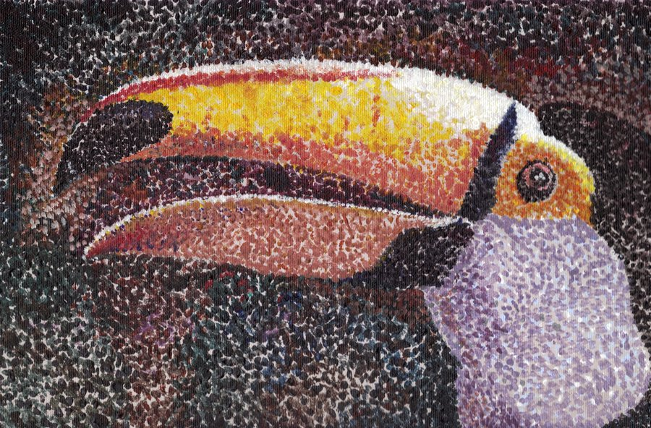
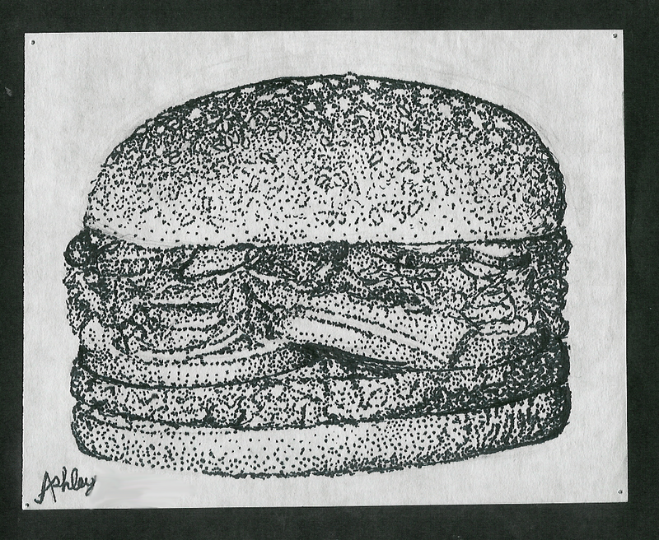
Examples of how it can be applied

Slide 17
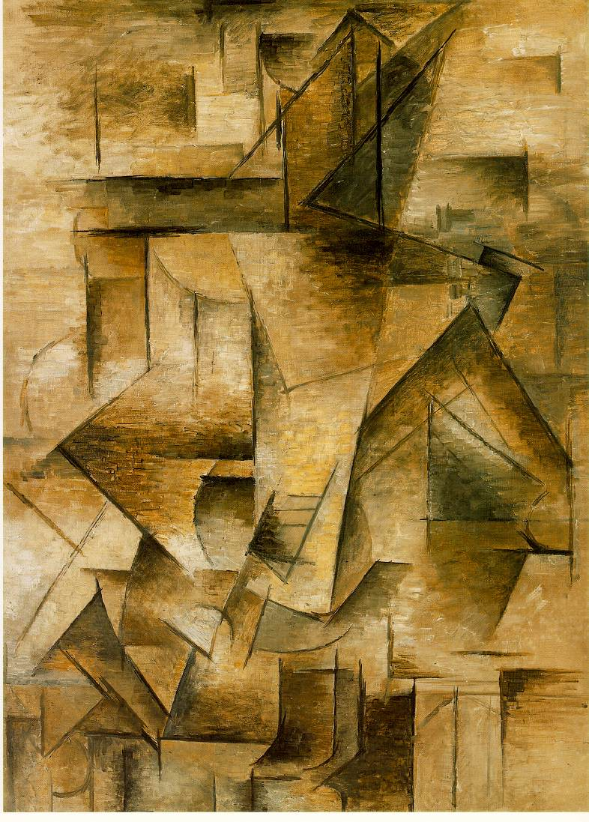
In your journal… Critique the Painting
Pablo Picasso, The Guitar Player, 1910

Slide 18
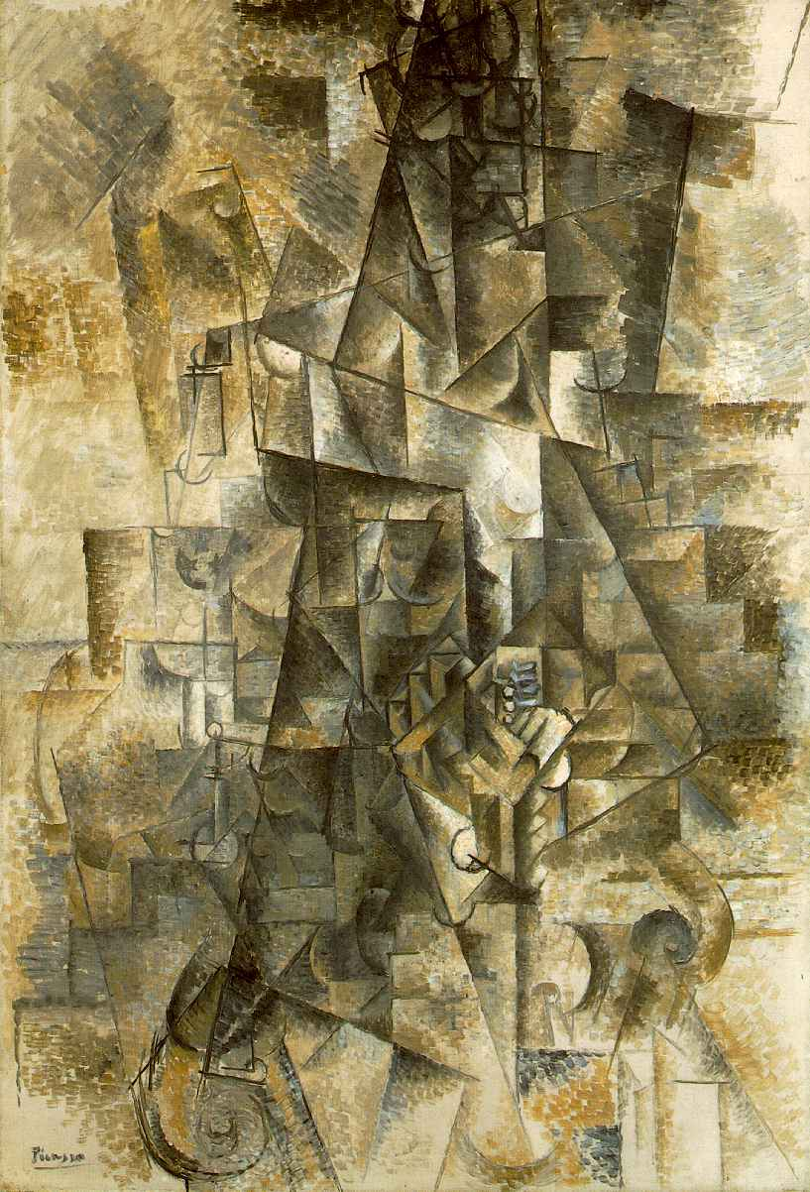
Pablo Picasso, The Accordionist, 1911

Slide 19
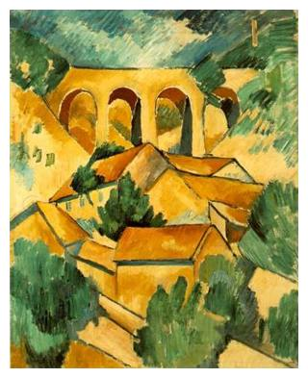
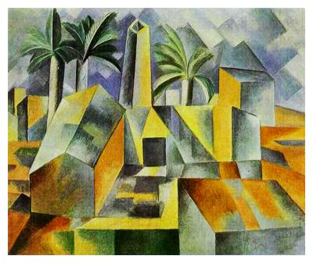
Any Similarities?
Think about the elements:
Line, Shape, Color, Texture, etc.
Georges Braques, Viaduct at L’Estaque, 1908
Pablo Picasso, Factory, 1909

Slide 20
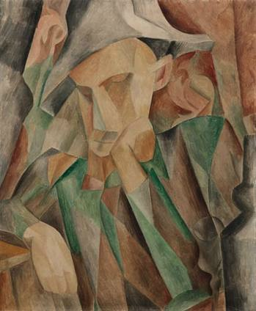
Cubism
First form of Abstract Art
Challenged the idea of Perspective
They did not like the idea of only 1 viewpoint & found it restrictive
Used relativity: Fusing memories and observation
Subject: Real people, places or things
Color and Form were alterable
Hard Lines drawn throughout
Influenced by African Masks

Slide 21
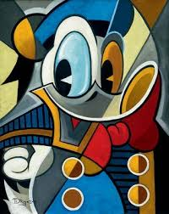
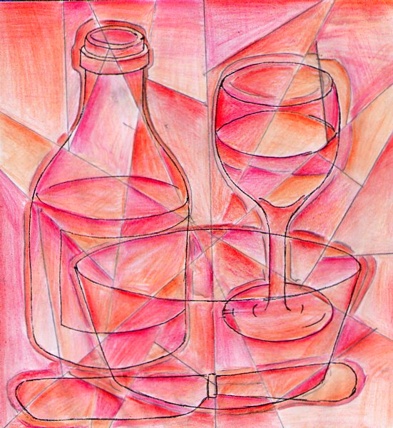
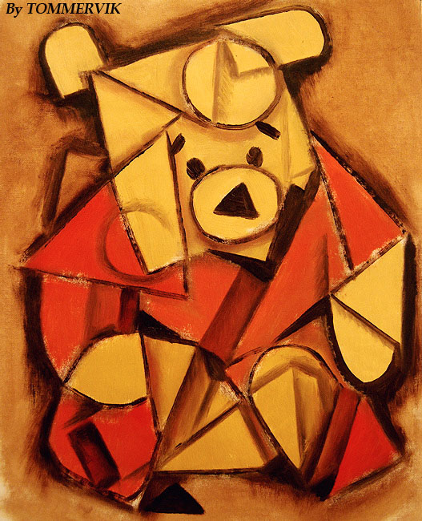
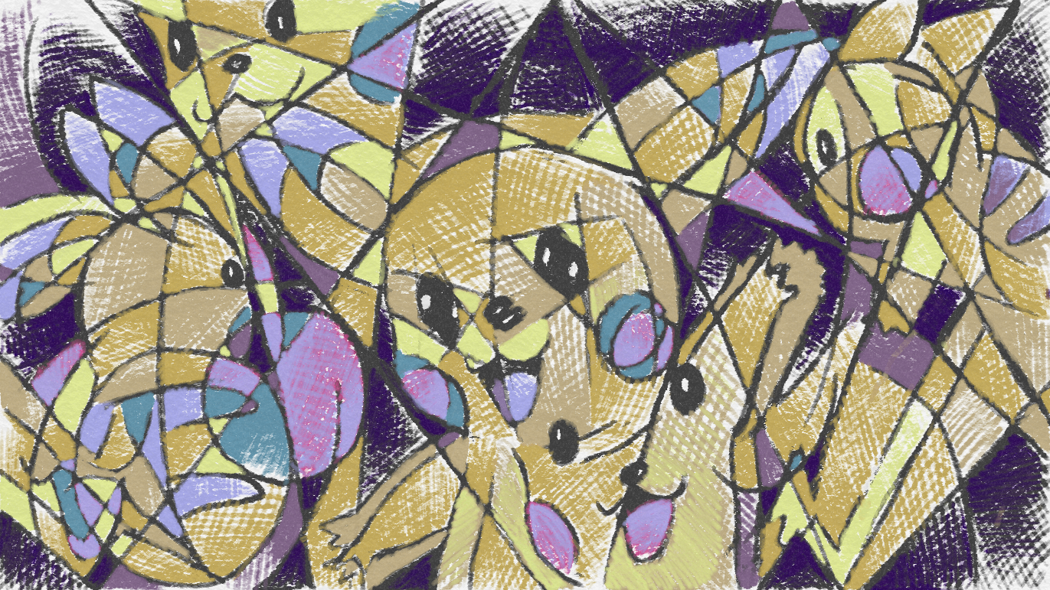
Examples of how it can be applied

Slide 22
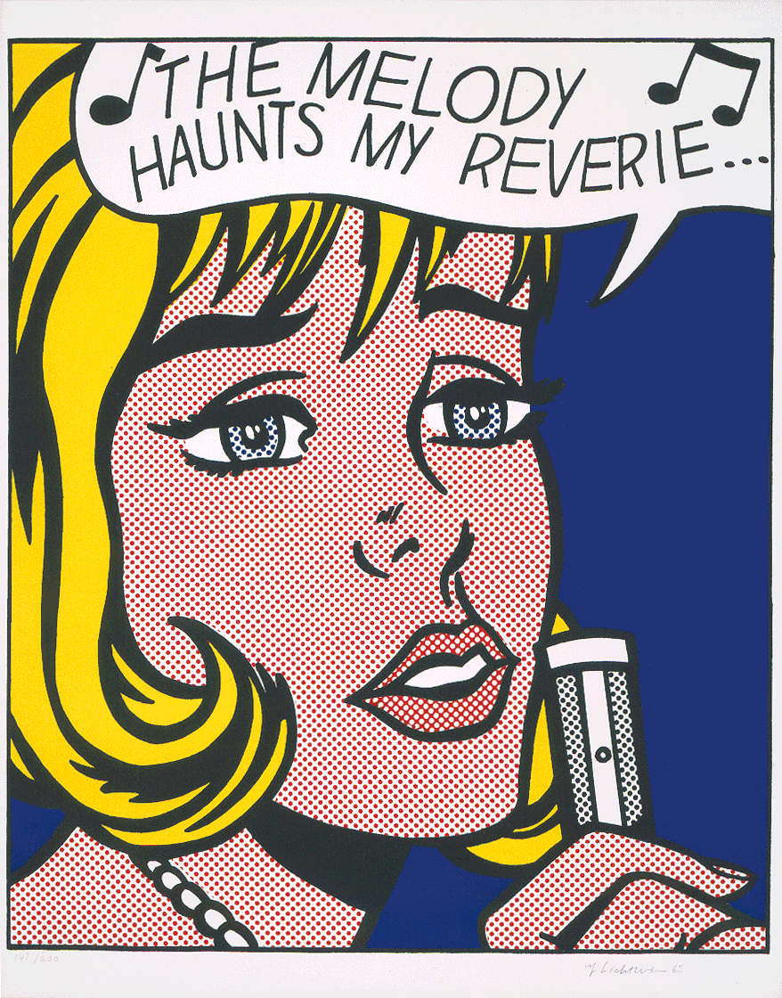
In your journal… Critique the Painting
Roy Lichtenstein, The Melody Haunts My Reverie,
1965

Slide 23
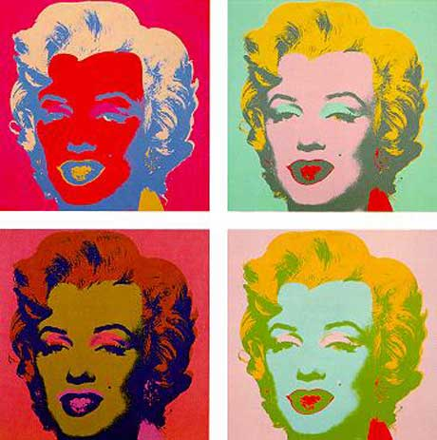
Andy Warhol, Marilyn Quadtych, 1962

Slide 24
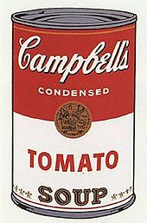
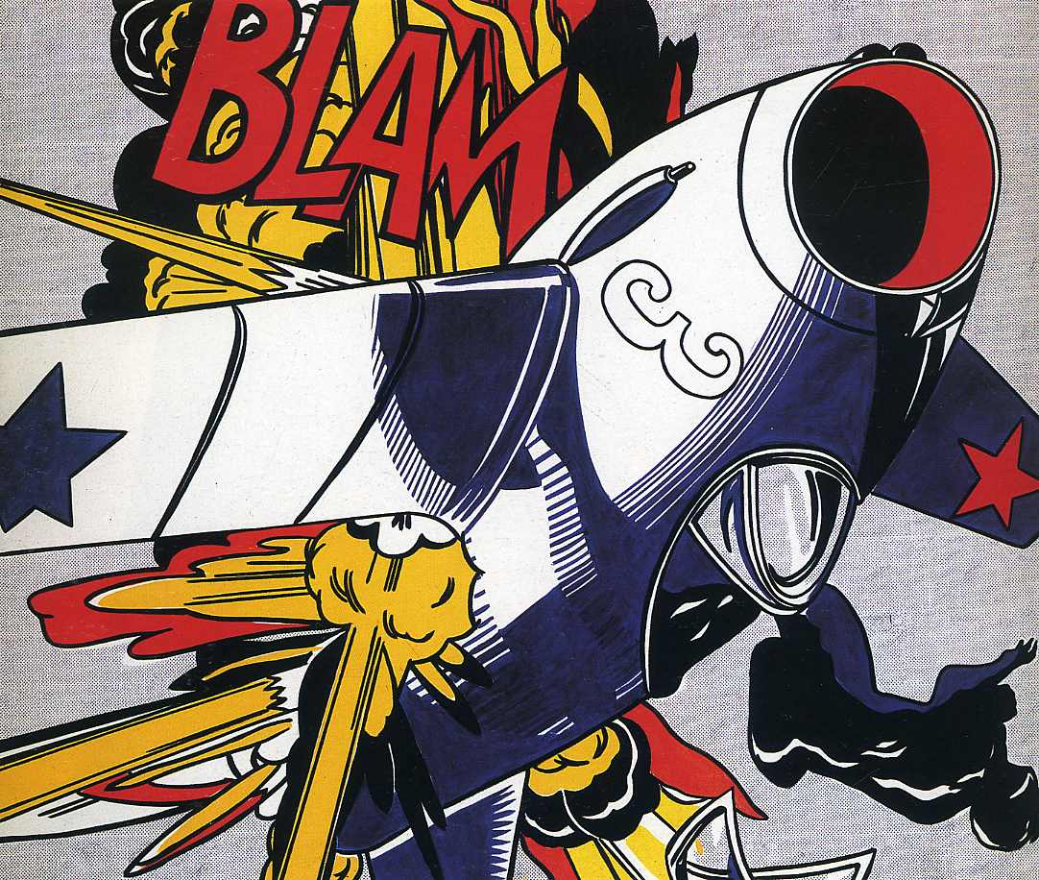
Any Similarities?
Think about the elements:
Line, Shape, Color, Texture, etc.
Andy Warhol, Campbell’s Soup, 1968
Roy Lichtenstein, Blam, 1960s

Slide 25
POP Art
Challenged the traditional subject matter of art by introducing images from popular media, advertisement and news

Slide 26
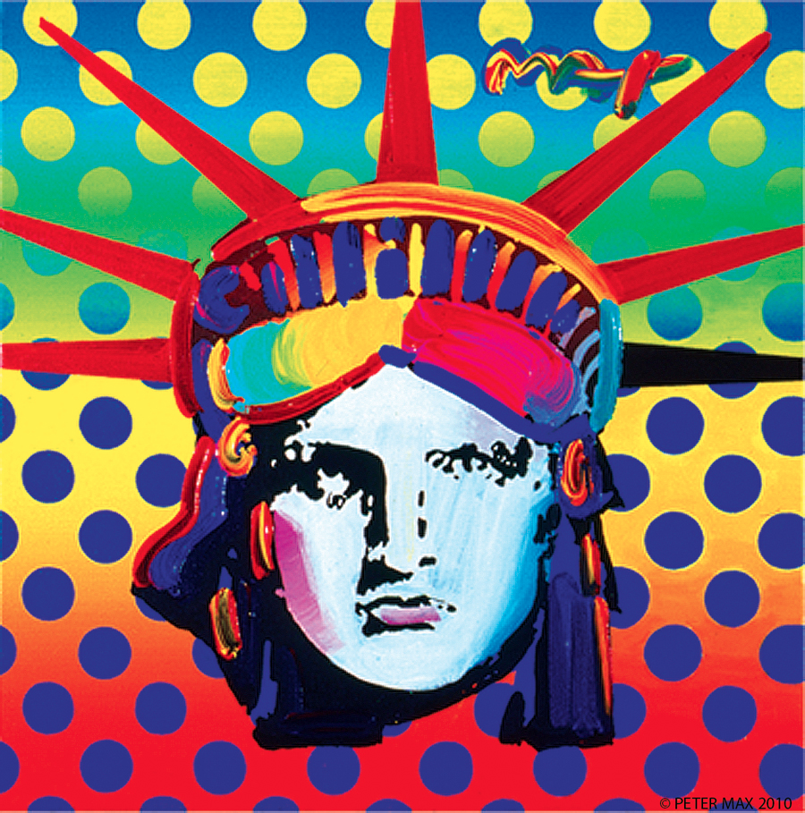
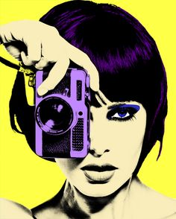
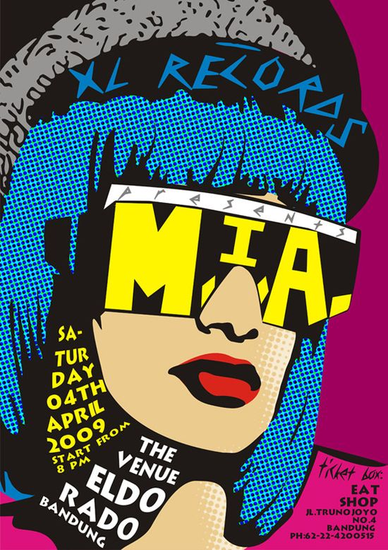
Examples of how it can be applied

