Slide 1
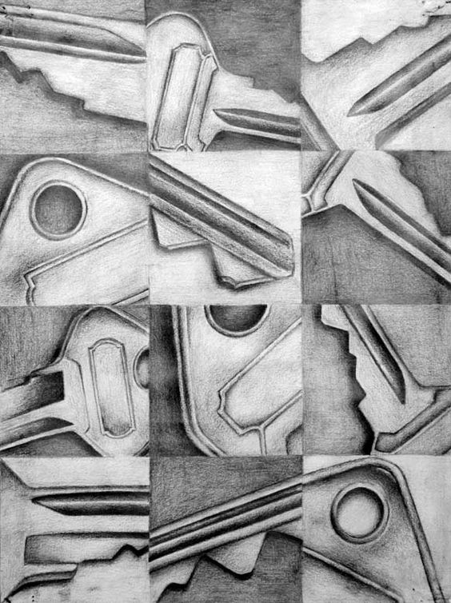
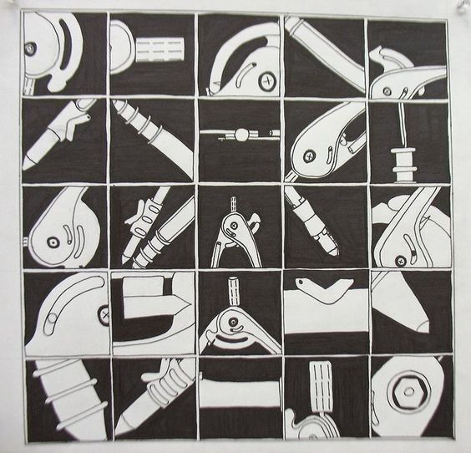
JOURNAL: Cropping
Choose a simple object and attempt to draw it 9 different ways by cropping & altering perspective
Notes:
Simple objects would include expo markers, eraser tops, forks, spoons, pencil sharpeners, scissors, glue, etc. Students have the choice of objects and have 15 minutes to draw and shade on their worksheet and glue it into their journals.

Slide 2
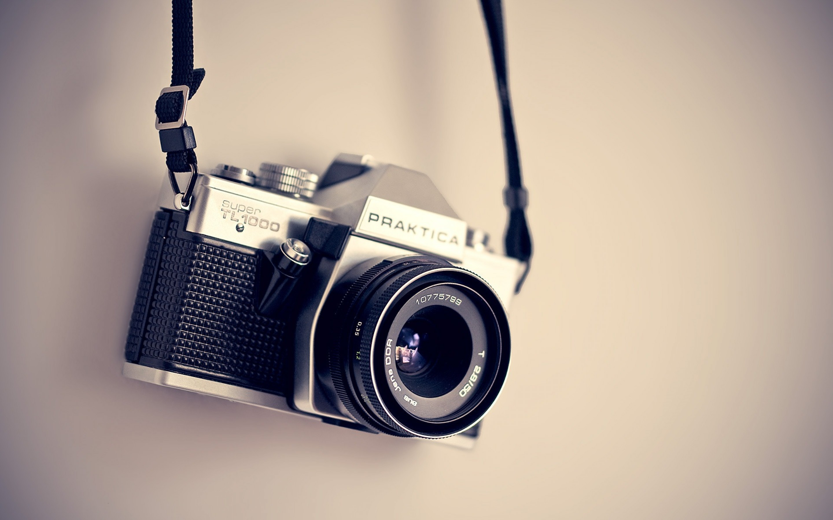
OBSERVATIONAL PHOTOGRAPHY – OBSERVATIONAL PHOTOGRAPHY
OBSERVATIONAL PHOTOGRAPHY – OBSERVATIONAL PHOTOGRAPHY

Slide 3
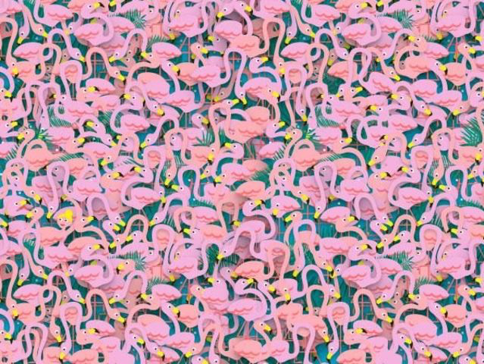
CAN YOU FIND THE BALLERINA?
Notes:
I just love seeing eye tricks. These are great challenges for a viewer as all the flamingos in this image create a sort of visual texture.

Slide 4
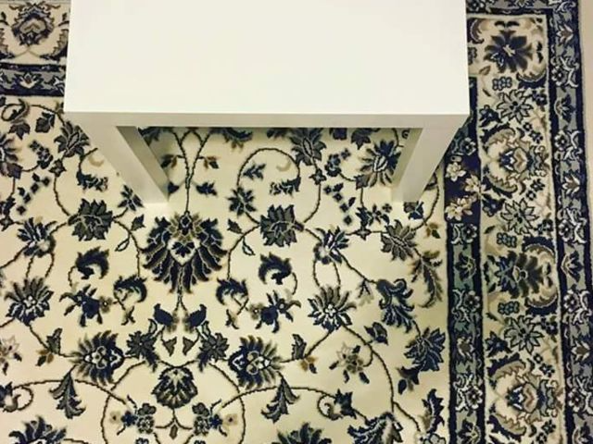
CAN YOU FIND THE PHONE?
Notes:
This is an example of what we DON’T want to do in art photography (for the most part). The usual goal is to encourage an image to pop out.

Slide 5
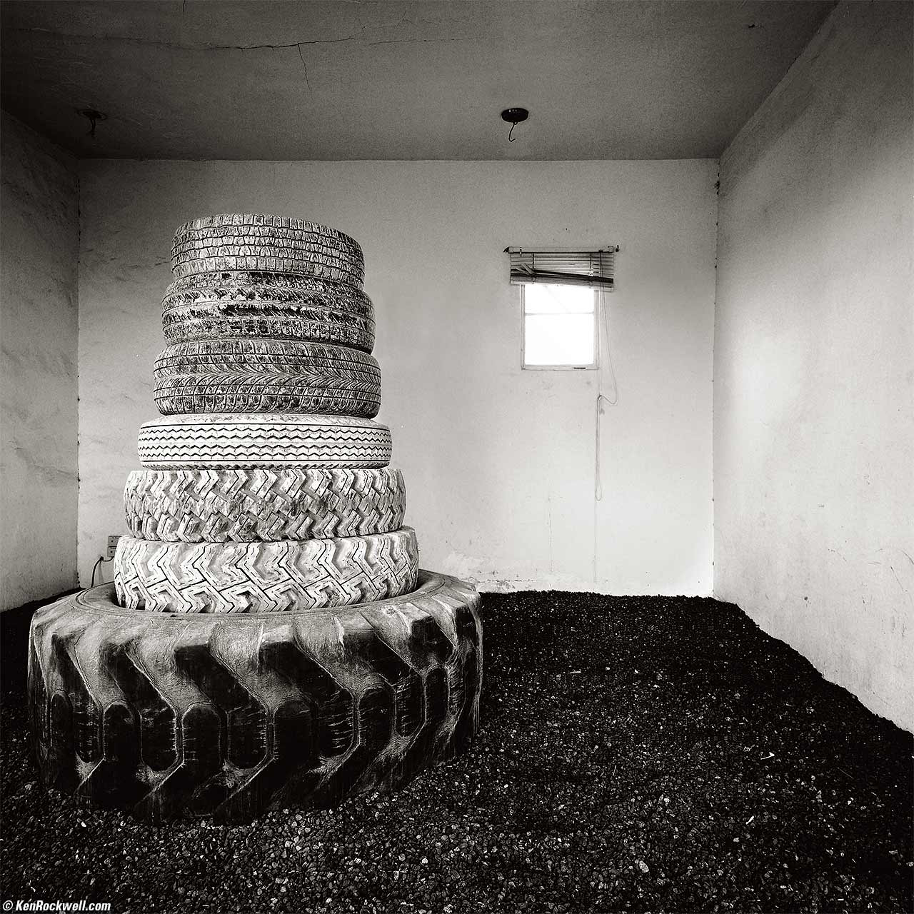
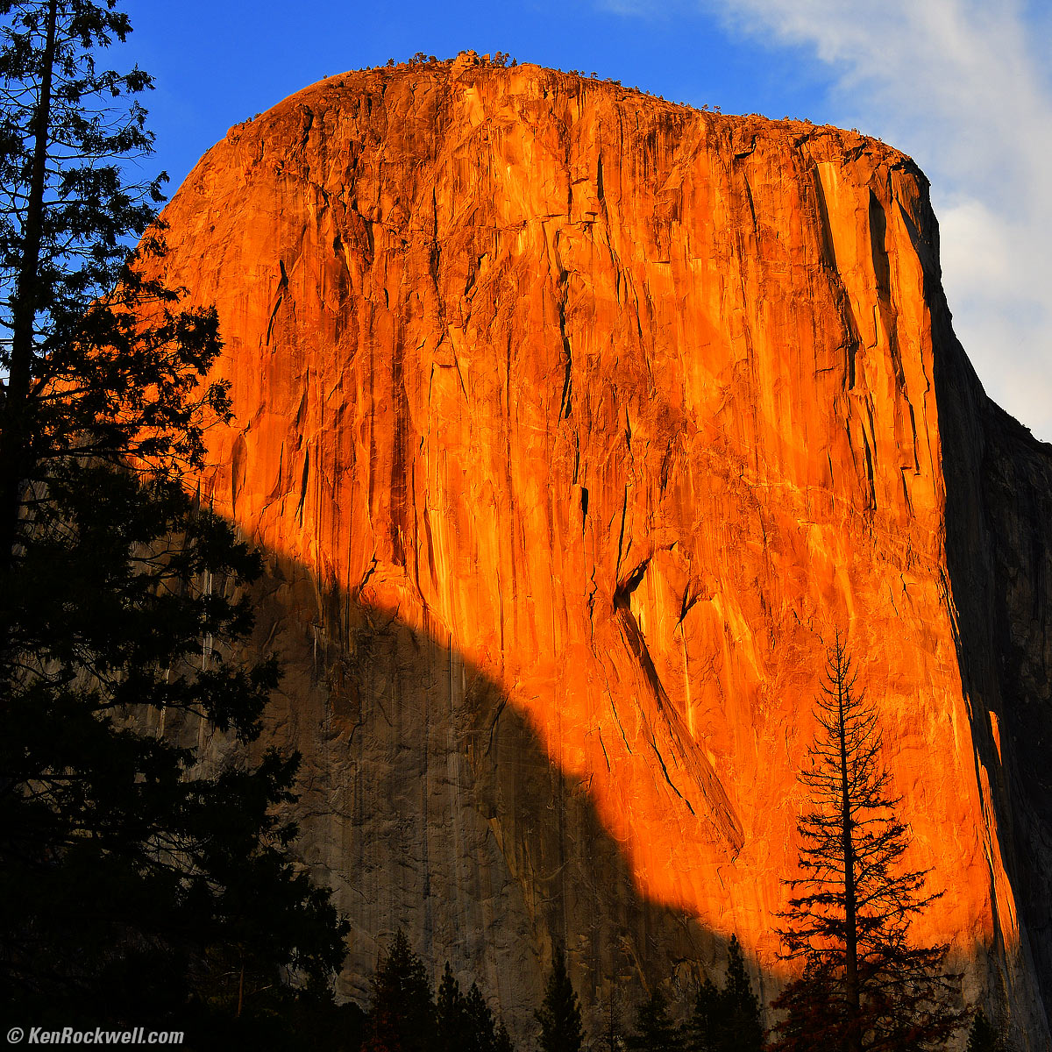
KEN ROCKWELL
How To
Website
Notes:
According to landscape photographer Ken Rockwell, “Every image needs a basic structure. Without an underlying structure, it is just another boring photo”
Once a photo has caught your attention, it needs to have details to keep the eyes interested.

Slide 6
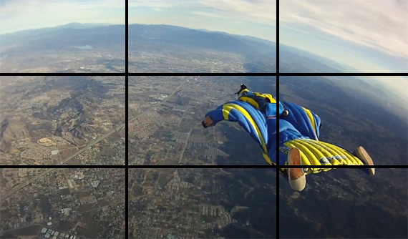
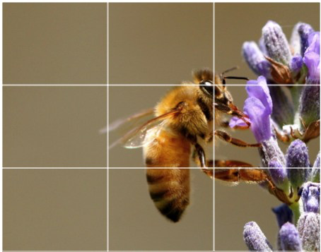
RULE OF THIRDS
Article
Notes:
In rule of thirds you visually divide the image by 3 & 3 to create 9 separate sections. Placing important parts of the image along or on these intersections can help create non-centered interest in the image. Here are some visual examples of Rule of Thirds.
You may choose not to use any of the compositional tools but it is important to understand them in order to break them.

Slide 7
STRUCTURES of COMPOSITION
the artistic arrangement of the parts of a picture
Notes:
To change your composition you must change your perspective or point of view (it’s not just zoom). As Ken Rockwell states, It’s important to first grab the interest of your viewer with an engaging layout/arrangement of focal points in the image.

Slide 8
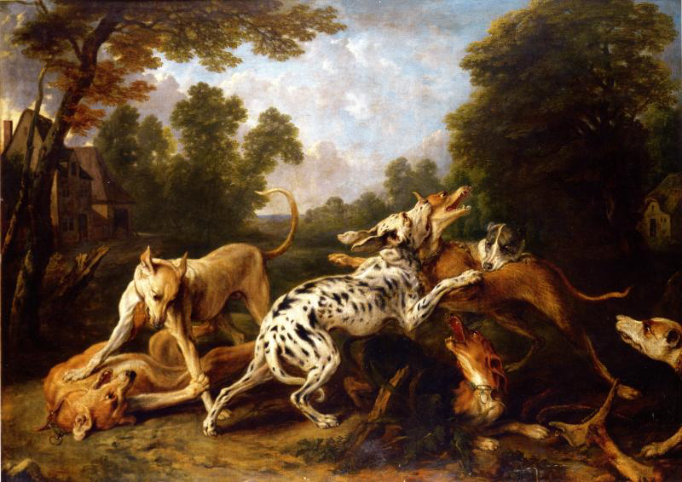
Notes:
In this example you can see how the golden triangle was applied to the image overall in this painting, Snyder’s Dogs.

Slide 9
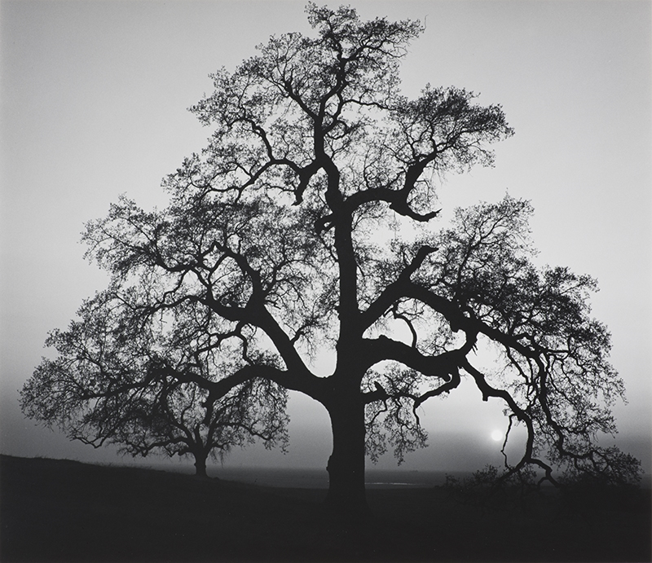
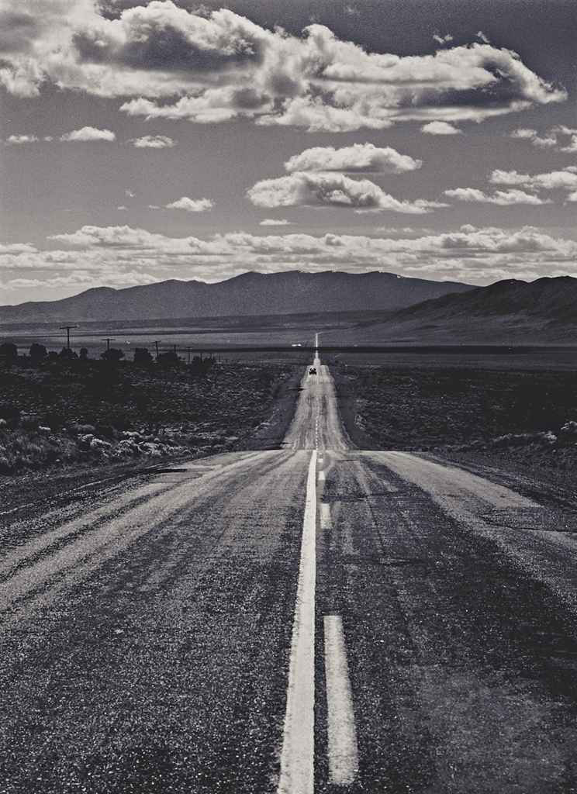
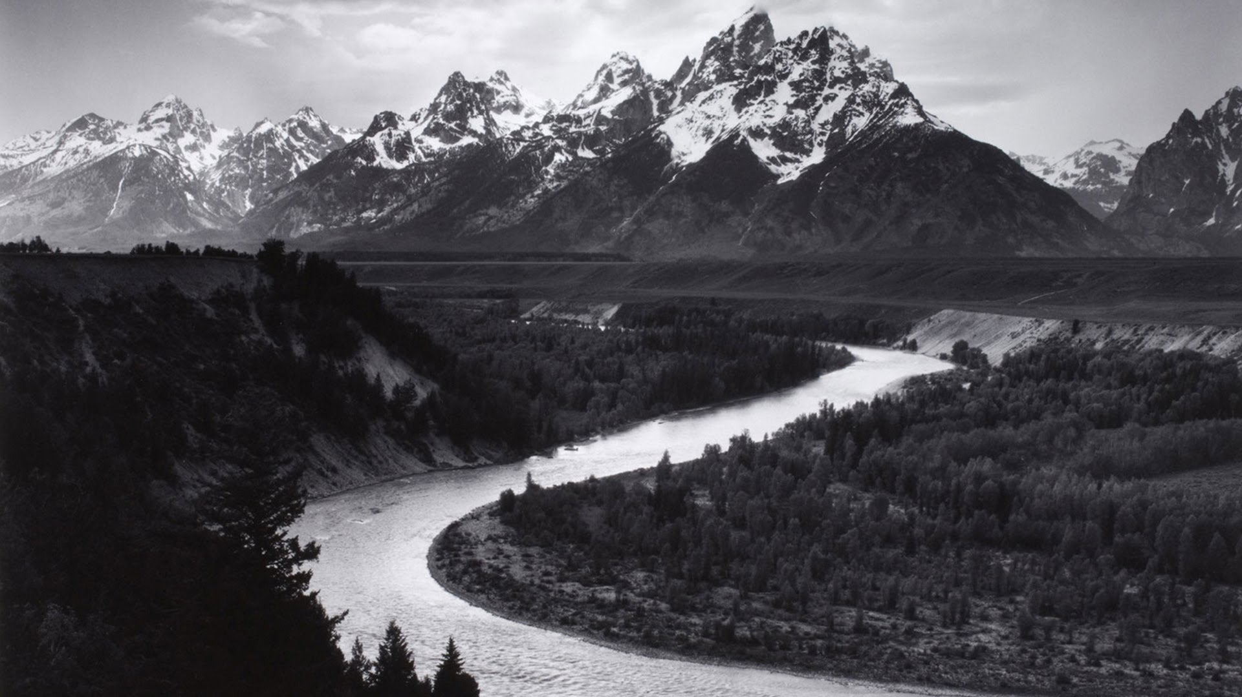
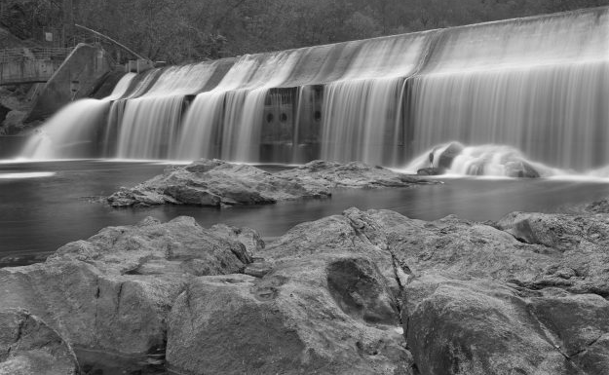
ANSEL ADAMS
Website
Notes:
A landscape photographer who is well known for capturing the beauty of the west. Many of his photographs are in black and white and use contrast to show movement and form in the composition. Although we can see that some of his photos do not use the same compositional tools they do have a high sense of contrast in the image using value. We can see the bold differences between the positive and negative space or foreground and background.

Slide 10
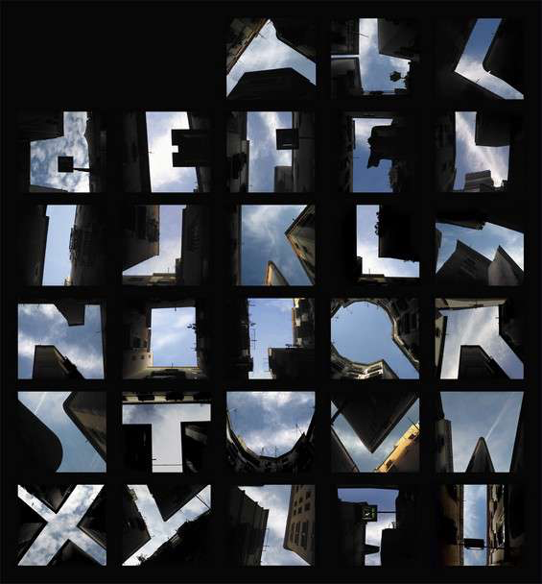
LISA RIENERMANN
Website
Notes:
Lisa Rienermann creates infographics and advertisements using colorful photography. In her alphabet series she created all the letters of the alphabet by looking upward to the intersections of rooftops. This uses contrast of the bright blue sky and darkened buildings to create the letter.
We are going to use Lisa Rienermann’s work as inspiration for our next mini project on Photography.

Slide 11
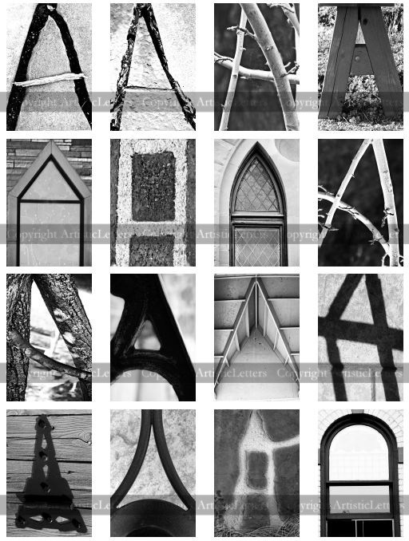
MP: OBSERVATIONAL PHOTOGRAPHY
Project Requirements:
Find & Photograph 3 letters
Architecture/Shadow
NOT made or drawn
Crop/Rotate
Compose photo to accentuate the letter itself
Alter color and contrast of photo
Black & White
High Contrast
Design, Print & Mount Letters
Form a word or Phrase
Notes:
Please view the rubric for more information about how the final product will be graded.

Slide 12
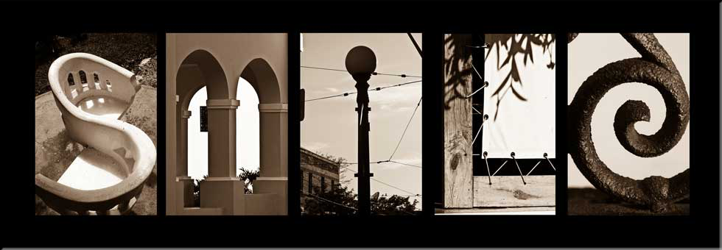
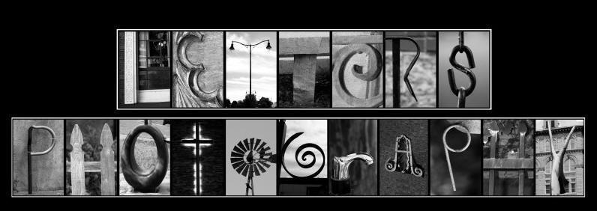
Notes:
After uploading your letters to Google drive or other photo sharing website you will be asked to find, print and mount the letters onto black paper to form a word of your choice with at least 5 letters.

Slide 13
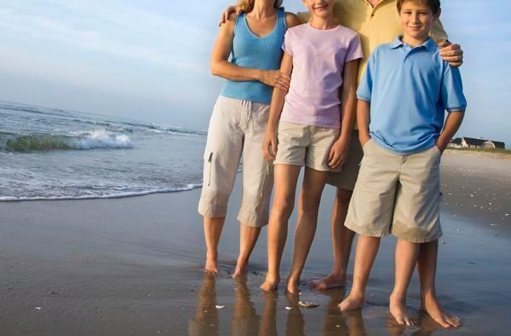
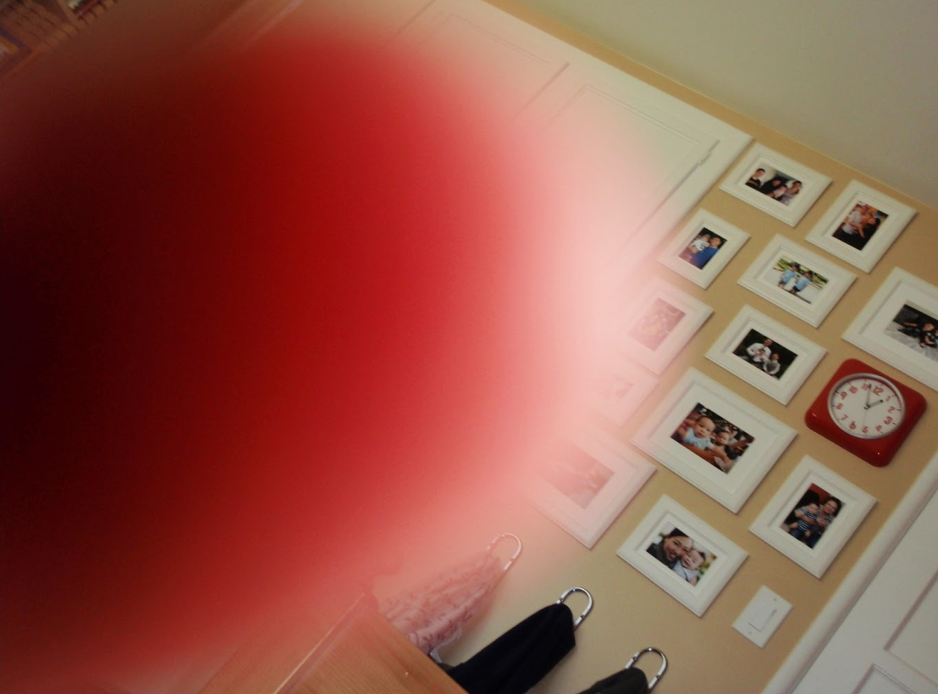
Notes:
Keep in mind when you’re taking a photo that you want to look at the framing (how an image is centered and cropped), lighting (whether a photo is under or over exposed) and miscellaneous background information (get your finger out of there).

Slide 14
EDITING YOUR PHOTOS
Tutorial
My Tutorial
Use the APP Portal to Download Snapseed
Watch the linked tutorial
Import and alter your photos using the project guidelines

Slide 15
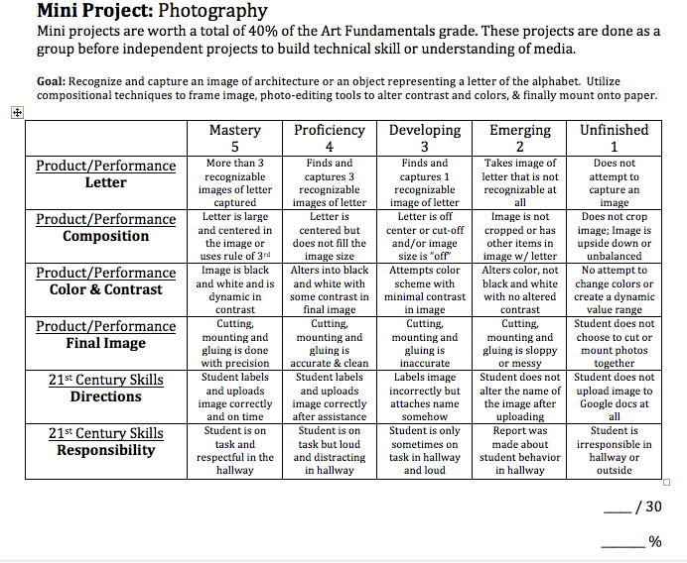
Notes:
Review requirements with students

