Slide 1
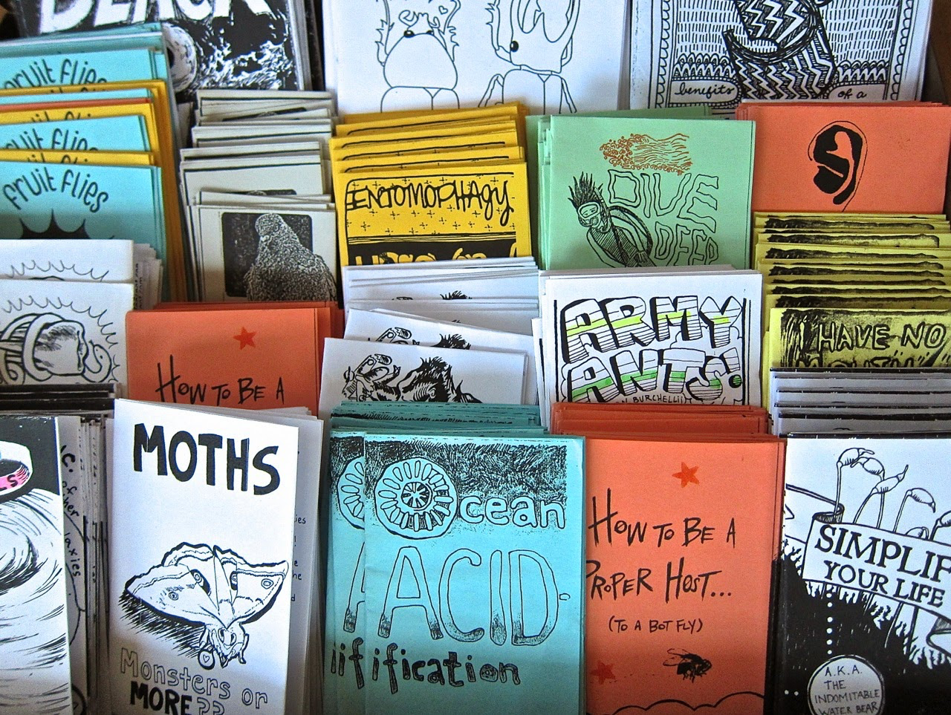
ZINES
A zine is a cheaply-made &-priced publication, often in black and white, which is mass-produced via photocopier and bound with staples. Most zines revolve around a music scene of some sort, but others are dedicated to artwork, poetry, cartoons, editorials and short stories.

Slide 2
Notes:
Zines are different from these two examples in quality, size, production and more. A professional magazine like Vogue can cost up to 10 dollars per issue. To produce something like this magazine

Slide 3
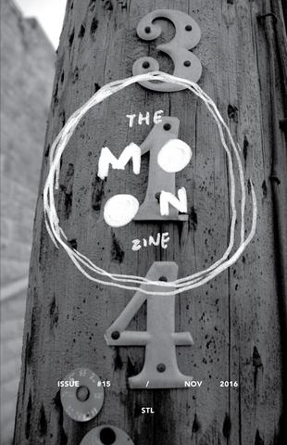
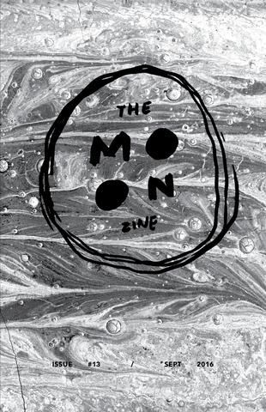
the MOON ZINE
Website

Slide 5
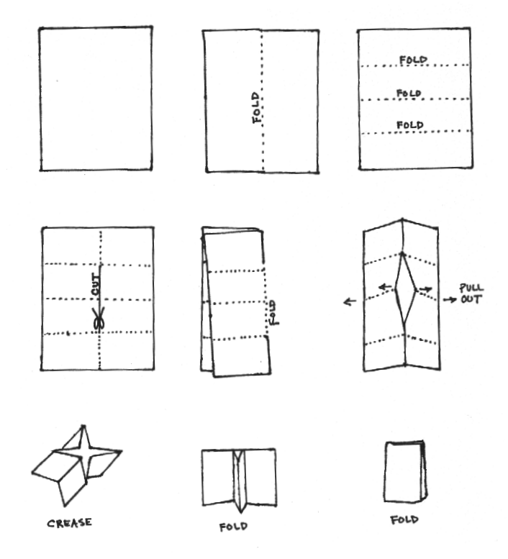
HOW TO FOLD A ZINE:
Although some zines are made with stapled or bound pages sometimes professionally done… There’s a simple way to make a zine using only 1 page and no adhesives:
Video

