Slide 1
ZENTANGLES

Slide 2
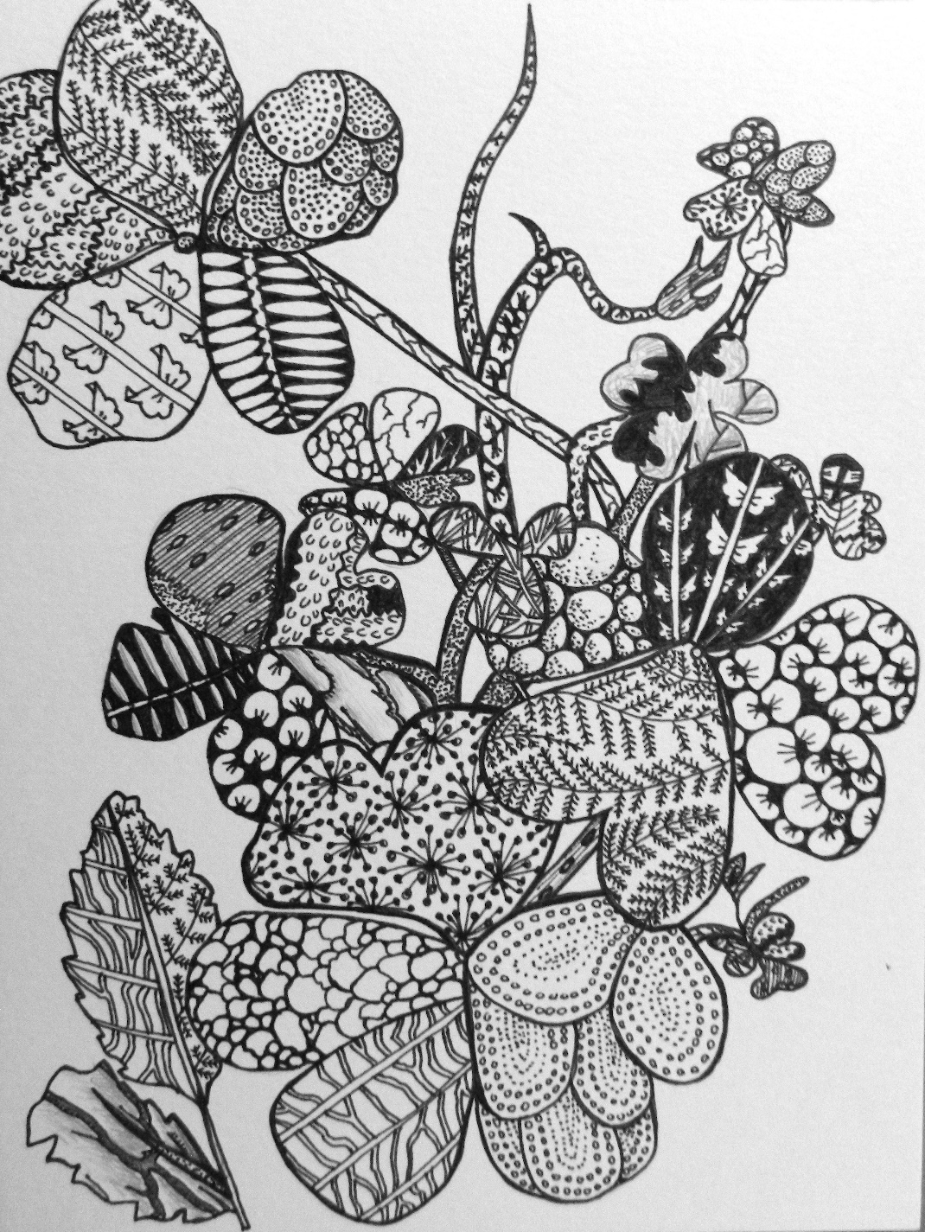
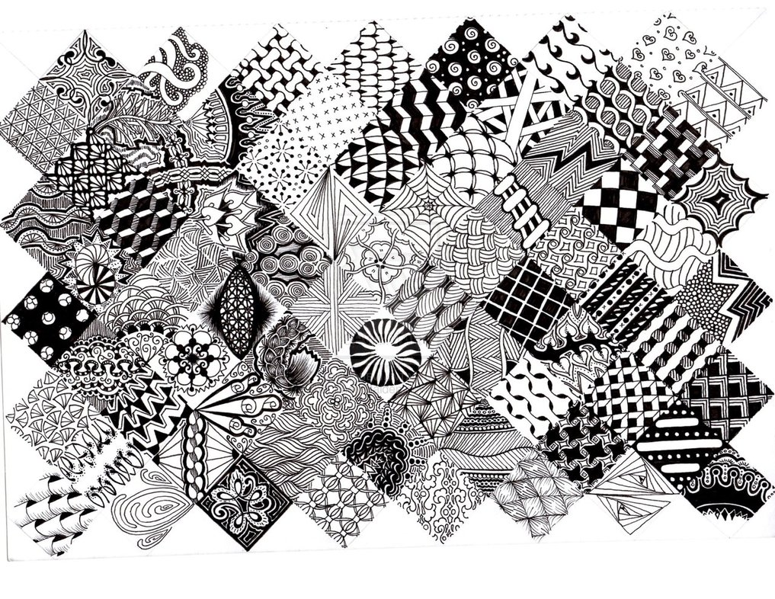
A design made from many patterns fitting in and filling a space

Slide 3
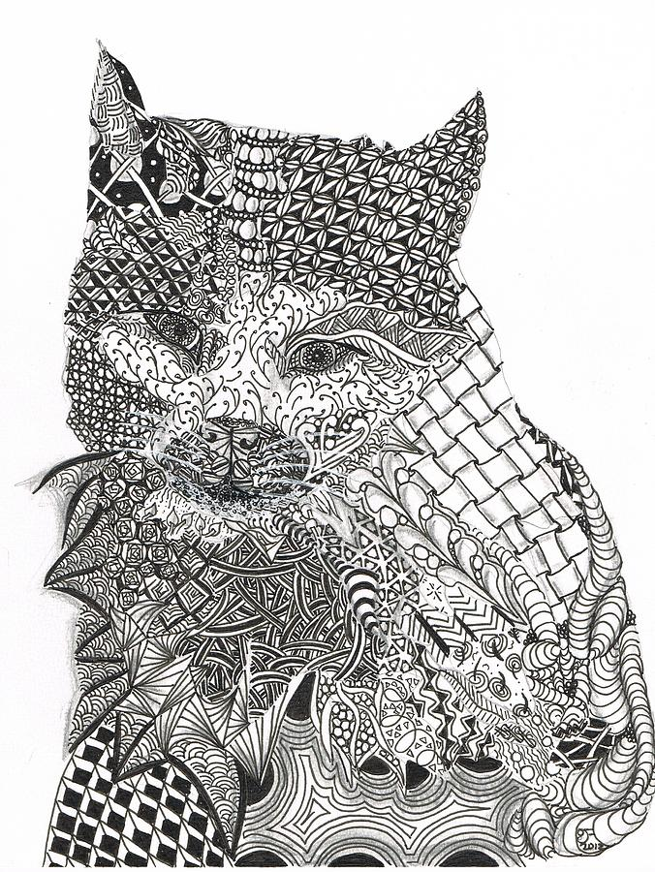
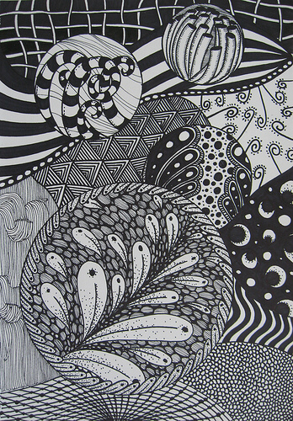
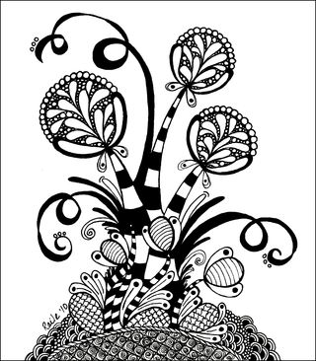
CONTRAST
The difference between light and dark in an artwork

Slide 4
HORROR VACUI
The absence of empty space in an artwork

Slide 5
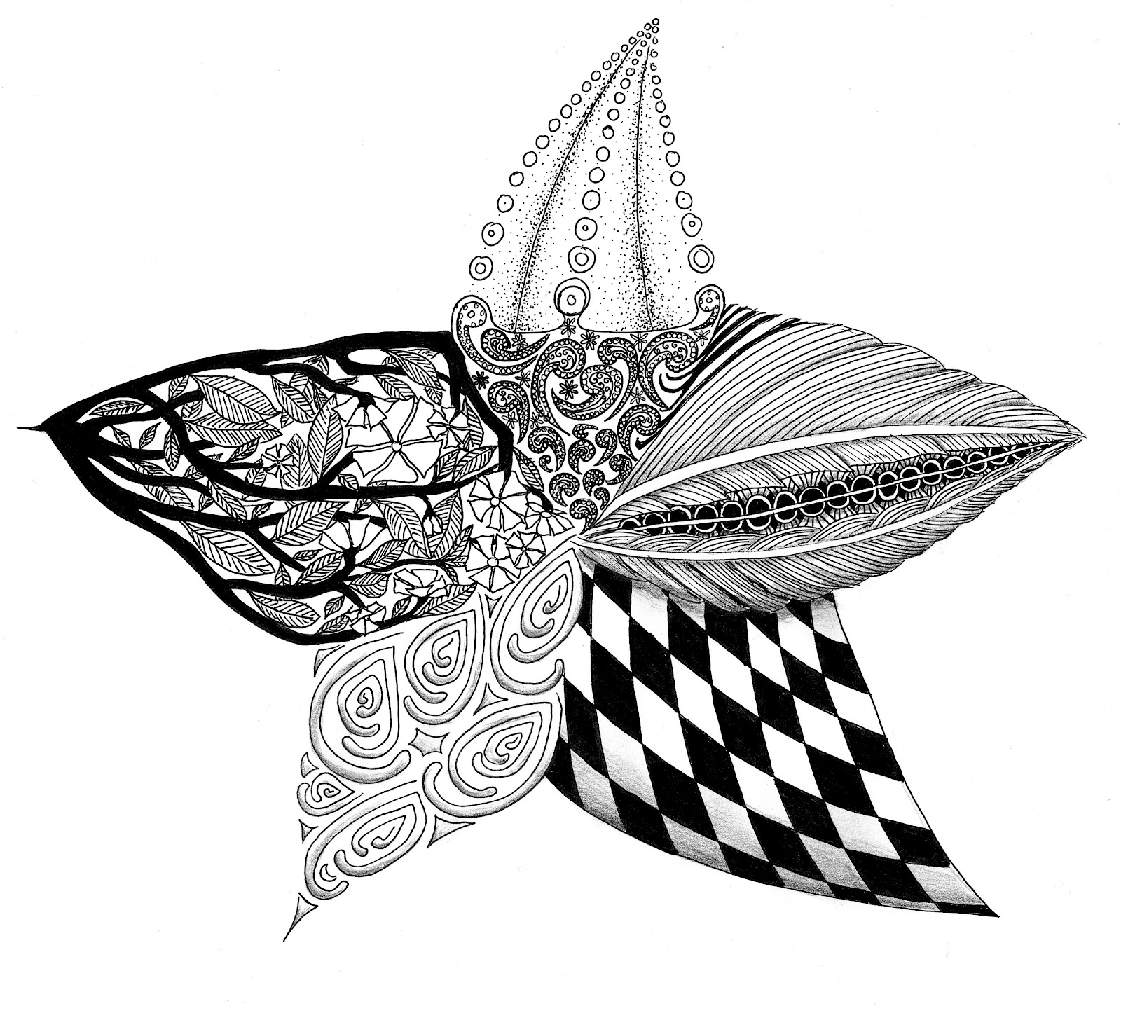
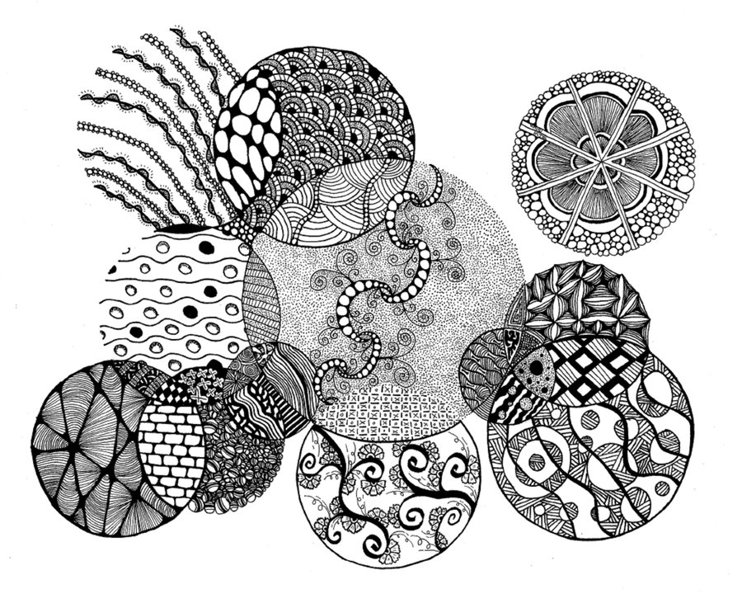

Slide 6
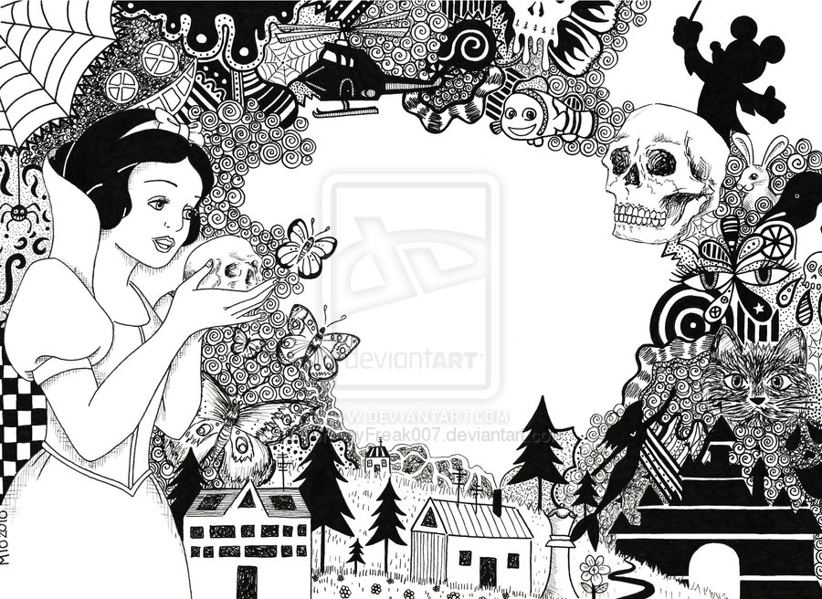
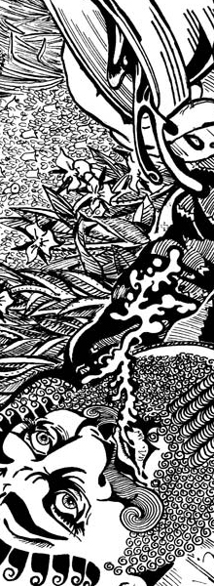

Slide 7
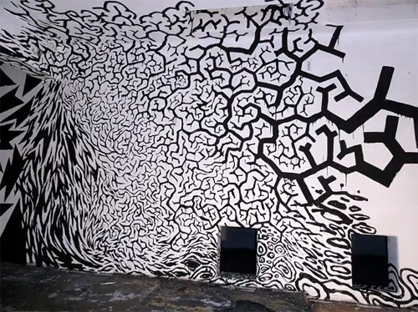
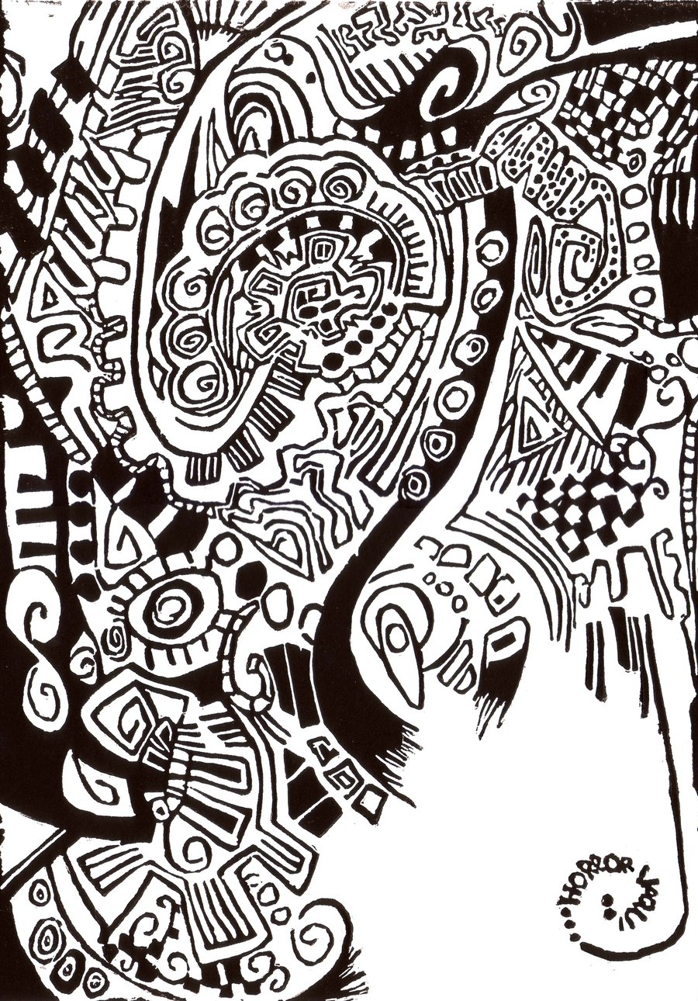
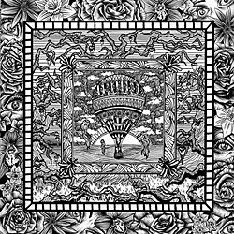
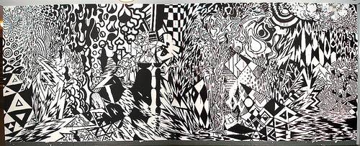
FOCAL POINT
The main area of interest in a picture

Slide 8
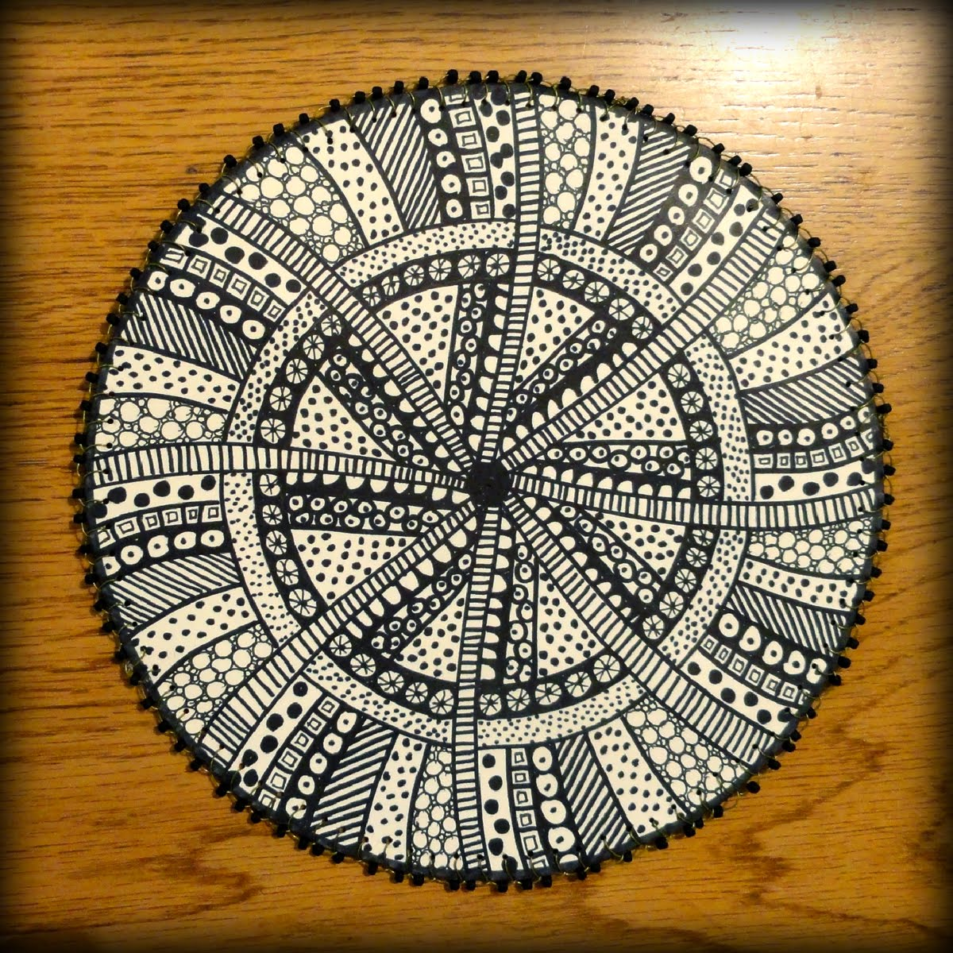
COMPLEX PATTERN
The clear repetition of 3 or more elements in a unit

Slide 9
VALUE SCALE
The scale of light to dark mark making

Slide 10
Hatching & Cross Hatching

Slide 11
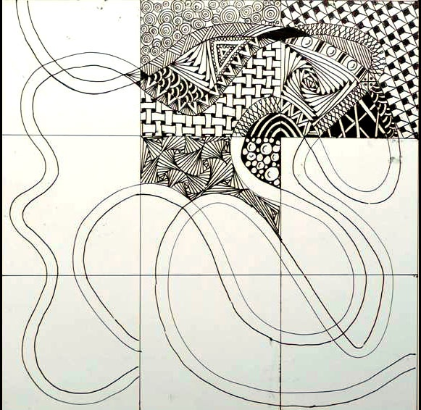
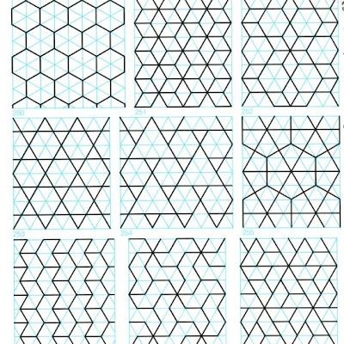
STRING
GEOMETRIC
PATTERN
A string is a random line drawn in pencil which creates an area within which you draw your tangles
Interlocking repetitive shapes

Slide 12
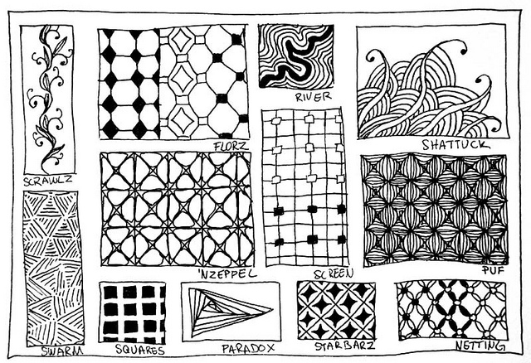
Notes:
Tangles can be inspired by many things. Nature, wildlife, inanimate objects… the possibilities are endless. Often, Zentangle artists name their tangles. Can you tell what some of tangles are inspired by?

Slide 13
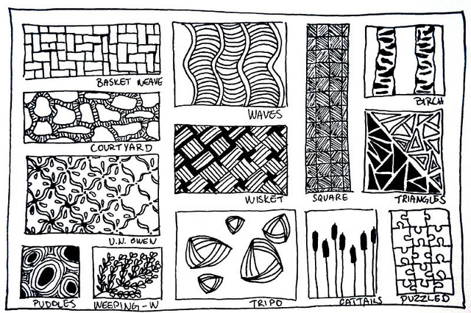

Slide 14
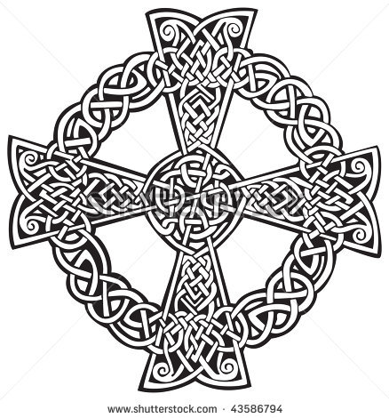
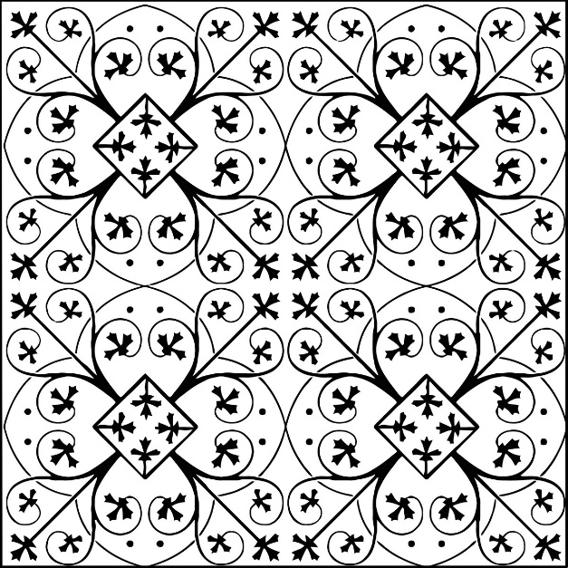
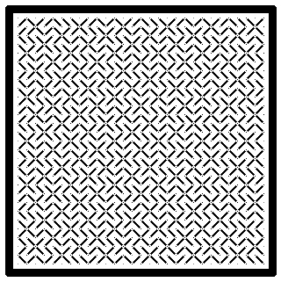
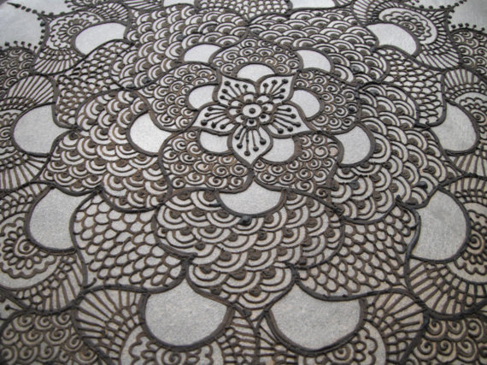
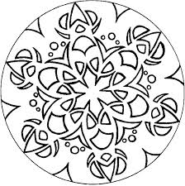
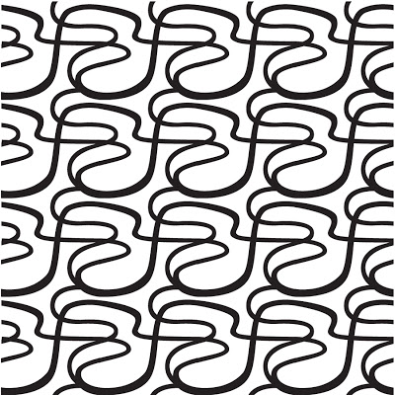

Slide 15
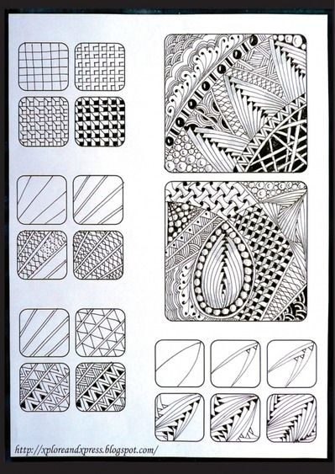
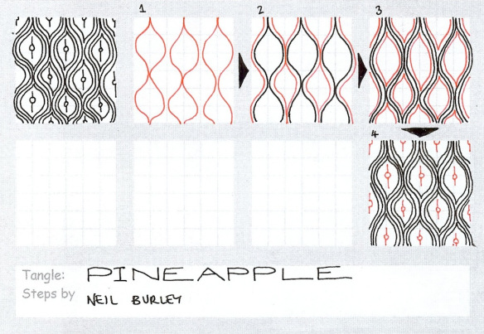
DESIGN YOUR OWN

Slide 16
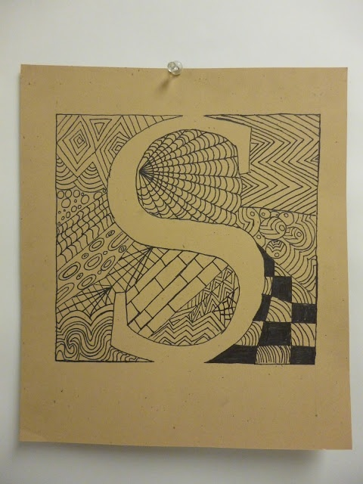
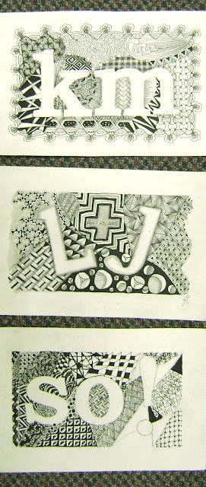
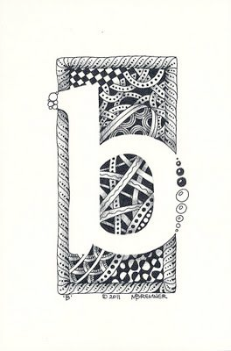
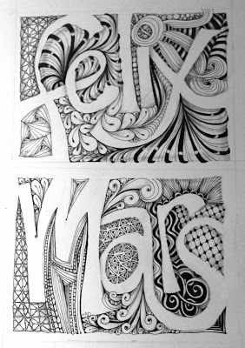
EXAMPLES

Slide 17
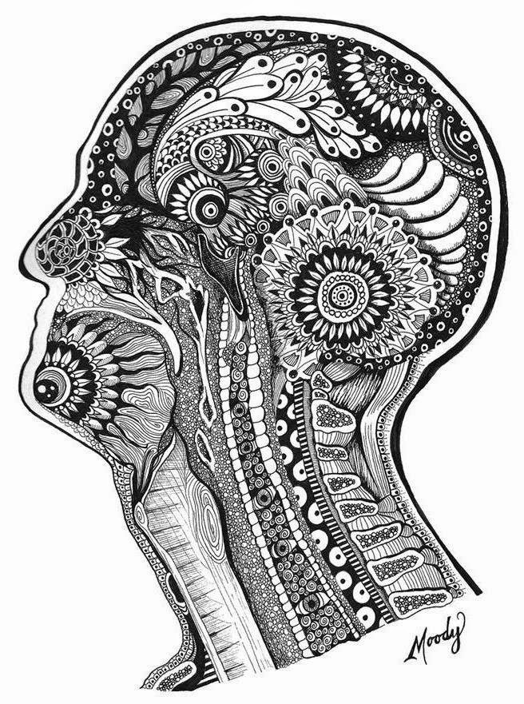
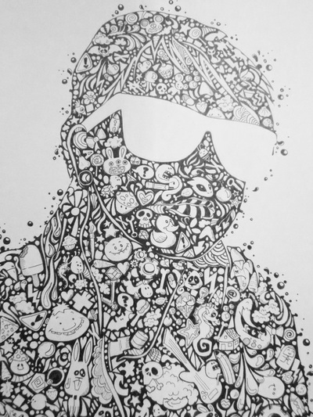

Slide 18
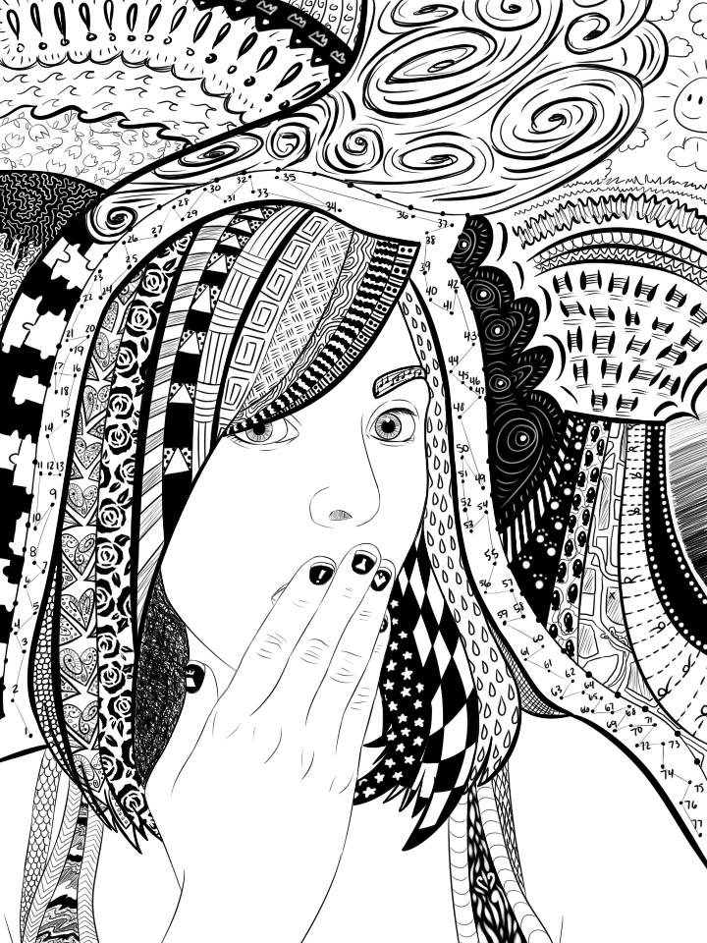

Slide 19
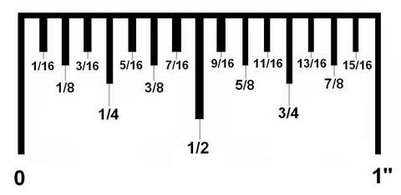
Step - 4.5: Practice layouts, designs, tangles and techniques in your journal
STEP 1: Use a ruler to sketch a straight and clean border
Think about your composition
A sketch is a LIGHT drawing done to create structure
STEP 2: Sketch either a silhouette or bubble letter inside
STEP 3: Start filling your design with zentangles using pencil and pen

